Slide 1
Free application for federal student aid (fafsa): section-by-section
JACQUELYNN MOL, SAINT MARY’S UNIVERSITY OF MN
SOLEDAD KERN, CAPELLA UNIVERSITY
“MAKING A DIFFERENCE”
2014-2015

Slide 2
FAFSA4Caster
Used to estimate Federal Stafford Loans and Federal Expected Family Contribution
No student or parent social security or tax information is required
FAFSA4CASTER.ED.GOV
“MAKING A DIFFERENCE”
2014-2015

Slide 3
Fafsa filing options
File electronically at: FAFSA.ed.gov
Note: this is a FREE application
Paper Application
Up to school whether applications can be sent to school or directly to Department of Education (DoED)
Other Possible Financial Aid Applications:
State
Institutional
Military
“MAKING A DIFFERENCE”
2014-2015

Slide 4
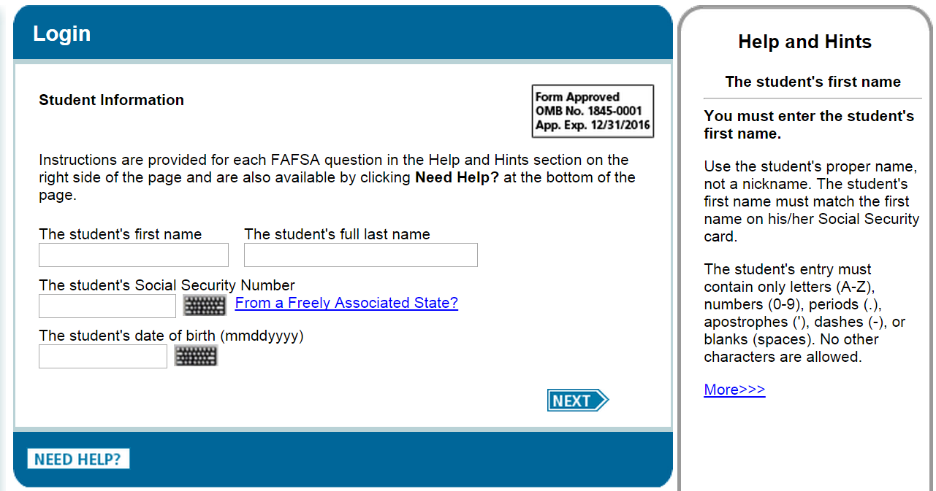
FAFSA: Login
“MAKING A DIFFERENCE”
2014-2015

Slide 5
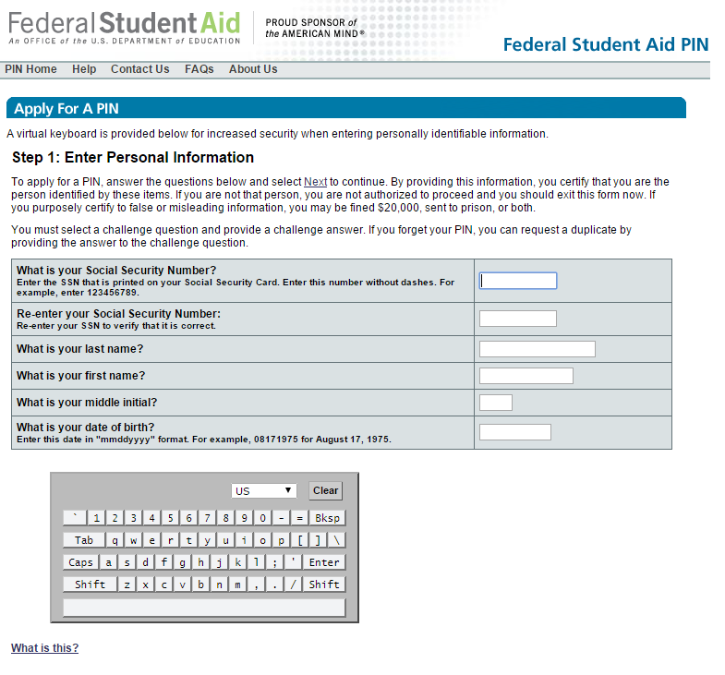
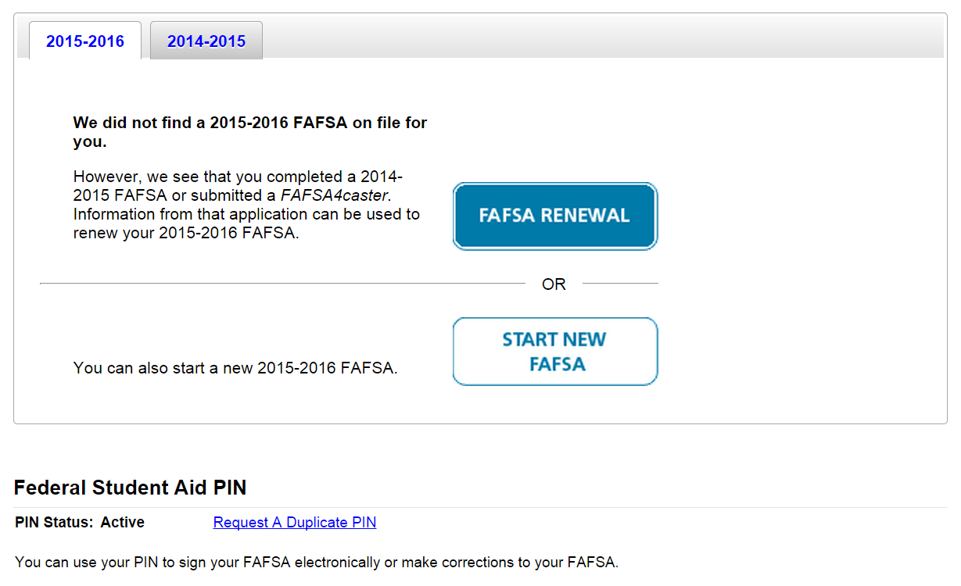
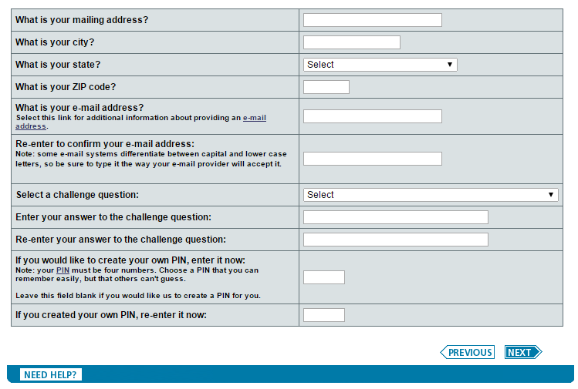
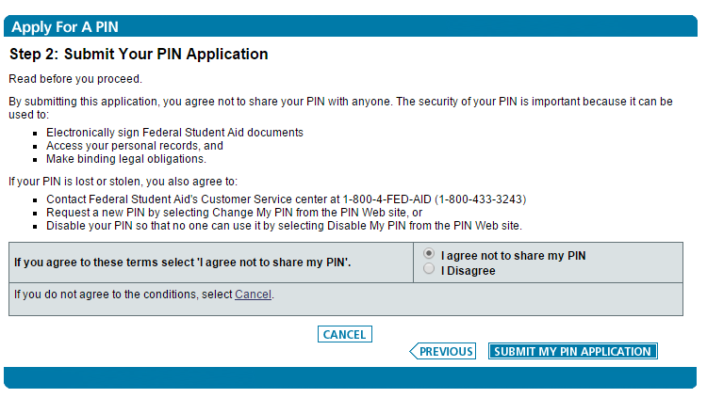
FAFSA: Login
“MAKING A DIFFERENCE”
2014-2015

Slide 6
FAFSA: General layout
“MAKING A DIFFERENCE”
2014-2015

Slide 7
FAFSA Section-by-section
Student Demographics
School Selection
Dependency Status
Parent Demographics (if applicable)
Financial Information
Sign & Submit
Confirmation
“MAKING A DIFFERENCE”
2014-2015

Slide 8
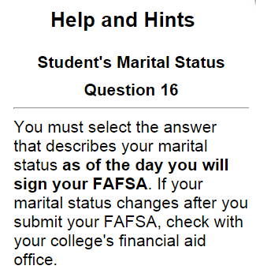
FAFSA: Student Demographics
“MAKING A DIFFERENCE”
2014-2015

Slide 9
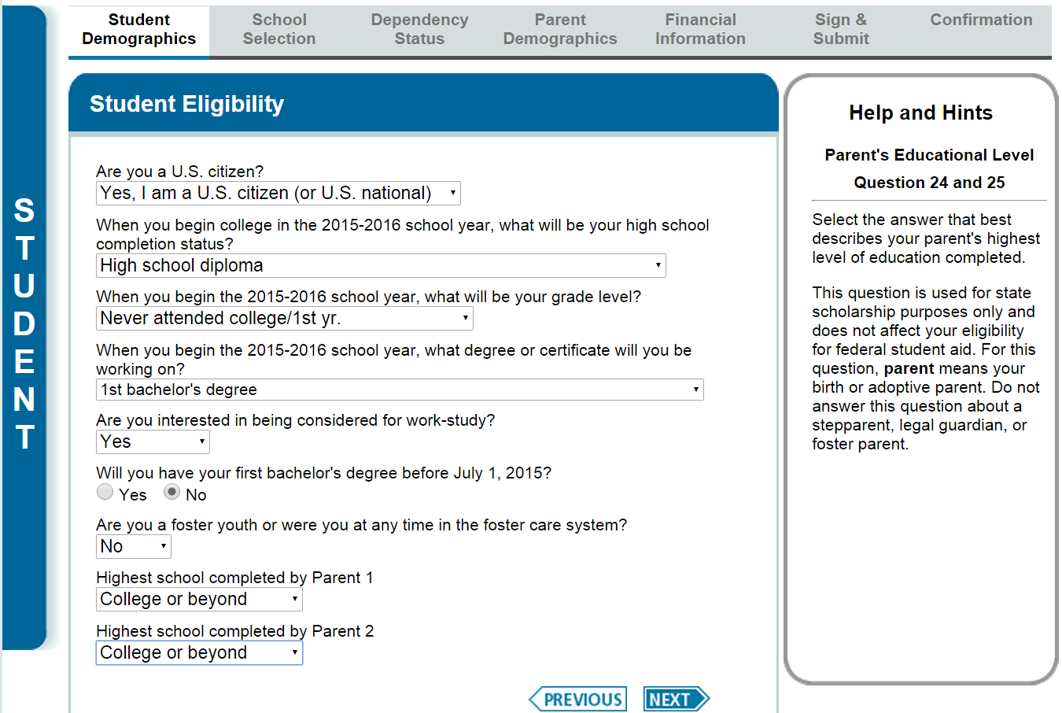
FAFSA: Student Demographics
“MAKING A DIFFERENCE”
2014-2015

Slide 10
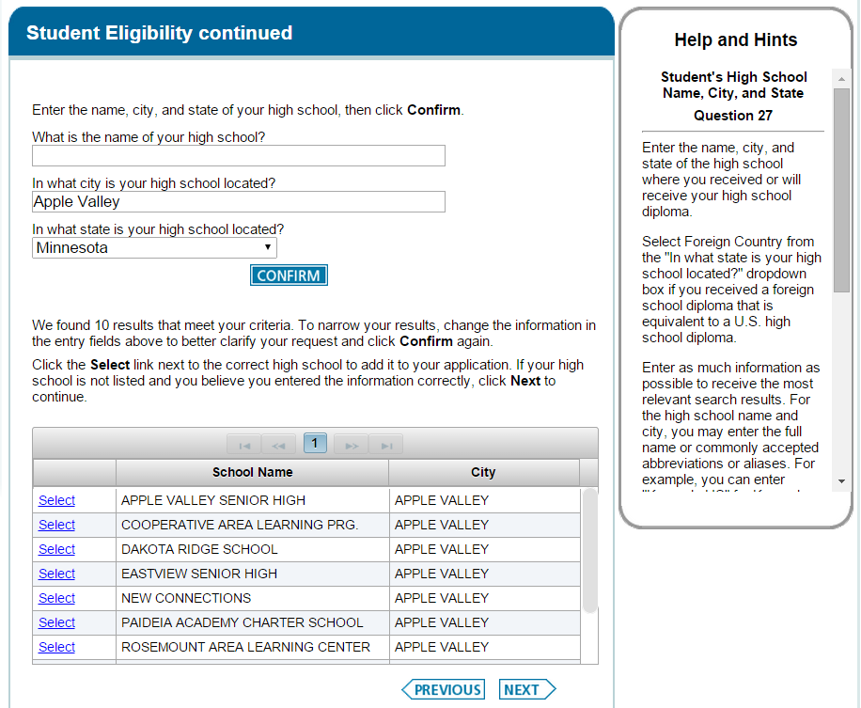
FAFSA: Student Demographics
“MAKING A DIFFERENCE”
2014-2015

Slide 11
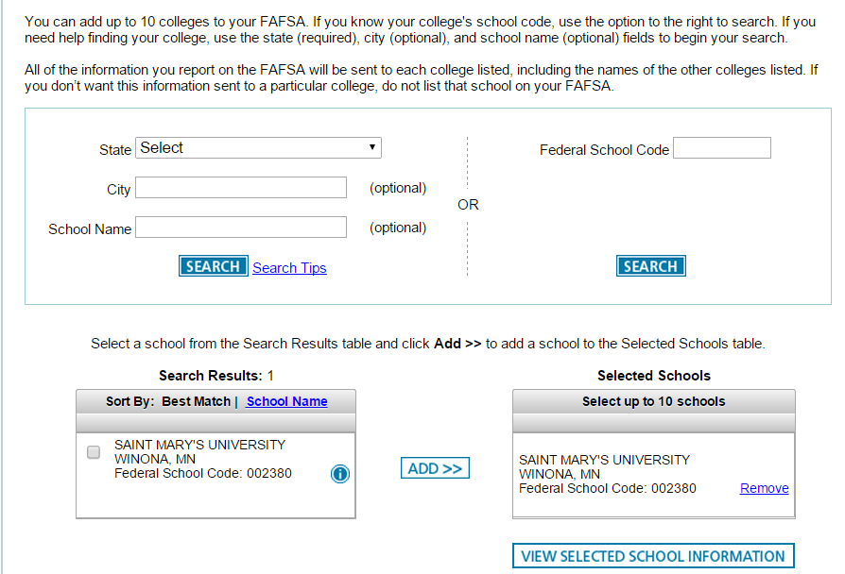
FAFSA: school selection
“MAKING A DIFFERENCE”
2014-2015

Slide 12
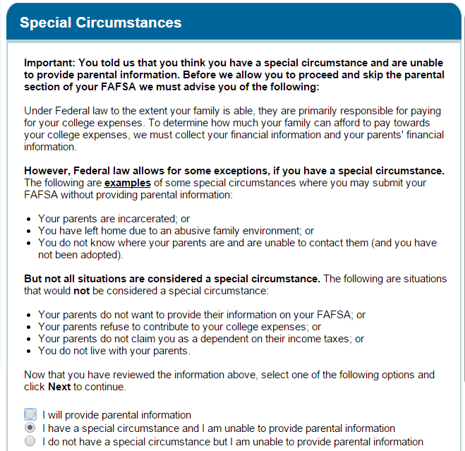
FAFSA: Dependency Status
Determining Your Dependency Status Video
“MAKING A DIFFERENCE”
2014-2015

Slide 13
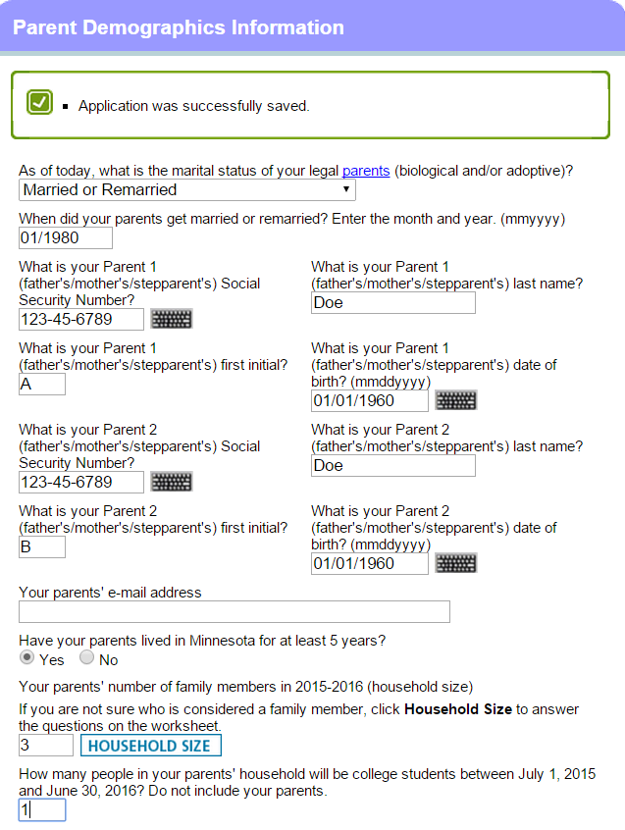
FAFSA: parent Demographics
“MAKING A DIFFERENCE”
2014-2015

Slide 14
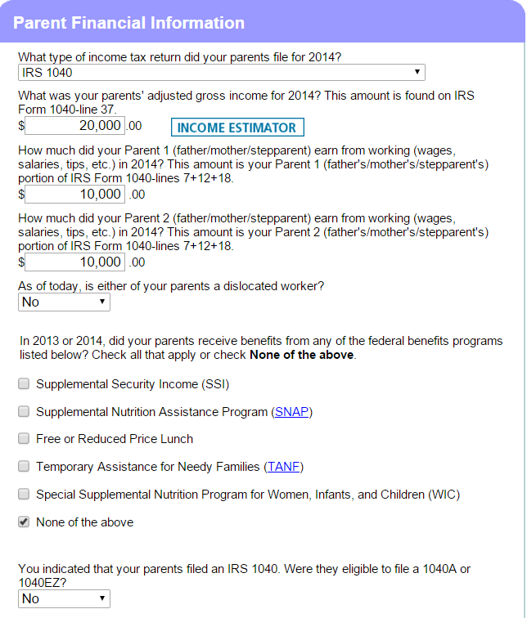
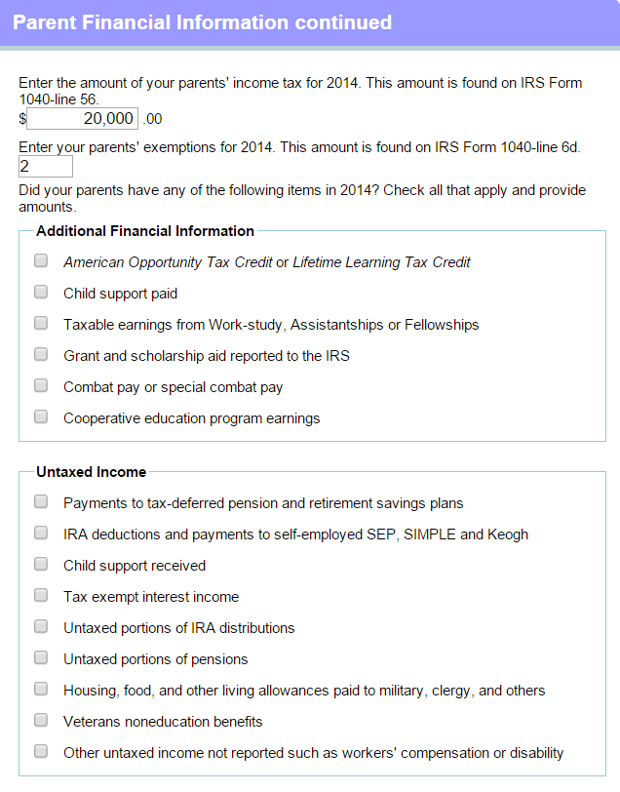
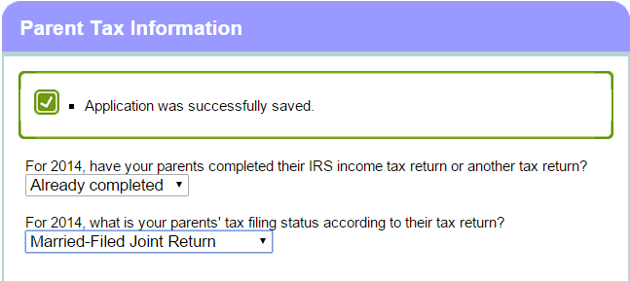
FAFSA: Financial information (parent)
“MAKING A DIFFERENCE”
2014-2015

Slide 15
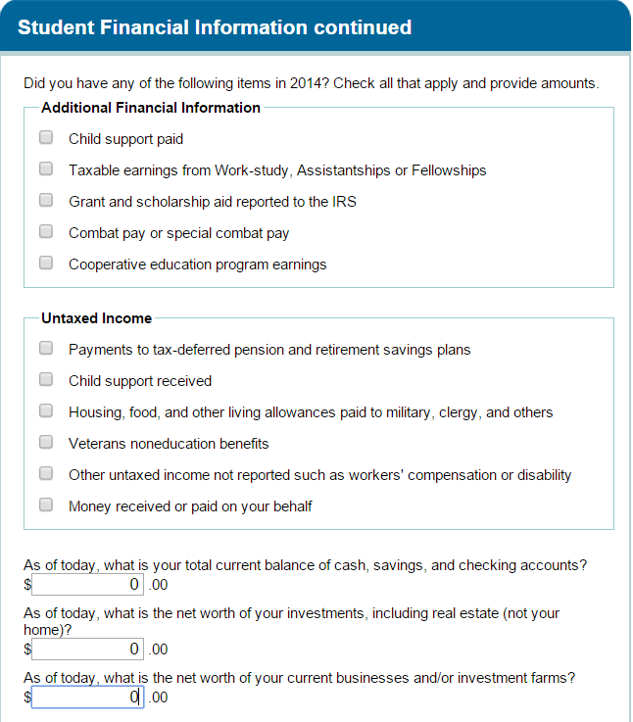
FAFSA: Financial information (Student)
“MAKING A DIFFERENCE”
2014-2015

Slide 16
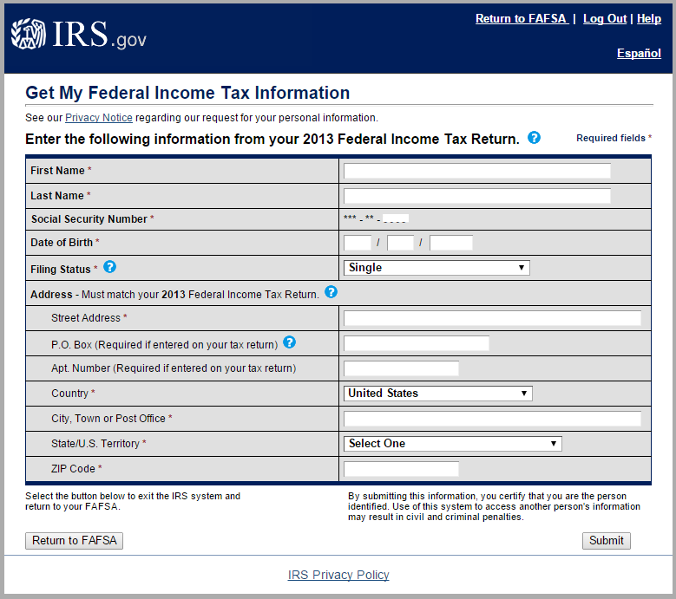
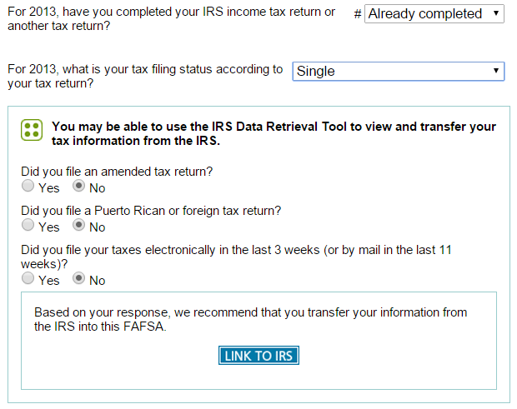
FAFSA: IRS Data Retrieval Tool
*ONCE A STUDENT/PARENT USES THE IRS DATA RETREIVAL TOOL, THEY MUST NOT MAKE ANY CHANGES TO THAT INFO ON THE FAFSA*
“MAKING A DIFFERENCE”
2014-2015

Slide 17
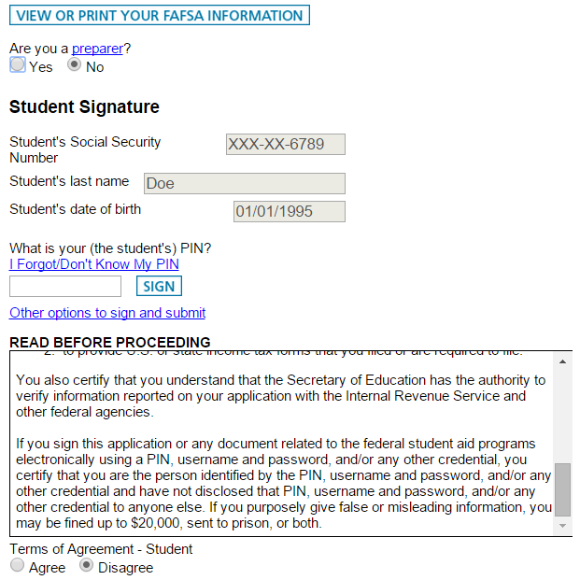
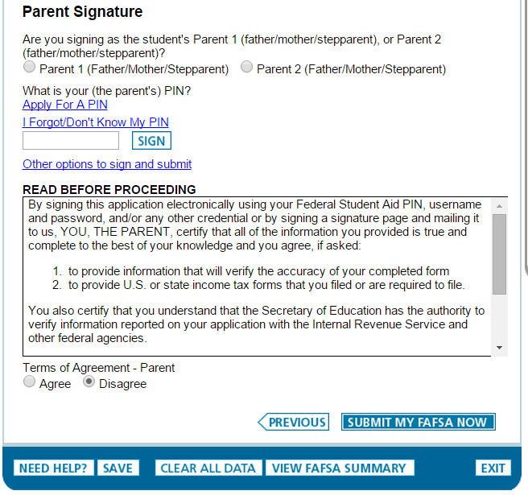
FAFSA: SIGN & SUBMIT
“MAKING A DIFFERENCE”
2014-2015

Slide 18
FAFSA: test drive
FAFSA.ed.gov
“MAKING A DIFFERENCE”
2014-2015

Slide 19
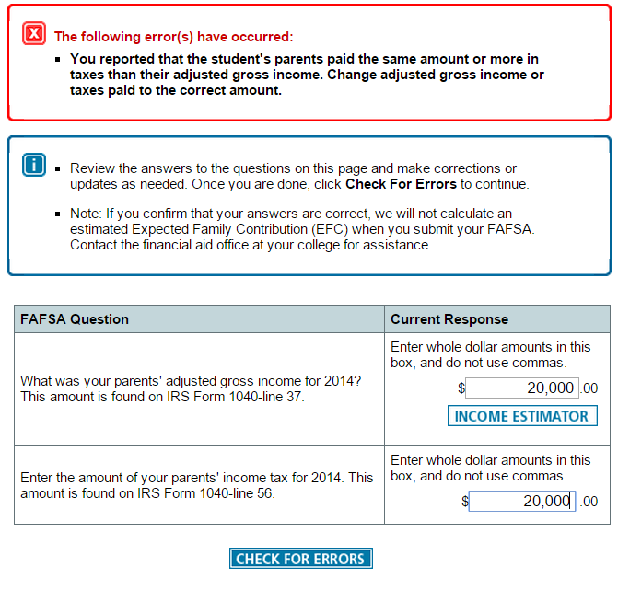
Common Mistakes
FREE Application for Federal Student Aid
Some websites charge to help you fill out the FAFSA (information will, eventually, end up with Department of Education)
Marital Status
As of the 1st day you file the FAFSA for the aid year
Contact school if wanting to update for any reason (marriage/divorce)
Household Size
Must include student
Dependents: anyone student (or student’s parent) will provide support of more than 50% during aid year
Adjusted Gross Income = Taxes Paid →
IRS tax data transferred, then changed
Saving vs. Submitting
Must re-submit FAFSA after any change is made
“MAKING A DIFFERENCE”
2014-2015

