Slide 1
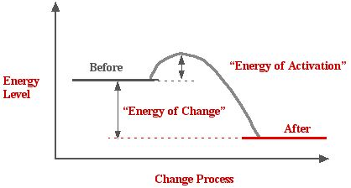
Energy of Reactions
Minimum amount of energy needed for chemical reaction = activation energy

Slide 2
Types of Reactions
Anabolic reactions - consume energy to build complex molecules from simpler ones
Eg. amino acids link to form muscle protein
Energy is required (Uses heat/energy)
Endothermic/endergonic
Creates larger molecules

Slide 3
Catabolic reactions - release energy by breaking down complex molecules into simpler compounds
Eg. digestive enzymes break down food → release energy
break down molecules
Energy/heat is released
Exothermic/exergonic

Slide 4
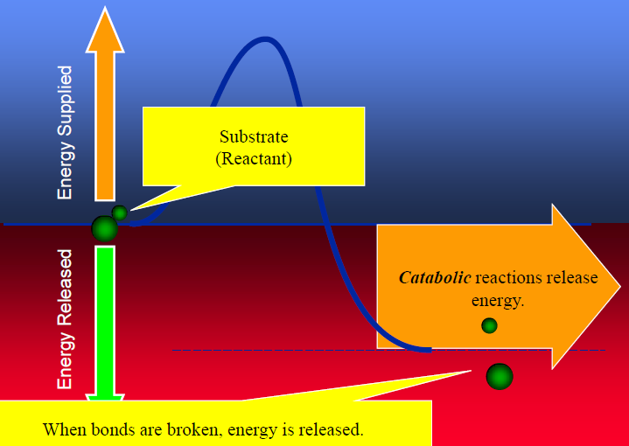
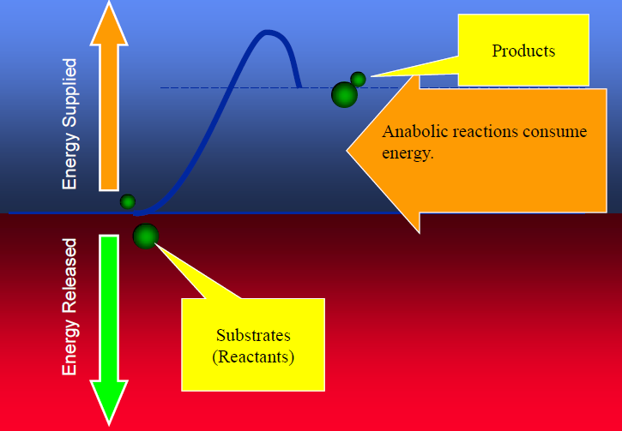
What are these reactions?
1
2

Slide 5
Catalyst: substance that can change the rate of a reaction without being altered in the process
Enzyme = biological catalyst
Speeds up metabolic reactions by lowering the activation energy (energy needed to start reaction)

Slide 6
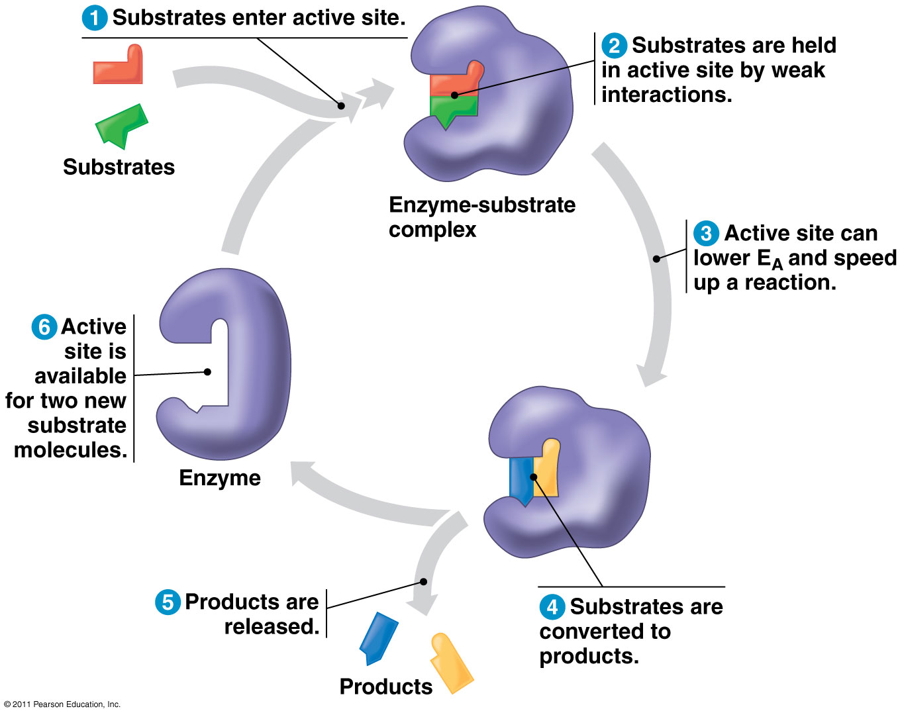

Slide 7
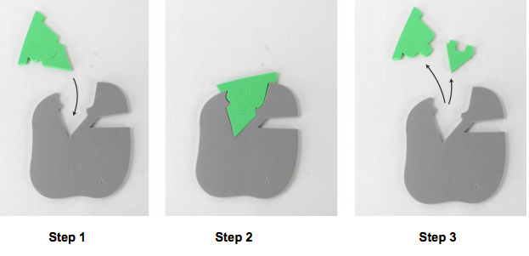
Enzyme Action: Catabolism

Slide 8
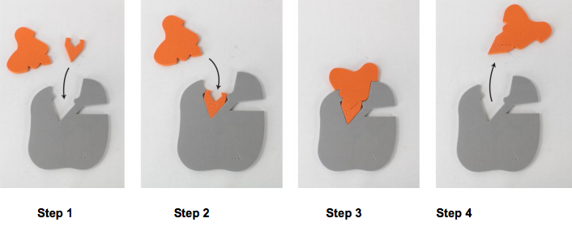
Enzyme Action: Anabolism

Slide 9
Enzymes
Enzymes: molecules that catalyze reactions in living cells
most are proteins
lower the activation energy required for a reaction
are not changed or consumed by the reaction
Named for what they do
lactase - breaks down lactose (milk sugars)
Amylase - breaks down starch in food in mouth
Protease - breaks down protein

Slide 10
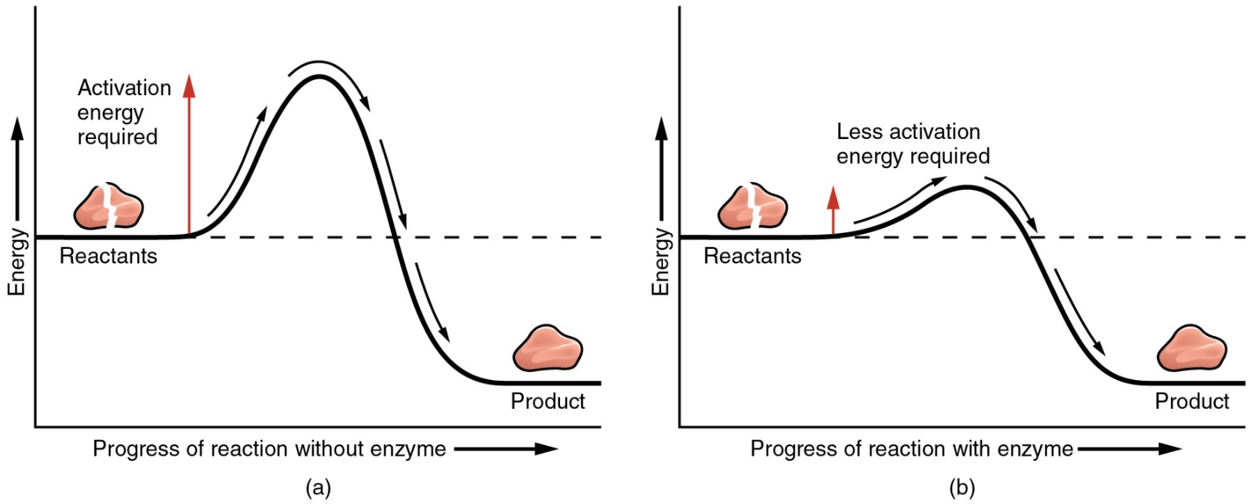
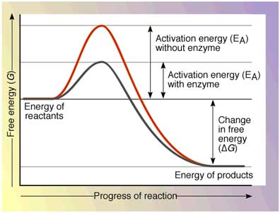
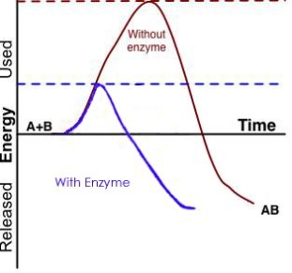
Reaction before and after enzyme

Slide 11
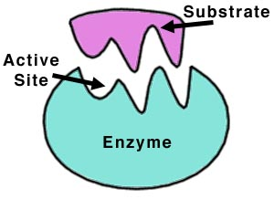
Enzymes
Enzymes interact with substrates. It is like a catchers mitt and a ball.
substrate: molecule that will undergo a reaction
active site: region of the enzyme that binds to the substrate
Binding of an enzyme to a substrate causes the enzyme to change shape, producing a better induced fit between the molecules.

Slide 12
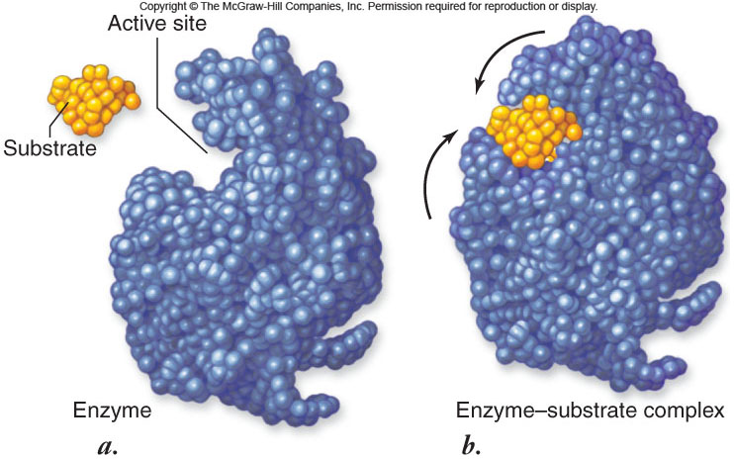

Slide 13
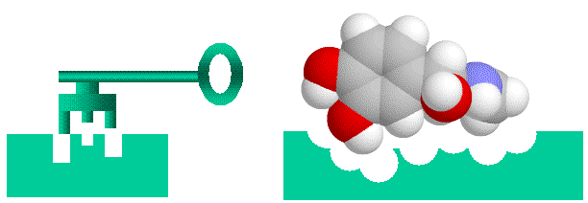
Induced Fit Theory/Key and Lock Model
Enzymes are SPECIFIC
Will only function correctly if the shape of the substrate matches the active site

Slide 14
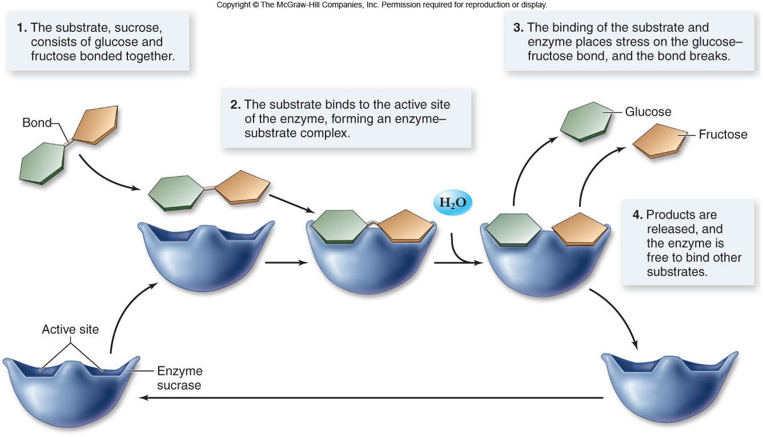

Slide 15
Enzymes
Multienzyme complexes offer certain advantages:
1. The product of one reaction can be directly delivered to the next enzyme.
2. The possibility of unwanted side reactions is eliminated.
3. All of the reactions can be controlled as a unit.

Slide 16
Enzymes
Not all enzymes are proteins.
Certain reactions involving RNA molecules are catalyzed by the RNA itself.
ribozymes: RNA with enzymatic abilities
For example, the ribosome is a ribozyme.

Slide 17
Enzymes
Enzyme function is affected by its environment.
Factors that can change an enzyme’s 3-dimensional shape can change its function.
for example, pH, temperature, regulatory molecules

Slide 18
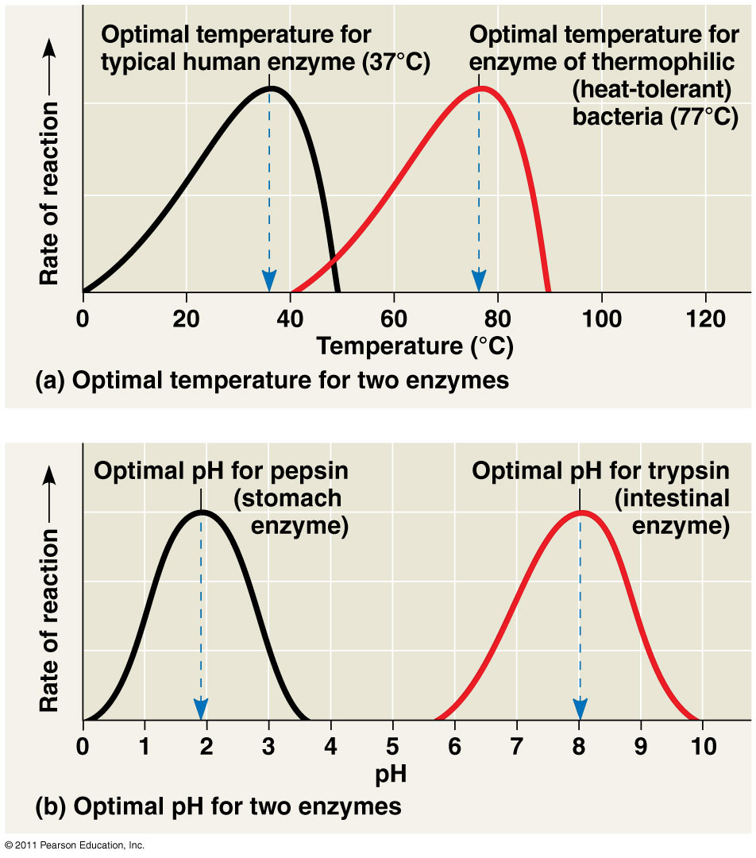
4 Conditions that affect enzymes
Substrate/enzyme Concentration
Chemicals
pH
Temp

Slide 19
Enzymes
Temperature
enzyme activity may be increased with increasing temp, up to the temp optimum
temperatures too far above the temp optimum can denature the enzyme, destroying its function
pH – most enzymes prefer pH values from 6 to 8.

Slide 20
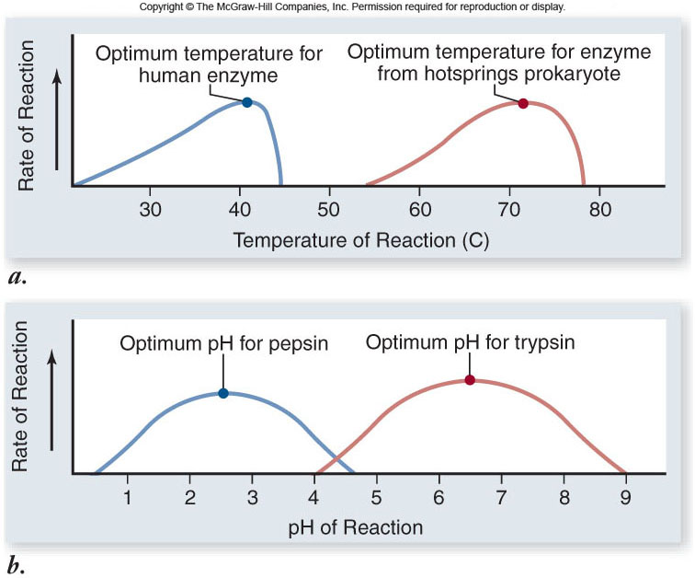

Slide 21
Regulation of Enzyme Activity
To regulate metabolic pathways, the cell switches on/off the genes that encode specific enzymes
Allosteric enzymes exist in either an active or inactive state.
possess an allosteric site where molecules other than the substrate bind
allosteric inhibitors bind to the allosteric site to inactivate the enzyme
allosteric activators bind to the allosteric site to activate the enzyme

Slide 22
CoFactors
Cofactors are nonprotein enzyme helpers such as minerals (eg. Zn, Fe, Cu)
Coenzymes are organic cofactors (eg. vitamins)
Inhibitors are molecules that bind to an enzyme to decrease enzyme activity.
competitive inhibitors compete with the substrate for binding to the same active site
noncompetitive inhibitors binds to another part of an enzyme → enzyme changes shape → active site is nonfunctional

Slide 23
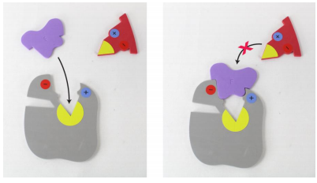
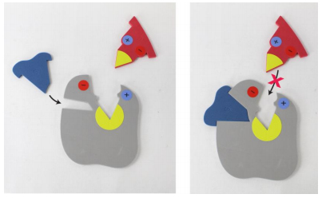
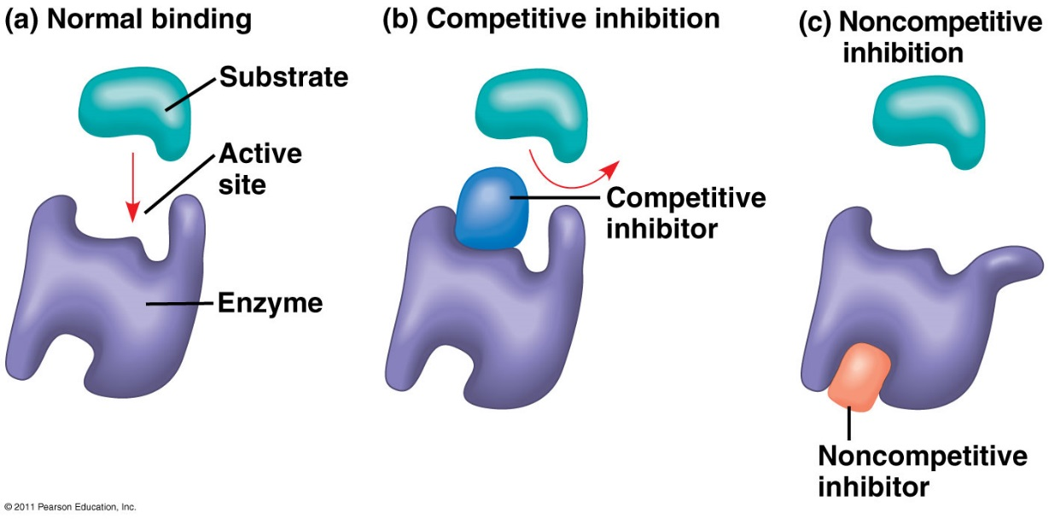
Competitive Inhibition
Non - Competitive Inhibition

Slide 24
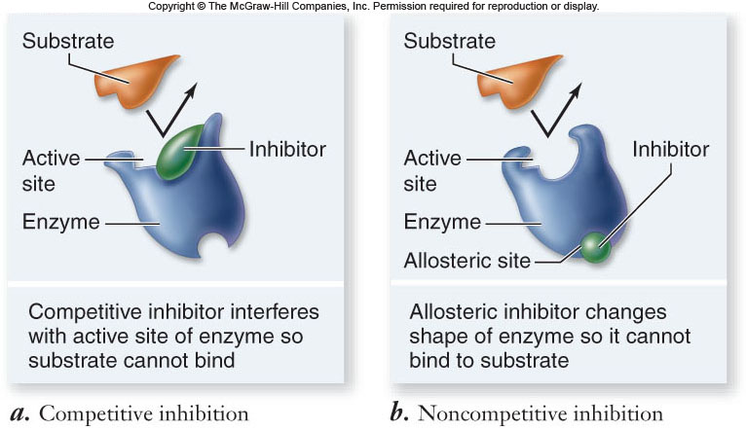

Slide 25
Feedback Inhibition
End product of a metabolic pathway shuts down pathway by binding to the allosteric site of an enzyme
Prevent wasting chemical resources, increase efficiency of cell

Slide 26
Feedback Inhibition

Slide 27
Metabolism is the totality of an organism’s chemical reactions
Manage the materials and energy resources of a cell

Slide 28
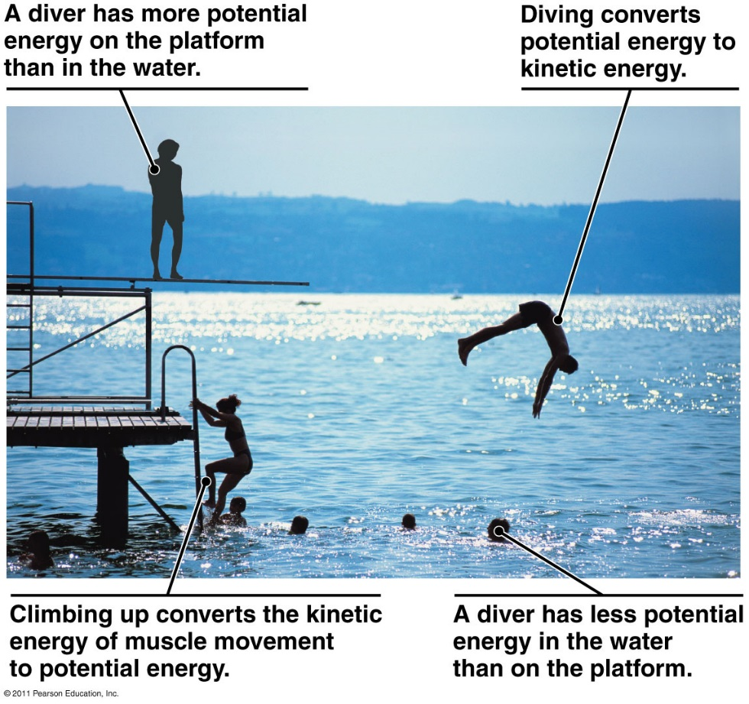
Energy = capacity to do work
Kinetic energy (KE): energy associated with motion
Heat (thermal energy) is KE associated with random movement of atoms or molecules
Potential energy (PE): stored energy as a result of its position or structure
Chemical energy is PE available for release in a chemical reaction
Energy can be converted from one form to another
Eg. chemical → mechanical → electrical

Slide 29
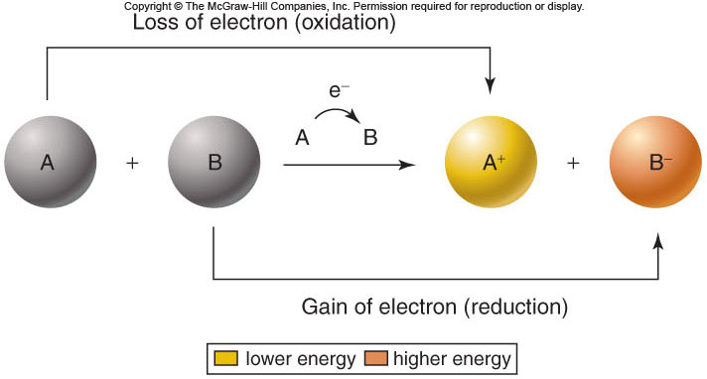
Flow of Energy
Potential energy stored in chemical bonds can be transferred from one molecule to another by way of electrons.
oxidation: loss of electrons
reduction: gain of electrons
redox reactions are coupled to each other.

Slide 30
Thermodynamics is the study of energy transformations that occur in nature
A closed system, such as liquid in a thermos, is isolated from its surroundings
In an open system, energy and matter can be transferred between the system and its surroundings
Organisms are open systems

Slide 31
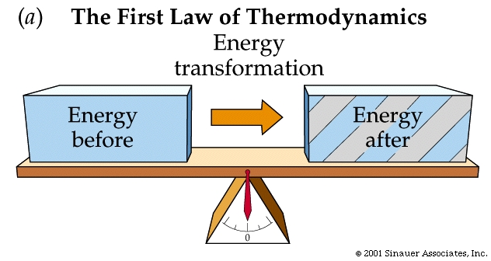
The First Law of Thermodynamics
Energy cannot be created or destroyed
Energy can be converted from one form to another
Also called the principle of Conservation of Energy

Slide 32
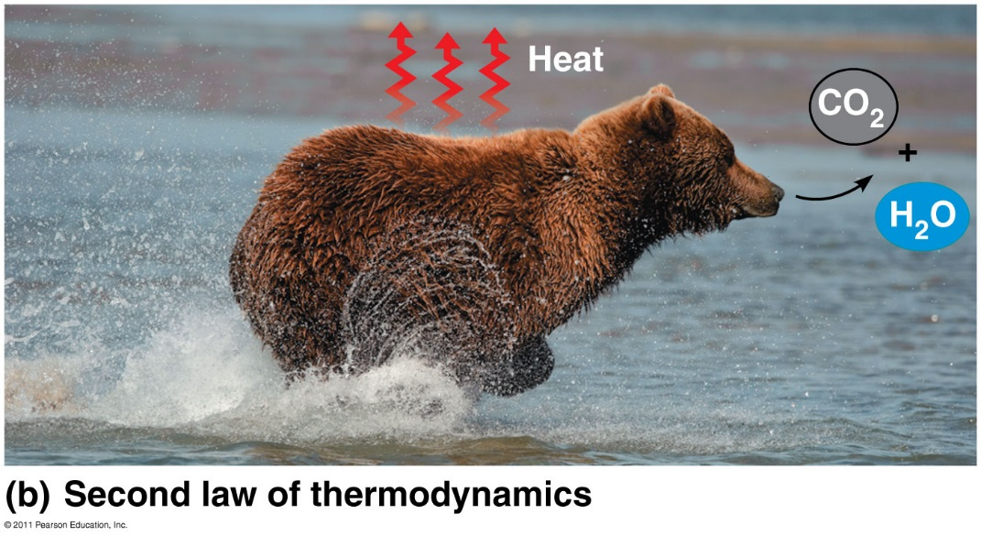
The Second Law of Thermodynamics
Every energy transfer or transformation increases the entropy (disorder) of the universe
During every energy transfer or transformation, some energy is unusable, often lost as heat
• Often, this means that:
- the change in energy includes transformation to heat
- small molecules result from the break down of larger ones
- an ordered system becomes more disordered

Slide 33
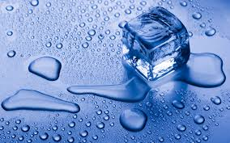
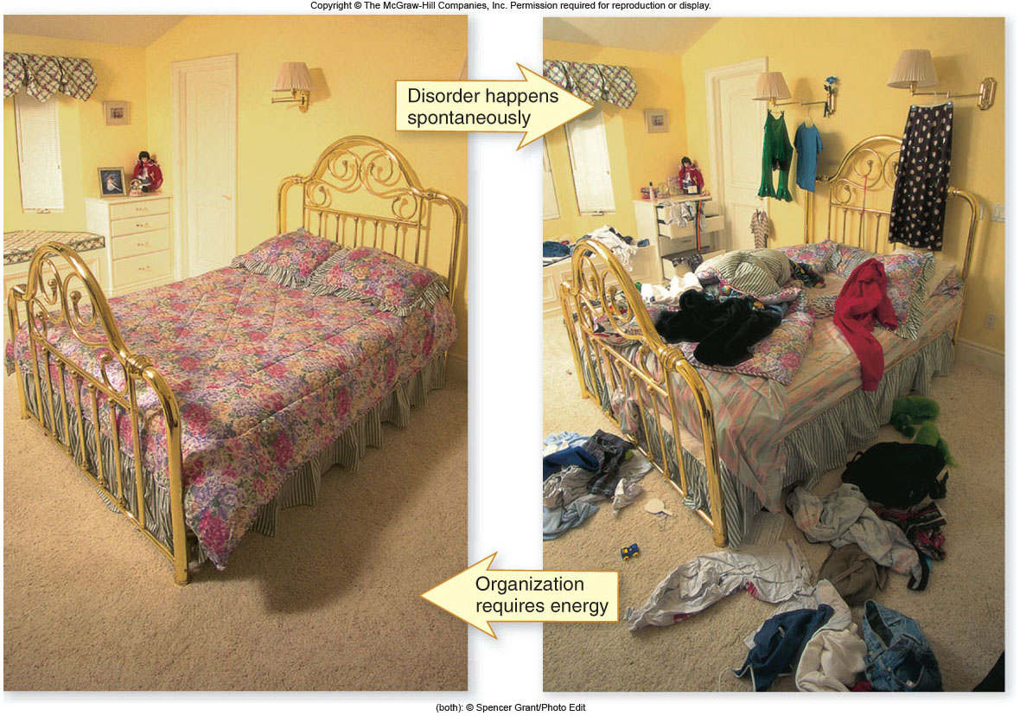
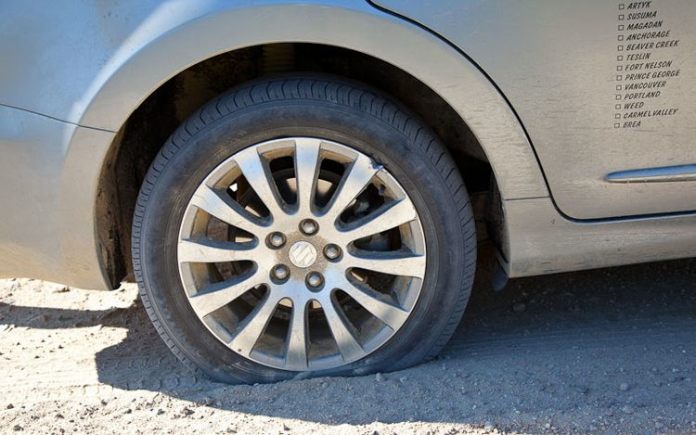
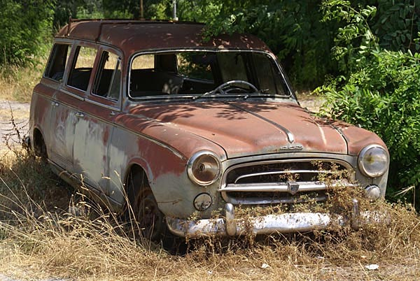

Slide 34
Laws of Thermodynamics
Free energy: the energy available to do work. AKA Gibbs Free Energy
-denoted by the symbol G (Gibb’s free energy)
enthalpy: energy contained in a molecule’s chemical bonds
free energy = enthalpy – (entropy x temp.)
G = ΔH – TΔS

Slide 35
This relationship can be used to determine the energy change of a rxn: exergonic or endergonic?
useable = total _ unusable
energy energy energy
GIBBS
FREE ENERGY = ENTHALPY - ENTROPY
As entropy increases, free energy decreases

Slide 36
Gibbs Free Energy
△G=△H-T△S
△G= free energy available
△S=change in entropy (disorder) △H=change in enthalpy (total energy of a system) T=temperature in Kelvin
***Questions involving Gibbs free energy will most likely ask whether the reaction is spontaneous or not. Know that a spontaneous reaction occurs when △G is less than 0. Also, be sure the temperature is in Kelvin.

Slide 37
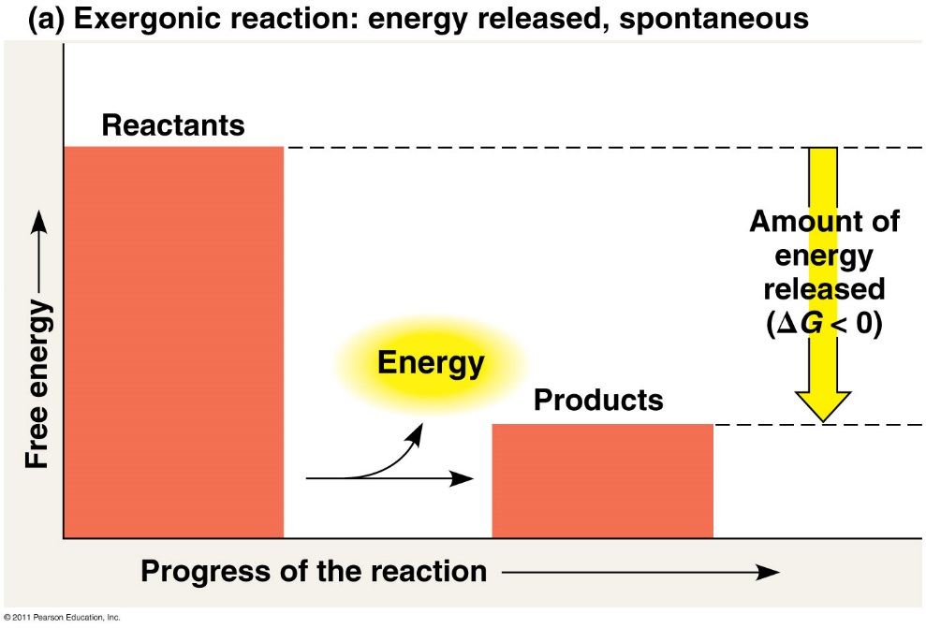
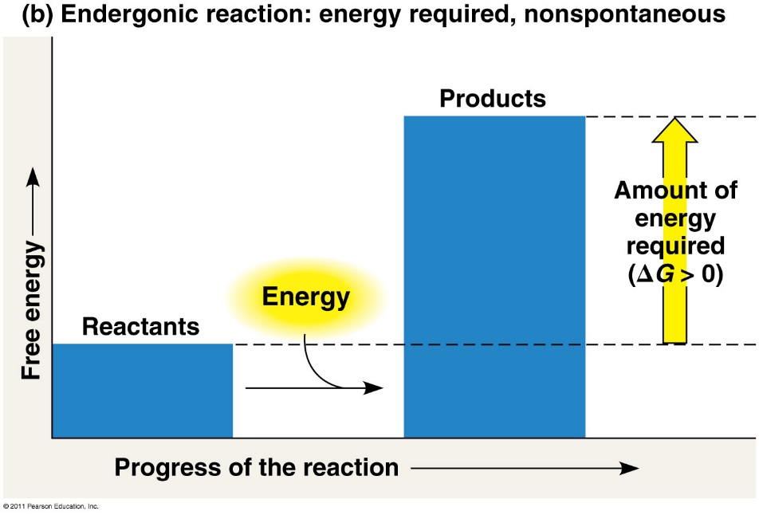
Free energy: part of a system’s energy available to perform work
ΔG = change in free energy
Exergonic reaction: energy is released
Spontaneous reaction
ΔG < 0
Endergonic reaction: energy is required
Absorb free energy
ΔG > 0

Slide 38
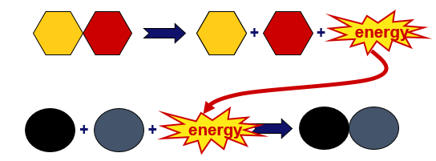
A cell does three main kinds of work:
Mechanical
Transport
Chemical
Cells manage energy resources to do work by energy coupling: using an exergonic process to drive an endergonic one

Slide 39
ATP
Adenosine Triphosphate
modified nucleotide
nucleotide = adenine + ribose + P_{i} → AMP
AMP + P_{i} → ADP
ADP + P_{i} → ATP
adding phosphates is endergonic
high potential bonds
Notes:
Marvel at the efficiency of biological systems!
Build once = re-use over and over again.
Start with a nucleotide and add phosphates to it to make this high energy molecule that drives the work of life.
Let’s look at this molecule closer.
Think about putting that Pi on the adenosine-ribose ==>
EXERGONIC or ENDERGONIC?

Slide 40
How does ATP store energy?
O–
O–
O–
O–
P
O–
O–
O–
O–
P
P
P
P
P
P
P
–O
–O
–O
–O
–O
O–
O–
O–
–O
O–
O–
–O
O–
–O
O–
O–
O
O
O
O
AMP
O
O
O
O
ADP
ATP
Each negative PO₄ more difficult to add
a lot of stored potential energy in each bond
most energy stored in 3rd P_{i}
3rd P_{i} is hardest group to keep bonded to molecule
Bonding of negative P_{i} groups is unstable
spring-loaded
P_{i} groups “pop” off easily & release energy
Instability of its P bonds makes ATP an excellent energy donor
Notes:
Not a happy molecule
Add 1st Pi → Kerplunk! Big negatively charged functional group
Add 2nd Pi → EASY or DIFFICULT to add? DIFFICULT→ takes energy to add = same charges repel → Is it STABLE or UNSTABLE? UNSTABLE = 2 negatively charged functional groups not strongly bonded to each other So if it releases Pi → releases ENERGY
Add 3rd Pi → MORE or LESS UNSTABLE? MORE = like an unstable currency • Hot stuff! • Doesn’t stick around • Can’t store it up • Dangerous to store = wants to give its Pi to anything

Slide 41
How does ATP transfer energy?
7.3 energy
O–
O–
O–
O–
P
P
P
P
–O
–O
O–
–O
O–
O–
–O
O–
+
ATP
O
O
O
O
ADP
ATP → ADP (larger molecule is more unstable)
releases energy when bonds are formed
∆G = -7.3 kcal/mole (free energy)
can fuel other reactions
Phosphorylation
released P_{i} can transfer to other molecules
destabilizing the other molecules
enzyme that phosphorylates = kinase
Notes:
How does ATP transfer energy?
By phosphorylating
Think of the 3rd Pi as the bad boyfriend ATP tries to dump off on someone else = phosphorylating
How does phosphorylating provide energy?
Pi is very electronegative. Got lots of OXYGEN!! OXYGEN is very electronegative. Steals e’s from other atoms in the molecule it is bonded to. As e’s fall to electronegative atom, they release energy.
Makes the other molecule “unhappy” = unstable. Starts looking for a better partner to bond to. Pi is again the bad boyfriend you want to dump.
You’ve got to find someone else to give him away to. You give him away and then bond with someone new that makes you happier (monomers get together).
Eventually the bad boyfriend gets dumped and goes off alone into the cytoplasm as a free agent = free Pi.

Slide 42
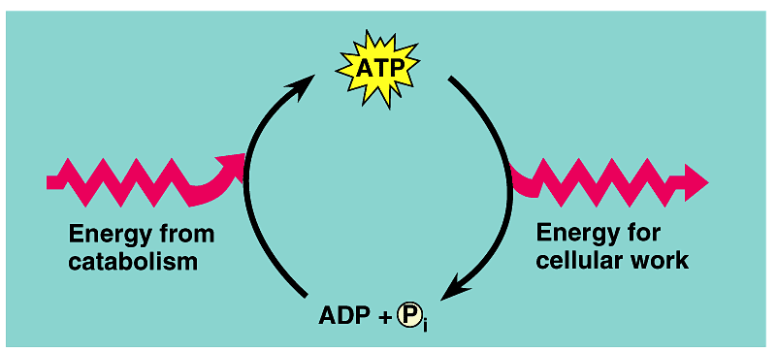
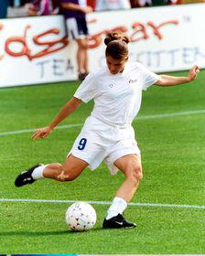
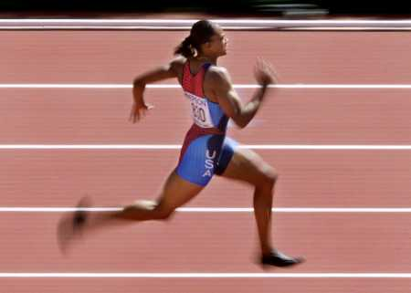
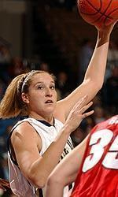
ATP / ADP cycle
Can’t store ATP
too reactive
transfers P_{i} too easily
only short term energy storage
carbohydrates & fats are long term energy storage
ATP
respiration
7.3 kcal/mole
ADP
+
P
A working muscle recycles over 10 million ATPs per second

Slide 43
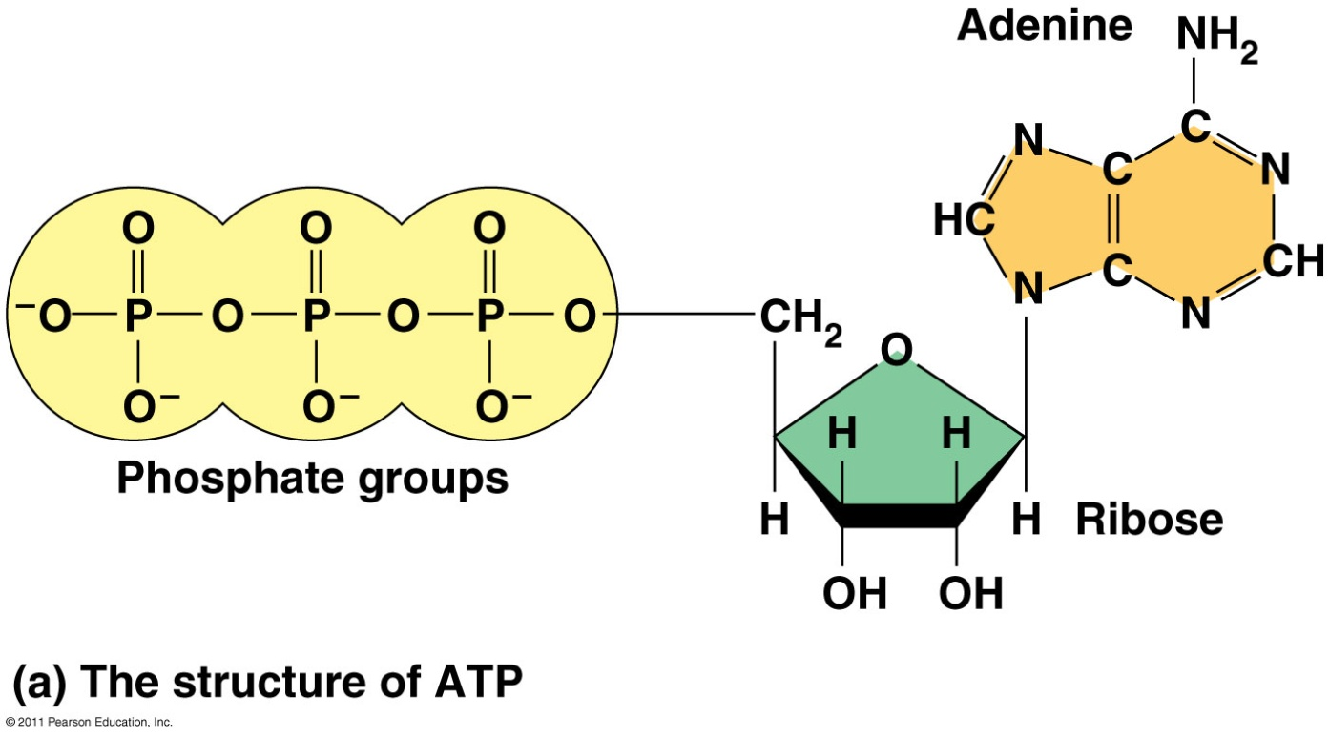
ATP (adenosine triphosphate) is the cell’s main energy source in energy coupling
ATP = adenine + ribose + 3 phosphates

Slide 44
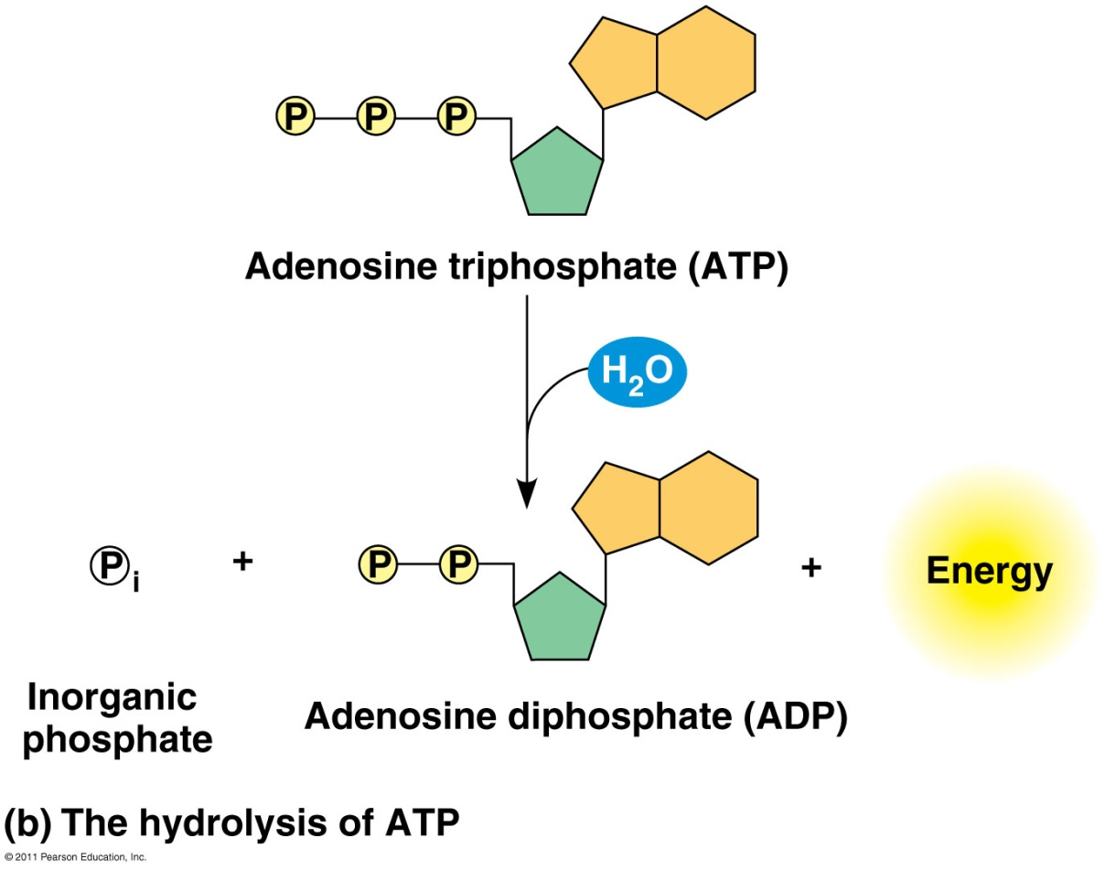
When the bonds between the phosphate groups are broken by hydrolysis → energy is released
This release of energy comes from the chemical change to a state of lower free energy, not in the phosphate bonds themselves

Slide 45
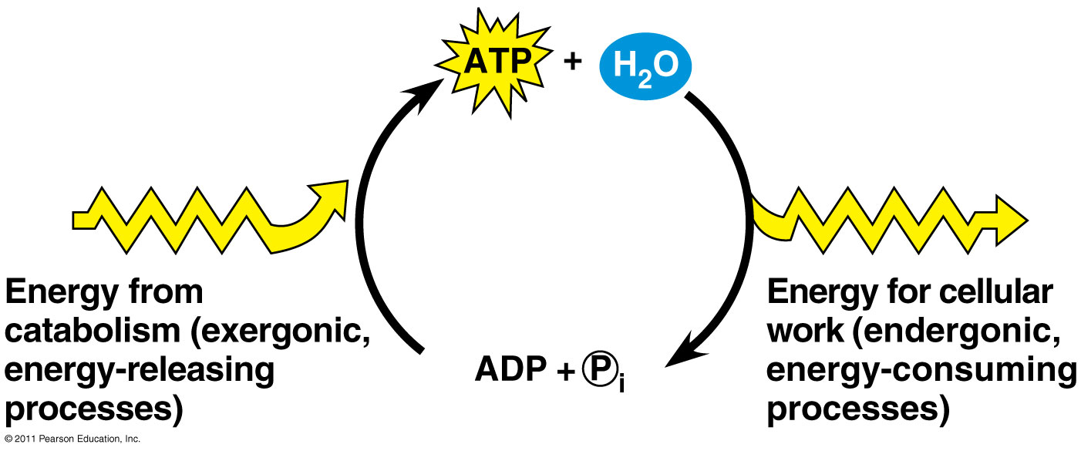
How ATP Performs Work
Exergonic release of P_{i} is used to do the endergonic work of cell
When ATP is hydrolyzed, it becomes ADP (adenosine diphosphate)

Slide 46
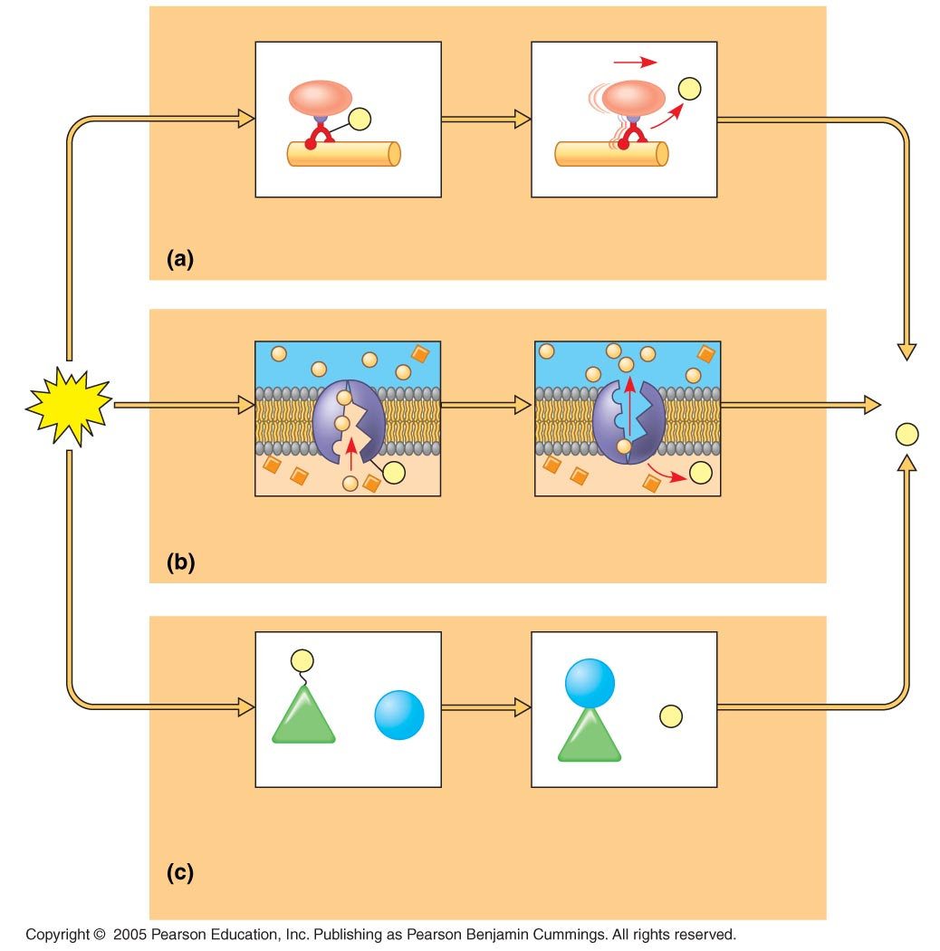
P
i
P
Motor protein
Protein moved
Mechanical work: ATP phosphorylates motor proteins
Membrane
protein
ADP
ATP
+
P
i
P
P
i
Solute
Solute transported
Transport work: ATP phosphorylates transport proteins
P
NH₂
Glu
+
NH₃
+
P
i
Glu
Reactants: Glutamic acid
and ammonia
Product (glutamine)
made
Chemical work: ATP phosphorylates key reactants

Slide 47
2H₂O₂ -> 2H₂O + 0₂
Building or breaking down molecules?
Decreasing or increasing complexity?
Catabolic or anabolic?
Energy stored or released?
Endergonic or exergonic?
Increasing or decreasing disorder?
Change in G positive or negative?
Spontaneous or coupled with ATP?
Notes:
Chemical reactions can be “coupled” together if they share intermediates. In this case, the overall Gibbs Free Energy change is simply the sum of the ∆G values for each reaction. Therefore, an unfavorable reaction (positive ∆G1) can be driven by a second, highly favorable reaction (negative ∆G2 where the magnitude of ∆G2 > magnitude of ∆G1). For example, the reaction of glucose with fructose to form sucrose has a ∆G value of +5.5 kcal/mole. Therefore, this reaction will not occur spontaneously. The breakdown of ATP to form ADP and inorganic phosphate has a ∆G value of -7.3 kcal/mole. These two reactions can be coupled together, so that glucose binds with ATP to form glucose-1-phosphate and ADP. The glucose-1-phosphate is then able to bond with fructose yielding sucrose and inorganic phosphate. The ∆G value of the coupled reaction is -1.8 kcal/mole, indicating that the reaction will occur spontaneously. This principle of coupling reactions to alter the change in Gibbs Free Energy is the basic principle behind all enzymatic action in biological organisms.^{[10}
For a reaction that is not spontaneous ΔG is positive. This means that work must be done on the system (through some outside intervention) to force the non-spontaneous reaction to occur. The minimum work that must be done is given by ΔG. This tells us that in order to create order in the universe, our bodies must somehow do work to force non-spontaneous reactions to occur. Our bodies do this by consuming fuel that, when oxidized, provides excess Gibbs free energy with which to do work. By combining the oxygen we breathe with the food we eat, we can generate excess Gibbs free energy to force otherwise non-spontaneous reactions to occur.

Slide 48
Building or breaking down molecules?
Decreasing or increasing complexity?
Catabolic or anabolic?
Energy stored or released?
Endergonic or exergonic?
Increasing or decreasing disorder?
Change in G positive or negative?
Spontaneous or coupled with ATPrxn?
Notes:
Chemical reactions can be “coupled” together if they share intermediates. In this case, the overall Gibbs Free Energy change is simply the sum of the ∆G values for each reaction. Therefore, an unfavorable reaction (positive ∆G1) can be driven by a second, highly favorable reaction (negative ∆G2 where the magnitude of ∆G2 > magnitude of ∆G1). For example, the reaction of glucose with fructose to form sucrose has a ∆G value of +5.5 kcal/mole. Therefore, this reaction will not occur spontaneously. The breakdown of ATP to form ADP and inorganic phosphate has a ∆G value of -7.3 kcal/mole. These two reactions can be coupled together, so that glucose binds with ATP to form glucose-1-phosphate and ADP. The glucose-1-phosphate is then able to bond with fructose yielding sucrose and inorganic phosphate. The ∆G value of the coupled reaction is -1.8 kcal/mole, indicating that the reaction will occur spontaneously. This principle of coupling reactions to alter the change in Gibbs Free Energy is the basic principle behind all enzymatic action in biological organisms.^{[10}
For a reaction that is not spontaneous ΔG is positive. This means that work must be done on the system (through some outside intervention) to force the non-spontaneous reaction to occur. The minimum work that must be done is given by ΔG. This tells us that in order to create order in the universe, our bodies must somehow do work to force non-spontaneous reactions to occur. Our bodies do this by consuming fuel that, when oxidized, provides excess Gibbs free energy with which to do work. By combining the oxygen we breathe with the food we eat, we can generate excess Gibbs free energy to force otherwise non-spontaneous reactions to occur.

