Slide 1
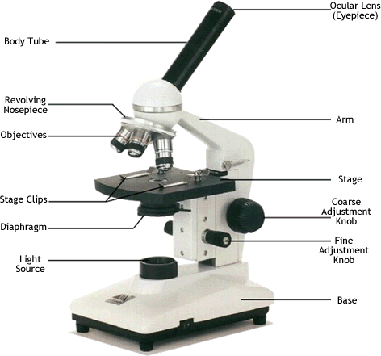

Slide 2
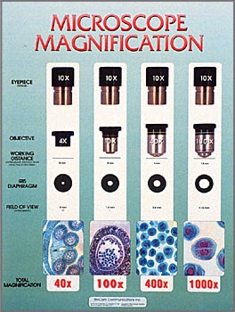
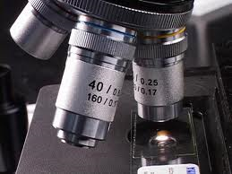
Terms
1.)Magnification – ability of Microscope to enlarge image of object – up to 2000X

Slide 3
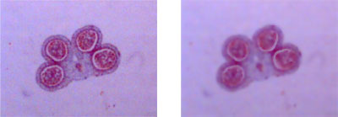
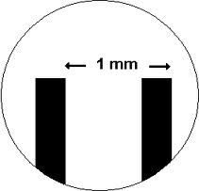
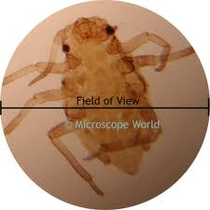
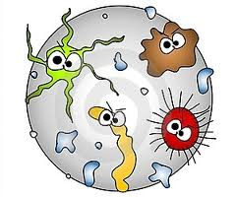
2.)Resolution – ability of Microscope to show detail clearly.
3.)Field of View(FOV) Diameter – distance across light spot

Slide 4
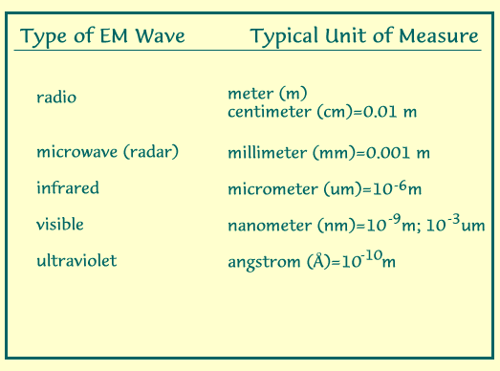
4.)Micrometer – 1000 micrometers in 1mm
5.)Nanometer -1000 nanometers in 1 micrometer

Slide 5
Path of Light
Bulb Diaphragm(adjusts light) Stage Hole
Slide Specimen Cover Slip
Objective Lens(Magnifies) Mirrors
Eyepiece(Magnifies) Eyeball (Cornea to Lens to Retina
to Optic Nerve to Brain)

Slide 6
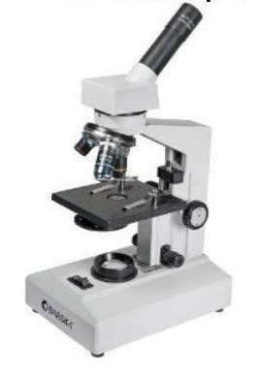
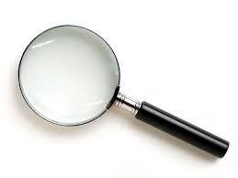
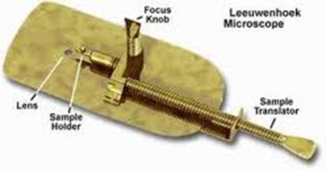
Types of Microscopes
1. Light Microscope - use compound lenses to magnify objects. The lenses bend or refract light to make the object beneath them appear closer.
1. Simple microscope – one lens
*Examples – Magnifying glass + Leeuwenhoeks
2. Compound microscope – two lenses:
Ex. = ours

Slide 7
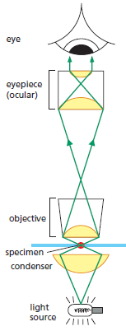
*More stuff about the compound microscope
a. Real Image –
Created by objective lens
b. Virtual image – Image
bouncing off mirror
through eyepiece lens into the eyeball.

Slide 8
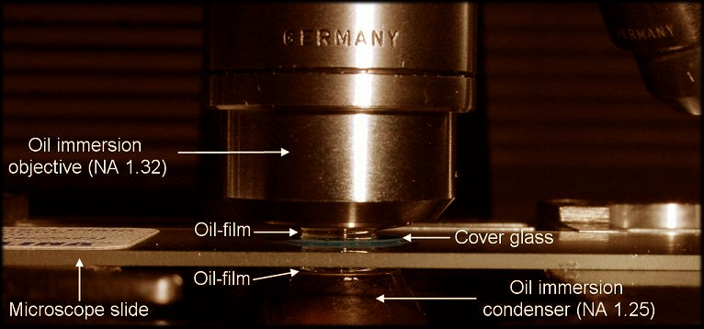
c. High Resolution occurs with shorter (blue) light waves.
d. Since air refracts light, oil between slide and objective increases resolution.
e. .2 Micrometer is the limit

Slide 9
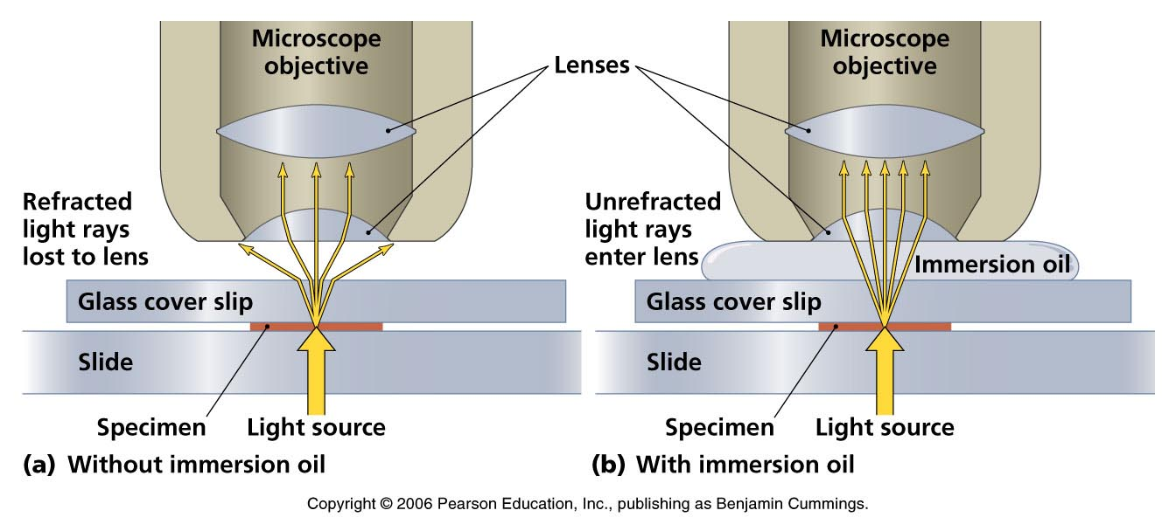
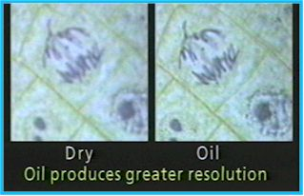

Slide 10
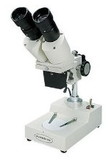
2. Stereoscope
binocular (two eyes)
Can be used for thicker, larger specimens or dissections
Magnification ranges between 4X – 40X
Creates a 3D view of specimen
Better for Opaque objects
Better for large microbes
Can use reflected or transmitted light
Not compound = real image.

Slide 11
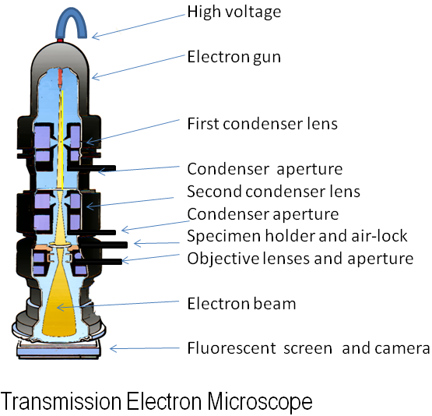
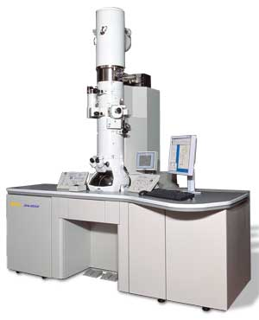
H. Electron Microscope
1. Create the greatest magnified images with the greatest resolution
2. Very expensive $$$
3. Cannot view live specimens
4. No colored images
5. Specimens pretreated with dyes
6. No direct observations –
viewed on a
screen
or photographed

Slide 12
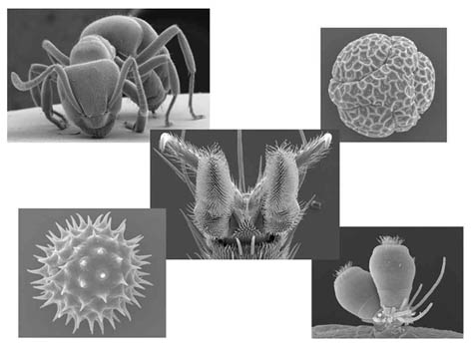
3. Scanning Electron Microscope -
SEMs use electrons to magnify objects up to two million times
creates a 3D view of specimen with great external detail
  cannot view living specimens (process kills them)
Produces super 3d image with great external detail
Magnifies up to 100,000x

Slide 13
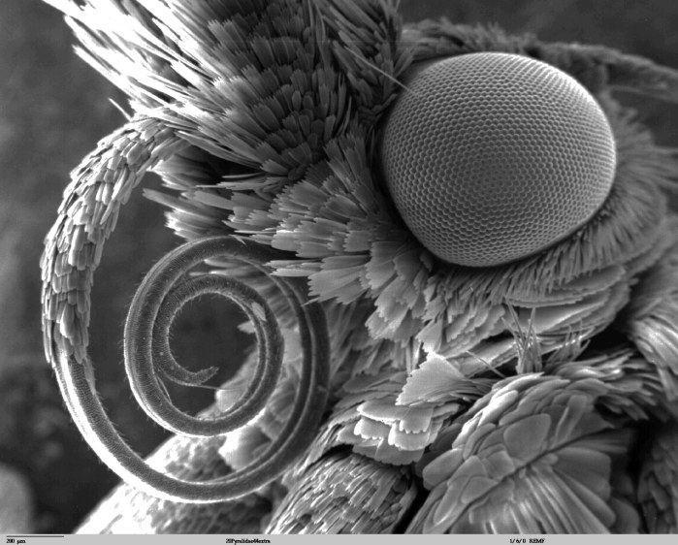
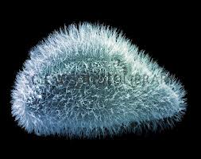
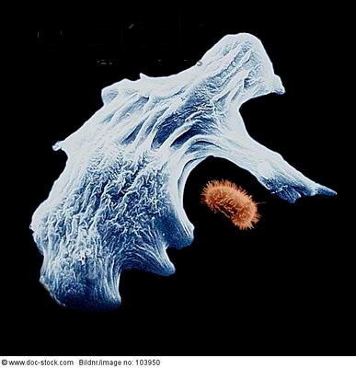
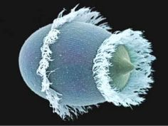
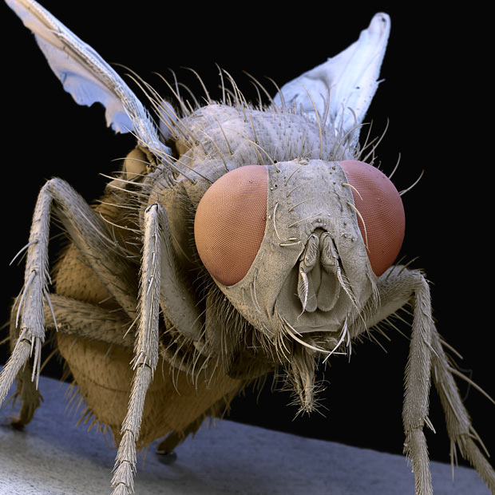
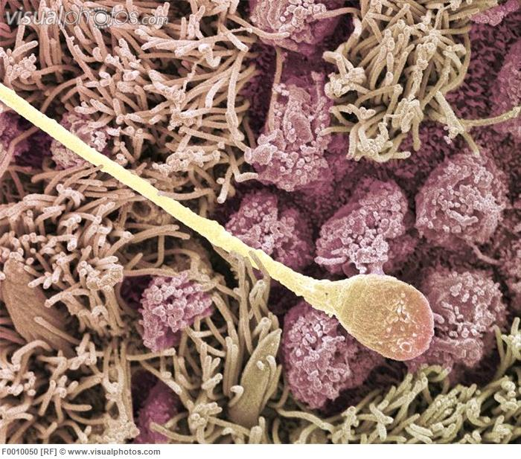
SEM Micrographs

Slide 14
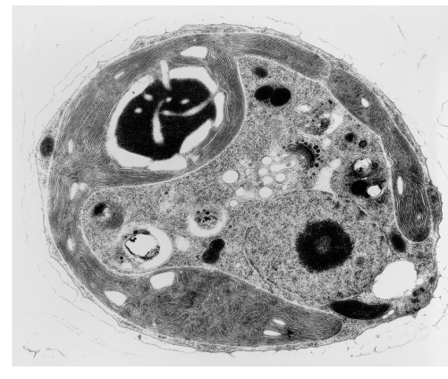
4. Transmission Electron Microscope
uses electrons, but instead of scanning the surface electrons are passed through very thin specimens
  TEM = "thin“
Magnifies up to 1,000,000x
Specimen Preparation = thin slice
(20-100 nm) = staining
Shows incredible internal detail

Slide 15
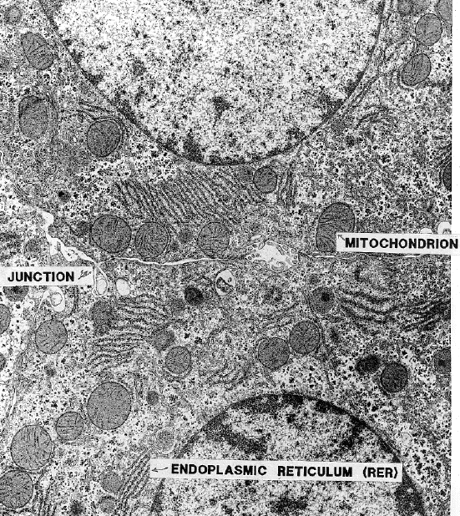
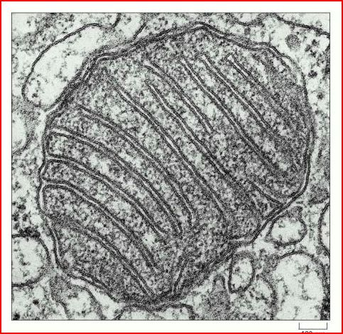
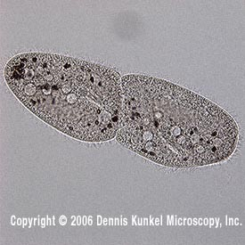
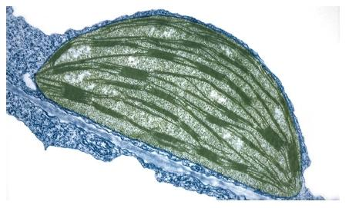
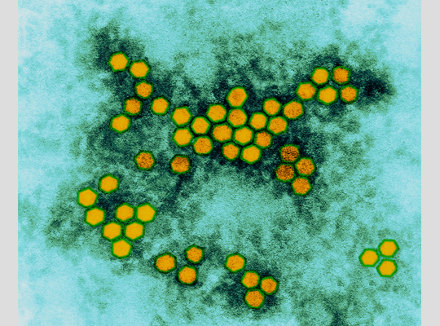
TEM Micrographs

Slide 16

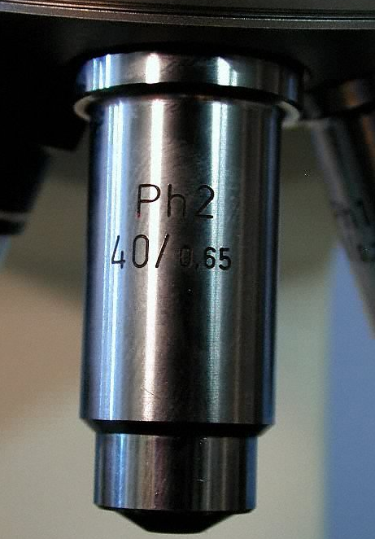
Magnification
Your microscope has 3 magnifications: Low, medium, and High.
In addition the ocular lens (eyepiece) has a magnification
The total magnification is the ocular x objective

Slide 17

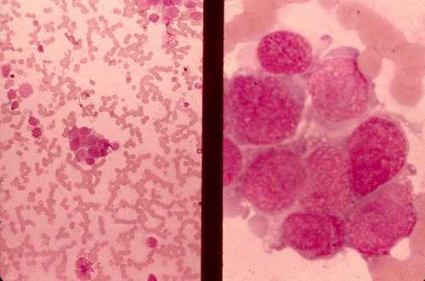
Comparing Powers of Magnification
We can see better details with higher the powers of magnification, but we cannot see as much of the image.
Which of these images would be viewed at a higher power of magnification?

Slide 18
Focusing Specimens
1. Always start with the scanning (low) objective.
  Use the Coarse Knob to focus and then the fine adjustment knob until clear.
  Then center object
2. Switch to medium Power.
  Use the Coarse Knob to focus and then the fine adjustment knob until clear.
  Center specimen
3. Now switch to High Power.
  ONLY use the Fine Adjustment Knob to focus.
Recap
1. Scanning --> use coarse and fine knob
2. Low power --> use coarse and fine knob
3. High power --> use fine knob only
DO NOT SKIP STEPS!!!!

Slide 19
Troubleshooting
Occasionally you may have trouble with working your microscope. Here are some common problems and solutions.
1. Image is too dark!
Adjust the diaphragm, make sure your light is on.
2. There's a spot in my viewing field, even when I move the slide the spot stays in the same place!
Your lens is dirty. Use lens paper, and only lens paper to carefully clean the objective and ocular lens. The ocular lens can be removed to clean the inside. The spot is probably a spec of dust.
3. I can't see anything under high power!
Remember the steps, if you can't focus under scanning and then low power, you won't be able to focus anything under high power. Start at scanning and walk through the steps again.
4. Only half of my viewing field is lit, it looks like there's a half-moon in there!
You probably don't have your objective fully clicked into place..

Slide 20
How to make a wet-mount slide …
1 – Get a clean slide and coverslip from your teacher.
2 – Place ONE drop of water in the middle of the slide. Don’t use too much or the water will run off the edge and make a mess!
3 – Place the edge of the cover slip on one side of the water drop.
4 - Slowly lower the cover slip on top of the drop.
Cover Slip
Lower slowly

Slide 21
Unit of Measure
Micrometer or micron
Unit of measure for microscopic images
Symbol = µ
1 mm = 1000 µm

Slide 22
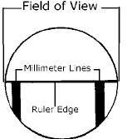
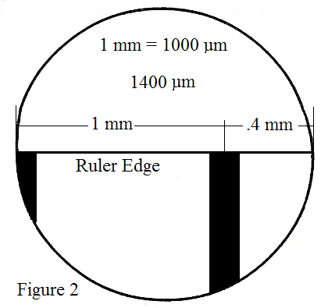
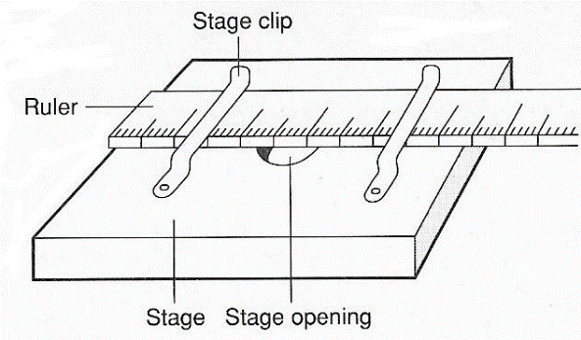
Calculate Field of View
Clear Ruler
Determine how many millimeters across
Convert to micrometers
1mm=1000μm
one millimeter is the distance from the middle of one mark to the middle of the next mark.

Slide 23
Calculate Size of Specimen
Figure out how many will fit across the field of view (estimate)
Divide field of view length by how many fit across
Example:
*About 8 fit across
  field of view is 800 μm
  800 μm/8 = 100 μm

Slide 24
Microscope Rules
1. Carry the microscope properly (by arm and base)
2. Always begin focusing with the 4X (lowest) objective.
3. Use the coarse focus only with the 4X objective in place.
4. Use immersion oil only with the 100X objective (oil immersion lens) in place. Use only ONE drop of oil.
5. Lower the stage and then remove the slide when you are done.
6. ALWAYS clean the microscope when you are done. Use a Kimwipe or lens paper
7. Always place the 4X objective over the stage and be sure the stage is at its lowest position before putting the microscope away.
8. Always turn off the light before putting the microscope away.
9. Always wrap the cord correctly before putting the microscope away.
10. Cover the microscope before putting it away.

