Slide 1
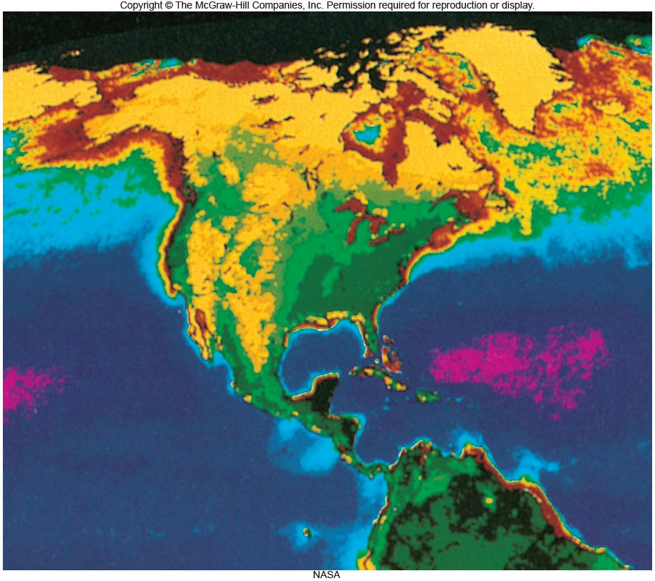
The Biosphere
Chapter 58

Slide 2
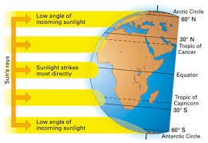
Effects of Sun, Wind, Water
Biosphere: includes all living communities on Earth
Global patterns of life on Earth are influenced by
  The amount of solar radiation that reaches different areas
  Patterns of global atmospheric circulation which influence oceanic circulation

Slide 3
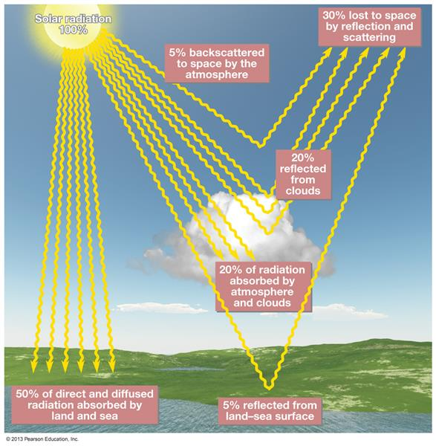
Effects of Sun, Wind, Water
Earth receives energy from the Sun
Solar radiant energy passes through the atmosphere and its intensity and wavelength composition are modified
About 1/2 of the energy is absorbed within the atmosphere
  UV-B is strongly absorbed by the ozone

Slide 4
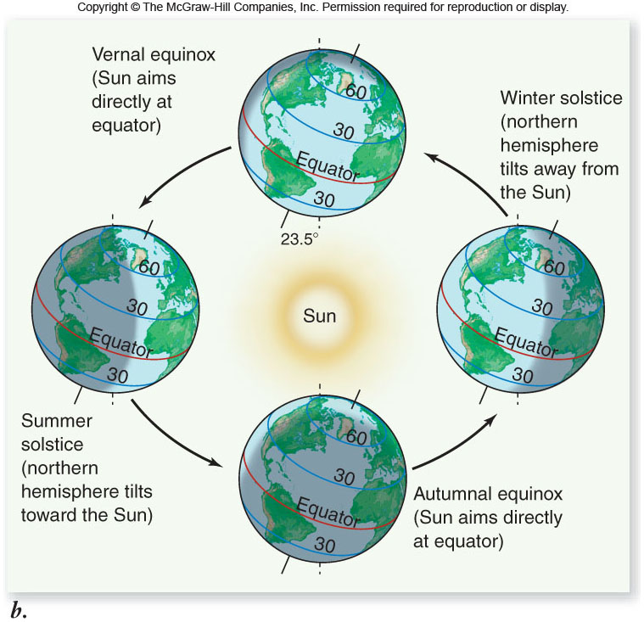
Effects of Sun, Wind, Water
Angle of incidence: how the Sun’s rays strike the spherical Earth
Earth’s orbit around the Sun and its daily rotation on its own axis affect climate

Slide 5
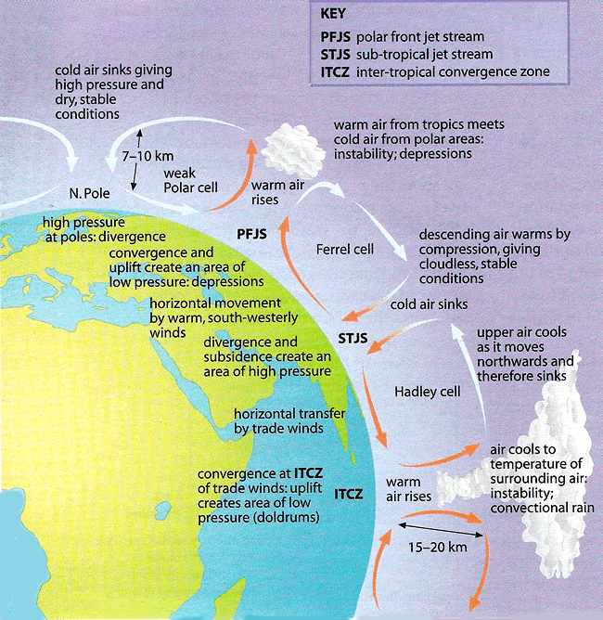
Effects of Sun, Wind, Water
Global circulation patterns
  Hot air rises relative to cooler air
  Heating at the equator causes air to rise from the surface to high in the atmosphere
  Rising air is rich in water vapor
    Warm air holds more water than cold
    Intense solar radiation at the equator provides the heat needed for water to evaporate

Slide 6
Effects of Sun, Wind, Water
After the warm moist air moves from the surface at the equator
  Warm air moves north and south
  Cooler air flows toward the equator from both hemispheres
  Air descends at 30˚ latitude-desert regions of the earth
  At 60˚ latitude air begins to rise again

Slide 7
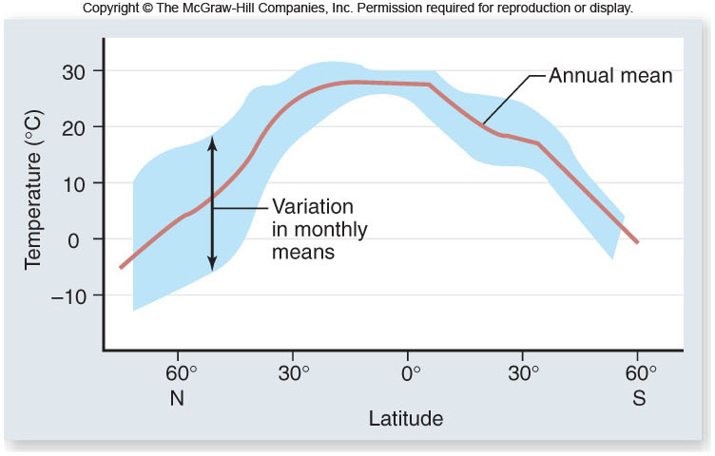
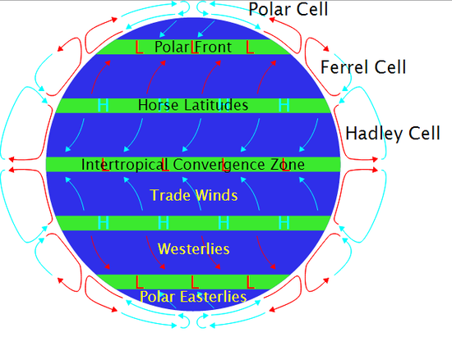
Effects of Sun, Wind, Water
Annual mean temperature varies with latitude
Global patterns of atmospheric circulation

Slide 8
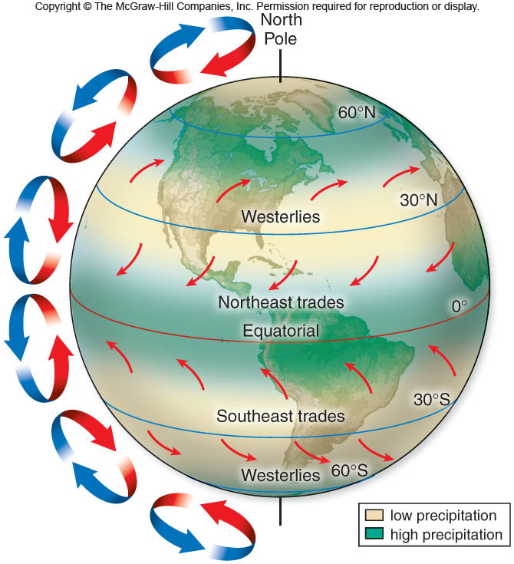
Effects of Sun, Wind, Water
The Coriolis effect: The Apparent deflection of the paths of the Wind/Projectiles due to Earth’s rotation.
Northern hemisphere: counterclockwise--winds curve to the right of their direction of motion
Southern hemisphere: clockwise --winds curve to the left; blow westward as well as toward the equator

Slide 9
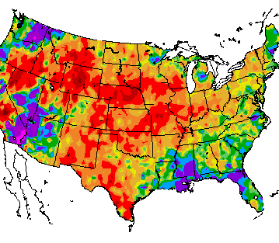
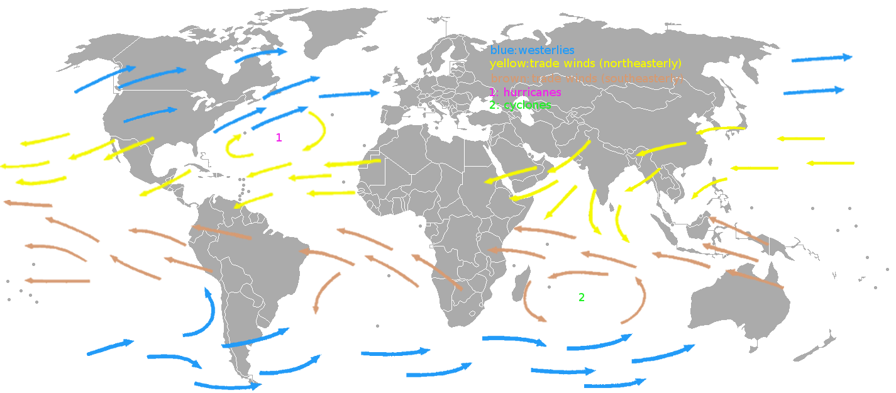
Climate
The long-term prevailing weather conditions.
This is the most significant reason for the distribution of organisms.

Slide 10
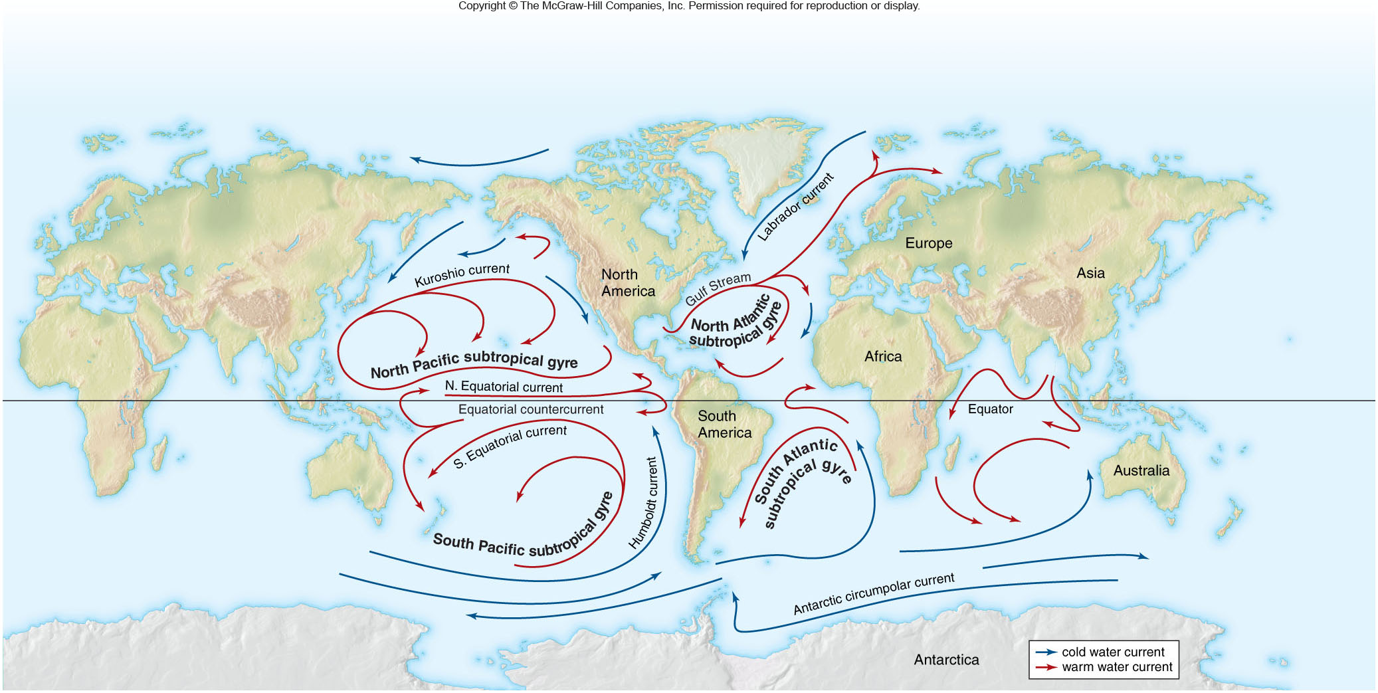
Effects of Sun, Wind, Water
Ocean currents are largely driven by winds

Slide 11
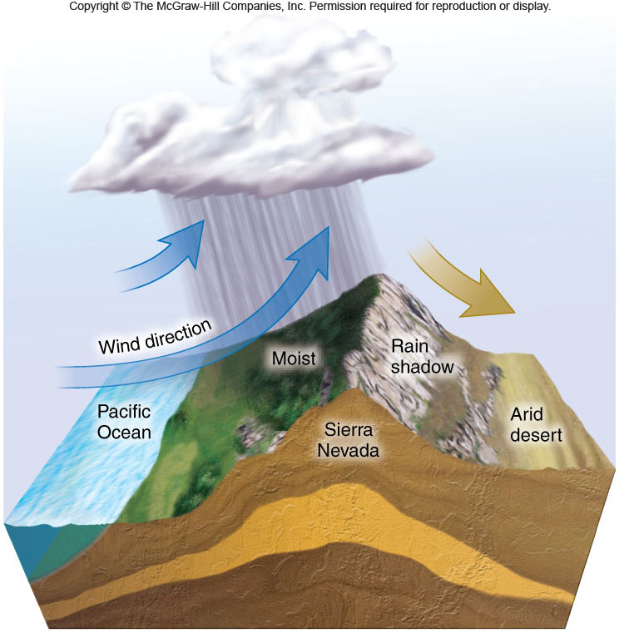
Effects of Sun, Wind, Water
Regional and local differences affect terrestrial ecosystems
Rain shadows:
  Rain falls as air rises
  Remains dry on the leeward side of the mountain

Slide 12
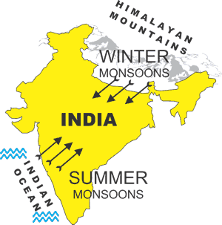
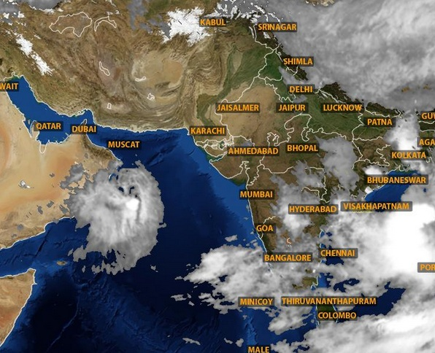
Effects of Sun, Wind, Water
Monsoon winds
  Heating and cooling of continent
  Winds blow off the water into the interior in the summer
  Winds blow from the Himalayans toward the interior of India in the winter.
  Winds affect rainfall patterns
    Duration
    Strength

Slide 13
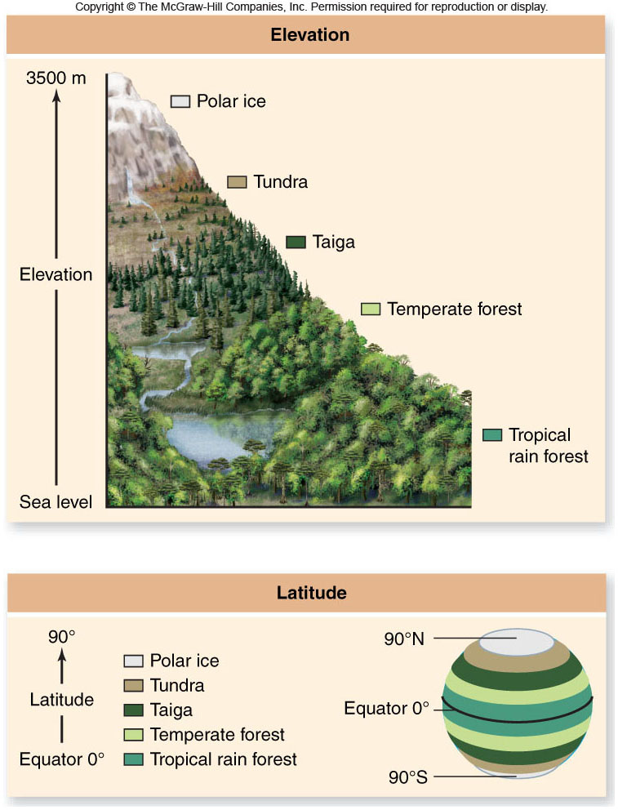
Effects of Sun, Wind, Water
Elevation: temperature and other conditions change with elevation
Air temperature falls about 6˚C/43ºF for every 1000m/3280ft increase in elevation

Slide 14
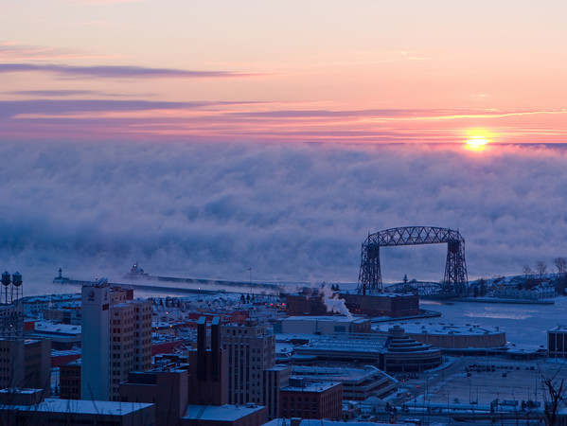
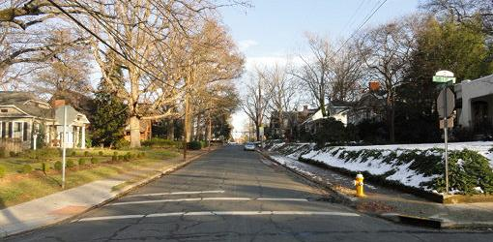
Effects of Sun, Wind, Water
Presence of microclimate factors
Microclimates: highly localized sets of climatic conditions. Could be a few feet or many miles.
  Gaps in forest canopy
    High air temperature and low humidity
  Under a log in the forest
    Low air temperature and high humidity

Slide 15
Biomes
Biomes: a major type of ecosystem on land
Each biome has a characteristic appearance
  Defined largely by sets of regional climatic conditions
Biomes are named according to their vegetational structures
Eight principle biomes

Slide 16
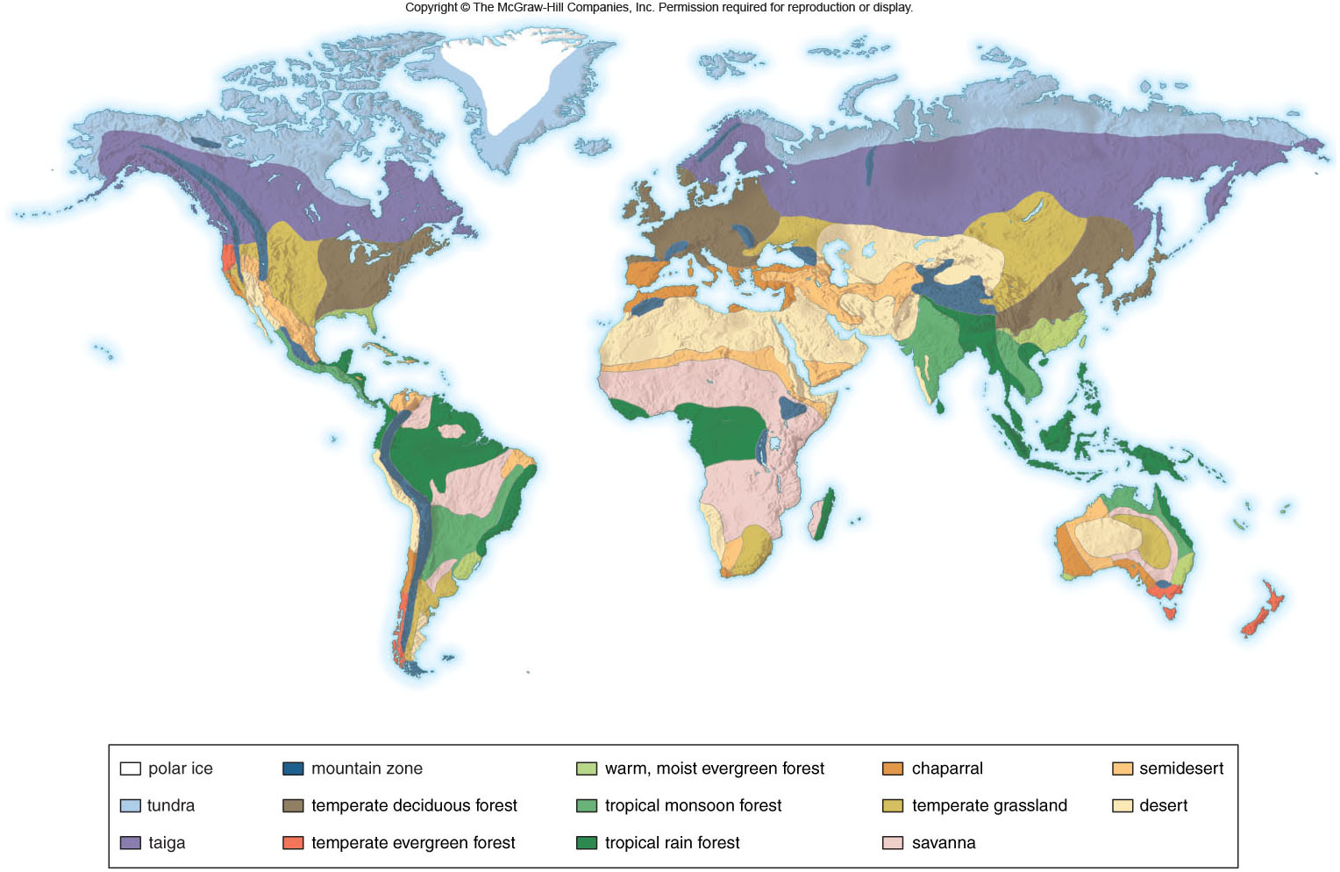

Slide 17
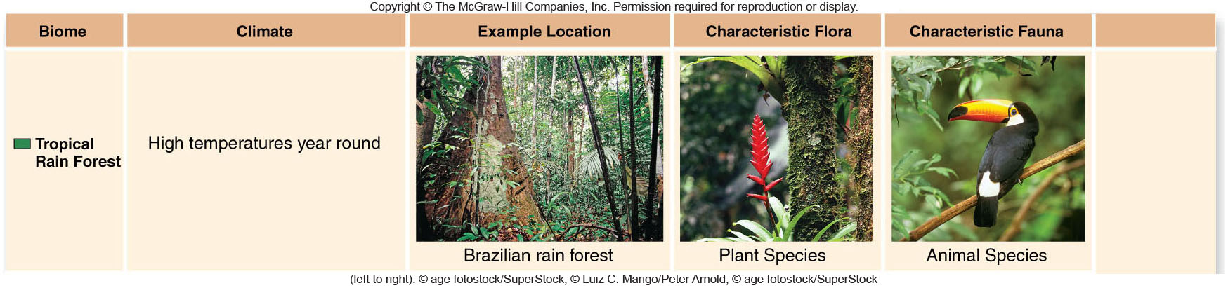
Biomes
Tropical rain forests
  140-450 cm or 55- 177 inches rain/yr
  Richest ecosystems in Biodiversity on land.
  High temperature and high rainfall
  Very high diversity: 1200 species of butterflies in a single square mile

Slide 18
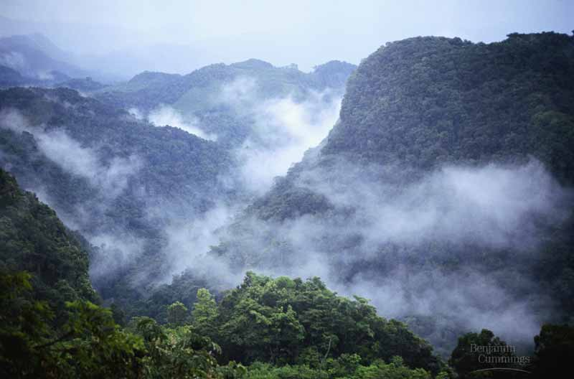
Tropical Forest: Vertical stratification with trees in canopy blocking light to bottom strata. Many trees covered by epiphytes (plants that grow on other plants).

Slide 19
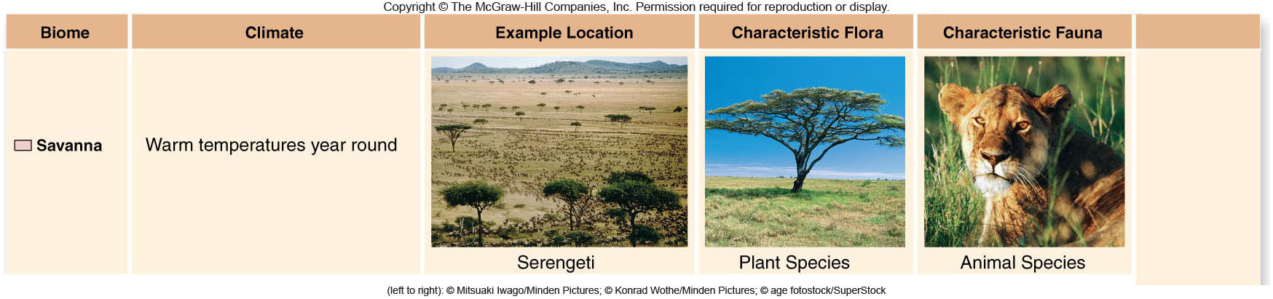
Biomes
Savanna
  50-120 cm or 20- 47 inches rainfall/yr
  Tropical or subtropical grasslands or tall and Short Grass Prairie.
  Occur as a transition ecosystem between tropical rainforests and deserts.
  In Minnesota transition of Deciduous and Prairie.
  Serengeti of East Africa We live on the Red Oak Savanna

Slide 20
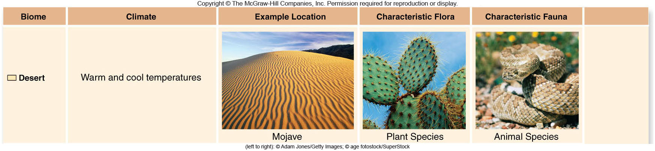
Biomes
Deserts
  25-40cm or 10-16 inches rainfall/yr; unpredictable
    Plants and animals cannot depend on any rainfall
  30˚N and S latitudes, rainshadows
  Vegetation sparse, animals adapted to little water availability

Slide 21
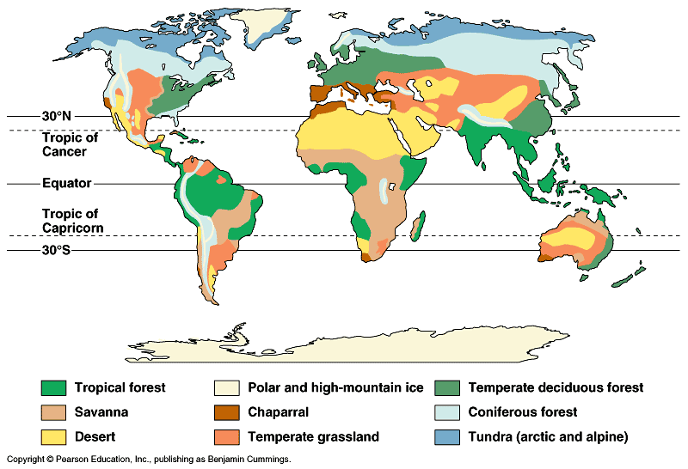

Slide 22
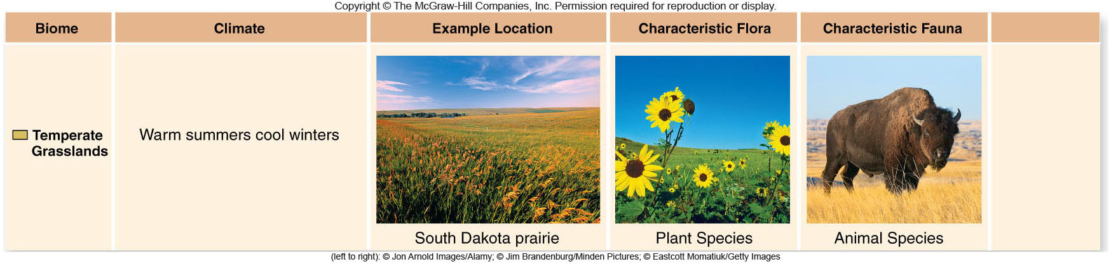
Biomes
Temperate grasslands or Prairies
  Rich soils
  Grasses with roots that penetrate deep into the soil
  In North America converted to agricultural use
  Adapted to periodic fire

Slide 23
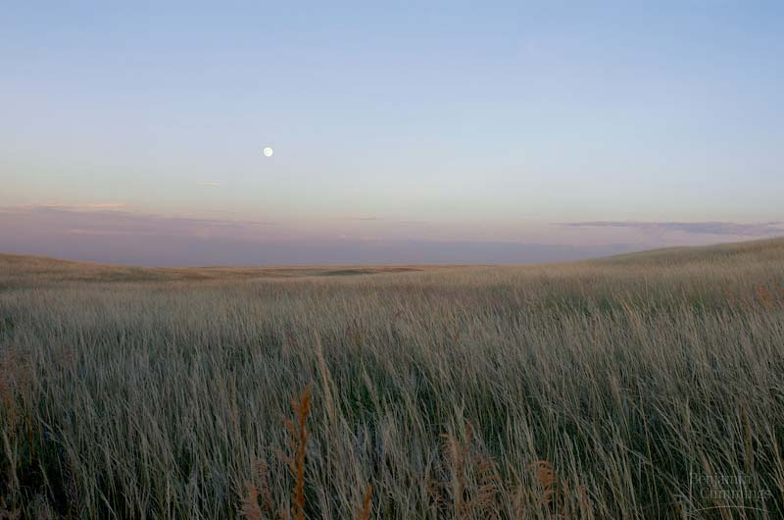
Temperate Grassland: Marked by seasonal drought and fires, and grazing by large animals. Rich habitat for agriculture, very little prairie exists in US today.
Precipitation: 19.6 inches to 25.1 inches.
Ave Temp: 64 to 70 degrees F

Slide 24
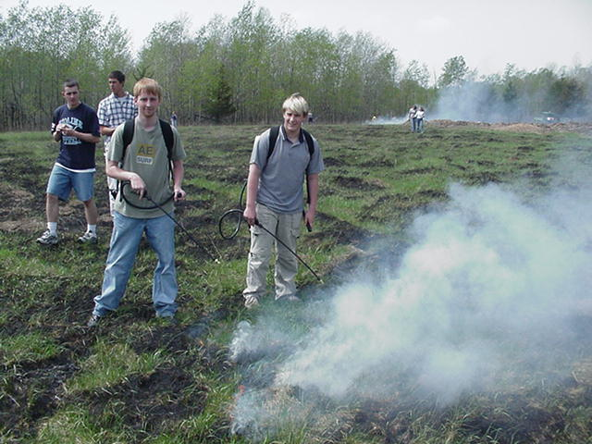

Slide 25
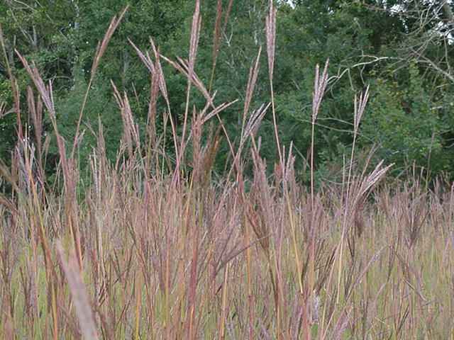

Slide 26
Deciduous Forest
Deciduous : Comes from the Latin term that means to fall off.
The reason for the leaf fall is due to the lack of sunlight .
The absision layer these cells cut off the flow of nutrients from the roots to the leaves.
The chlorophyll breaks down into a colorless compound. The other secondary pigments then come out.

Slide 27
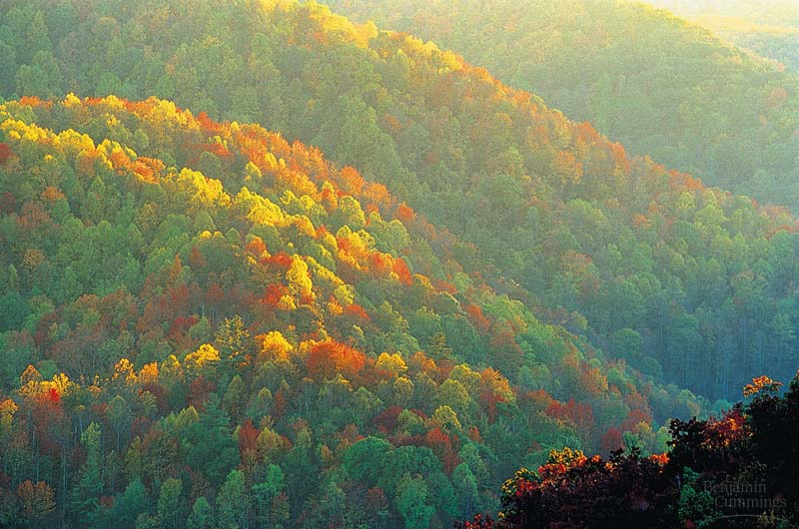
Temperate Deciduous Forest: Mid-latitudes with moderate amounts of moisture, distinct vertical strata: trees, understory shrubs, herbaceous sub-stratum. Loss of leaves in cold, many animals hibernate or migrate then. Original forests lost from North America by logging and clearing.

Slide 28
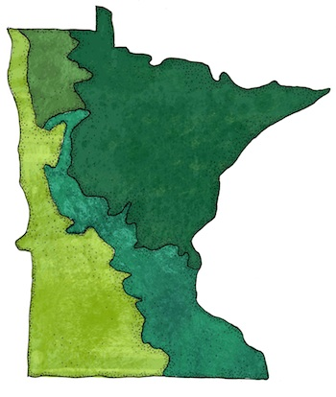
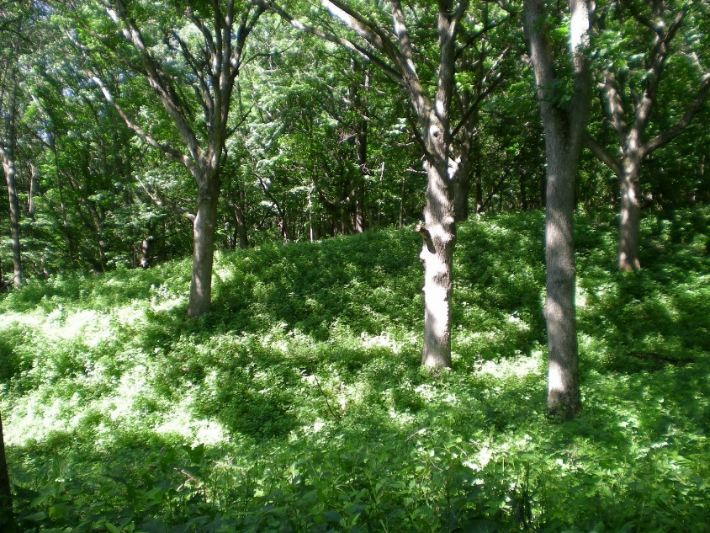
Deciduous
Climate: In Minnesota
The temperature range: is from 37ºF in NW to 45ºF in SE
Precipitation: 20” in NW to 32+” in the SE.
Frost free days: 100 in the northwest; 160 in the southeast.

Slide 29
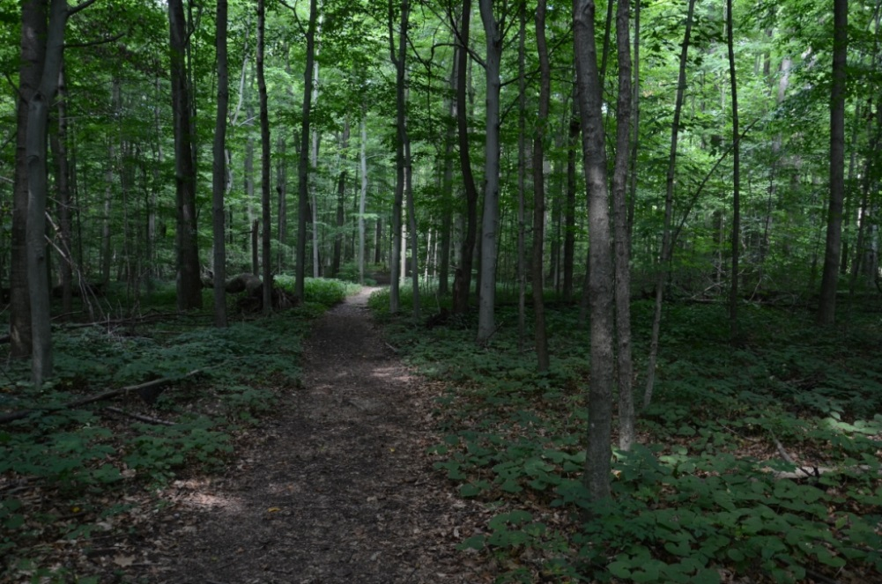
Deciduous Forest
Seven types of deciduous forests in the state.
1. Beech- Maple
2. Aspen. 3. Aspen Birch 4. Paper Birch 5. Oak 6. Northern Hardwood.
7. Lowland Hardwood.

Slide 30
Deciduous Forest
Ecosystem Functions
The deciduous forest is the highest in productivity found in Minnesota.
This area has a high rate of decomposition as well as a good rate of precipitation to supply the area for good plant growth.

Slide 31
Deciduous Forest
The precipitation gradient increases as one moves from Northwest to Southeast.
The Temperature gradient increases as one moves from the Northeast to the Southwest.

Slide 32
Present Status of the Deciduous Forest:
2.3 million acres today 2.7 million acres in 1962. 15 % loss due to agriculture and urban development.
O f this remaining acreage most is fragmented. This plays an important roll in the loss of species that need large home ranges.
287 Species of plants and animals listed as endangered or threatened in Minnesota.
51 occur in this biome.

Slide 33
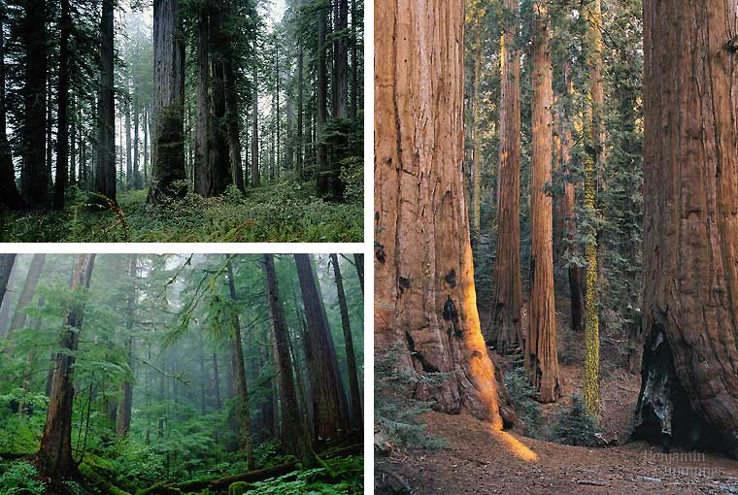
Coniferous forest: Largest terrestial biome on earth, old growth forests rapidly disappearing, usually receives lots of moisture as rain or snow.

Slide 34
Coniferous Forest OF Minnesota
Found in the Northeastern 1/3 of the state.
They surface of this area is mainly exposed rock with very little humus. This is an area that was glaciated heavily and had to go though Primary Succession. Lichens are the pioneer species that breaks up rock material to make soil.
The soil in this region are very acidic do to pine needles, and there is not a lot of ground cover.

Slide 35
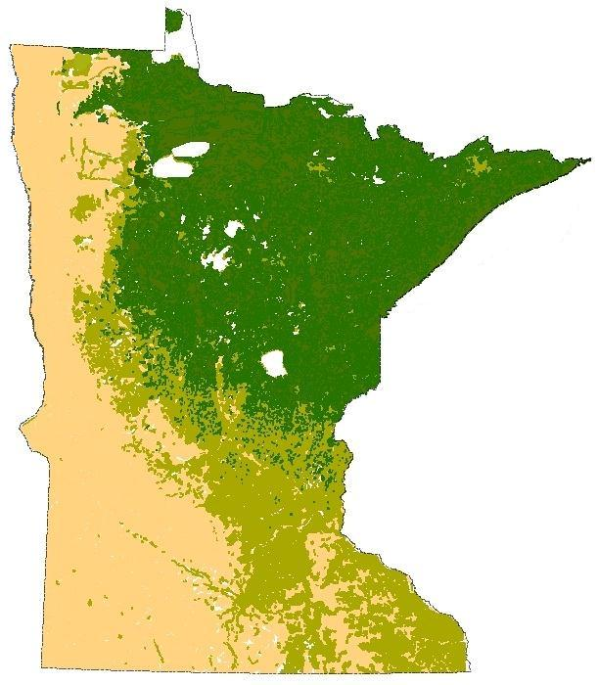
Coniferous Forest OF Minnesota
Consists of Jack ,White, Norway Pines and Balsam Fir.
Ave Temperature is 36ºF – 41ºF
Precipitation is 21-28 inches
Snowfall is over 68 inches with a 1 inch cover for about 125 Days.
Frost free season may be less than 100 days. May to Sept.

Slide 36
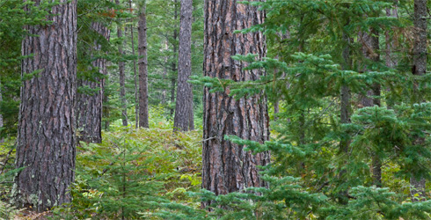
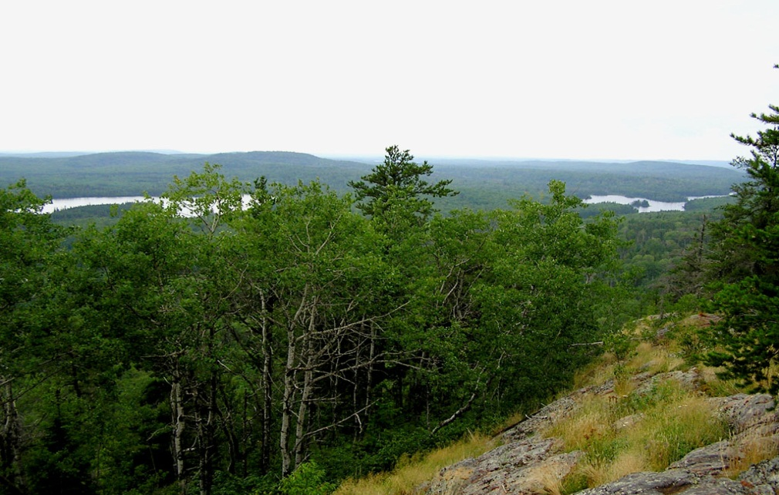
Coniferous Forest OF Minnesota
Conifers grow in soils that are dry and coarse with little nutrients. It is beneficial for them to have needles all year because they can begin photosynthesis as soon as water is available. (From early spring to early winter.)

Slide 37
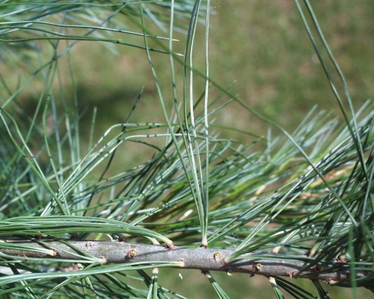
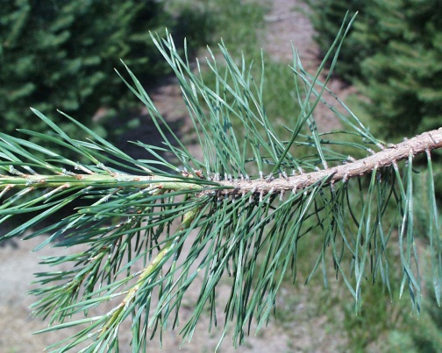
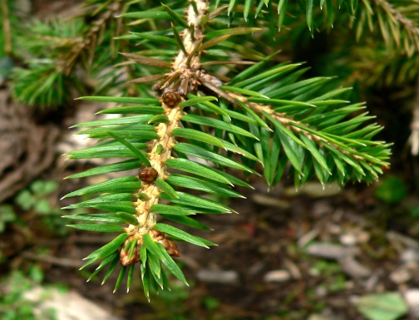
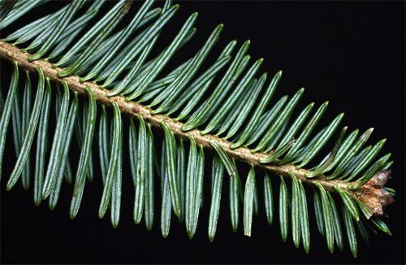
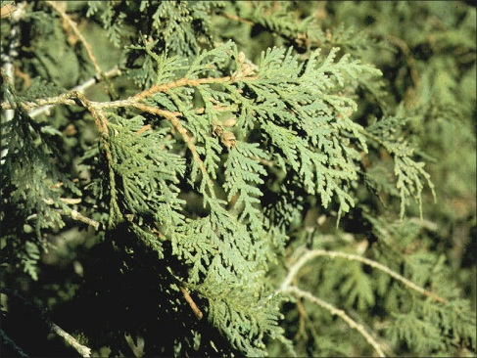
Coniferous Forest OF Minnesota
Pines have more than 1 needle per cluster.
White, Red ( Norway) Jack, Scotch(non Native)
Spruce have 1 needle.
White, Black,
Firs have flat needles.
Balsam Fir
Cedars have Scales on needles.

Slide 38
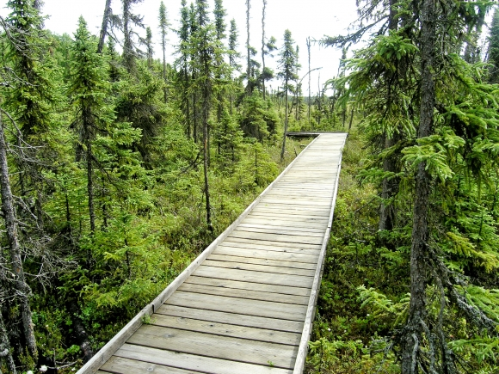
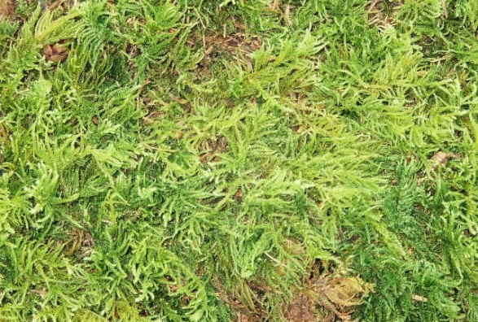
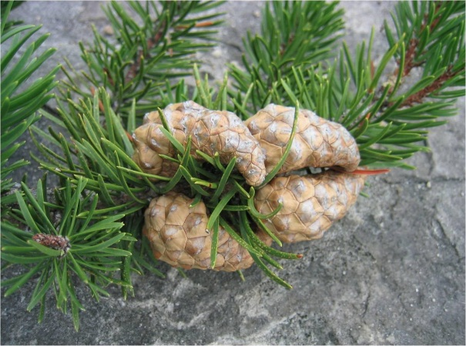
Coniferous Forest OF Minnesota
Five different Coniferous forests
1. Balsam Fir - White Spruce Forest
2. Black Spruce -Feathermoss Forest
3. White Cedar Forest
4. White & Red Pine Forest
5. Jack Pine Forest

Slide 39
Spring Overturn
Very Deep lakes do not experience Spring Overturn or Turnover
Only the upper 100 ft will experience this.
Nutrient rich materials from the bottom are carried to the top. This causes a good mixing of nutrients and dissolved materials. Oxygen rich water from the top are mixed

Slide 40
Thermal Stratification
Thermal Stratification Of Lakes: Happens in lakes over 40 ft. (Summer)
Caused by warm water becoming less dense. (Three layers)
Lake stratification and mixing → alters oxygen and nutrient levels. Dependent on temperature changes and effect on water density.

Slide 41
Warm upper = Epilimnion & Cool lower = Hypolimnion.
Metalimnion or Thermocline: Transition layer.
1 oC drop for ever 1 meter drop.

Slide 42
In Autumn: Late Sept. to early December.
Epilimnion becomes more dense as the temp cools down and the lake temp becomes homogenized again.
This is called the fall overturn.

Slide 43
In December as the upper layer cools it becomes more dense.
This continues untill the water temp reaches 4 ºC.
Water colder than 4 C stays at the surface to freeze
3 layers Again Form.

Slide 44
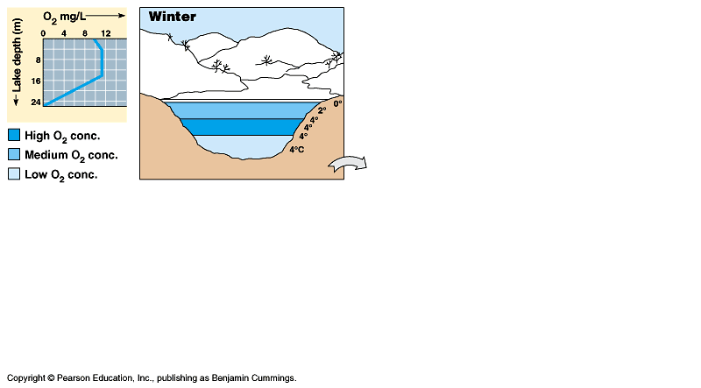

Slide 45
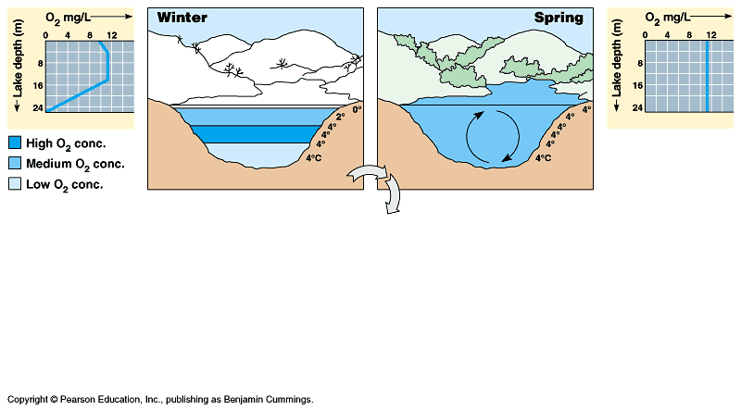

Slide 46
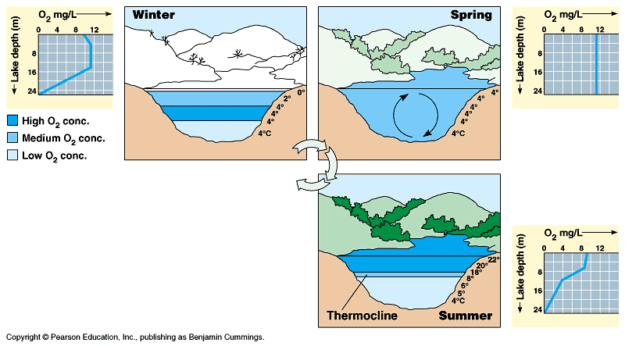

Slide 47
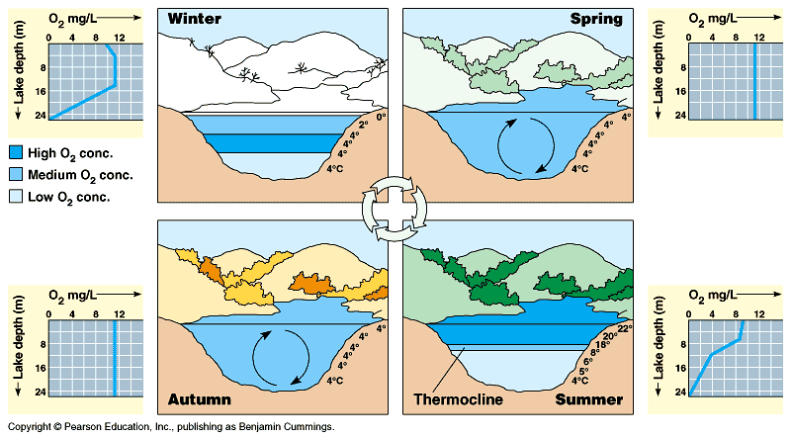

Slide 48
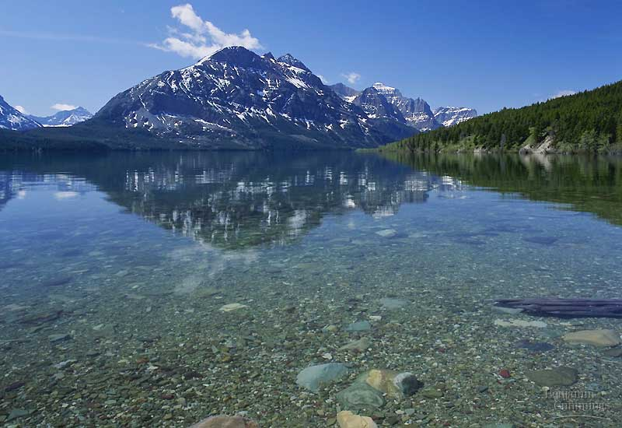
Oligotrophic Lake: Nutrient poor, water is clear, oxygen rich; little productivity by algae, relatively deep with little surface area.

Slide 49
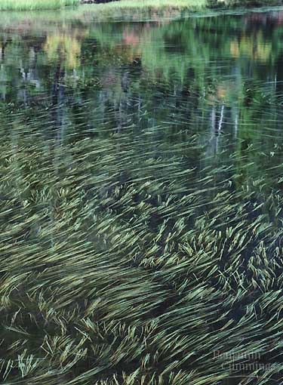
Eutrophic lake: nutrient rich, lots of algal productivity so it’s oxygen poor at times, water is murkier → often a result of input of agricultural fertilizers

Slide 50
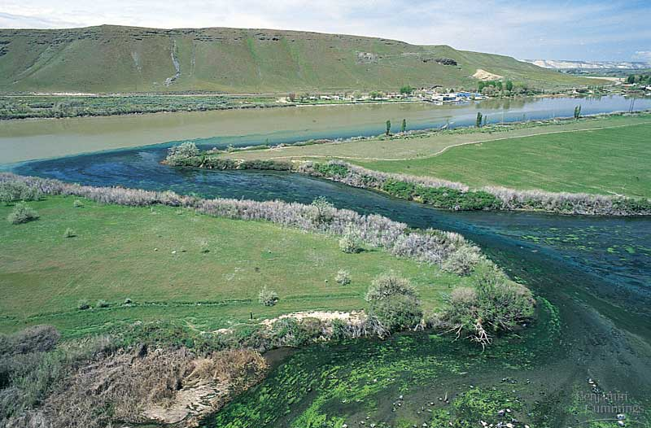
Rivers and Streams: Organisms need adaptations so that they are not swept away by moving water; heavily affected by man changing the course of flow (E.g. dams and channel-straightening) and by using rivers to dispose of waste.

Slide 51

Wetlands: includes marshes, bogs, swamps, seasonal ponds. Among richest biomes with respect to biodiversity and productivity. Very few now exist as they are thought of often as wastelands.

