Slide 1
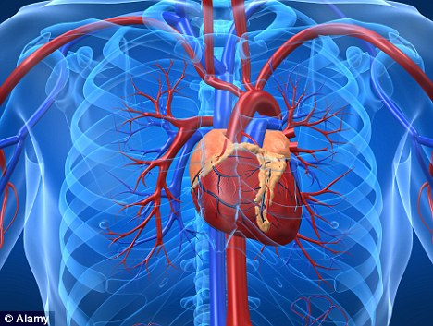
Cardiovascular System

Slide 2
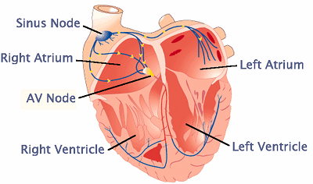
Parts of the Heart
Atrium: Also known as Auricles. the smaller superior chambers of the heart where blood collects either from the body or the lungs.
Ventricle: these are the larger chambers that collect the blood from the atriums.

Slide 3
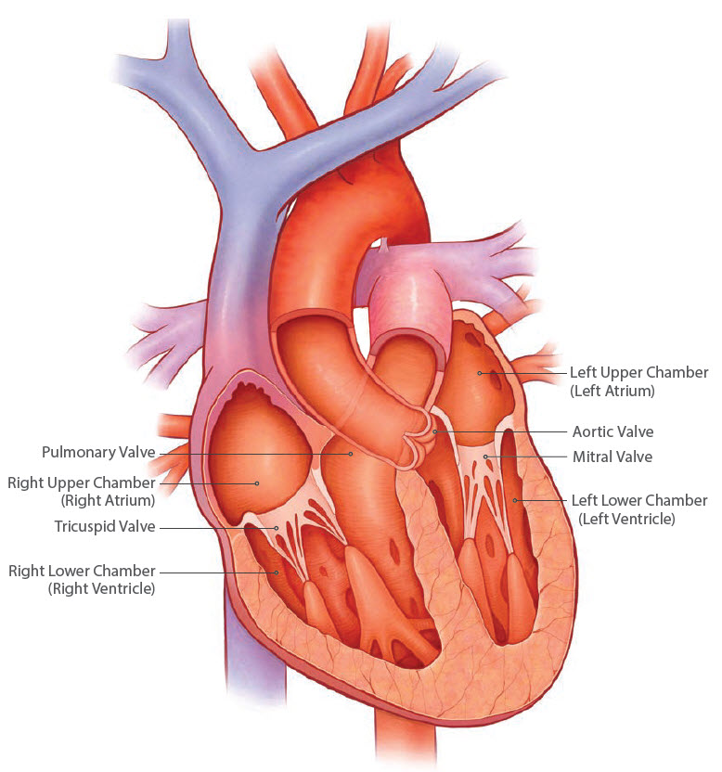
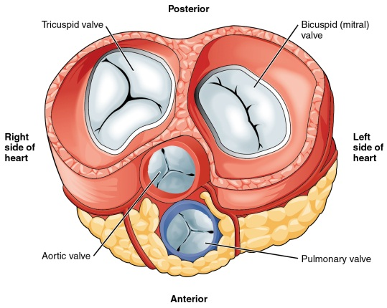
Parts of the Heart
Bicuspid Valves ( Mitral bishops hat or miter) these are Atrioventricular valves that are located between the left atrium and left ventricles.
Tricuspid valves: three cusps found between the right atrium and right ventricle.

Slide 4
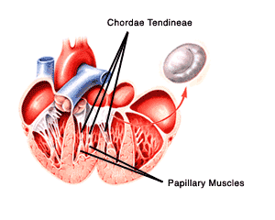
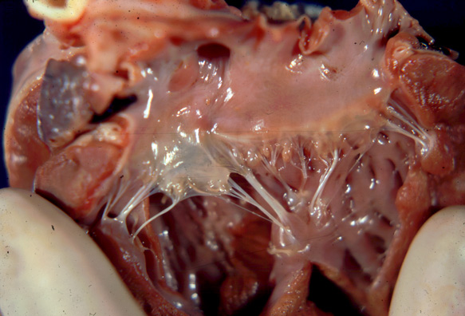
Parts of the Heart
Papillary muscles : cone shaped muscles of the ventricle.
Chordae Tendineae: the strong connective tissue that are attached to the papillary muscles.

Slide 5
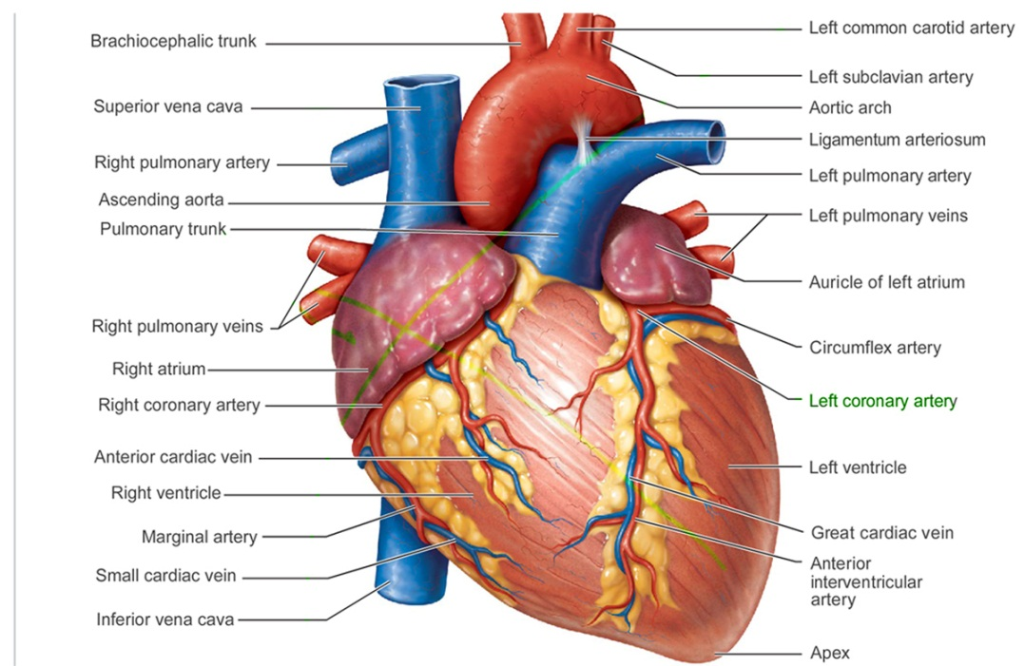
Parts of the Heart
Pulmonary Artery: The vein that carries deoxygenated blood from the heart to the lungs
Pulmonary Vein: The artery that carries oxygenated blood from the lungs to the heart.

Slide 6
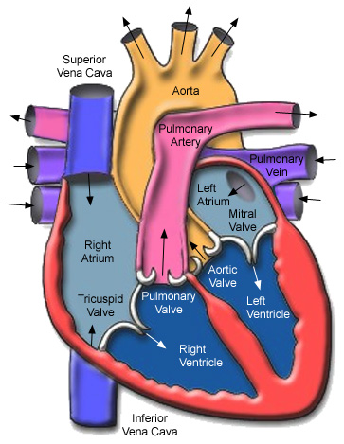
Parts of the Heart
Aorta: Largest blood vessel of the body.
Runs very deep.
Carries oxygenated blood to the body
Ascending Aorta: Runs to the head and brain.
Descending Aorta: Runs to the abdomen and the legs
Aortic Arch: Portion of the aorta that runs around the heart.
The ascending and decending aortas branch off from here.

Slide 7
Parts of the Heart
Vena Cava: The largest vein of the body.
Superior Vena Cava : The portion that carries blood back from the head and chest region.
Inferior Vena Cava: the portion that carries blood back from the abdomen and legs.
These come together to form the vena cava.

Slide 8
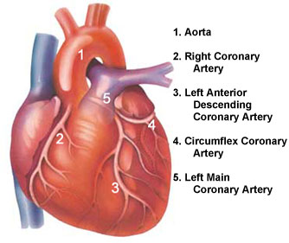
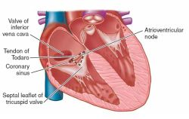
Parts of the Heart
Coronary Artery: the artery that supplies the heart with oxygen.
Coronary Sinus holds the blood from the coronary veins. Then sends the blood into the right atrium. Located on the Posterior portion of the heart.

Slide 9
Parts of the Heart
Pericardium:
Fibrous Pericardium: Outer layer Prevents the heart from moving. Protects the heart
Serous Pericardium: Double layer. Parietal or outer layer.
Visceral or Epicardium:
Paricardial Fluid and Paricardial Cavity:
Interatrial Septum the area between the atrium
Foramen Oval/ Foramen Ovalis: the opening between the atrium that closes after birth
Interventricular Septum: The area between the ventricles.

Slide 10
Blood Vessels
Arteries: These are the thicker blood vessels, due to the higher blood pressure.
Arteries carry, usually, oxygenated blood from the heart to the body.
The only artery to carry deoxygenated blood is the Pulmonary Artery.

Slide 11
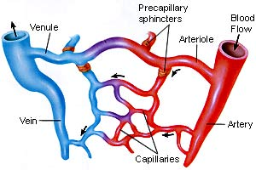
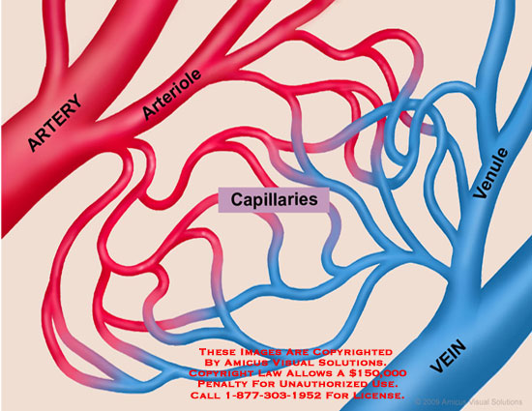
Blood Vessels
Arterioles: Smaller arteries
Capillaries: Small microscopic blood vessels that connect arterioles to Venules.
They are used or exchange of nutrients and oxygen.
They are found in nearly every cell in the body.
( not in the cornea, or cartilage)

Slide 12
Blood Vessels
Veins: Bring Blood from the body to the heart the blood is usually deoxygenated.
The only vein with oxygenated blood is the Pulmonary vein.
Veins are much thinner than arteries but very similar in structure.
Many veins have folds in the inner lining that form valves which Prevent backflow.

Slide 13
Blood Vessels
Veins and venules hold and carry about 60 % of the blood at any 1 time.
Arteries and arterioles hold about 15 % of the blood and Systemic Capillaries about 5%,.
Pulmonary blood vessels 12%, Heart Chambers about 8 %

Slide 14
Blood
Blood is about 8% of the total body mass and it is slightly alkaline.
About 5 to 6 liters in the body.
Hemopoiesis: the process of forming the formed elements.

