Slide 1
How Cells Harvest Energy Chapter 7

Slide 2
Laws of Thermodynamics
Most reactions require some energy to get started.
activation energy: extra energy needed to get a reaction started
-destabilizes existing chemical bonds
-required even for exergonic reactions
catalysts: substances that lower the activation energy of a reaction

Slide 3
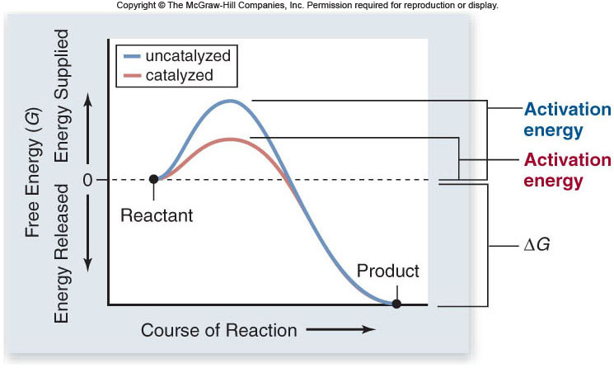

Slide 4
Energy Currency of Cells
ATP = adenosine triphosphate
-the energy “currency” of cells
ATP structure:
-ribose, a 5-carbon sugar
-adenine
-three phosphates

Slide 5
Respiration
Organisms can be classified based on how they obtain energy:
autotrophs: are able to produce their own organic molecules through photosynthesis
heterotrophs: live on organic compounds produced by other organisms
All organisms use cellular respiration to extract energy from organic molecules.

Slide 6
Respiration
Cellular respiration is a series of reactions that:
-are oxidations – loss of electrons
-are also dehydrogenations – lost electrons are accompanied by hydrogen
Therefore, what is actually lost is a hydrogen atom (1 electron, 1 proton).

Slide 7
Respiration
Free energy: the energy available to do work
-denoted by the symbol G (Gibb’s free energy)
enthalpy: energy contained in a molecule’s chemical bonds
free energy = enthalpy – (entropy x temp.)
G = H - TS

Slide 8
Respiration
During redox reactions, electrons carry energy from one molecule to another.
NAD⁺ is an electron carrier.
-NAD accepts 2 electrons and 1 proton to become NADH
-the reaction is reversible

Slide 9
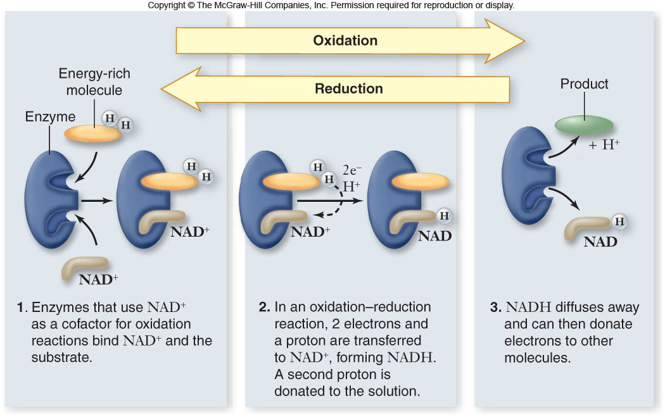

Slide 10
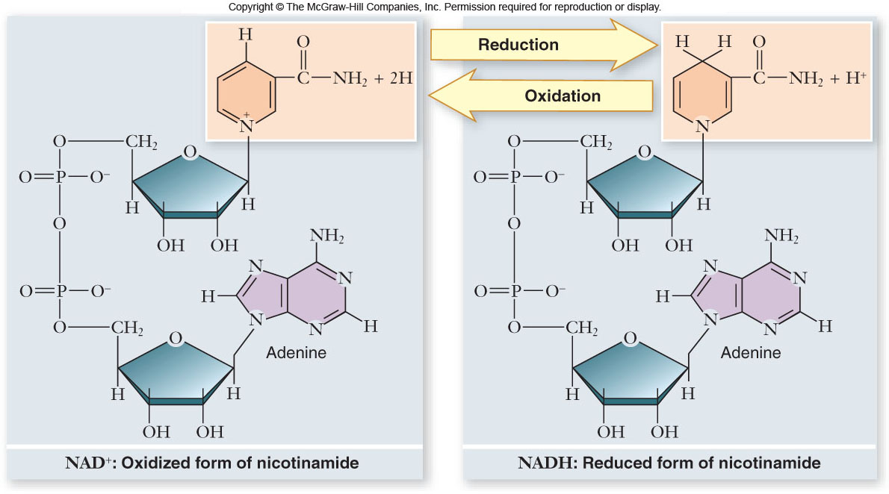

Slide 11
Respiration
During respiration, electrons are shuttled through electron carriers to a final electron acceptor.
aerobic respiration: final electron receptor is oxygen (O₂)
anaerobic respiration: final electron acceptor is an inorganic molecule (not O₂)
fermentation: final electron acceptor is an organic molecule

Slide 12
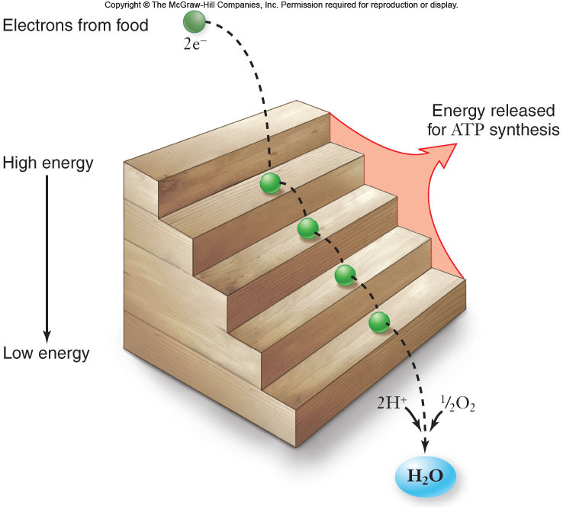

Slide 13
Respiration
Aerobic respiration:
C₆H₁₂O₆ + 6O₂ + 6H₂O → 6CO₂ + 12H₂O
ΔG = -686kcal/mol of glucose
ΔG can be even higher than this in a cell
This large amount of energy must be released in small steps rather than all at once.

Slide 14
Oxidation of Glucose
Cells are able to make ATP via:
1. substrate-level phosphorylation – transferring a phosphate directly to ADP from another molecule
2. oxidative phosphorylation – use of ATP synthase and energy derived from a proton (H⁺) gradient to make ATP

Slide 15
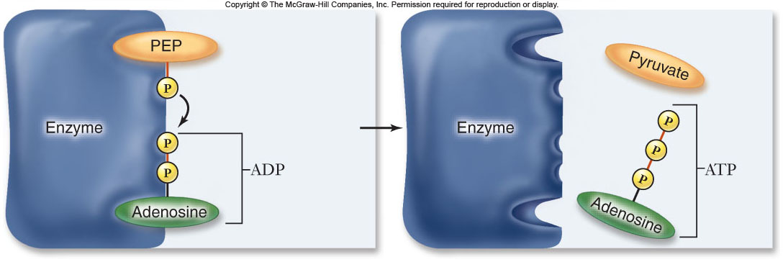

Slide 16
Oxidation of Glucose
The complete oxidation of glucose proceeds in stages:
1. glycolysis
2. pyruvate oxidation
3. Krebs cycle
4. electron transport chain & chemiosmosis

Slide 17
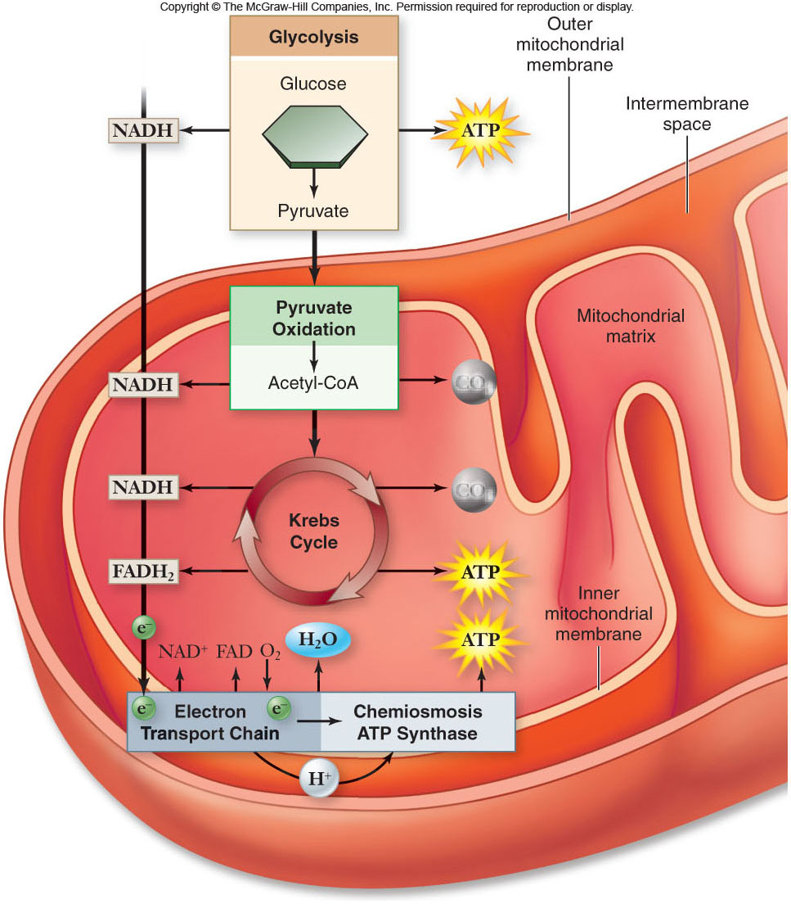

Slide 18
Glycolysis
As you can see that Glycolysis is a series of chemical reactions that changes Glucose, one step at a time, into Different Molecules.
1. It starts with Glucose or a Monosaccharide
2. C₆H₁₂O₆ ; Split the sugar using up two ATP to form 2 PGAL= 3Carbon compound
3. Energy from the 2 PGAL forms 4 ADP and 2 NADH.

Slide 19
Glycolysis
4. 4 ADP forms into 4 ATP by phosphorylation.
This uses 2 ATP.
5. That is a Net gain of 2 ATP in Glycolysis
And Pyruvic Acid.
Glycolysis is an Anerobic Phase!! No O₂ requirement.

Slide 20
Glycolysis
Glycolysis converts glucose to pyruvate.
-a 10-step biochemical pathway
-occurs in the cytoplasm
-2 molecules of pyruvate are formed
-net production of 2 ATP molecules by substrate-level phosphorylation
-2 NADH produced by the reduction of NAD⁺

Slide 21
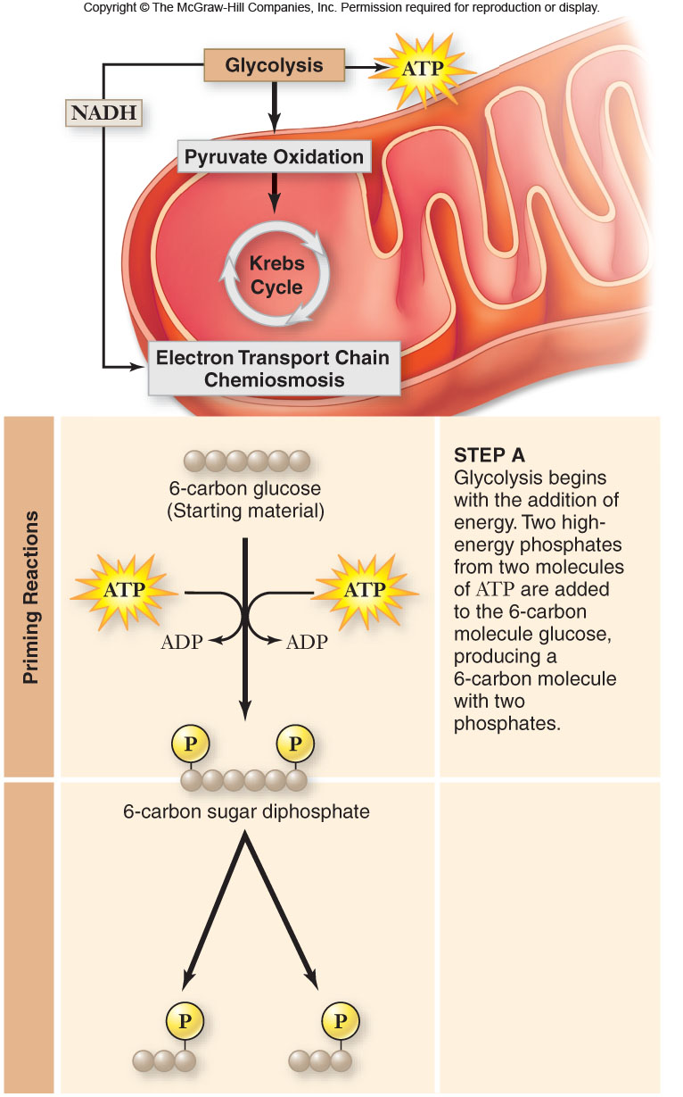
1. Glucose:
2.6 Carbon Sugar PGAL

Slide 22
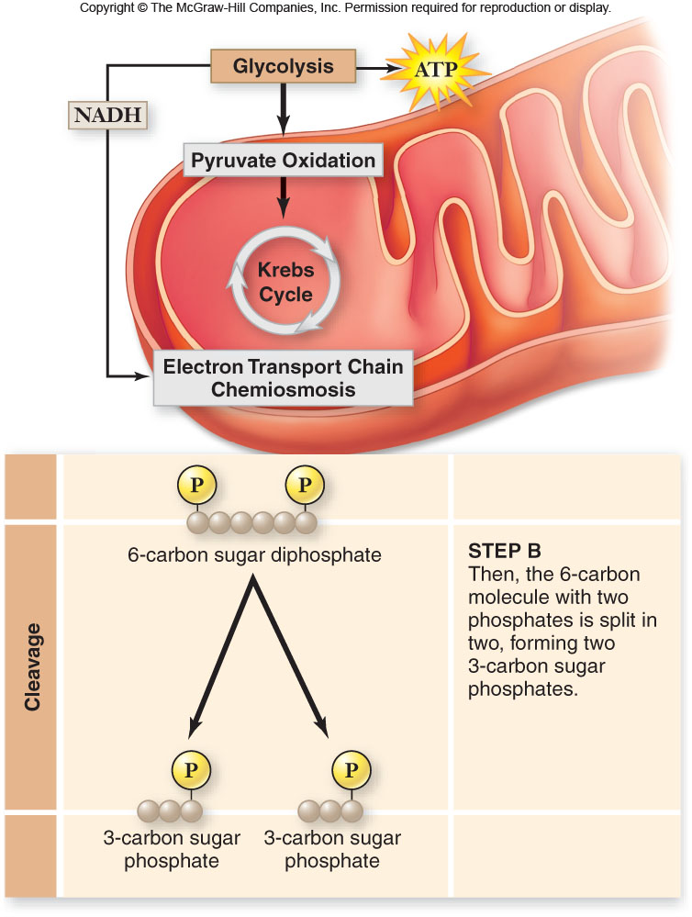

Slide 23
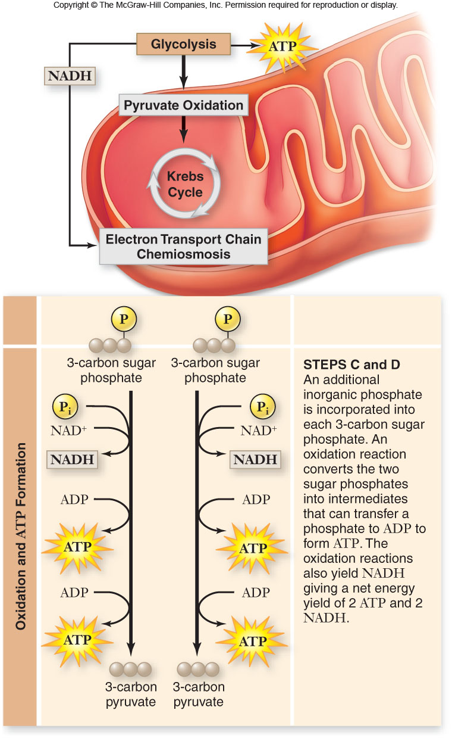

Slide 24
Glycolysis
The fate of pyruvate depends on oxygen availability.
When oxygen is present, pyruvate is oxidized to acetyl-CoA which enters the Krebs cycle
Without oxygen, pyruvate is reduced in order to oxidize NADH back to NAD⁺

Slide 25
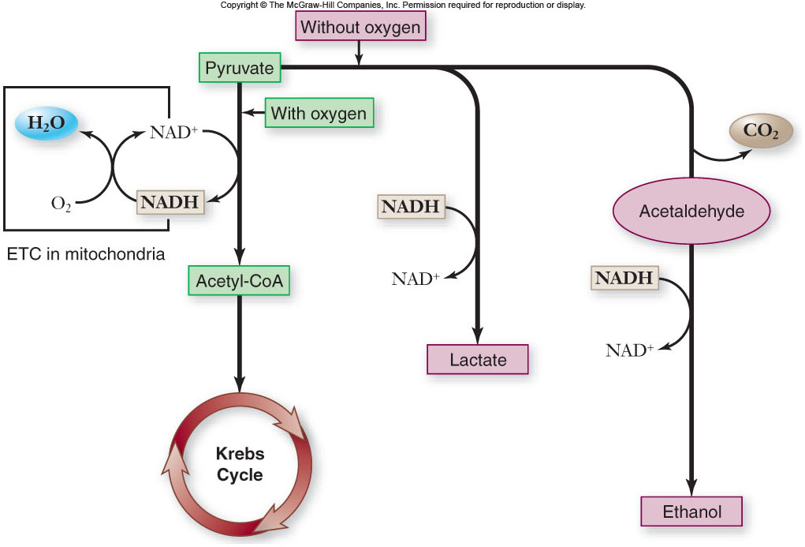

Slide 26
Respiration Overview
The Process that involves the breakdown of Food molecules such as Glucose to Release energy.
Pyruvate used in Glycolysis is Broken down and 34 ATP are formed. Oxygen is needed to release the energy and the chemical reactions occur in the Mitochondria of the cell.

Slide 27
Krebs Cycle
Acetyl Coenzyme A Produced in Glycolysis is added to a 4 carbon compound to produce a 6 carbon compound. (Citric Acid.)
Several Step Sequence of electron yielding reactions. NAD+ to NADH forming 2 CO₂ and a 4 Carbon Compound.
Phosphorylation of a GDP to GTP. This GTP can then transfer a Phosphate to ADP forming ATP.

Slide 28
4. The 4 Carbon Compound is Oxidized by FAD to FADH₂. Not enough Free energy to reduse NAD+. FADH contributes electrons for the Electron transport chain.
5. Water is added to form Malate. Malate is oxidized to form Oxaloacetate (4Carbon). NAD+ is reduced to form NADH.

Slide 29
Energy Yield of Respiration
theoretical energy yields
- 38 ATP per glucose for bacteria
- 36 ATP per glucose for eukaryotes
actual energy yield
- 30 ATP per glucose for eukaryotes
- reduced yield is due to “leaky” inner membrane and use of the proton gradient for purposes other than ATP synthesis

Slide 30
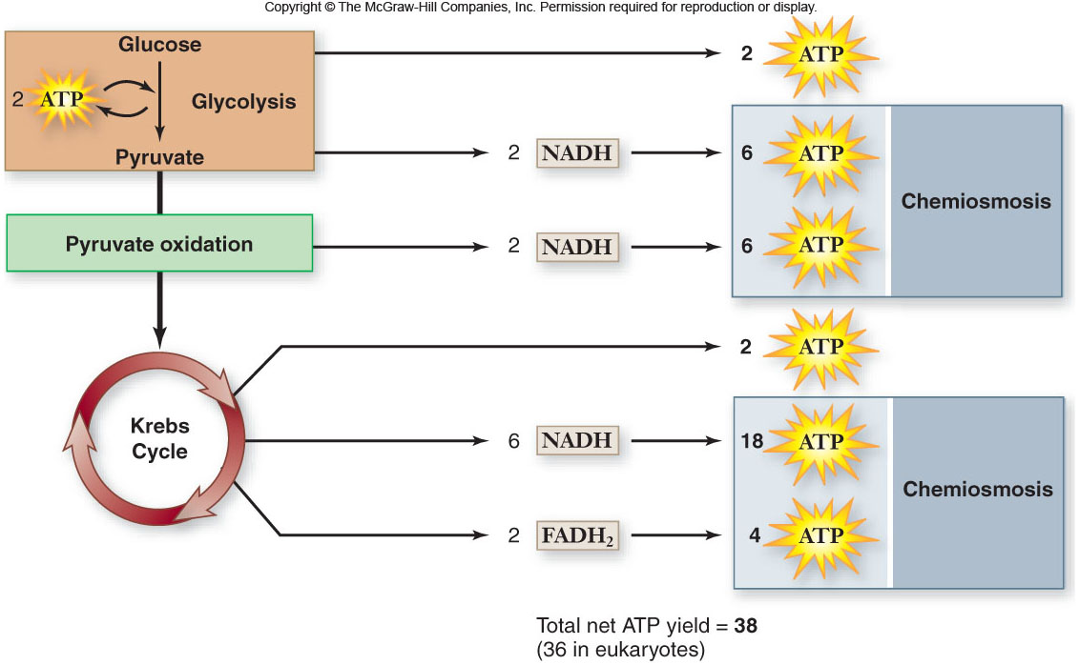

Slide 31
Photosynthesis Overview
Energy for all life on Earth ultimately comes from photosynthesis.
6CO₂ + 12H₂O C₆H₁₂O₆ + 6H₂O + 6O₂
Oxygenic photosynthesis is carried out by:
cyanobacteria, 7 groups of algae,
all land plants

Slide 32
Photosynthesis is divided into:
light-dependent reactions
-capture energy from sunlight
-make ATP and reduce NADP⁺ to NADPH
carbon fixation reactions
-use ATP and NADPH to synthesize organic molecules from CO₂

Slide 33
Dark Reaction (Calvin Cycle)
Does not need light but can occur in the light.
Uses CO₂ and ATP & NADPH to form PGAL, to form Glucose (sugar).
Calvin Cycle:
CO₂ enters the cycle and combines with a 5 carbon compound. This forms a 3 carbon compound.
Energy from 12 ATP and 12 NADPH change the 3 carbon compound to PGAL, and 12 ADP and 12 NADP.
PGAL is then converted to make glucose.
This cycle must go around 6 times to make glucose.

Slide 34
Light Reaction Light is required for this to happen
Energy from the sun is used to converted to the energy storing compounds ATP & NADPH.
Photosynthesis takes place in the Thylakoid membrane in the Granum inside the chloroplasts.
Inside the chloroplasts is the photosynthetic membrane which contain the chlorophyll.

Slide 35
Light Reaction
Steps to make Energy Compounds:
Photosynthetic Membrane has a photo system that captures the suns energy.
Two types of photosystems, Photosystem I & photosystem II.
The chlorophyll and other accessory pigments capture the light. ( Water is split here, releasing hydrogen’s and making free O2.)
Energy is transferred through the pigments until it reaches the reaction center.
Electrons are then released and passed to the first of many carriers. These carriers are called the electron transport chain.
Electrons are carried to NADP and converted into NADPH. This is then stored and used in the Dark Reaction.

Slide 36
Pigments: molecules that absorb visible light
Each pigment has a characteristic absorption spectrum, the range and efficiency of photons it is capable of absorbing.

Slide 37
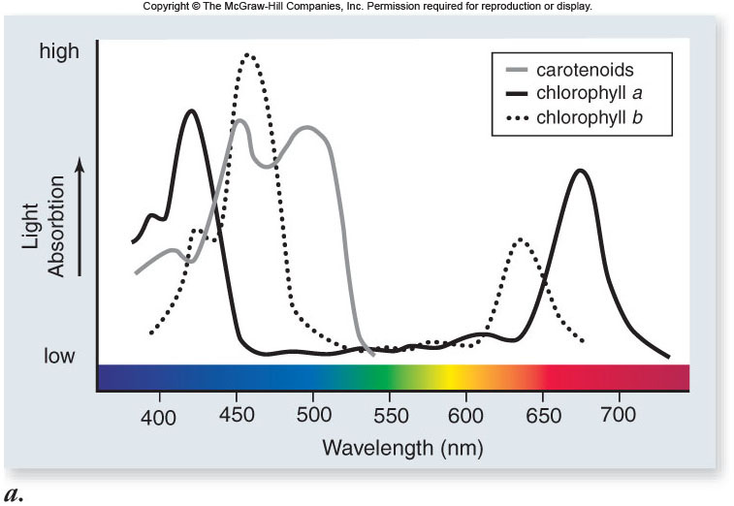

Slide 38
chlorophyll a – primary pigment in plants and cyanobacteria
-absorbs violet-blue and red light
chlorophyll b – secondary pigment absorbing light wavelengths that chlorophyll a does not absorb

Slide 39
accessory pigments: secondary pigments absorbing light wavelengths other than those absorbed by chlorophyll a
-increase the range of light wavelengths that can be used in photosynthesis
-include: chlorophyll b, carotenoids, phycobiloproteins
-carotenoids also act as antioxidants

Slide 40
Light-Dependent Reactions
Light-dependent reactions occur in 4 stages:
1. primary photoevent – a photon of light is captured by a pigment molecule
2. charge separation – energy is transferred to the reaction center; an excited electron is transferred to an acceptor molecule
3. electron transport – electrons move through carriers to reduce NADP⁺
4. chemiosmosis – produces ATP

Slide 41
In sulfur bacteria, only one photosystem is used for cyclic photophosphorylation
1. an electron joins a proton to produce hydrogen
2. an electron is recycled to chlorophyll
-this process drives the chemiosmotic synthesis of ATP

Slide 42
Photosynthetic Membrane has a photo system that captures the suns energy.
Two types of photosystems: Photosystem I & photosystem II.
The chlorophyll a, chlorophyll b and other accessory pigments capture the light. ( Water is split here, releasing hydrogen’s and making free O2.)
Steps to make Energy Compounds:

Slide 43
Carbon Fixation Reactions
To build carbohydrates, cells need:
1. energy
-ATP from light-dependent reactions
2. reduction potential
-NADPH from photosystem I

Slide 44
Dark Reaction (Calvin Cycle)
Calvin cycle
-biochemical pathway that allows for carbon fixation
-occurs in the stroma
-uses ATP and NADPH as energy sources
-incorporates CO₂ into organic molecules

Slide 45
Dark Reaction (Calvin Cycle)
Does not need light but can occur in the light.
Uses CO₂ and ATP & NADPH to form PGAL, to form sugar.
Calvin Cycle:
CO₂ enters the cycle and combines with a 5 carbon compound. This forms a 3 carbon compound.
Energy from 12 ATP and 12 NADPH change the 3 carbon compound to PGAL, and 12 ADP and 12 NADP.
PGAL is then converted to make glucose.
This cycle must go around 6 times to make glucose.

Slide 46
Glucose is not a direct product of the Calvin cycle.
-2 molecules of G3P leave the cycle
-each G3P contains 3 carbons
-2 G3P are used to produce 1 glucose in reactions in the cytoplasm

Slide 47
During the Calvin cycle, energy is needed. The energy is supplied from:
- 18 ATP molecules
- 12 NADPH molecules

Slide 48
The energy cycle:
-photosynthesis uses the products of respiration as starting substrates
-respiration uses the products of photosynthesis as starting substrates

Slide 49
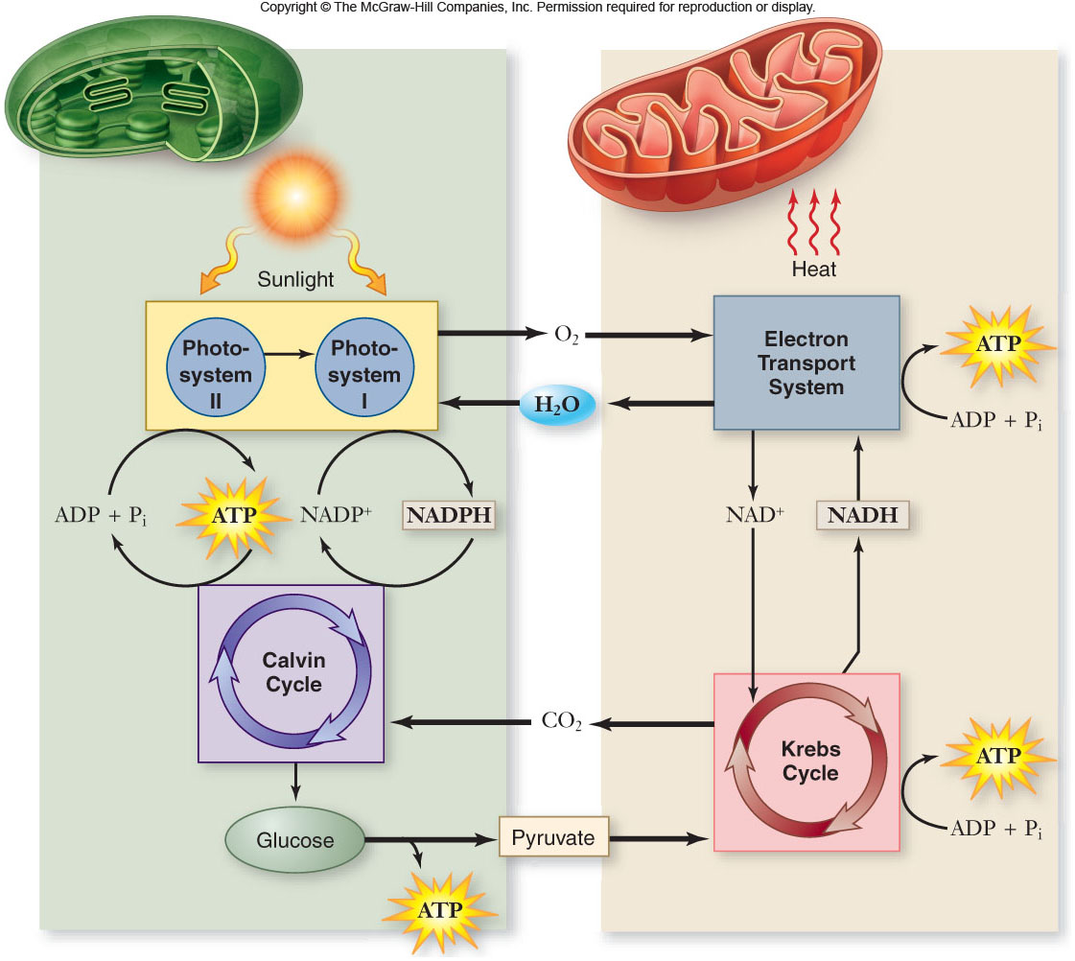

Slide 50
Reactions
Respiration
C₆H₁₂O₆ + 6O₂--------- 6CO₂ + 6H₂O + 6O₂
Photosynthesis
6CO₂ + 6H₂O + 6O₂ -------- C₆H₁₂O₆ + 6O₂

