Slide 1
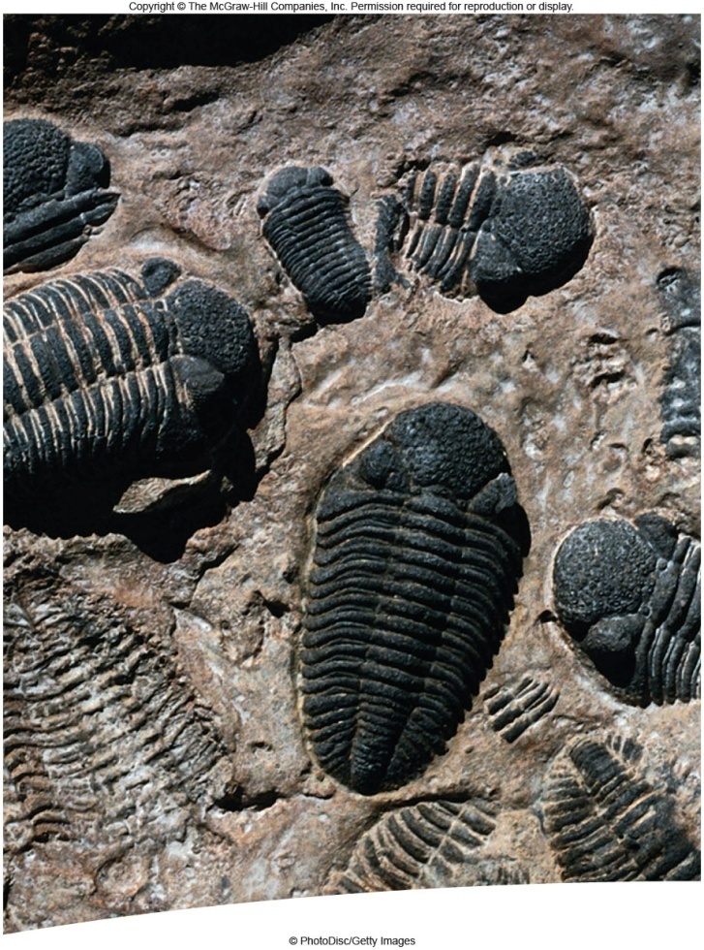
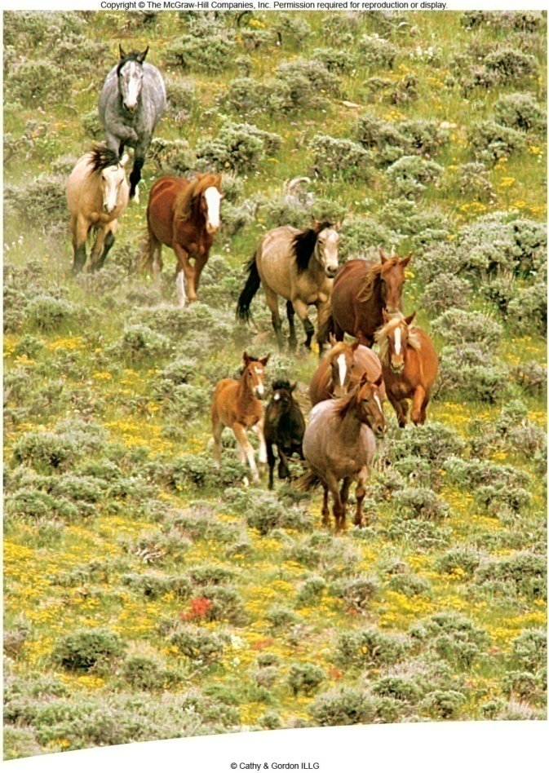
Evolution
Ch 15 and 14

Slide 2
Evolution: The process by which organism change over time. Based on science, not opinion.

Slide 3
Darwin: Evolution is descent with modification
Evolution: changes through time
  Species accumulate difference
  Descendants differ from their ancestors
  New species arise from existing ones

Slide 4
1. Micro-Evolution: Change over a small period of time.
Kittlewell: A scientist who proved that the species of Peppered Moths changed over a few years due to the change in tree color.

Slide 5
2. Macro-Evolution: Change over a large period of time.
Domestic dogs evolved from wolves with the help from humans.

Slide 6
Early Ideas of Evolution
Lamarck’s theory: Before Darwin. first to realize living organisms change over time.
By selective use or disuse of organs, organisms acquired or lost traits which were
passed on to their offspring.

Slide 7
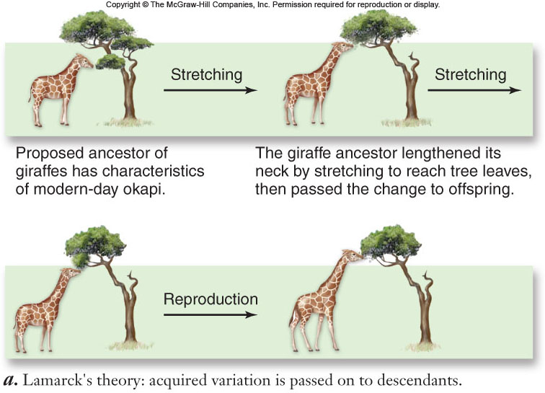
Lamarck’s theory of how giraffes’ long necks evolved

Slide 8
Ideas that helped Shape Darwin
Malthusian Doctrine: 1859 (Thomas Malthus) He observed that the human birth rate was higher than the death rate. If it continued, humans would run out of room and food. (Malthusian Doctrine referred to during famine, war and mass disease)
Competition for resources will cause variations.

Slide 9
Ideas that helped Shape Darwin
Charles Lyell’s Book: Principle of Geology
That proposed the Earth was Millions of Years Old not a few thousand.
When he found ocean floor fossils he referred back to this book.

Slide 10
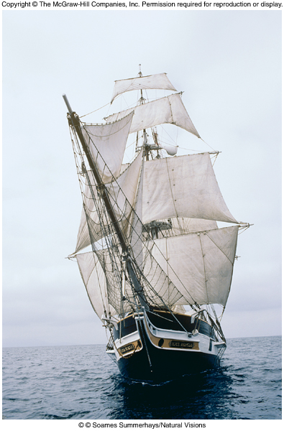
Charles Darwin:
Charles Darwin: (1809 - 1882) HMS Beagle.
Traveled around the world to collect specimens at the age of 23 in 1831.
Galapagos Islands:
(Finches and Tortoises)
Wrote: “The Origin of Species
by Means of Natural Selection”.
Degree in Theology from Cambridge University

Slide 11
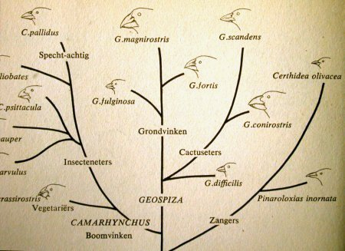
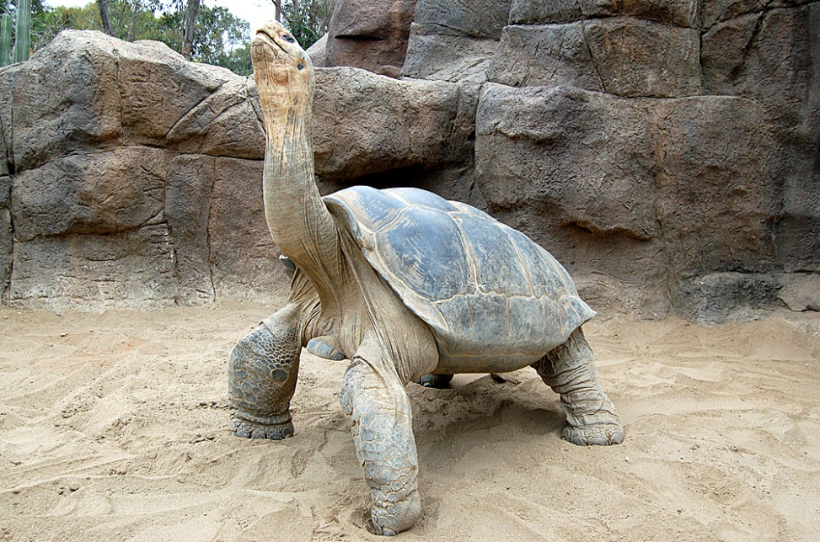
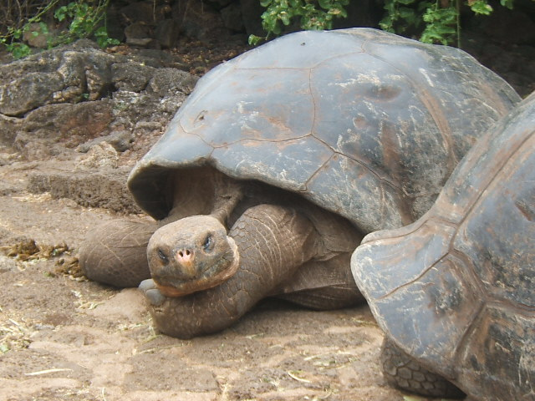

Slide 12
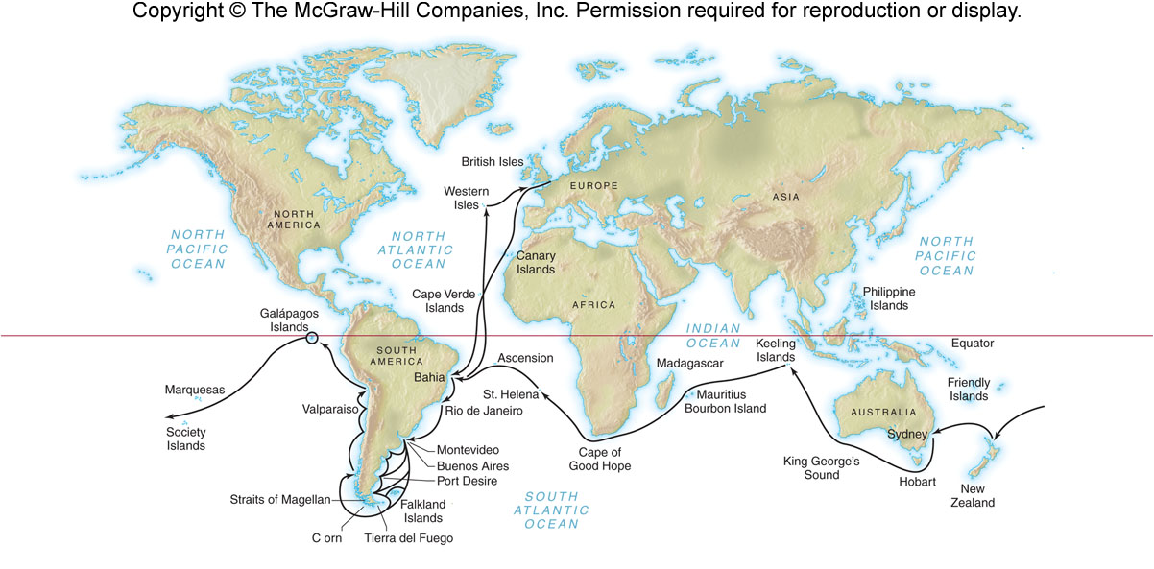
Voyage of the Beagle

Slide 13
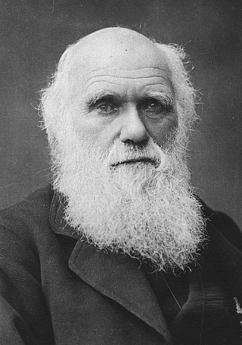
Charles Darwin
Served as naturalist on mapping expedition around coastal South America.
Used many observations to develop his ideas
Proposed that evolution occurs by
natural selection

Slide 14
Published 30 years after the voyage.
It explained that evolution is a long slow process.
All organisms have a common ancestor (Common descent)
and are descendents from other species
Alfred Russel Wallace proposed the identicle theory, which made Darwin publish his book.

Slide 15
Darwin’s Evidence
Population growth vs. availability of resources
- Darwin realized that not all members of a
population survive and reproduce.
-Darwin based these ideas on the writings of Thomas Malthus.

Slide 16
Post-Darwin Evolution Evidence
Fossil record
- New fossils are found all the time
- Earth is older than previously believed
Mechanisms of heredity
- Early criticism of Darwin’s ideas were resolved by Mendel’s theories for genetic inheritance.

Slide 17
Fossils
Fossil Records: Preserved remains of old organisms.
* Petrification. minerals in soil replace calcium.
* Imprints.
* molds

Slide 18
Adaptation: Having a mutation which enables an organism to survive and
reproduce better. (without adaptation, species would become extinct)
(Remember, over 99% of all species on earth have already become extinct)

Slide 19
Absolute Dating:
Radio-Active Dating: (ex. Carbon 14 and Potassium 40)
Geologist. People who study rocks and land forms. (Pangea, Continental Drift,
Mid-Atlantic Ridge).

Slide 20
Geologic Time Scale:
(time line of the earth) Eras and periods.
Precambrian Time: 90 % of Earths history. Few fossils.

Slide 21
Paleozoic Era: (544 - 245 millions years ago)
Cambrian Period: Many marine life forms (hard shells). Drifted around the world in the oceans.
Ordovician Period:
Silurian Period:
Devonian Period: “Age of the fish”
Carboniferous Period: Reptile, fish and insects .
Permian Period: Reptile, fish and insects abundant.

Slide 22
MASS EXTINCTION AT END OF PALEOZOIC ERA:
95 % of all life died. 5% survived
Mesozoic Era: (Age of the Reptile)
Triassic Period:
Jurassic Period: (DINOSAURS RULED)
Cretaceous period: small mammals

Slide 23
MASS EXTINCTION AT END OF MESOZOIC ERA:
Over 50% of all live died, Including most dinosaurs.

Slide 24
Cenozoic Era: (65 mya - present) (Age of Mammals)
Tertiary Period
Quanternary Period

Slide 25
Darwin to the Galapagos Islands
Darwin arrived in the Galapogos in 1835.
Darwin spotted 14 different species of finches on the Galopagose Islands.
All of these finches came from 1 single ancestral species. Each lived in a different Niche. HOW DID THIS HAPPEN?

Slide 26
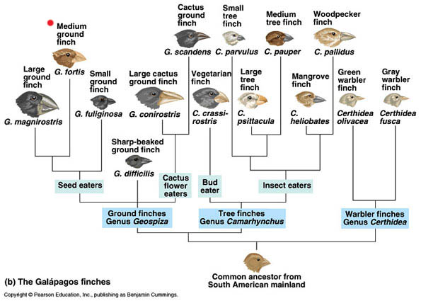

Slide 27
Natural selection: mechanism of evolutionary change
Natural selection: proposed by Darwin as the mechanism of evolution
individuals have specific inherited characteristics
they produce more surviving offspring
the population includes more individuals with these specific characteristics
the population evolves and is better adapted to its present environment

Slide 28
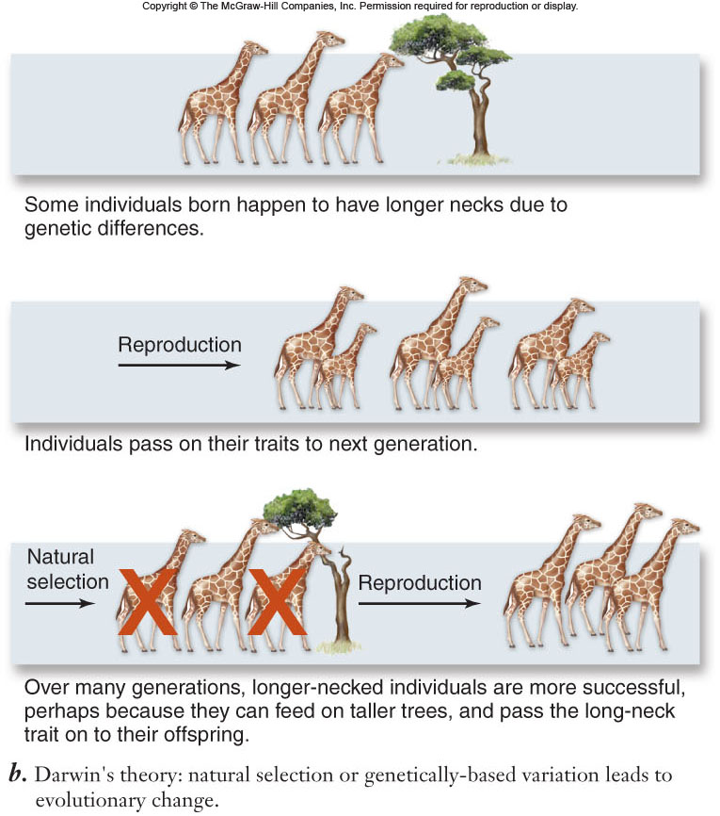
Darwin’s theory for how long necks evolved in giraffes

Slide 29
Natural selection
3 conditions for natural selection to occur
  Variation must exist among individuals in a population
  Variation among individuals must result in differences in the number of offspring surviving
  Variation must be genetically inherited

Slide 30
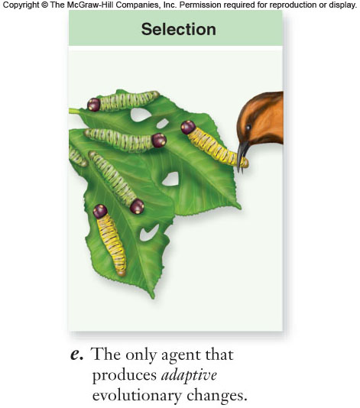
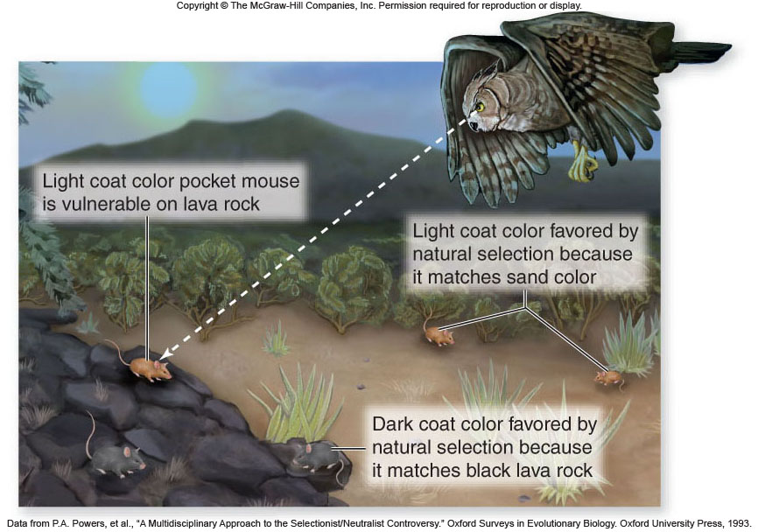

Slide 31
Natural Selection
Adaptation: Species pass on inherited traits that increase their ability to survive.
He had internal conflicts with what he discovered. It went against what he believed.

Slide 32
Evidence That Suports Darwin’s Theory:
1.) Geology: By studying fossils he believed the earth was much older than people of his time had thought.
He also studied and observed areas that were affected by volcanoes and earthquakes. These changed the surface of the earth.

Slide 33
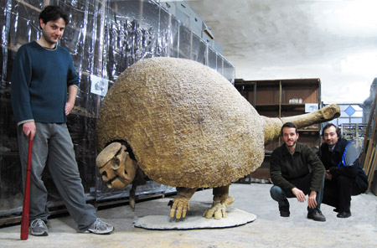
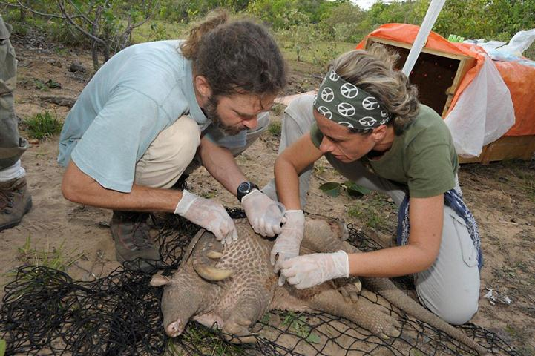
Evidence For Evolution
He also saw that certain places contained a certain species that changed as we looked thought the fossil record.

Slide 34
2.) Farmers / Breeders: Farmers altered and improved their own live stalk though selective breeding Techniques. (Artificial Selection)
He noticed this with Pigeons.
3.) Population Controls: Over time conditions prevent the endless growth o a population.
1. Famine 2. Disease 3. War 4. Drought
These apply to plants as well as animals.

Slide 35
What we know and understand about Darwin’s finches.
1. Parent birds came from the South American mainland to the island. How?
2. The island caused a separation of the population.
3. Once separated changes in the gene pool occur.
This depends on the niche and this may lead to phenotypic differences.

Slide 36
4. Reproductive isolation caused by gene pooling the genes change .

Slide 37
5. If the species migrated near each other 3 possible outcome could happen.
1. coexistance if they occupy different niches.
2. Extinction if they occupy the same niche and compete.
3. Further Evolution if one species has many genetic variations this may be the result.

Slide 38
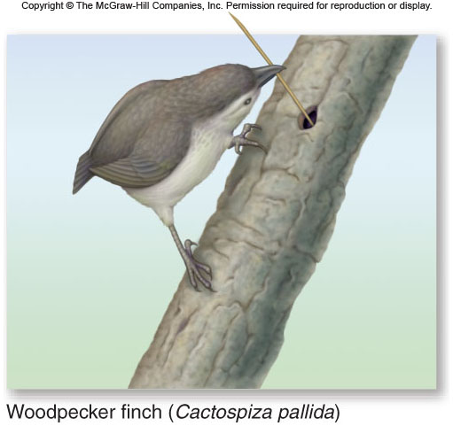
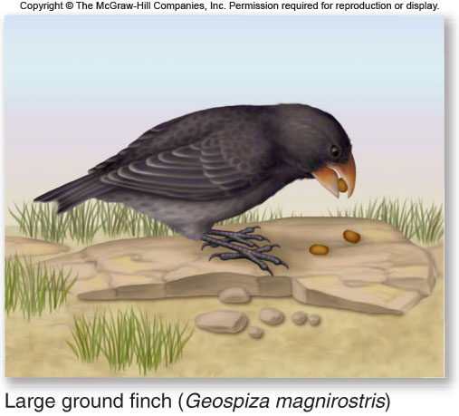
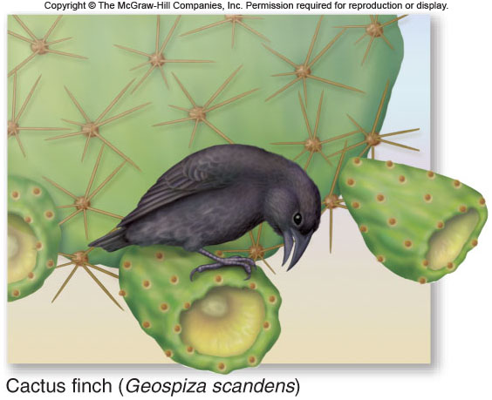
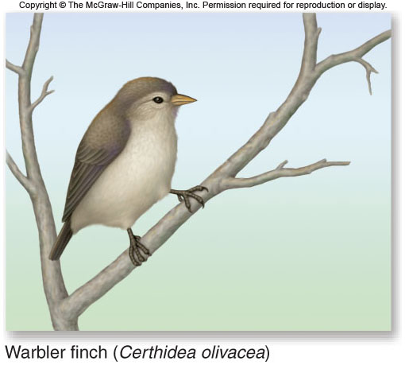

Slide 39
Artificial Selection: People select the desired traits in the parents so the offspring
will possess those desired traits. (ex. farmers = corn, or cows etc) ( dog breeder
= good hunting dog, friendly, guard dog etc. )

Slide 40
Natural Selection: The fittest organisms survive so the offspring will posses those fit
traits. (Mother Natures way of artificial selection).
Nature produces the most fit offspring.
Ex. Dogs their are many breeds and wild dogs and street dogs have the same traits everywhere around the world. ( Short hair, curly tails, about 30-40 pounds).

Slide 41
“Survival of the fittest”: Species of Organisms compete for food and space to live.Those that can are consided more fit and win the struggle to exist.
Genetic Fitness: The fitness of an organism is based on the genetic makeup.
Gene Variation: All organisms are genetically different. (Mutations and Gene shuffling)

Slide 42
Gene Variation in Nature
Measuring levels of genetic variation
  blood groups
  enzymes
Enzyme polymorphism
  A locus with more variation than can be explained by mutation is termed polymorphic.
  Natural populations tend to have more polymorphic loci than can be accounted for by mutation.
DNA sequence polymorphism

Slide 43
Hardy-Weinberg Principle
Godfrey H. Hardy: English mathematician
Wilhelm Weinberg: German physician
Concluded that:
The original proportions of the genotypes in a population will remain constant from generation to generation as long as five assumptions are met

Slide 44
Hardy-Weinberg Principle
Five assumptions :
No mutation takes place
No genes are transferred to or from other sources
Random mating is occurring
The population size is very large
No selection occurs

Slide 45
Hardy-Weinberg Principle
Calculate genotype frequencies with a binomial expansion
(p+q)² = p² + 2pq + q²
p = individuals homozygous dominant for first allele
2pq = individuals heterozygous for both alleles
q = individuals homozygous recessive for second allele
because there are only two alleles:
p plus q must always equal
www.bozemanscience.com/solving-hardy-weinberg-problems
Notes:
New Technology: Hyperlink to the Video that helps students further understand the Hardy-Weinberg equation.

Slide 46
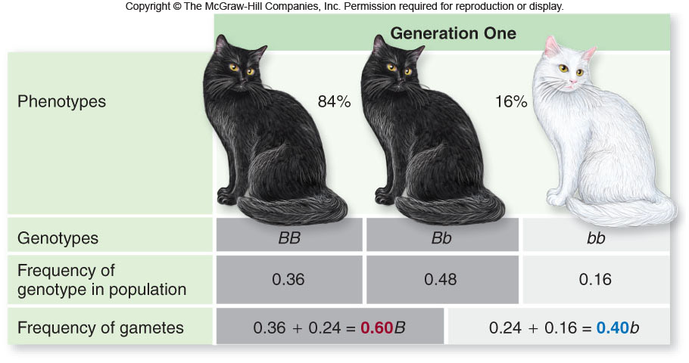

Slide 47
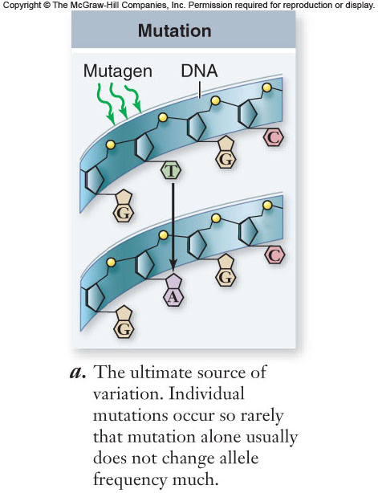
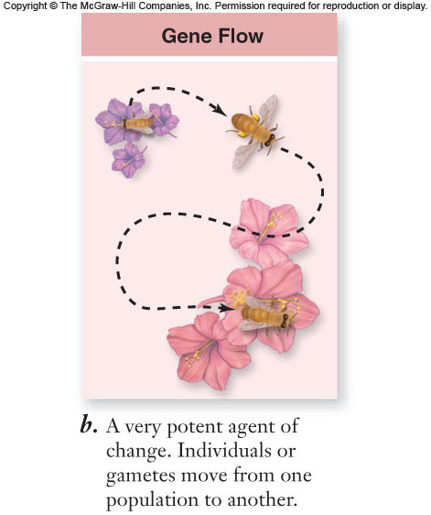
A population not in Hardy-Weinberg equilibrium indicates that one or more of the five evolutionary agents are operating in a population
Five agents of evolutionary change

Slide 48
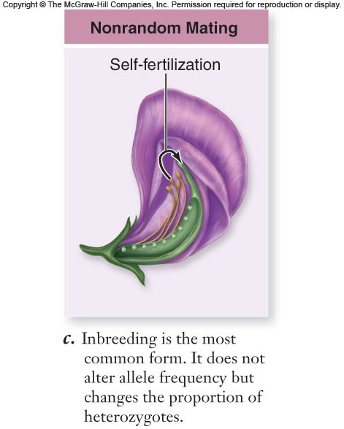
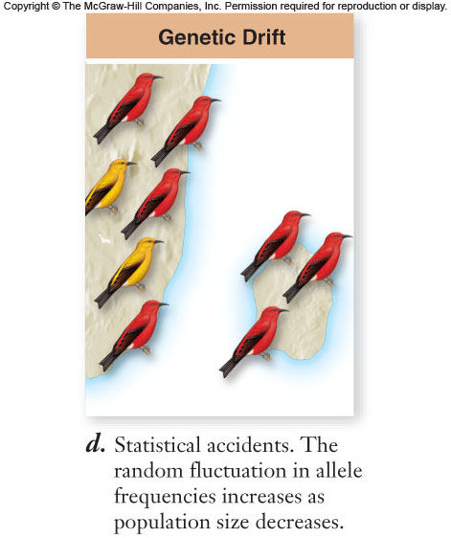
Five agents of evolutionary change

Slide 49
Five agents of evolutionary change

Slide 50
Genetic Drift
Genetic drift: Random fluctuation in allele frequencies over time by chance
    important in small populations
      founder effect - few individuals found new population (small allelic pool)
      bottleneck effect - drastic reduction in population, and gene pool size

Slide 51
Fitness:
Physical traits and behavior that enable an organism to survive and
reproduce. Gene mutations make some organism more fit, others less fit. The more
fit will survive and reproduce. Based on Genetics. This is the bases of Evolution.
Fitness is a combination of:
  Survival: how long does an organism live
  Mating success: how often it mates
  Number of offspring per mating that survive

Slide 52
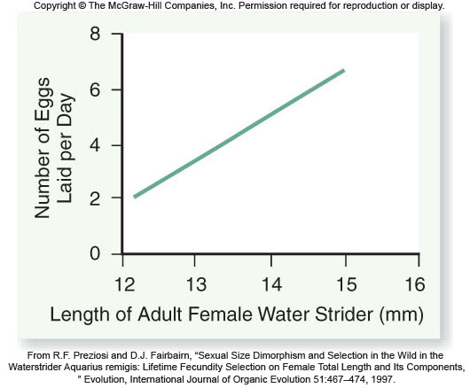
Body size and egg-laying in water striders

Slide 53
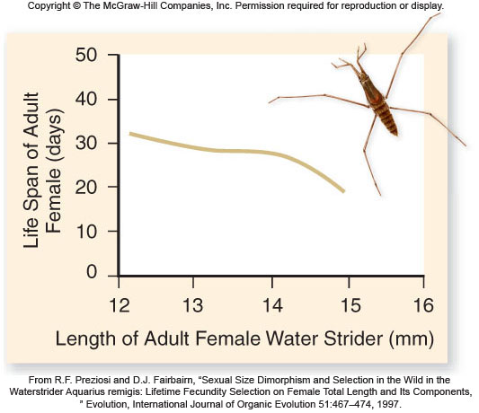
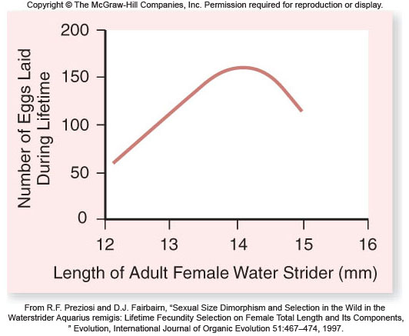

Slide 54
Maintenance of Variation
Frequency-dependent selection: depends on how frequently or infrequently a phenotype occurs in a population
  Negative frequency-dependent selection: rare phenotypes are favored by selection
  Positive frequency-dependent selection: common phenotypes are favored; variation is eliminated from the population
Strength of selection changes through time

Slide 55
Maintenance of Variation
Oscillating selection: selection favors one phenotype at one time, and a different phenotype at another time
Galápagos Islands ground finches
  Wet conditions favor big bills (abundant seeds)
  Dry conditions favor small bills

Slide 56
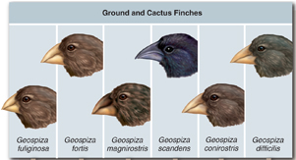
Maintenance of Variation
Fitness of a phenotype does not depend on its frequency
Environmental changes lead to oscillation in selection

Slide 57
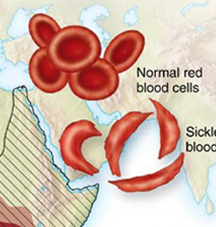
Maintenance of Variation
Heterozygotes may exhibit greater fitness than homozygotes
Heterozygote advantage: keep deleterious alleles in a population
Example: Sickle cell anemia
Homozygous recessive phenotype: exhibit severe anemia

Slide 58
Fitness
Fitness Topography: Two curves that fit over each other. One is the environmental
fitness level. The other is the organisms genetic fitness level.

Slide 59
Adaptation: Having a mutation which enables an organism to survive and
reproduce better. (without adaptation, species would become extinct)
(Remember, over 99% of all species on earth have already become extinct)

Slide 60
Evolutionary Tree: A linear chart showing how species might be related.
http://www.bozemanscience.com/cladograms
Adaptive Radiation: One species evolved into many different species.
Coevolution: Two unrelated organism evolve together and become dependent on each
other. (ex. Certain bees and flowers
http://www.bozemanscience.com/coevolution
Notes:
New Tool: Hyperlink to the Bozeman Science web page. This will help students to learn about evolution and how species evolve.

Slide 61
Convergent Evolution: Unrelated organisms evolve similar body parts which best suits
the environment. (dolphins, fish, penguins)
http://www.pbs.org/wgbh/nova/evolution/evolution-action-salamanders.html
Notes:
New tool: Embedded a web page address that helps to describe convergent evolution.

Slide 62
Genetics And Evolution:
Genes can cause random variations for natural selection, in the form of Mutations or changes caused by crossing over.
Remember that natural selection only works on the Phenotipic Variations.

Slide 63
Speciation
Development of a New Species: (Speciation)
All species eat different foods and live in different areas or the organisms will not survive. This role that an organism plays is called a Niche.
If Two organisms occupy the same niche than they must compete. and no two speicies can occupy the same niche or very long.

Slide 64
Speciation
A new species will form only if populations are isolated or separated.
If this does not occur than the gene pools will blend together and the species will look the same.

Slide 65
Isolation can happen by......
1. Geographic barriers. Rivers Mountains, lakes, Oceans etc.... Ecological Isolation
2. Courtship Behaviors or Fertile Periods: Each species has their specific behaviors for finding a mate. The individual with the best method will pass on there traits more often.
Temporal Isolation: Different Species mate at different times due to Temperature Changes.

Slide 66
Behavioral Isolation
3. Obtaining Food. The individuals that obtain food the easiest will look much healthier and therefore have a better chance of mating.
Mechanical Isolation: Shape of body or body parts.
http://www.bozemanscience.com/003-genetic-drift

Slide 67
**Once Reproductive isolation happens natural selection usually increases the difference between separate populations

Slide 68
Evidence for Evolution
Fossils not the only evidence:
1. Embryonic Stage:
* gill slits, notocord. etc
* Similarity in all cells(Organelles, mitosis, meiosis)
* DNA (ATCG).

Slide 69
Evidence for evolution
2. Similar Body Structure:
* Homologous Structures
Bird wings, dog legs (same bones)
* Vestigial organs.
(don’t serve a function anymore. Tail bone, appendix, ear muscle, legs on snakes, etc)

Slide 70
Post-Darwin Evolution Evidence
Comparative anatomy
- Homologous structures have same evolutionary origin, but different structure and function.
- Analogous structures have similar structure and function, but different evolutionary origin.

Slide 71
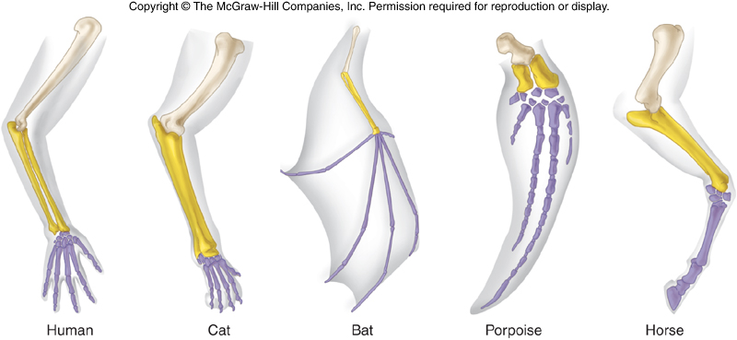
Homologous Structures

Slide 72
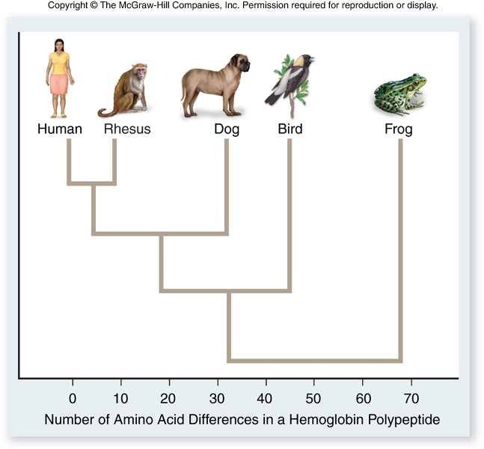
Post-Darwin Evolution Evidence
Molecular Evidence
- Our increased understanding of DNA and protein structures has led to the development of more accurate phylogenetic trees.

Slide 73
Endosymbiosis
Endosymbiosis
-proposal that eukaryotic organelles evolved through a symbiotic relationship
-one cell engulfed a second cell and a symbiotic relationship developed
-mitochondria and chloroplasts are thought to have evolved this way

Slide 74
Endosymbiosis
Much evidence supports this endosymbiosis theory.
Mitochondria and chloroplasts:
-have 2 membranes
-possess DNA and ribosomes
-are about the size of a prokaryotic cell
-divide by a process similar to bacteria

Slide 75
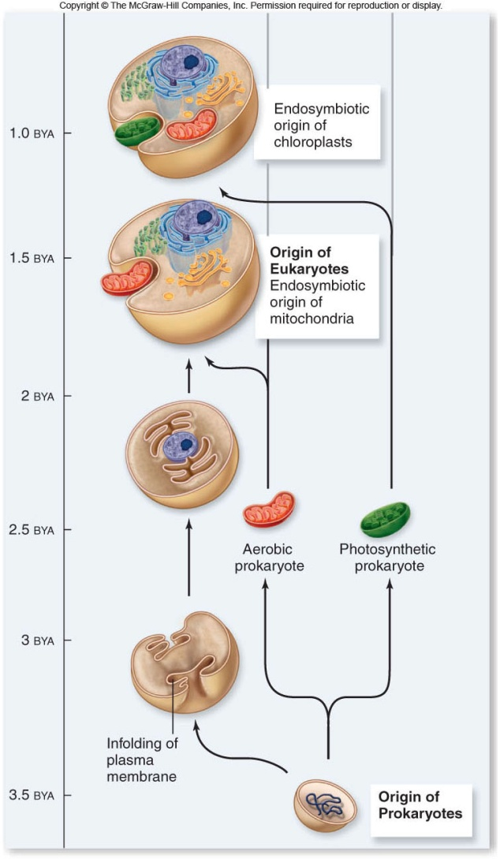

Slide 76
Unifying Themes in Biology
Cell theory
- All living organisms are made of cells, and all living cells come from preexisting cells.
Molecular basis of inheritance
- DNA encodes genes which control living organisms and are passed from one generation to the next.

Slide 77
Unifying Themes in Biology
Structure and Function
-The proper function of a molecule is dependent on its structure.
-The structure of a molecule can often tell us about its function.

Slide 78
Unifying Themes in Biology
Evolutionary change
- Living organisms have evolved from the same origin event. The diversity of life is the result of evolutionary change.
Evolutionary conservation
- Critical characteristics of early organisms are preserved and passed on to future generations.

Slide 79
