Slide 1
Genetics

Slide 2
Genetics: Is the study of heredity.
Biologists study Genetics to find out what controls we can have on disease and traits that are passed on though the generations.
Traits are the characteristics that may be passed on some may be visible and others may be not or difficult to see.

Slide 3
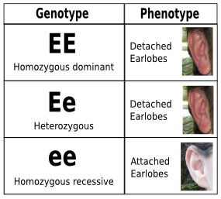
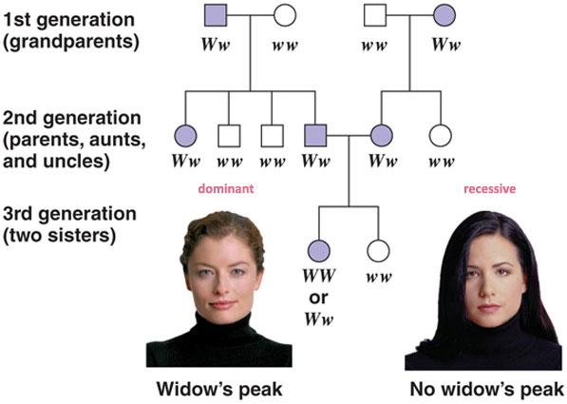
TWO TYPES OF TRAITS: Some traits may be expressed and others may not be expressed at all.

Slide 4
Phenotypic traits : These are the physical characteristic or what the individual looks like.
Ex. Color, Height, etc.
Genotypic traits: What the actual genes are like. THESE ARE THE LETTERS!!!
This may give a clue to what traits an individual organism carries regardless of their Phenotype.

Slide 5
Genes: These are factors that control the traits.
They are located on a chromosome and are made up of DNA.
Alleles: Are different forms of a gene.
There are Dominant and Recessive alleles

Slide 6
Alleles may be….
1.)Homozygous or alleles that are the same. This means that both parents gave the same gene to their offspring. (DD, dd )
2.) Heterozygous or alleles that are opposite, not the same. ( Dd)

Slide 7
Dominant: These are alleles that will be expressed when present.
Always use a capitol letter.
Recessive: Alleles are expressed only when homozygous.
Always use a lowercase letter.

Slide 8
Punnet Square: this is a way of showing all the possible allele combinations.
It Gives a probability of what the offspring from each cross may look like.

Slide 9
Early Ideas of Heredity
Before the 20th century, 2 concepts were the basis for ideas about heredity:
-heredity occurs within species
-traits are transmitted directly from parent to offspring
This led to the belief that inheritance is a matter of blending traits from the parents.

Slide 10
Early Ideas of Heredity
Botanists in the 18th and 19th centuries produced hybrid plants.
When the hybrids were crossed with each other, some of the offspring resembled the original strains, rather than the hybrid strains.
This evidence contradicted the idea that traits are directly passed from parent to offspring.

Slide 11
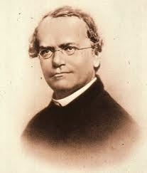
Gregor Mendell
The Father of Genetics. 1850’s
He worked with pea plants and noticed that if he crossed peas with different characteristics that some would be passed on to the next generation.
*Used true breeding plants
that would only produce a
certain trait such as color
He did not know how this
happens only that it did.
Did not know about alleles,
genes or chromosomes

Slide 12
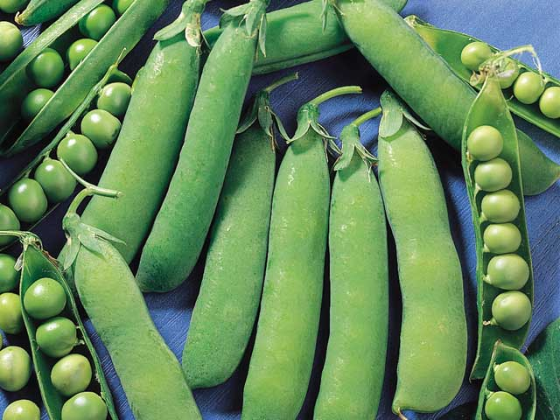
Mendel
He chose to study pea plants because:
1. other research showed that pea hybrids could be produced
2. many pea varieties were available
3. peas are small plants and easy to grow
4. peas can self-fertilize or be cross-fertilized

Slide 13
Gregor Mendell
He did find out through Experimenting:
1. That each individual had 2 chromosomes for each trait because they had 2 parents.
Each gene was could be passed on to the next generation.
2. Gametes are separate cells that have only 1 chromosome and that there must be a process that breaks the pair in two.

Slide 14
Gregor Mendell
3. Alleles/Traits for each gene are segregated independently.
4. In the cases of when there are to or more forms of a single trait some forms of the gene may be dominant or recessive.

Slide 15
Gregor Mendell
Purebred: If self - pollinated, the offspring will have the same traits as the parents. (AKA: Homozygous) (T T)
Hybrids: Organisms produce by crossing parents with different
characteristics. (T t) (AKA: Heterozygous)
Genes: The heredity material that determines a trait. (Found on the
Chromosomes) (DNA = the chemical found in the genes)

Slide 16
Gregor Mendell
Recessive: The allele that is not dominant. If two recessive allele are
present, then and only then will that trait be present.
P generation: The parents.
F1: The offspring of the P generation.
F2: The offspring of the F1 generation.

Slide 17
Gregor Mendell
Mendel’s Experiment:
Purebred Tall (TT) Crossed with Purebred Short (tt)
F1 All tall plants (Tt) (Hybrids)
F2 Three tall One short. (3:1 ratio)
TT, Tt, Tt, tt

Slide 18
Monohybrid Crosses
Monohybrid cross: a cross to study only 2 variations of a single trait
Mendel produced true-breeding pea strains for 7 different traits
-each trait had 2 alternate forms (variations)
-Mendel cross-fertilized the 2 true-breeding strains for each trait

Slide 19
Monohybrid Crosses
F₁ generation (1st filial generation): offspring produced by crossing 2 true-breeding strains
For every trait Mendel studied, all F₁ plants resembled only 1 parent
-no plants with characteristics intermediate between the 2 parents were produced

Slide 20
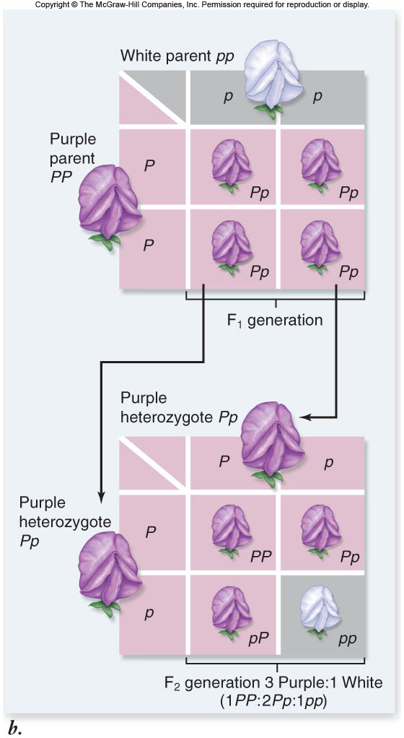

Slide 21
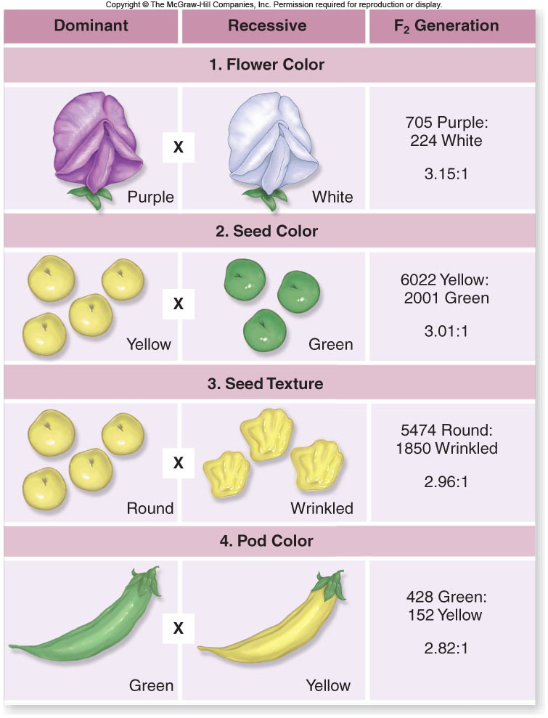
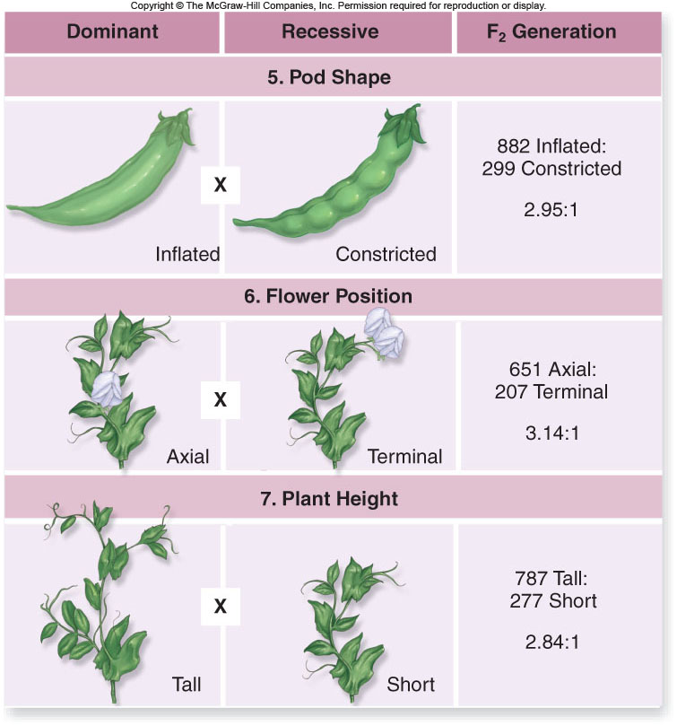

Slide 22
Monohybrid Crosses
F₁ generation: offspring resulting from a cross of true-breeding parents
F₂ generation: offspring resulting from the self-fertilization of F₁ plants
dominant: the form of each trait expressed in the F₁ plants
recessive: the form of the trait not seen in the F₁ plants

Slide 23
F₂ plants exhibited both forms of the trait in a very specific pattern:
¾ plants with the dominant form
¼ plant with the recessive form
The dominant to recessive ratio was 3 : 1.
Mendel discovered the ratio is actually:
1 true-breeding dominant plant
2 not-true-breeding dominant plants
1 true-breeding recessive plant

Slide 24
Law of Segregation
Two alleles for a gene must seperate during gamete formation (Meiosis) and are rejoined at random, one from each parent, during fertilization.

Slide 25
Thomas Morgan
1900’s He expanded on the principles of Mendel by working with animals. Drosophila or Fruit Flies.
He Proved that mieotic division works in animals.

Slide 26
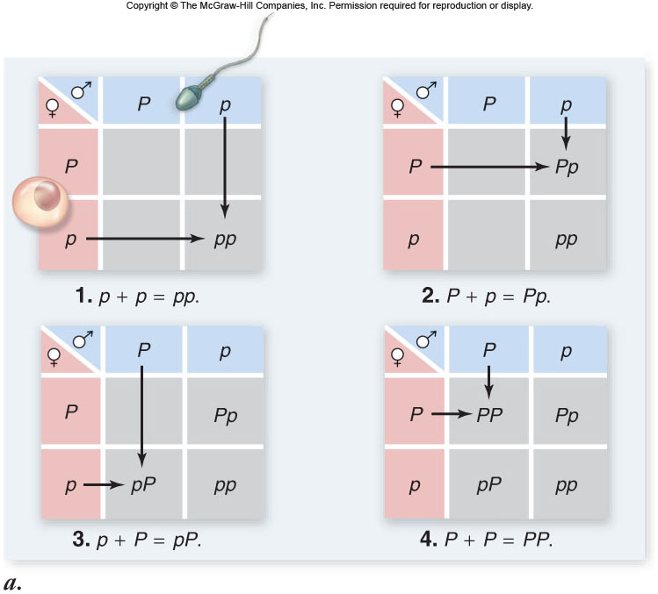

Slide 27
Monohybrid Crosses
Some human traits are controlled by a single gene.
-some of these exhibit dominant inheritance
-some of these exhibit recessive inheritance
Pedigree analysis is used to track inheritance patterns in families.

Slide 28
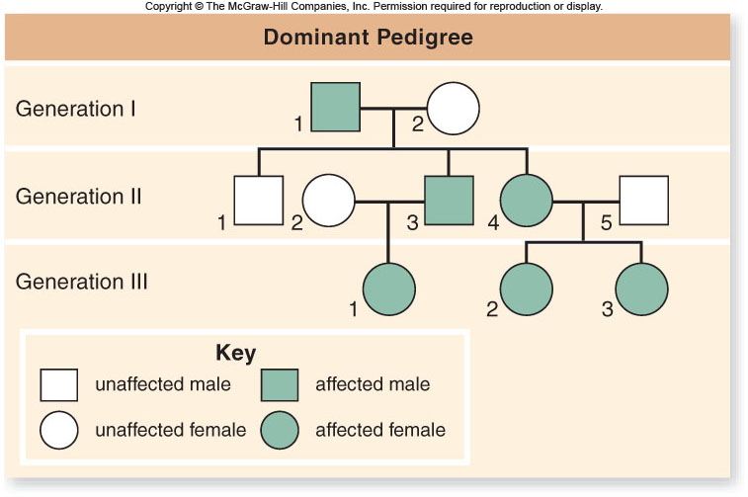

Slide 29
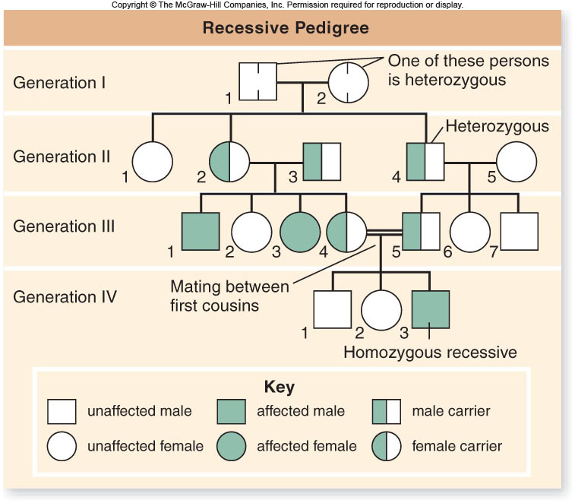

Slide 30
Dihybrid Crosses
Dihybrid cross: examination of 2 separate traits in a single cross
-for example: RR YY x rryy
The F₁ generation of a dihybrid cross (RrYy) shows only the dominant phenotypes for each trait.

Slide 31
Dihybrid Crosses
The F₂ generation is produced by crossing members of the F₁ generation with each other or allowing self-fertilization of the F₁.
-for example RrYy x RrYy
The F₂ generation shows all four possible phenotypes in a set ratio:
9 : 3 : 3 : 1

Slide 32
Probability – Predicting Results
Rule of addition: the probability of 2 mutually exclusive events occurring simultaneously is the sum of their individual probabilities.
When crossing Pp x Pp, the probability of producing Pp offspring is
probability of obtaining Pp (1/4), PLUS
probability of obtaining pP (1/4)
¼ + ¼ = ½

Slide 33
Probability – Predicting Results
Rule of multiplication: the probability of 2 independent events occurring simultaneously is the PRODUCT of their individual probabilities.
When crossing Rr Yy x RrYy, the probability of obtaining rr yy offspring is:
probability of obtaiing rr = ¼
probability of obtaining yy = ¼
probability of rr yy = ¼ x ¼ = 1/16

Slide 34
Special Types Of Dominance
Dominance: Some alleles are dominant. Tall alleles are dominant
over short alleles. (T / t). (Dominance does NOT apply to all genes).
Incomplete Dominance / Codominance: Neither allele is dominant. (A red flower parent and a white flower parent = a pink flower) (Rr = pink).

Slide 35
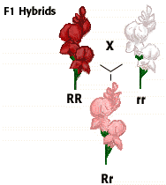
Incomplete dominance: the heterozygote is intermediate in phenotype between the 2 homozygotes.
Red crossed with white makes pink.

Slide 36
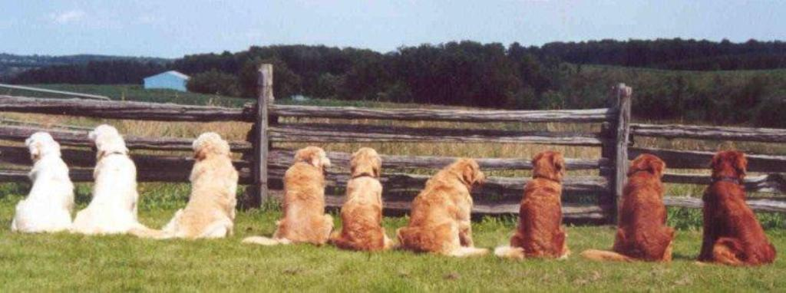
Incomplete Dominance

Slide 37
1. Go over Incomplete/codominance wkst
2. Sex linked traits
In humans, straight hair and curly hair are incompletely dominant traits that result in hybrids that have wavy hair.
Cross a straight hair with a wavy hair.
What are the chances of having a curly haired child?
What are the chances of having a straight hair child?

Slide 38
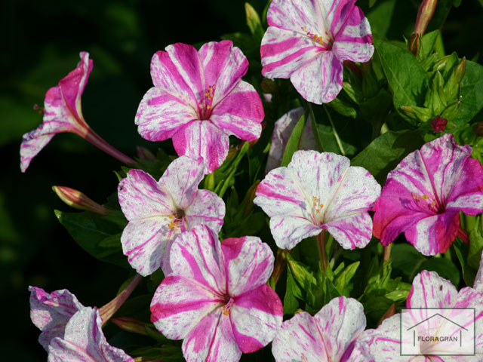
Codominacnce
Codominance: the heterozygote shows some aspect of the phenotypes of both homozygotes.
Black crossed with white makes gray.

Slide 39
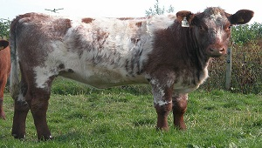
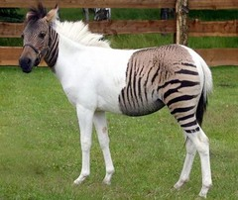
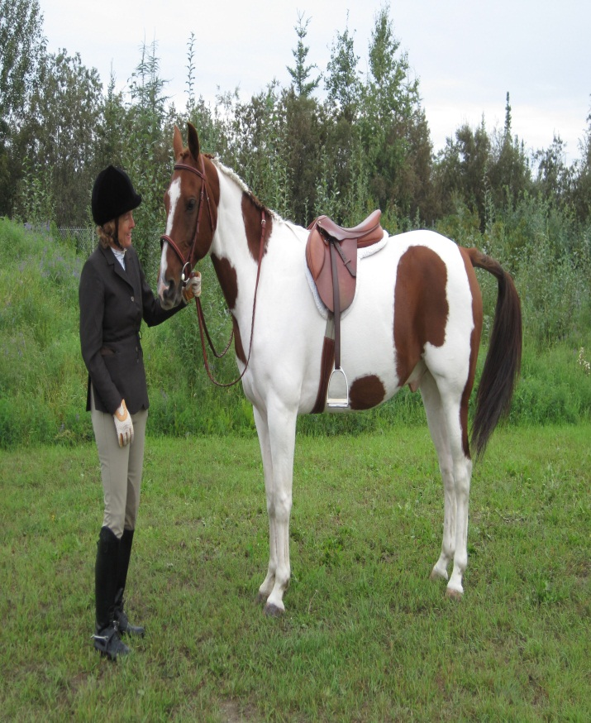
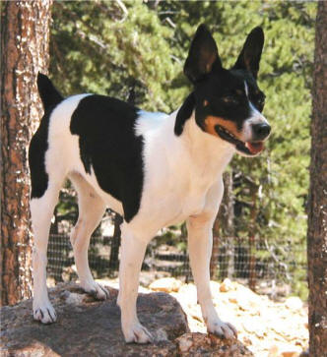

Slide 40
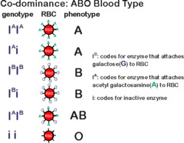
Blood Types

Slide 42
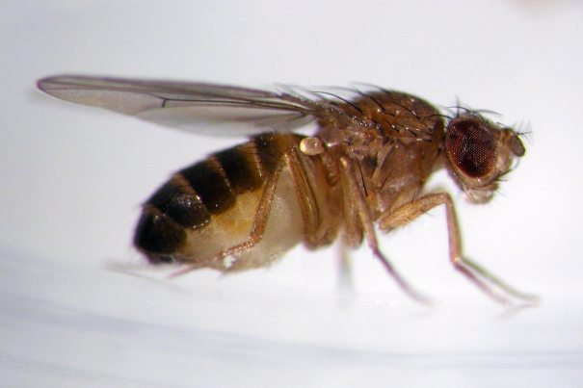
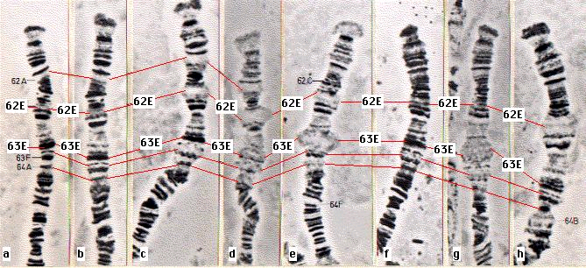
Sex Determination
Thomas Hunt Morgan – studied fruit flies in the early 1900’s

Slide 43
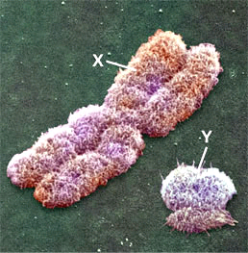
Sex Determination
Observed that one pair of chromosomes was different between males and females
  Large one named “X” chromosome
  Smaller one named “Y” chromosome
  XX = female; XY = male

Slide 44
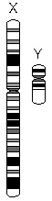
Sex Linkage
Sex Linkage: the presence of a gene on a sex chromosome (X or Y)
X-linked genes: genes found on the X chromosome
  X chromosome carries more genes
Y-linked genes: genes found on the Y chromosome

Slide 45
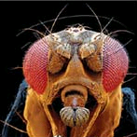
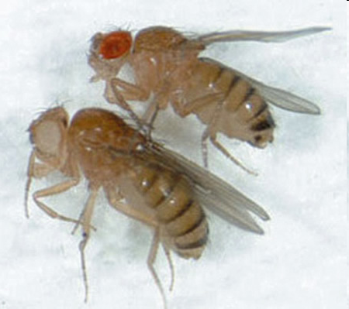
Fruit Fly Eye Color
Fruit flies normally have red eyes
  Red is dominant; white is recessive
A few males have white eyes

Slide 46


Morgan’s Fruit Fly Experiments
Red-eyed female (X^{R}X^{R)} x White-eyed male (X^{r}Y)
X^{R}
X^{R}
X^{R}X^{r}
X^{R}X^{r}
RESULTS:
F₁ generation – all red-eyed
X^{r}
X^{R}Y
X^{R}Y
Y

Slide 47
Morgan’s Fruit Fly Experiments
Red-eyed female (X^{R}X^{r)} x Red-eyed male (X^{R}Y)
X^{R}
X^{r}
RESULTS:
F₂ generation – 3 red-eyed and 1 white-eyed
** all white-eyed where males…why?
X^{R}X^{R}
X^{R}X^{r}
X^{R}
X^{R}Y
X^{r}Y
Y

Slide 48
Morgan’s Conclusions
Gene for eye color is carried on the X chromosome = eye color is an X-linked trait
Y chromosome does not carry a gene for eye color
Red-eyed = X^{R}X^{R}, X^{R}X^{r} , X^{R}Y
White-eyed = X^{r}X^{r}, X^{r}Y

Slide 49
In humans colorblindness (b) is an example of a sex-linked recessive trait. A male without colorblindness marries a female who isn’t colorblind but carries the allele.
How many females will be colorblind?
What sex will any colorblind children be?
What percent will be male and colorblind?

Slide 50
In fruit flies red eye color (R) is dominant to white eyes (r) and is a sex linked trait.
A heterozygous red eye female mates with a red eye male.
How many will have red eyes?
What percent will have white eyes?
How many will be female and red eyed?

Slide 51
In fruit flies red eye color (R) is dominant to white eyes (r) and is a sex linked trait.
A homozygous red eye female mates with a white eye male.
How many males will have white eyes?

Slide 52
In humans colorblindness (b) is an example of a sex-linked recessive trait. A male with colorblindness marries a female who isn’t colorblind and does not carry the allele.
What is the chance they will have a child that is colorblind?

Slide 53
Extensions to Mendel
Pleiotropy refers to an allele which has more than one effect on the phenotype.
This can be seen in human diseases such as cystic fibrosis or sickle cell anemia.
In these diseases, multiple symptoms can be traced back to one defective allele.

Slide 54
Chromosomal Theory of Heredity
Genes are located on the chromosomes and each occupies a specific place.
Genes and chromosomes are inherited together. These are linked genes.
Some genes can move or trade places to another chromosome due to crossing over

Slide 55
The human chromosome has about 21,000 genes on the human Genome.

Slide 56
Chromosomes
Chromosomes = Structures that contain genetic information.
- Means colored body because when dye is added the Chromosomes pick up the color so we can see them.
- Made of material called Chromatin which is made up of DNA and Protein.
- Humans contain 46 chromosomes - 23 from each parent.

Slide 57
Chromosome Structure
Made up of two Chromatids. these are the large thread structures. Each Chromosome has 2.
The Chromatids are attached at an area called the Centromere.

Slide 58
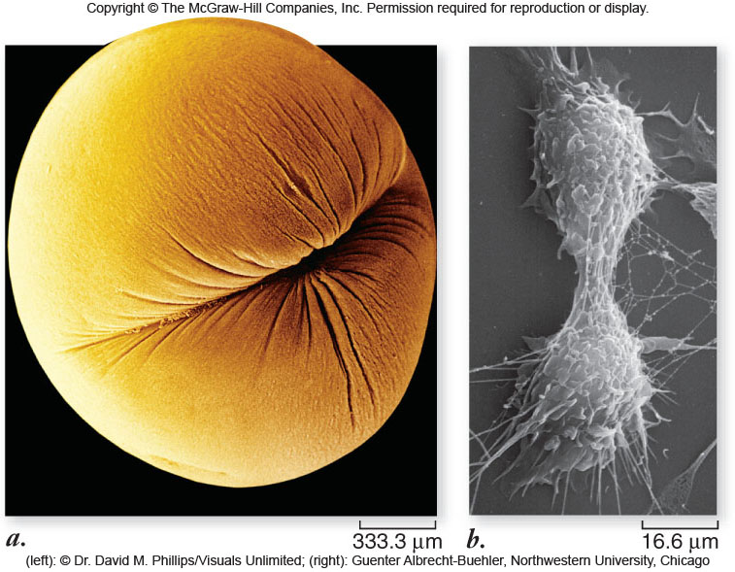

Slide 59
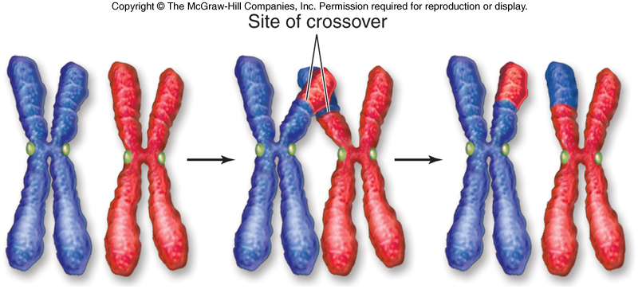

Slide 60
Meiosis II resembles a mitotic division:
-prophase II: nuclear envelopes dissolve and spindle apparatus forms
-metaphase II: chromosomes align on metaphase plate
-anaphase II: sister chromatids are separated from each other
-telophase II: nuclear envelope re-forms; cytokinesis follows

Slide 61
Mutations
Mutations: Changes that occur to the chromosomes.
-These can be both good or bad.
-Most Mutations are never shown.
-These can occur in any cell that divides.
-Mutations can eventualy lead to changes in the entire population over many years.

Slide 62
Chromosomal Mutations
Change in the number or structure of chromosomes.
-These are mutations that can involve the entire chromosome, on part or even pairs of chromosomes.

Slide 63
Four types of Chromosomal Mutations:
1. Deletion: A loss of part of the chromosome.
2. Duplication: Segment of chromosome is repeated.
3. Inversion: Part of the chromosome is orientated in reverse of its usual direction.
4.Translocation: One part of the chromosome breaks off and attaches to another chromosome

Slide 64
Nondisjunction:
This is a failure for a chromosome to separate during Meiosis.
-Extra chromosome results in one cell and a loss of a chromosome occurs in the other cell.

Slide 65
Gene Mutations
These mutations involve individual genes.
-Any chemical change that affects the DNA can cause this type of mutation to happen.
-Some may cause a change to 1 nucleotide, while some may change many.

Slide 66
Point Mutation
Affects only one nucleotide.
Frameshift Mutation: May change the entire polypeptide or protein chain produced by the gene.

Slide 67
Germ Mutations: Mutations that affect the reproductive cells.
Somatic Mutations: These do not affect the reproductive cells.
-They are not inherited.
(Both can occur at the level of Chromosomal and Gene Mutations)
Sex Linked Genes:

Slide 68
Remember Nondisjunction can be caused by a failure of the chromosomes to seperate duing meiosis.
-This can cause a great increase in the numbers of chromosomes.
This is called Polyploidy: Triploidy (3n) tetraploidy(4n)
-This is almost always fatal in animals.

Slide 69
Aneuploidy: Not true multiples of chromosomes.
Only one half of a pair is given off.
Aneuploidy: Not and even number of chromosomes. ( not 46 in humans)
1. Trisomy: One extra chromosome. (3 of one chromosome)
2. Monosomy: One less chromosome.

Slide 70
Examples:
. Down Syndrome: Trisomy chromosome #21. 1 in 770 live births.
Low muscle tone, broad hands, thick neck , retardation.
2 Al-aish Syndrome: Monosomy #21. Lethal. Very rare. 3 known cases.

Slide 71
Examples:
3. Edwards Syndrome: Trisomy 18. 1 - 4500 births.
Deaths usually by 6 months. 78% females. Rocker bottom feet.
80% have heart deformities.

Slide 72
. Patau Syndrome: Trisomy 13. 1 - 5000 births.
Death by 1 month. Incomplete forebrain development. Cleft lip and
Palate and heart disorder.

Slide 73
Sex Chromosomes aneuploidy:
1. Turner Syndrome: Missing a sex chromosomes. (45 chromosomes)
(XO) 1 - 3000 female births. Short, bigger ears, web neck, sterile. May have a lower IQ.

Slide 74
Sex Chromosomes aneuploidy:
2. Klinefelters syndrome: One extra chromosome. (47 chromosomes) (XXY) 1 - 500 male births. Limbs longer than
average. Tall. Sterile, Breast Development. low IQ.

Slide 75
Sex Chromosomes aneuploidy:
3. Jacob Syndrome: (XYY) 1 - 1000 male births. Tall 6ft or more.
Antisocial, Aggressive, Violent (Criminal Behavior) Low IQ.

Slide 76
Extensions to Mendel
Polygenic inheritance occurs when multiple genes are involved in controlling the phenotype of a trait.
The phenotype is an accumulation of contributions by multiple genes.
These traits show continuous variation and are referred to as quantitative traits.
For example – human height

Slide 77
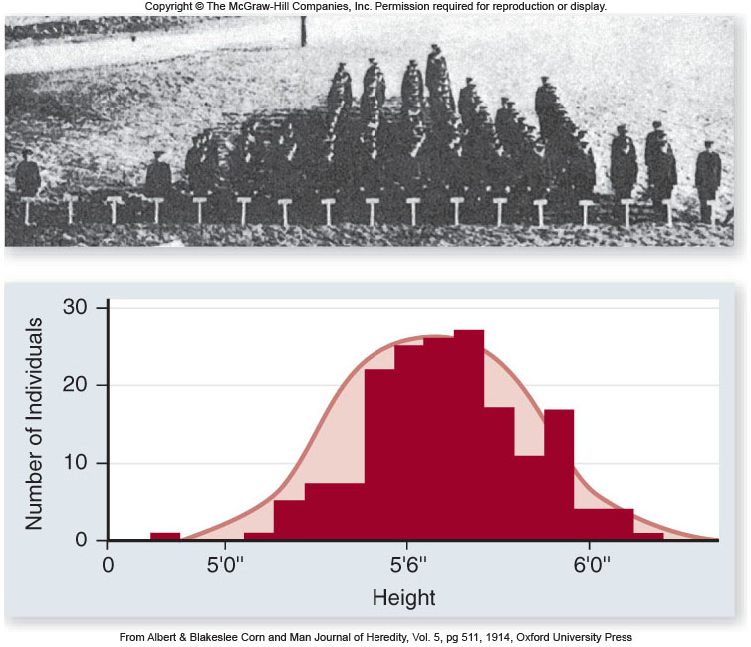

Slide 78
Huntington Disease
3-7 per 100,000 people of European Ancestry.
Less common in Japanese Chinese or African ancestry.
Autosomal Dominant disorder only need one copy of the gene. Mutation in the HIT gene.
Degeneration of the nerves in the Brain.
Causes jerking, Twitching, pycheatric problems, etc.
No cure.

Slide 79
Sickle-Cell Anemia
About 1 in 12 African Americans and 1-100 Hispanic Americans are carriers.
Mutation of the Hemoglobin Beta gene on Chromosome 11. Mutant Red Blood Cells.
The damaged gene causes the cells to stick together and to become stiff.
Cells clump together and damage organs of the body.
These cell die fast and the bone mattow cannot produce enough RBC.
Only cure is bone marrow transplants.

Slide 80
Hemophilia
1 in 5000 male births. 1/3 of the births happen to families with no history.
Sex-linked = X linked
This is a bleeding disorder, where the affected people cannot clot the blood.
Treatment is that patients are given injections of the clotting factors

Slide 81
Muscular Dystrophy
Disorder where the body fails to produce Dystrophin, which allows the muscle to grow and function.
Sex Linked.
Develop symptoms by are 2-3 and are in a wheel chair by age 12.
9 different forms of MD. All have different times of onset.
No Treatment for any form.

Slide 82
Tay Sachs
Mutation in the HEXA Gene.
Destroys the neurons in the brain and spinal chord.
Child appears normal until the ages of 3-6 months.
Loss of muscle control and child loses ability to roll over, sitting and crawling.
Prevalent in people of Eastern European Jews,
Amish, Cajun, and French Canadian communities.
No Cure.

Slide 83
Cystic Fibrosis
Autosomal Chromosome
Inherited disease of the secretory gland that make mucus and sweat. Individuals produce a very thick musus.
May effect the Lungs, skin, pancreas, liver, and intestines.

Slide 84
PKU

Slide 85
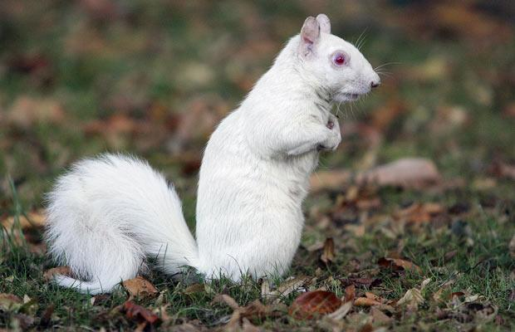
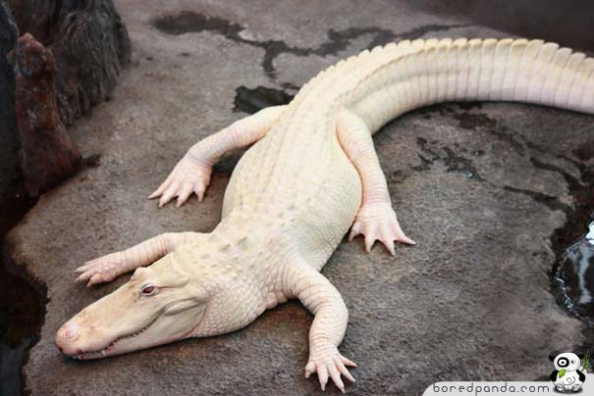
Albinism
Recessive
defect of melanin production
results in little or no color in the skin, hair, and eyes

Slide 86
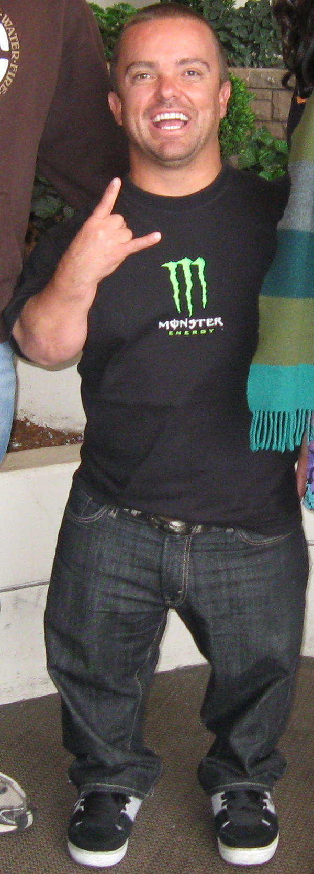
Achondroplasia
common cause of dwarfism
Sporadic mutation in approximately 75% of cases (associated with advanced paternal age)
Or dominant genetic disorder
Unlikely homozygous child will live past a few months of its life

Slide 87
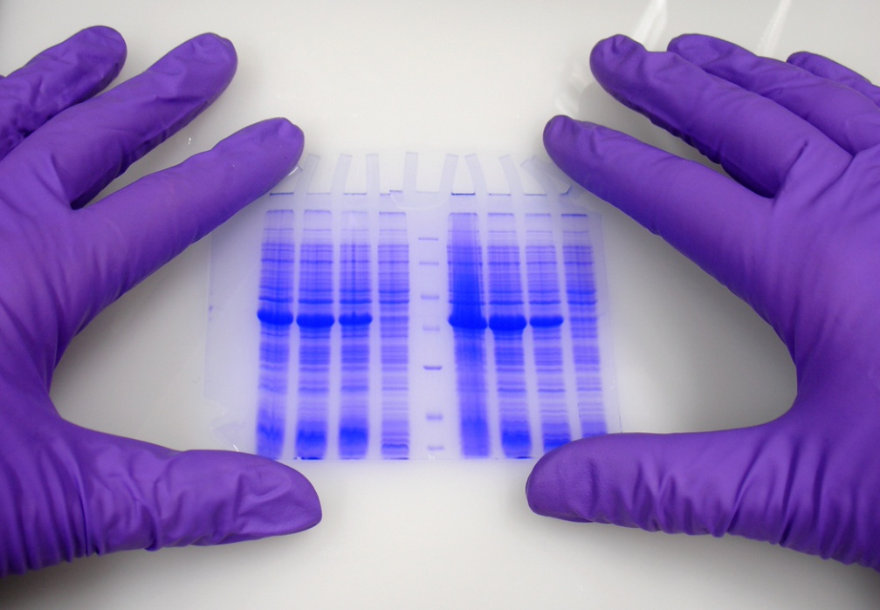
How is genetic testing done?
blood, hair, skin, amniotic fluid, or other tissue
Look for changes in chromosomes, DNA, proteins

Slide 88
Amniocentesis
An Amniocentesis is a procedure a pregnant woman can have in order to detect some genetics disorders…..such as non-disjunction.

Slide 89
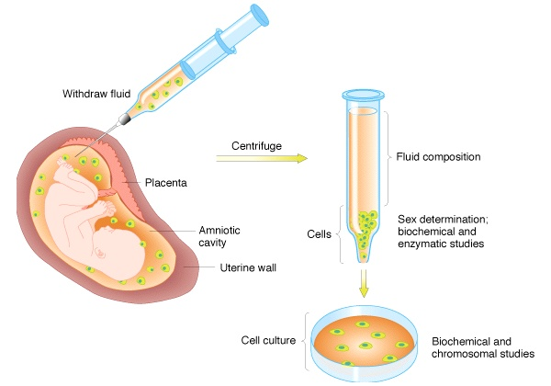
Amniocentesis
Amniotic fluid withdrawn

Slide 90
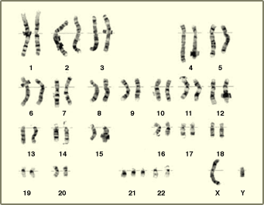
Karyotype
(picture of an individual’s chromosomes)
One of the ways to analyze the amniocentesis is to make a Karyotype
What genetic disorder does this karyotype show?
Trisomy 21….Down’s Syndrome

Slide 91
Sex - Linked Disorders
Sex Linked Genes: Genes located on the sex chromosome. (X or Y).
Typically effects males more often because males only have one X
chromosome.

Slide 92
Sex - Linked Disorders
Mutations: These are mistakes that occur in the processing of genetic
information. The nucleotides in the offspring are different than in the
parents. (Some mutations can be good, some can be deadly).

Slide 93
Sex - Linked Disorders
. Color Blindness: (Red / Green most common) 8% of males.
* Located on the X chromosome.
* XC = normal color vision.
* Xc = recessive allele for color blindness.
* XCXC = Homozygous normal.
* XCXc = Heterozygous normal (carrier) does not express.
* XcXc = Female with color blindness.
* XcY = Male with color blindness.

Slide 94
Sex - Linked Disorders
2. Hemophilia: Disease that causes blood not to clot properly.
* Located on the X chromosome.
* Males; 1 in 10,000
* Females: 1 in 100,000 (homozygous recessive)

Slide 95
Sex - Linked Disorders
3. Muscular Dystrophy: Disease that causes a wasting away of the muscles.
* Located on the X chromosome.
* Muscle protein known as Dystrophin which is not genetically coded correctly.

Slide 96
Sex - Linked Disorders
4. Baldness: Loss of hair.
* Located on the X chromosome.
5. Eye Color in Fruit Flies. (White Eye)

