Slide 1
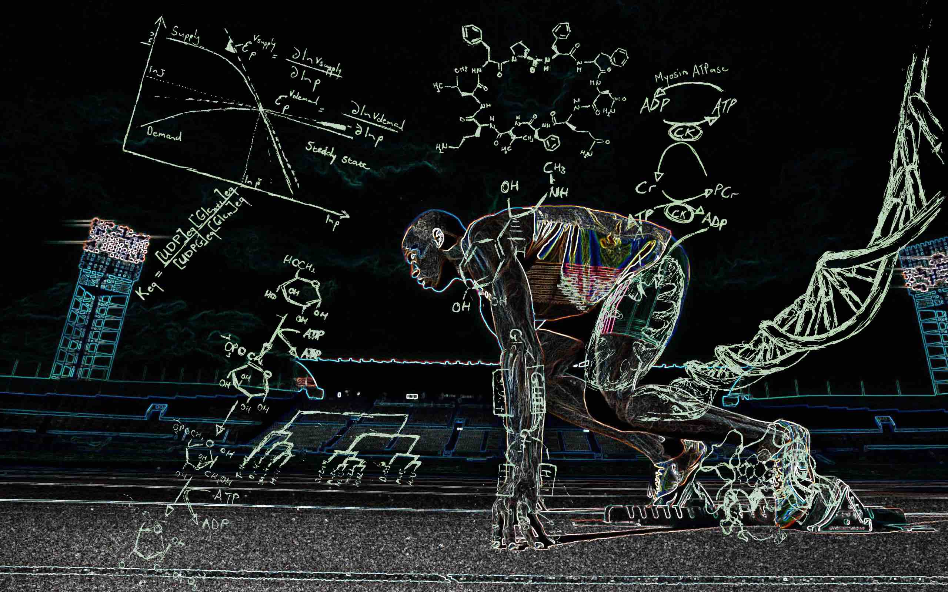
Unit 4 - Biochemistry

Slide 2
Misc. Info
All living things have carbon
Carbon, Hydrogen, Nitrogen, Oxygen, Phosphorous, Sulfur (CHNOPS)
  make up 96% of the body weight of organisms
Vocab
Monomer – one part, relatively small molecule
Polymer – many parts, many monomers put together

Slide 3
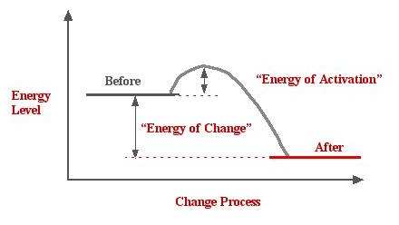
Energy of Reactions
Minimum amount of energy needed for chemical reaction = activation energy

Slide 4
Types of Reactions
Anabolic reactions are those that synthesize compounds
  Energy is required for these reactions - endothermic
  Uses heat/energy
  Creates larger molecules

Slide 5
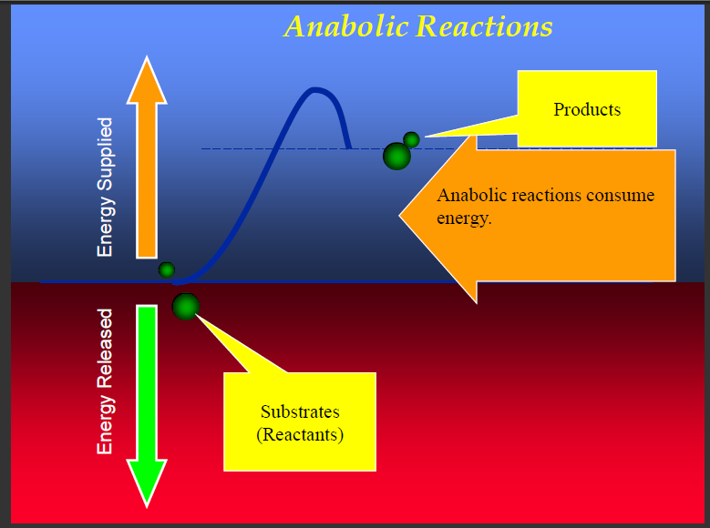

Slide 6
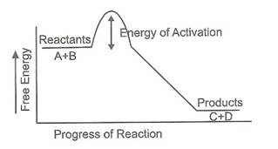
Catabolic/Exothermic Reactions
Reactions that break down molecules are called catabolic reactions
  Energy/heat is released - exothermic

Slide 7
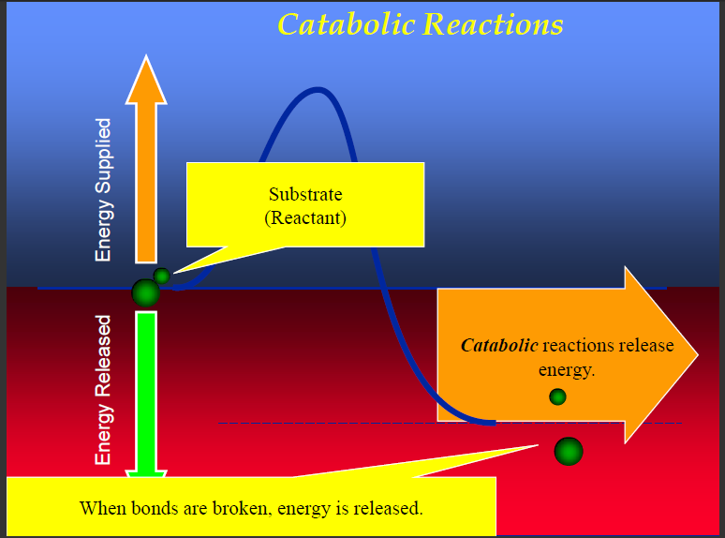

Slide 8
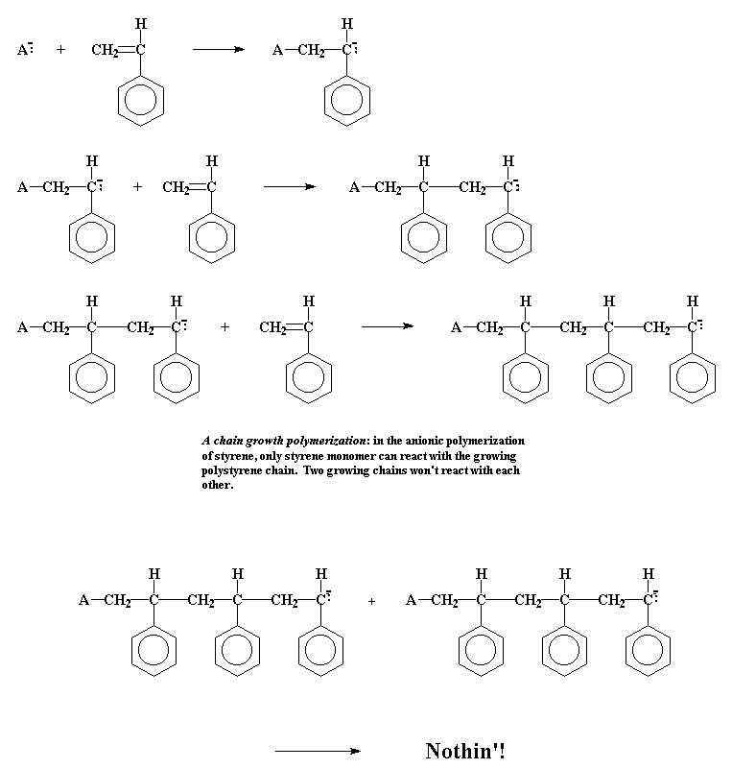
Reaction Types
Polymerization - monomers combine to produce a large chainlike or network molecule (polymer)

Slide 9
Reaction Types
Synthesis - two or more chemical species combine to form a more complex product
Hydrolysis - process in which water is used to split a substance into smaller particles

Slide 10
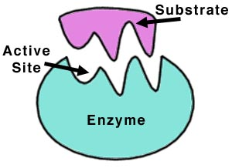
Enzymes
Catalyst – lowers the activation energy
  Speeds up a chemical reaction
Enzymes are biological catalysts

Slide 11
Enzymes as catalysts
Speed up reactions/Lower activation energy
Made up of PROTEINS
They are often named by adding "ase" to the name of the enzyme
  Example: Dehydrogenases are enzymes that remove hydrogen

Slide 12
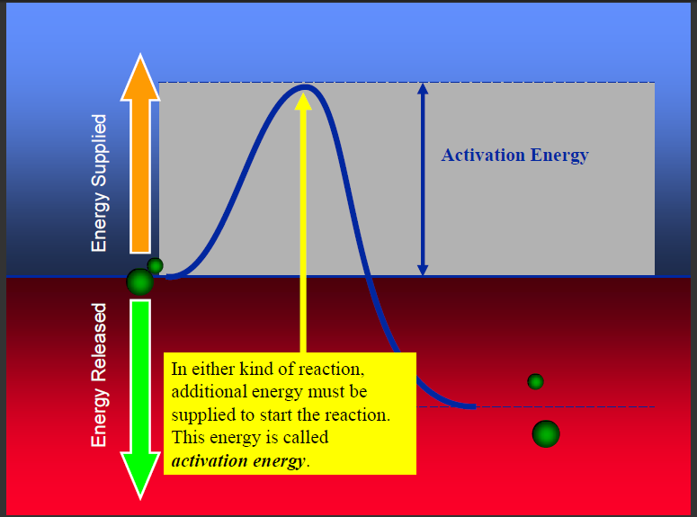

Slide 13
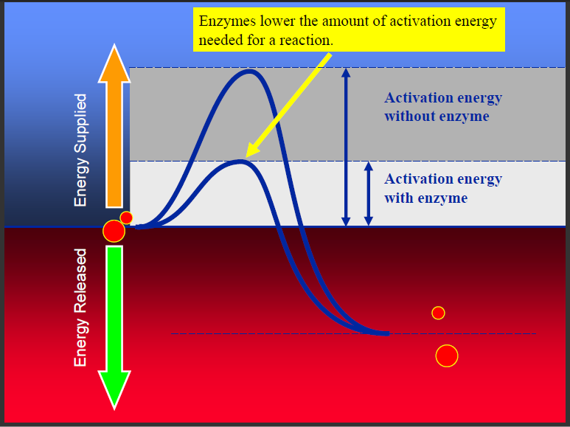

Slide 14
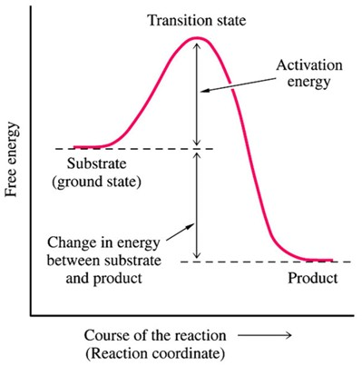
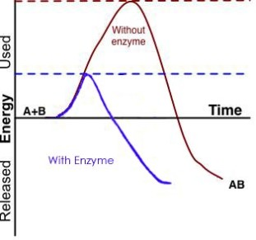
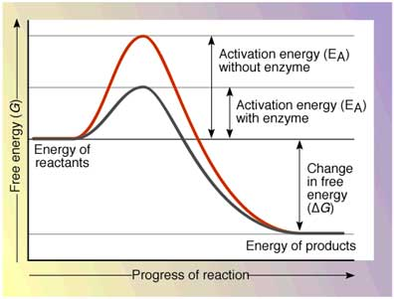

Slide 15
Enzymes
Reactants that bind to the enzyme are called substrates
Specific location where a substrate binds on an enzyme is called active site
Substrate (made up of reactants) bind to enzyme’s active site

Slide 16
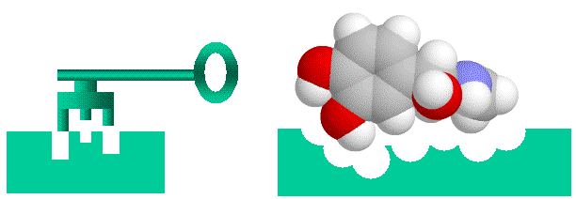
Induced Fit Theory/Lock and Key Model
Enzymes are SPECIFIC
Will only function correctly if the shape of the substrate matches the active site

Slide 17
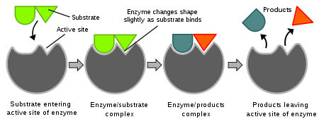
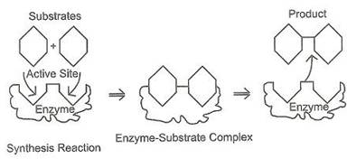

Slide 18
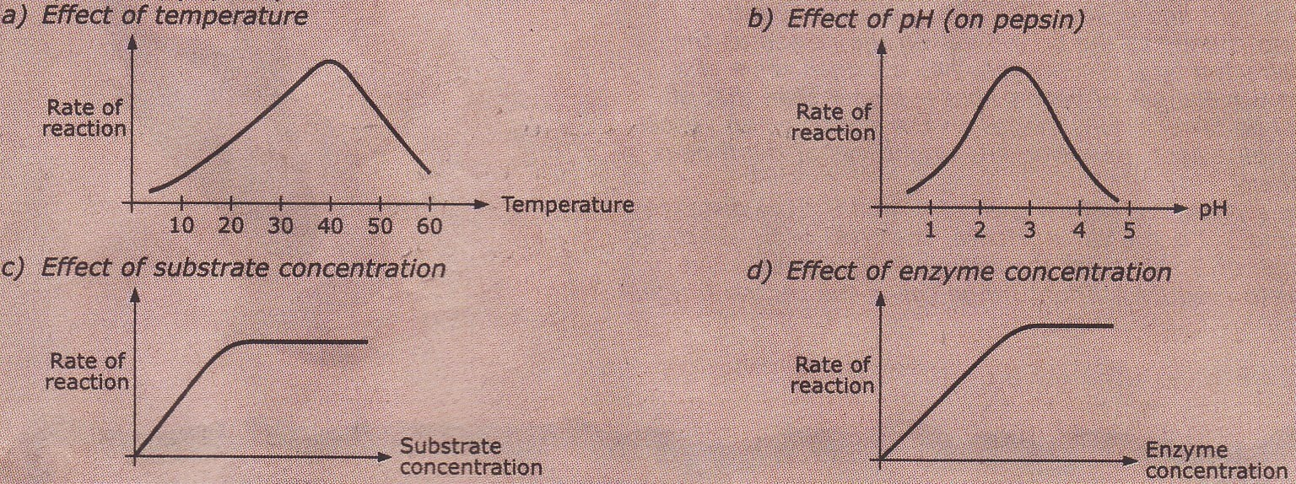
4 Conditions that affect enzymes
Substrate Concentration
Enzyme Concentration
pH
Temp

Slide 19
https://paul-andersen.squarespace.com/048-enyzmes

Slide 20
Salivary Amylase Lab
Amylase – enzyme found Saliva almost all living things
  Breaks down (dangerous by product)
  2 H₂O₂ → 2 H₂O + O₂
  High concentration in liver in humans
  Stored in cell organelles called Peroxisomes

Slide 21
Review Questions
What is an anabolic reaction?
What is a catabolic reaction?
List factors that can affect the effectiveness of an enzyme?
What does an enzyme do?
What is a monomer? Polymer?
What is an active site?
What is a substrate?
Describe the lock and key/induced fit model of enzymes.

Slide 22
How does changing the pH of the liver in the catalase lab relate to homeostasis in humans?

Slide 23
Homework
Read Pages 148 – 165
Questions
1 – 5 page 155
1 – 5 page 160
1, 2, 4 – 6 page 165
1,3-5 page 171
* Not for a grade but if you are feeling lost, it is highly recommended.

Slide 24
Regulation of Enzyme Activity
Regulation of Protein Synthesis (Genetic Regulation)
Enzymes are proteins
You can regulate them by making more or less of them as needed

Slide 25
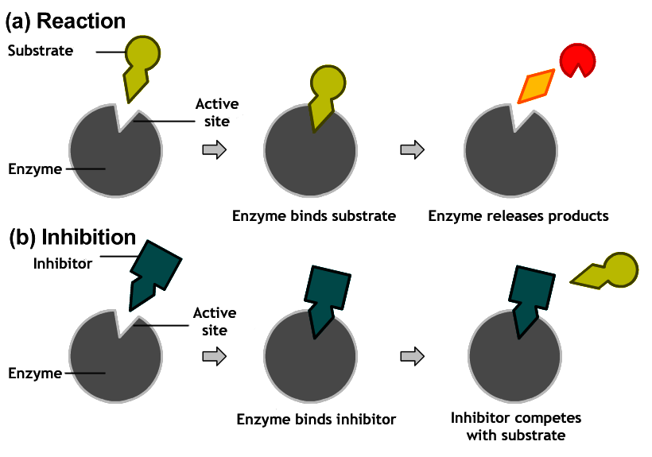
Regulation of Enzyme Activity
Competitive Inhibition
A similar-shaped molecule competes with the substrate for active sites

Slide 26
Regulation of Enzyme Activity
Another form of inhibition involves an inhibitor that binds to an allosteric site of an enzyme
  An allosteric site is a different location than the active site
  alters the shape of the enzyme, resulting in an active site that does not function properly
  Usually temporary

Slide 27
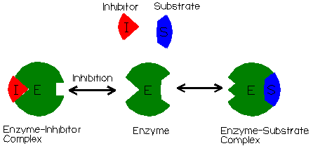

Slide 28
Regulation of Enzyme Activity
Feeback Inhibition
Thermostat
Same in Enzymes
  As an enzyme's product accumulates, it turns off the enzyme
  the end product of the pathway binds to an allosteric site on the first enzyme and shuts down the entire sequence

Slide 29
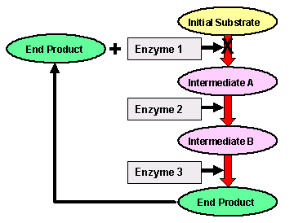

Slide 30
Coenzymes
Many enzymes require a cofactor to assist in the reaction.
  Nonprotein/metal ions such as magnesium, potassium, and calcium
  Cofactors bind to the enzyme and remove electrons, protons, or chemical groups
Vitamins usually act as coenzymes or precursors to coenzymes

