Slide 1
Macromolecules
Part II

Slide 2
Lipids
Carbon, Hydrogen, Oxygen
no specific ratio like Carbohydrates. BUT Hydrogen is always way more than 2x other atoms
4 types: fats, Oils, Phospholipids, Waxes
Hydrophobic - does not dissolve in water!
Stores energy

Slide 3
Energy Gained from Lipids
Eating 1 gram of fat provides your body with 9 Calories.
** Notice if you eat 1 gram of fat, you are gaining more than twice the amount of Calories than from a gram of carbohydrate or protein!

Slide 4
They are a great source of STORED ENERGY
They INSULATE the body to maintain body temperature
CUSHION the internal organs for protection
They produce hormones called STEROIDS (testosterone, estrogen)
They waterproof surfaces of animals, plants, and fruits- these are waxes

Slide 5
2 types of fats:
Saturated Fats -> Solid at room temperature
Butter & Fats in meat
Unsaturated Fats -> Liquid at room temperature
Olive oil & Flaxseed oil

Slide 6
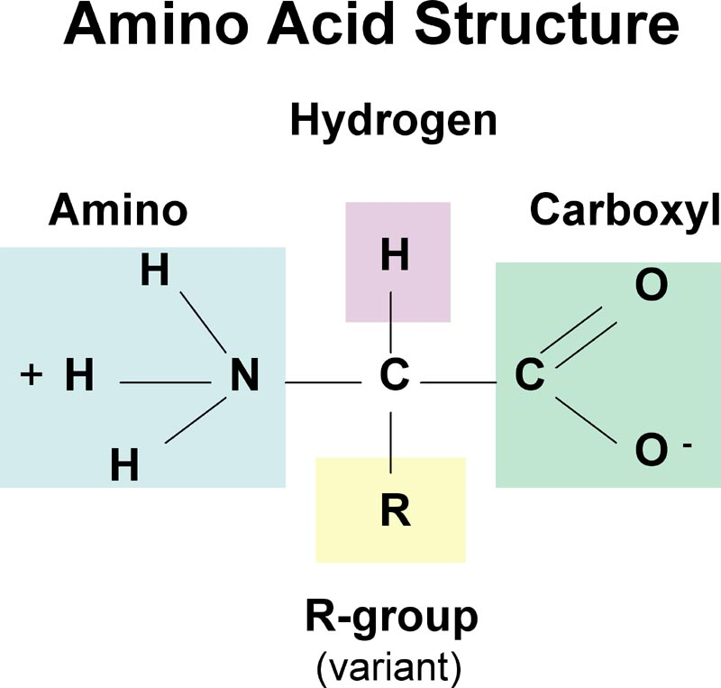
Proteins
Carbon, Hydrogen, Oxygen, Nitrogen
made of amino acids: all have same structure, difference is in the variable group (20 variable groups)
      Without amino acids, your body would break down it’s own muscle
Sources: legumes, eggs, fish, meat, dairy

Slide 7
Energy Gained From Protein
Eating 1 gram of protein provides your body with 4 Calories.

Slide 8
Six functions of proteins:
1. Storage: albumin (egg white)
2. Transport: hemoglobin
3. Regulatory: hormones
4. Movement: muscles
5. Structural: membranes, hair, nails
6. Enzymes: cellular reactions

Slide 9
Nucleic Acids
Store and transmit genetic information
Structure = phosphate, sugar, and nitrogen base
aka - nucleotide; link many nucleotides together to form a nucleic acid
2 types: DNA (deoxyribonucleic acid) & RNA (ribonucleic acid)

Slide 10
Nucleic acids
The nucleic acids in food are not considered a substance that the body uses to gain energy.

Slide 11
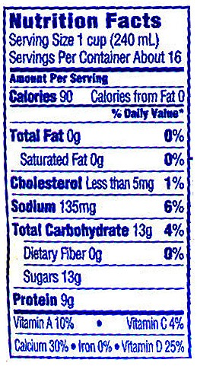
Look at the label to the left. 3 of the 4 macromolecules can be found in foods.
The 3 biochemical molecules
found on a nutrition label are:
FAT
  1____________________
  2____________________
  3____________________
(0 grams in this product)
Carbohydrates
(13 grams in this product)
Protein
(9 grams in this product)

Slide 12
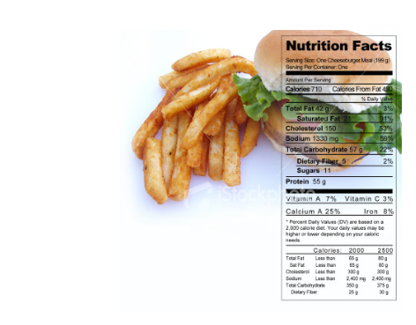
How to read nutrition labels…
Notes:
In SMART notebook

Slide 13
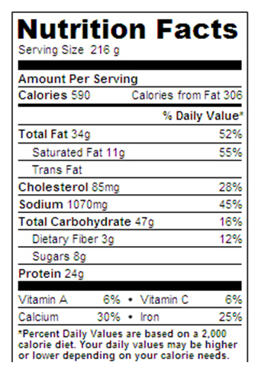
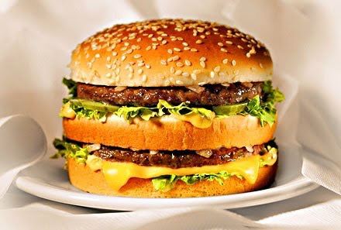
Food #1
BIG maC!

Slide 14
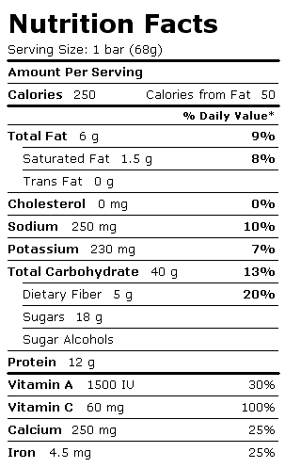
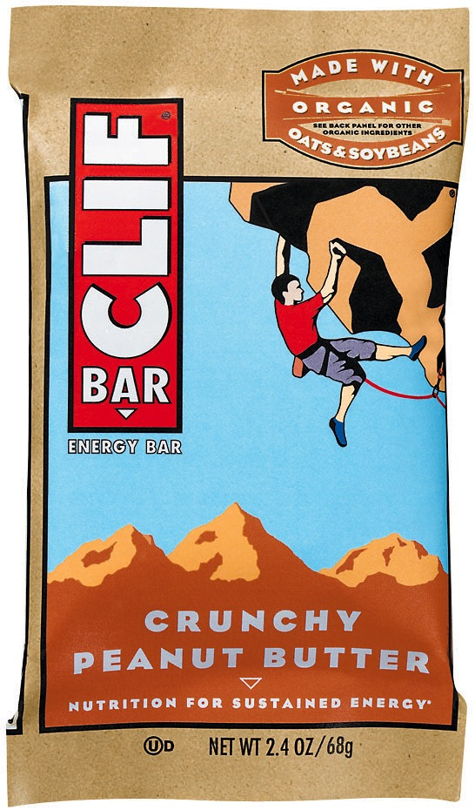
Food Sample #2

Slide 15
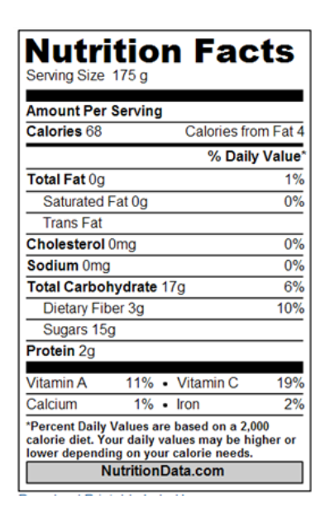
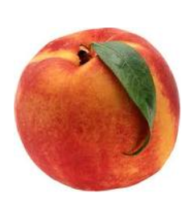
Food Sample #3

Slide 16
Which 3 of the 4 biological macromolecules are found in food?
List a function for each of the 4 biological macromolecules.

