Slide 1
MLA Formatting
Mary Johnson
Ms. Reisdorf
English 9B
1/23/15
Johnson 1
LT: I can name the elements needed to format a document in MLA and use these elements in my own documents.

Slide 2
When & Why do I need to use MLA
When: Typically used in the liberal arts and
humanities (English, Social Studies, etc.)
Why: Having a common formatting system
makes it easier for readers to read and
navigate through your work.

Slide 3
MLA Checklist: (write this down)
⏩ Header
⏩ First and Last Name
⏩ Teacher’s Name
⏩ Name of Class
⏩ Date
⏩ Page #s W/ Last Name
⏩ Correct Font
⏩ Size 12
⏩ Times New Roman/Arial
⏩ Double Space & One Inch Margins
Mary Johnson
Ms. Reisdorf
English 9B
1/23/15
Reisdorf 1

Slide 4
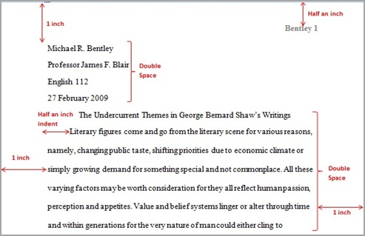
Example:
How to format document in Google Docs

Slide 5
Parenthetical Citations
When using textual evidence, you must cite it with an in-text parenthetical citation.
Requirements:
Author or Name of Organization
Page # (if applicable)
Parenthesis with period on outside
“Only 15% of teens are getting the required amount of sleep,” which means majority of students would benefit from a later start time (National Sleep Foundation).

Slide 6
Reference Citations
When using textual evidence, you can also cite with a reference to the source in the sentence.
Requirements:
“According to…”, “In a study…,” “As stated by…,” “Author says…”
Qualifications help boost ethos!
According to the National Sleep Foundation, a nonprofit committed to research, “Only 15% of teens are getting the required amount of sleep,” which means majority of students would benefit from a later start time.

Slide 7
Special Reminder:
The text inside the parenthesis MUST correspond with the first word on the works cited page!!
With Author: (Amis)
Amis, Kingsley. “Mimic and Moralist.” Interviews with Britain’s Angry Young Men. By Dale Salwak. San Bernardino: Borgo, 1984. Print.
Without Author: (The Purdue OWL Family of Sites)
The Purdue OWL Family of Sites. The Writing Lab and OWL at Purdue and Purdue U, 2008. Web. 23 Apr. 2008.

Slide 8
When in doubt… Refer to...
https://owl.english.purdue.edu/owl/

