Slide 1
2.7 DNA replication, transcription and translation
Essential Idea: Genetic information in DNA can be accurately copied and can be translated to make the proteins needed by the cell.
The image shows an electron micrograph of a Polysome, i.e. multiple ribosomes simultaneous translating a molecule of mRNA. The central strand is the mRNA, The darker circular structures are the ribosomes and the side chains are the newly formed polypeptides.
http://urei.bio.uci.edu/~hudel/bs99a/lecture23/lecture4_2.html

Slide 2
Understandings
 | Statement | Guidance
2.7.U1 | The replication of DNA is semi-conservative and depends on complementary base pairing.
2.7.U2 | Helicase unwinds the double helix and separates the two strands by breaking hydrogen bonds.
2.7.U3 | DNA polymerase links nucleotides together to form a new strand, using the pre-existing strand as a template. | The different types of DNA polymerase do not need to be distinguished.
2.7.U4 | Transcription is the synthesis of mRNA copied from the DNA base sequences by RNA polymerase.
2.7.U5 | Translation is the synthesis of polypeptides on ribosomes.
2.7.U6 | The amino acid sequence of polypeptides is determined by mRNA according to the genetic code.
2.7.U7 | Codons of three bases on mRNA correspond to one amino acid in a polypeptide.
2.7.U8 | Translation depends on complementary base pairing between codons on mRNA and anticodons on tRNA.

Slide 3
Applications and Skills
 | Statement | Guidance
2.7.A1 | Use of Taq DNA polymerase to produce multiple copies of DNA rapidly by the polymerase chain reaction (PCR).
2.7.A2 | Production of human insulin in bacteria as an example of the universality of the genetic code allowing gene transfer between species.
2.7.S1 | Use a table of the genetic code to deduce which codon(s) corresponds to which amino acid.
2.7.S2 | Analysis of Meselson and Stahl’s results to obtain support for the theory of semi-conservative replication of DNA.
2.7.S3 | Use a table of mRNA codons and their corresponding amino acids to deduce the sequence of amino acids coded by a short mRNA strand of known base sequence.
2.7.S4 | Deducing the DNA base sequence for the mRNA strand.

Slide 4
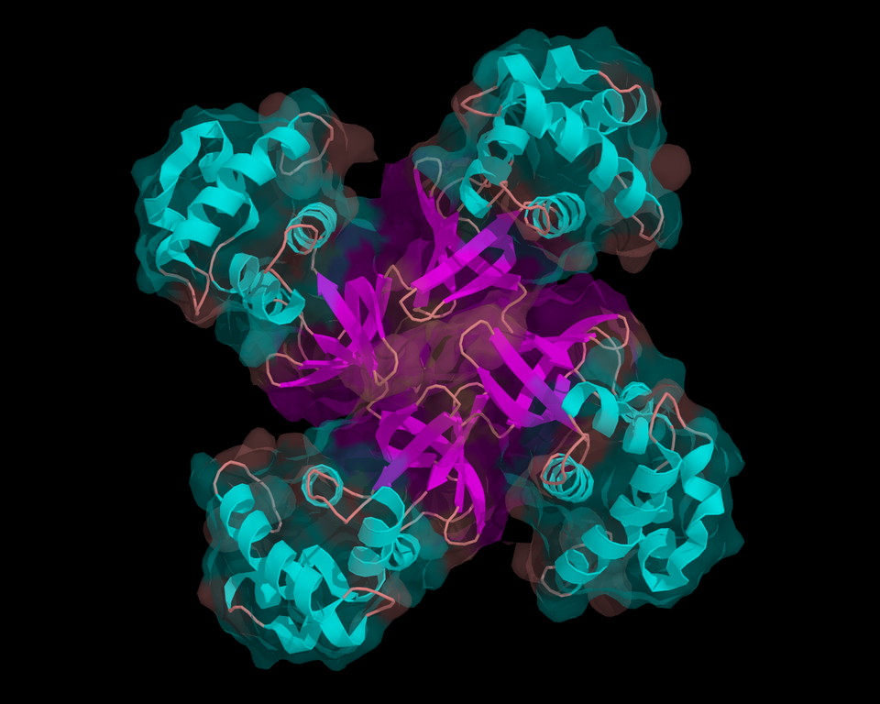
2.7.U2 Helicase unwinds the double helix and separates the two strands by breaking hydrogen bonds.
Helicase
The ‘ase’ ending indicates it is an enzyme
This family of proteins varies, but are often formed from multiple polypeptides and doughnut in shape
http://en.wikipedia.org/wiki/File:Helicase.png

Slide 5
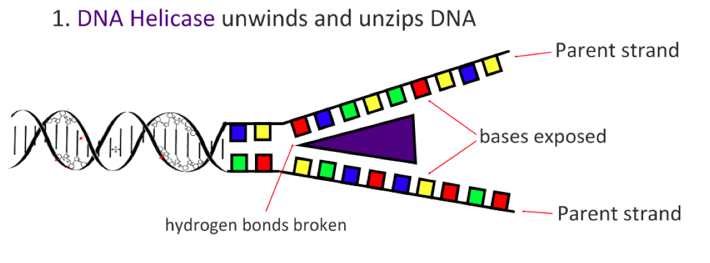
2.7.U2 Helicase unwinds the double helix and separates the two strands by breaking hydrogen bonds.
Unwinds the DNA Helix
Separates the two polynucleotide strands by breaking the hydrogen bonds between complementary base pairs
ATP is needed by helicase to both move along the DNA molecule and to break the hydrogen bonds
The two separated strands become parent/template strands for the replication process

Slide 6
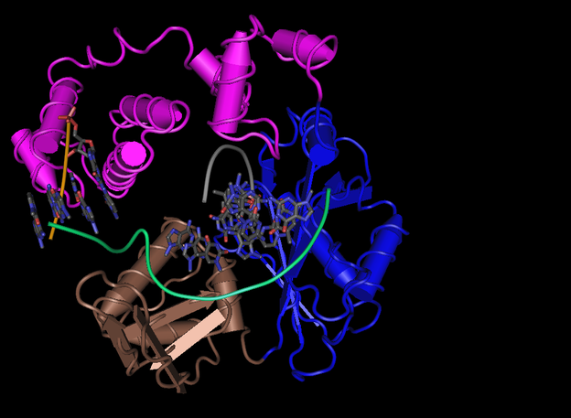
2.7.U3 DNA polymerase links nucleotides together to form a new strand, using the pre-existing strand as a template.
DNA Polymerase
The ‘ase’ ending indicates it is an enzyme
This protein family consists of multiple polypeptides sub-units
This is DNA polymerase from a human.
The polymerisation reaction is a condensation reaction

Slide 7
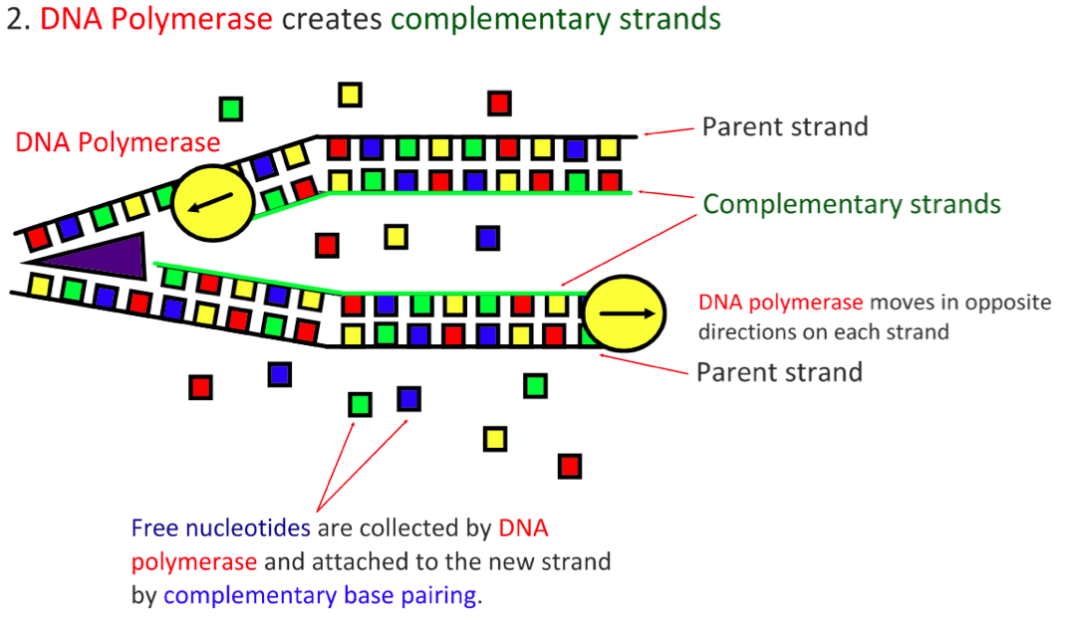
2.7.U3 DNA polymerase links nucleotides together to form a new strand, using the pre-existing strand as a template.
DNA polymerase always moves in a 5’ to 3’ direction
DNA polymerase catalyses the covalent phosphodiester bonds between sugars and phosphate groups
DNA Polymerase proof reads the complementary base pairing. Consequently mistakes are very infrequent occurring approx. once in every billion bases pairs
Free nucleotides are deoxynucleoside triphosphates
The extra phosphate groups carry energy which is used for formation of covalent bonds

Slide 8
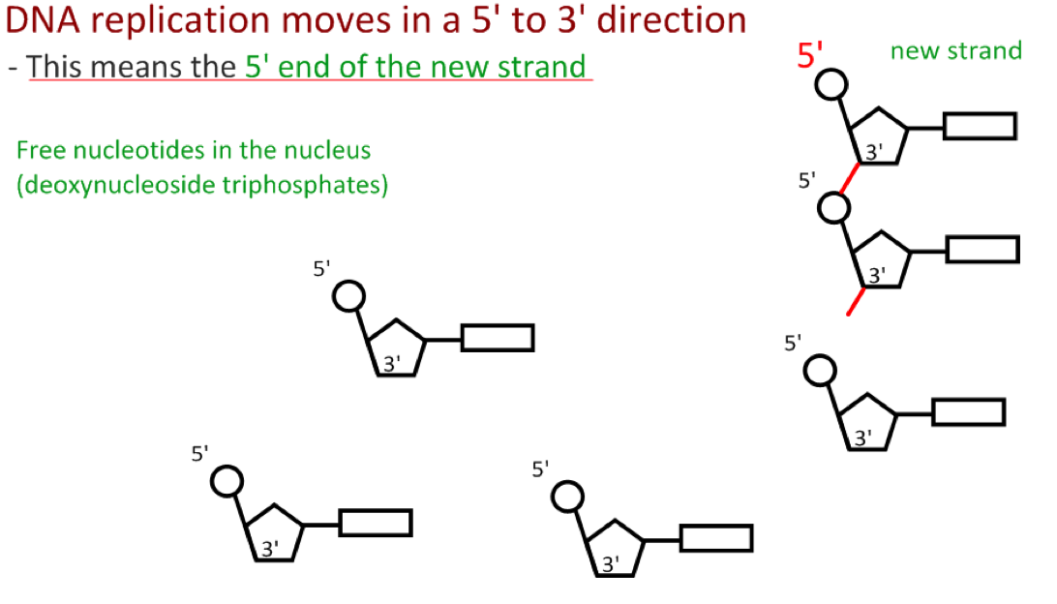
2.7.U3 DNA polymerase links nucleotides together to form a new strand, using the pre-existing strand as a template.
DNA polymerase always moves in a 5’ to 3’ direction
DNA polymerase catalyses the covalent phosphodiester bonds between sugars and phosphate groups

Slide 9
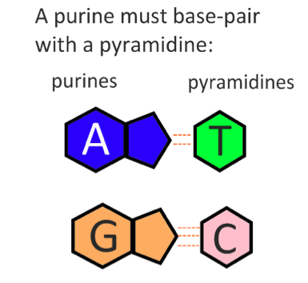
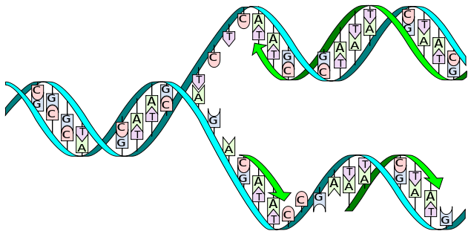
2.7.U1 The replication of DNA is semi-conservative and depends on complementary base pairing.
1. Each of the nitrogenous bases can only pair with its partner (A=T and G=C) this is called complementary base pairing.
2. The two new strands formed will be identical to the original strand.
https://upload.wikimedia.org/wikipedia/commons/3/33/DNA_replication_split_horizontal.svg

Slide 10
2.7.U1 The replication of DNA is semi-conservative and depends on complementary base pairing.
3. Each new strand contains one original and one new strand, therefore DNA Replication is said to be a Semi- Conservative Process.
https://upload.wikimedia.org/wikipedia/commons/3/33/DNA_replication_split_horizontal.svg

Slide 11
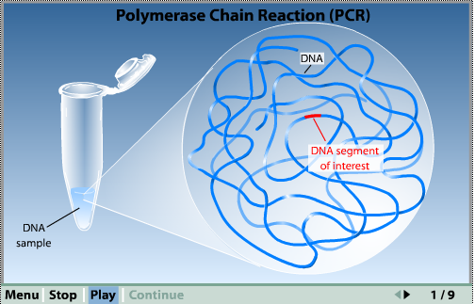
Review: 3.5.U2 PCR can be used to amplify small amounts of DNA.
Polymerase Chain Reaction (PCR)
Learn the detail using the virtual lab and/or the animation:
Typically used to copy a segment of DNA – not a whole genome
Used to amplify small samples of DNA
In order to use them for DNA profiling, recombination, species identification or other research.
The process needs a thermal cycler, primers, free DNA nucleotides and DNA polymerase.
http://learn.genetics.utah.edu/content/labs/pcr/
Can you see how the technology has mimicked the natural process of DNA replication?
http://www.sumanasinc.com/webcontent/animations/content/pcr.html
http://www.slideshare.net/gurustip/genetic-engineering-and-biotechnology-presentation

Slide 12
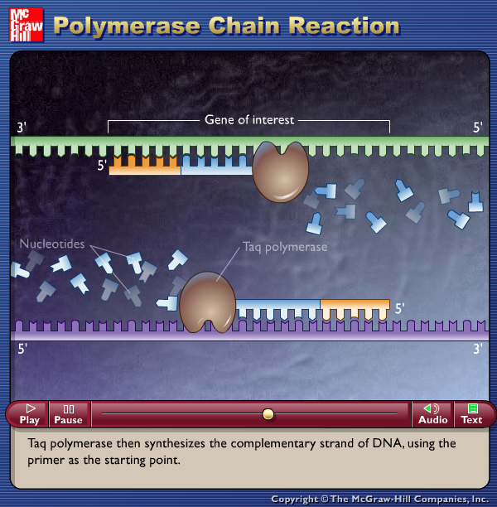
Review: 2.7.A1 Use of Taq DNA polymerase to produce multiple copies of DNA rapidly by the polymerase chain reaction (PCR).
After clicking on the myDNA link choose techniques and then amplifying to access the tutorials on the polymerase chain reaction (PCR).
Alternatively watch the McGraw-Hill tutorial
http://www.dnai.org/b/index.html
http://highered.mcgraw-hill.com/olc/dl/120078/micro15.swf

Slide 13
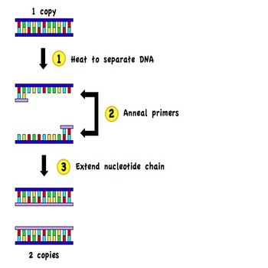
2.7.A1 Use of Taq DNA polymerase to produce multiple copies of DNA rapidly by the polymerase chain reaction (PCR).
To summarise:
PCR is a way of producing large quantites of a specific target sequence of DNA. It is useful when only a small amount of DNA is avaliable for testing e.g. crime scene samples of blood, semen, tissue, hair, etc.
PCR occurs in a thermal cycler and involves a repeat procedure of 3 steps:
1. Denaturation: DNA sample is heated to separate it into two strands
2. Annealing: DNA primers attach to opposite ends of the target sequence
3. Elongation: A heat-tolerant DNA polymerase (Taq) copies the strands
One cycle of PCR yields two identical copies of the DNA sequence
A standard reaction of 30 cycles would yield 1,073,741,826 copies of DNA (2³⁰)

Slide 14
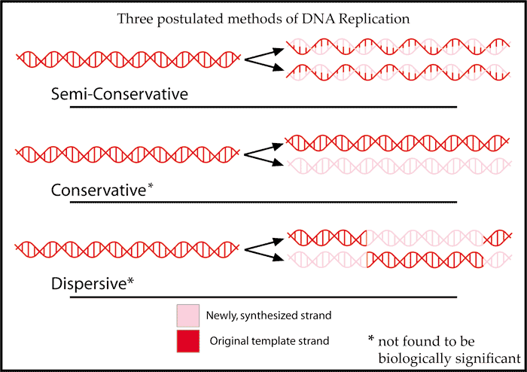
2.7.S2 Analysis of Meselson and Stahl’s results to obtain support for the theory of semi-conservative replication of DNA.
Before Meselson and Stahl’s work there were different proposed models for DNA replication. After their work only semi-conservative replication was found to be biologically significant.
https://upl oad.wikimedia.org/wikipedia/commons/a/a2/DNAreplicationModes.png

Slide 15
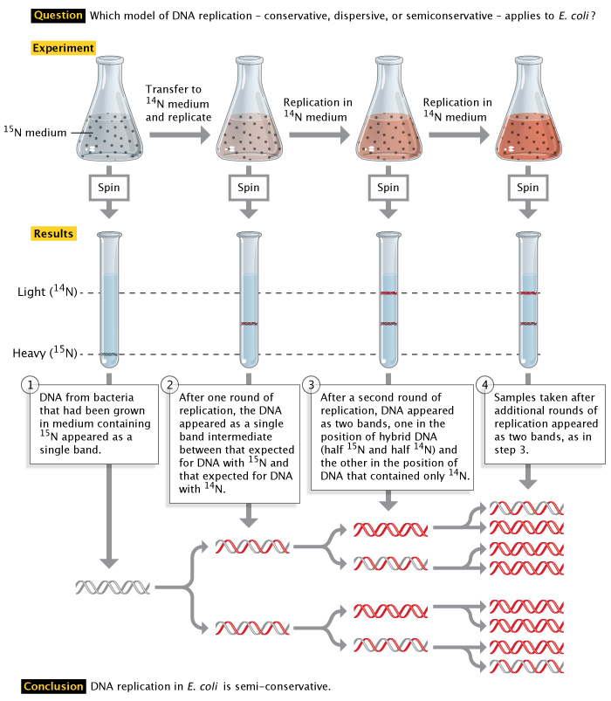
2.7.S2 Analysis of Meselson and Stahl’s results to obtain support for the theory of semi-conservative replication of DNA.
http://highered.mheducation.com/olcweb/cgi/pluginpop.cgi?it=swf::535::535::/sites/dl/free/0072437316/120076/bio22.swf::Meselson%20and%20Stahl%20Experiment
Learn about Meselson and Stahl’s work with DNA to discover the mechanism of semi-conservative replication
http://www.nature.com/scitable/topicpage/Semi-Conservative-DNA-Replication-Meselson-and-Stahl-421#

Slide 16
2.7.S2 Analysis of Meselson and Stahl’s results to obtain support for the theory of semi-conservative replication of DNA.
At the start of a Meselson and Stahl experiment (generation 0) a single band of DNA with a density of 1.730 g cm⁻³ was found. After 4 generations two bands were found, but the main band had a density of 1.700 g cm⁻³.
Explain why the density of the main band changed over four generations. (2)
After one generation one still only one DNA band appears, but the density has changed.
Estimate the density of the band. (1)
Which (if any) mechanisms of DNA replication are falsified by this result? (1)
Explain why the identified mechanism(s) are falsified. (1)
Describe the results after two generations and which mechanisms and explain the identified mechanism(s) (if any) are falsified as a consequence. (3)
Describe and explain the result found by centrifuging a mixture of DNA from generation 0 and 2. (2)

Slide 17
2.7.S2 Analysis of Meselson and Stahl’s results to obtain support for the theory of semi-conservative replication of DNA.
At the start of a Meselson and Stahl experiment (generation 0) a single band of DNA with a density of 1.730 g cm⁻³ was found. After 4 generations two bands were found, but the main band had a density of 1.700 g cm⁻³.
Explain why the density of the main band changed over four generations. (2)
N₁₅ isotope has a greater mass than N₁₄ isotope due to the extra neutron
Generation 0 contained DNA with exclusively N₁₅ isotopes (giving it a greater density)
With each generation the proportion N₁₄ isotope (from free nucleotides) increases as the mass of DNA doubles
After four generations most strands contain only N₁₄ isotope – the dominant band at a density of 1.700 g cm⁻³.
N₁₅ isotope remains, but is combined in strands with N₁₄ isotope – a second band at a density between 1.730 and 1.700 g cm⁻³.

Slide 18
2.7.S2 Analysis of Meselson and Stahl’s results to obtain support for the theory of semi-conservative replication of DNA.
At the start of a Meselson and Stahl experiment (generation 0) a single band of DNA with a density of 1.730 g cm⁻³ was found. After 4 generations two bands were found, but the main band had a density of 1.700 g cm⁻³.
After one generation only one DNA band appeared, but the density had changed.
Estimate the density of the band. (1)
The band would contain equally amounts of N₁₄ isotope and N₁₅ isotope
Density of an all N₁₅ isotope band is 1.730 g cm⁻³.
Density of an all N₁₄ isotope band is 1.700 g cm⁻³.
Density of an the mixed isotope band is the average of the two: = ( 1.730 g cm⁻³ + 1.700 g cm⁻³ ) / 2 = 1.715 g cm⁻³
Which (if any) mechanisms of DNA replication are falsified by this result? (1)
conservative replication
Explain why the identified mechanism(s) are falsified. (1)
For conservative replication to be the case two bands should appear in all generations after generation 0

Slide 19
2.7.S2 Analysis of Meselson and Stahl’s results to obtain support for the theory of semi-conservative replication of DNA.
At the start of a Meselson and Stahl experiment (generation 0) a single band of DNA with a density of 1.730 g cm-3 was found. After 4 generations two bands were found, but the main band had a density of 1.700 g cm-3.
Describe the results after two generations and which mechanisms and explain the identified mechanism(s) (if any) are falsified as a consequence. (3)
2 bands:
One band containing a mixture of N₁₅ and N₁₄ isotopes – semi-conservative replication preserves the DNA strands containing N₁₅ isotopes, but combines them with N₁₄ nucleotides during replication.
One band containing all N₁₄ isotopes - during replication from generation 1 to generation 2. The new strands consisting of of N₁₄ isotopes are replicated using N₁₄ nucleotides creating strands containing just N₁₄ isotopes.
Dispersive replication is falsified as this model would continue to produce a single band, containing proportionally less N₁₅ isotope.

Slide 20
2.7.S2 Analysis of Meselson and Stahl’s results to obtain support for the theory of semi-conservative replication of DNA.
At the start of a Meselson and Stahl experiment (generation 0) a single band of DNA with a density of 1.730 g cm-3 was found. After 4 generations two bands were found, but the main band had a density of 1.700 g cm-3.
Describe and explain the result found by centrifuging a mixture of DNA from generation 0 and 2. (2)
3 bands:
One band from generation 0 containing all N₁₅ isotopes – no replication has occured
One band from generation 2 containing a mixture of N₁₅ and N₁₄ isotopes – semi-conservative replication preserves the DNA strands containing N₁₅ isotopes, but combines them with N₁₄ nucleotides during replication.
One band from generation 2 (all replicated DNA) containing all N₁₄ isotopes - during replication from generation 1 to generation 2. The new strands consisting of of N₁₄ isotopes are replicated using N₁₄ nucleotides creating strands containing just N₁₄ isotopes.

Slide 21
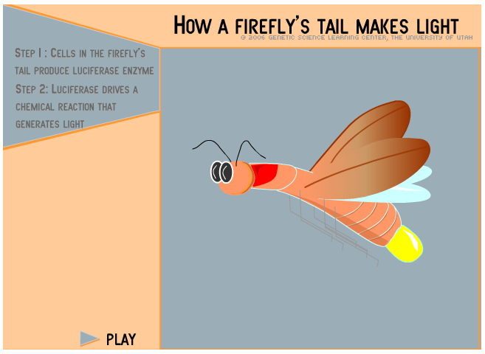
2.7.U4 Transcription is the synthesis of mRNA copied from the DNA base sequences by RNA polymerase. 2.7.U5 Translation is the synthesis of polypeptides on ribosomes.
Q - What is the purpose of transcription and translation?
A - These processes work together to create a polypeptide which in turns folds to become a protein. Proteins carry many essential functions in cells. For more detail review 2.4.U7 Living organisms synthesize many different proteins with a wide range of functions.
Catalysis
Tensile strengthening
Transport of nutrients and gases
Cell adhesion
Muscle contraction
Use the learn.genetics tutorial to discover one example:
Hormones
Receptors
Cytoskeletons
Packing of DNA
Blood clotting
Immunity
Membrane transport
http://learn.genetics.utah.edu/content/molecules/firefly/

Slide 22
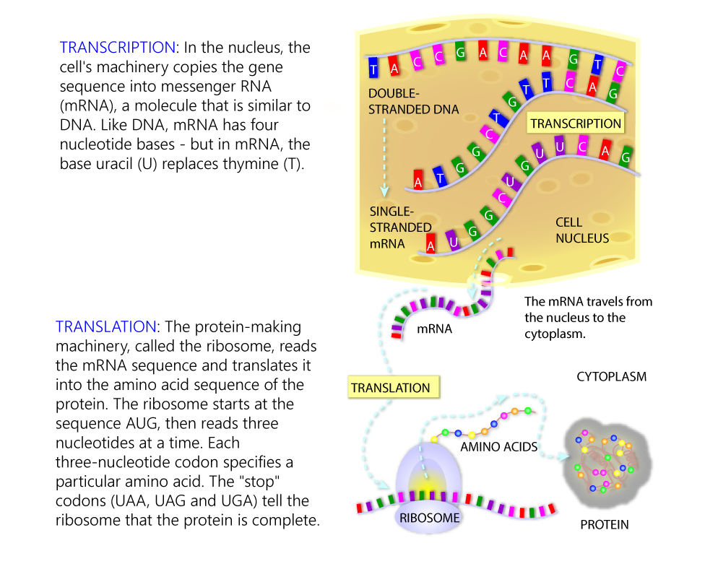
2.7.U4 Transcription is the synthesis of mRNA copied from the DNA base sequences by RNA polymerase. 2.7.U5 Translation is the synthesis of polypeptides on ribosomes.
http://learn.genetics.utah.edu/content/molecules/transcribe/

Slide 23
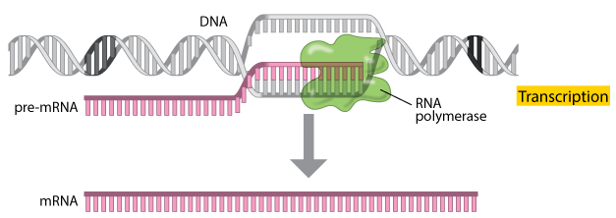
2.7.U4 Transcription is the synthesis of mRNA copied from the DNA base sequences by RNA polymerase.
Transcription is the process by which an RNA sequence is produced from a DNA template:
Three main types of RNA are predominantly synthesised:
Messenger RNA (mRNA): A transcript copy of a gene used to encode a polypeptide
Transfer RNA (tRNA): A clover leaf shaped sequence that carries an amino acid
Ribosomal RNA (rRNA): A primary component of ribosomes
We are focusing on mRNA
http://www.nature.com/scitable/topicpage/Translation-DNA-to-mRNA-to-Protein-393

Slide 24
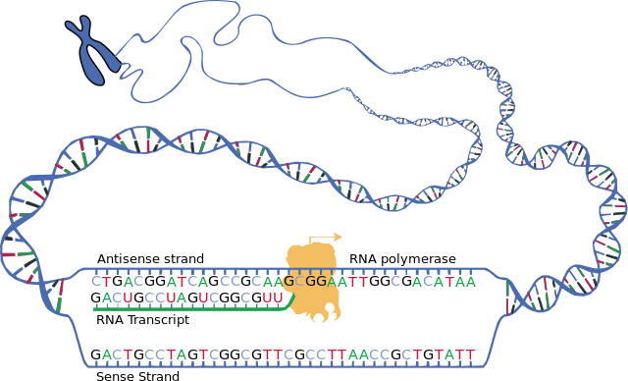
2.7.U4 Transcription is the synthesis of mRNA copied from the DNA base sequences by RNA polymerase.
The enzyme RNA polymerase binds to a site on the DNA at the start of a gene (The sequence of DNA that is transcribed into RNA is called a gene).
RNA polymerase separates the DNA strands and synthesises a complementary RNA copy from the antisense DNA strand
It does this by covalently bonding ribonucleoside triphosphates that align opposite their exposed complementary partner (using the energy from the cleavage of the additional phosphate groups to join them together)
Once the RNA sequence has been synthesised:
RNA polymerase will detach from the DNA molecule
RNA detaches from the DNA
the double helix reforms
Transcription occurs in the nucleus (where the DNA is) and, once made, the mRNA moves to the cytoplasm (where translation can occur)
https://upload.wikimedia.org/wikipedia/commons/3/36/DNA_transcription.svg

Slide 25
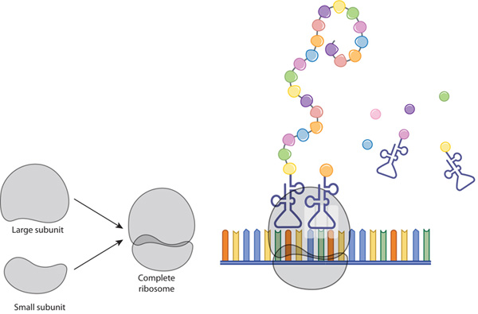
2.7.U5 Translation is the synthesis of polypeptides on ribosomes.
Translation is the process of protein synthesis in which the genetic information encoded in mRNA is translated into a sequence of amino acids in a polypeptide chain
A ribosome is composed of two halves, a large and a small subunit. During translation, ribosomal subunits assemble together like a sandwich on the strand of mRNA:
Each subunit is composed of RNA molecules and proteins
The small subunit binds to the mRNA
The large subunit has binding sites for tRNAs and also catalyzes peptide bonds between amino acids
http://www.nature.com/scitable/topicpage/ribosomes-transcription-and-translation-14120660

Slide 26
2.7.U6 The amino acid sequence of polypeptides is determined by mRNA according to the genetic code.
Messenger RNA (mRNA): A transcript copy of a gene used to encode a polypeptide
The length of mRNA molecules varies - the average length for mammals is approximately 2,200 nucleotides (this translates to approximately 730 amino acids in the average polypeptide)
Only certain genes in a genome need to be expressed depending on:
Cell specialism
Environment
Therefore not all genes (are transcribed) and translated
If a cell needs to produce a lot of a certain protein (e.g. β cells in the pancreas specialize in secreting insulin to control blood sugar) then many copies of the required mRNA are created.
image from:

Slide 27
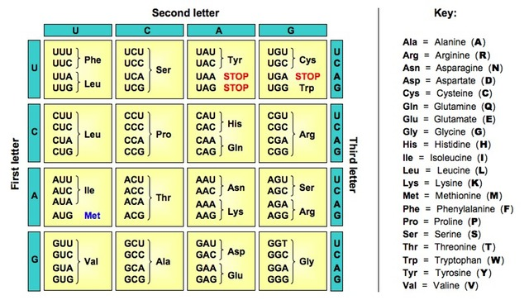
2.7.U7 Codons of three bases on mRNA correspond to one amino acid in a polypeptide.
The genetic code is the set of rules by which information encoded in mRNA sequences is converted into proteins (amino acid sequences) by living cells
Codons are a triplet of bases which encodes a particular amino acid
As there are four bases, there are 64 different codon combinations (4 x 4 x 4 = 64)
The codons can translate for 20 amino acids
Different codons can translate for the same amino acid (e.g. GAU and GAC both translate for Aspartate) therefore the genetic code is said to be degenerate
The order of the codons determines the amino acid sequence for a protein
The coding region always starts with a START codon (AUG) therefore the first amino acid in all polypeptides is Methionine
The coding region of mRNA terminates with a STOP codon - the STOP codon does not add an amino acid – instead it causes the release of the polypeptide
Amino acids are carried by transfer RNA (tRNA)
The anti-codons on tRNA are complementary to the codons on mRNA
based on

Slide 28
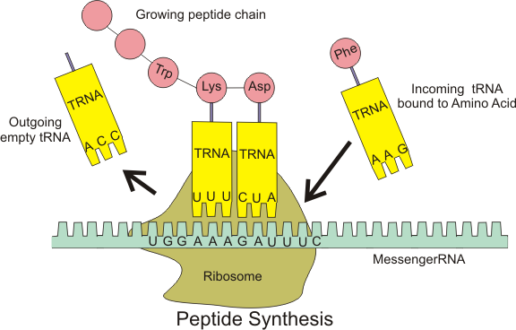
2.7.U8 Translation depends on complementary base pairing between codons on mRNA and anticodons on tRNA.
Key components of translation that enable genetic code to synthesize polypeptides
tRNA molecules have an anticodon of three bases that binds to a complementary codon on mRNA
tRNA molecules carry the amino acid corresponding to their codon
mRNA has a sequence of codons that specifies the amino acid sequence of the polypeptide
Ribosomes:
act as the binding site for mRNA and tRNA
catalyse the peptide bonds of the polypeptide
https://upload.wikimedia.org/wikipedia/commons/0/0f/Peptide_syn.png

Slide 29
2.7.U8 Translation depends on complementary base pairing between codons on mRNA and anticodons on tRNA.
An outline of translation and polypeptide synthesis
tRNA molecules contain anticodons which are complementary to the codons on the mRNA.
tRNA molecules bind to a specific amino acid that corresponds to the anticodon
The large subunit binds to the small subunit of the ribosome.
There are three binding sites on the large subunit of the ribosome, but only two can contain tRNA molecules at a time
3
4
The mRNA contains a series of codons (3 bases) each of which codes for an amino acid.
2
mRNA binds to the small subunit of the ribosome.
1
https://upload.wikimedia.org/wikipedia/commons/0/0f/Peptide_syn.png

Slide 30
2.7.U8 Translation depends on complementary base pairing between codons on mRNA and anticodons on tRNA.
An outline of translation and polypeptide synthesis
tRNAs with anticodons complementary to the codons bind (the bases are linked by the formation of hydrogen bonds)
A peptide bond is formed between the two amino acids (carried by the tRNAs)
7
6
The ribosome moves along the mRNA and presents codons in the first two binding sites
5
https://upload.wikimedia.org/wikipedia/commons/0/0f/Peptide_syn.png

Slide 31
2.7.U8 Translation depends on complementary base pairing between codons on mRNA and anticodons on tRNA.
An outline of translation and polypeptide synthesis
The process (i.e. the last two steps) repeats forming a polypeptide.
Another tRNA carrying an amino acid binds to the first site and a second peptide bond is formed
9
10
As the ribosome moves along mRNA a tRNA moves to the third binding site and detaches
8
https://upload.wikimedia.org/wikipedia/commons/0/0f/Peptide_syn.png

Slide 32
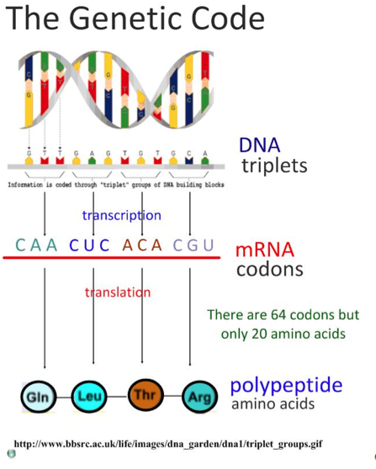
2.7.S1 Use a table of the genetic code to deduce which codon(s) corresponds to which amino acid. 2.7.S3 Use a table of mRNA codons and their corresponding amino acids to deduce the sequence of amino acids coded by a short mRNA strand of known base sequence. 2.7.S4 Deducing the DNA base sequence for the mRNA strand.
The diagram summarizes the process of protein synthesis. You should be able to use a section of genetic code, transcribe and translate it to deduce the polypeptide synthesized.

Slide 33
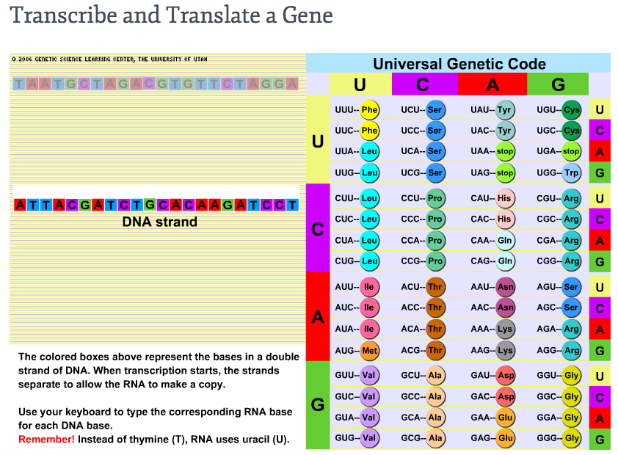
2.7.S1, 2.7.S3, 2.7.S4
Practice transcribing and translating using the learn.genetics tutorial.
http://learn.genetics.utah.edu/content/molecules/transcribe/

Slide 34
2.7.S1, 2.7.S3, 2.7.S4
Now use this table to answer the questions on the next slide
n.b. You just have to be able to use the table. You do not have to memorize which codon translates to which amino acid.

Slide 35
2.7.S1, 2.7.S3, 2.7.S4
Deduce the codon(s) that translate for Aspartate.
If mRNA contains the base sequence CUGACUAGGUCCGGA
deduce the amino acid sequence of the polypeptide translated.
deduce the base sequence of the DNA antisense strand from which the mRNA was transcribed.
If mRNA contains the base sequence ACUAAC deduce the base sequence of the DNA sense strand.

Slide 36
2.7.S1, 2.7.S3, 2.7.S4
Deduce the codon(s) that translate for Aspartate.
If mRNA contains the base sequence CUGACUAGGUCCGGA
deduce the amino acid sequence of the polypeptide translated.
deduce the base sequence of the DNA antisense strand from which the mRNA was transcribed.
If mRNA contains the base sequence ACUAAC deduce the base sequence of the DNA sense strand.
GAU, GAC
Leucine + Threonine + Lysine + Arginine + Serine + Glycine
GACTGATCCAGGCCT
(the antisense strand is complementary to the mRNA, but remember that uracil is replaced by thymine)
(the sense strand is the template for the mRNA the only change is that uracil is replaced by thymine)
ACTAAC

Slide 37
2.7.S1 Use a table of the genetic code to deduce which codon(s) corresponds to which amino acid.

Slide 38
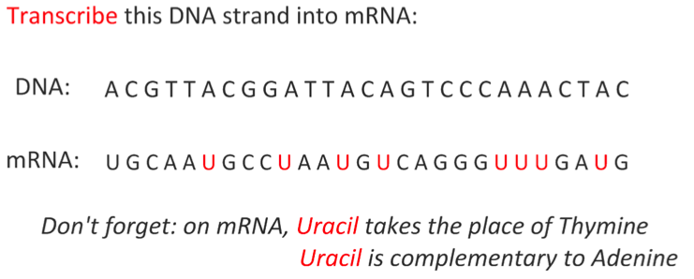
2.7.S1, 2.7.S3, 2.7.S4

Slide 39
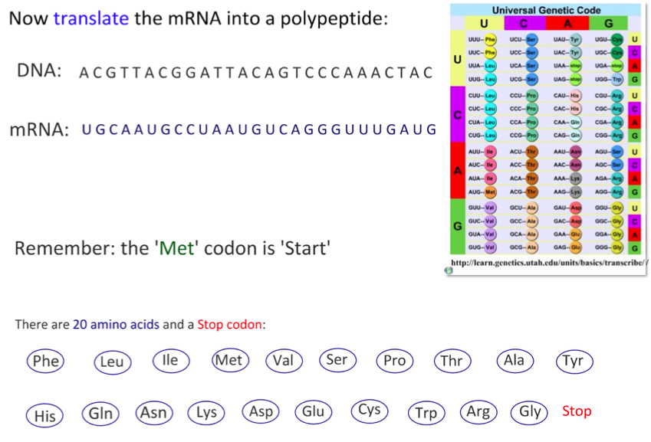
2.7.S1 Use a table of the genetic code to deduce which codon(s) corresponds to which amino acid.

Slide 40
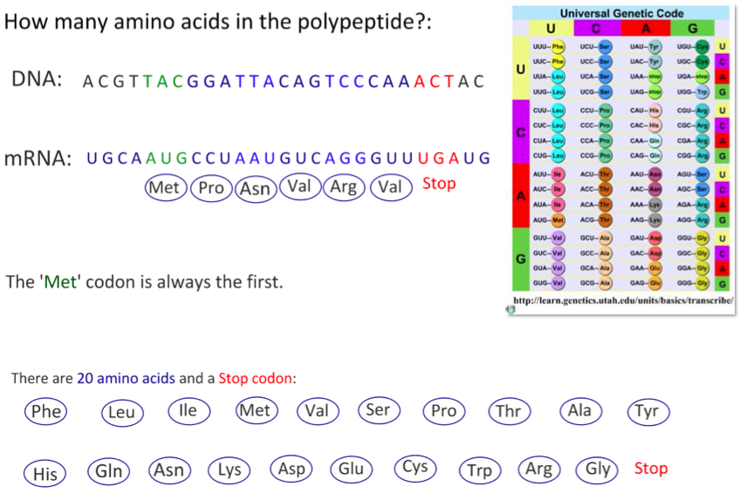
2.7.S1, 2.7.S3, 2.7.S4

Slide 41
2.7.S1 Use a table of the genetic code to deduce which codon(s) corresponds to which amino acid.

Slide 42
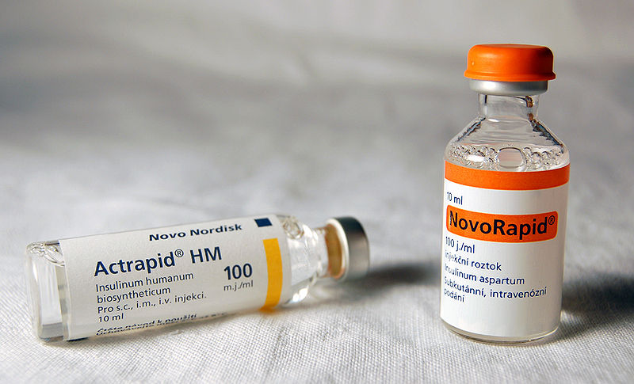
2.7.A2 Production of human insulin in bacteria as an example of the universality of the genetic code allowing gene transfer between species.
Diabetes in some individuals is due to destruction of cells in the pancreas that secrete the hormone insulin. It can be treated by injecting insulin into the blood. Porcine and bovine insulin, extracted from the pancreases of pigs and cattle, have both been widely used. Porcine insulin has only one difference in amino acid sequence from human insulin and bovine insulin has three differences. Shark insulin, which has been used for treating diabetics in Japan, has seventeen differences.
Despite the differences in the amino acid sequence between animal and human insulin, they all bind to the human insulin receptor and cause lowering of blood glucose concentration. However, some diabetics develop an allergy to animal insulins, so it is preferable to use human insulin. In 1982 human insulin became commercially available for the first time. It was produced using genetically modified E. coli bacteria. Since then methods of production have been developed using yeast cells and more recently safflower plants.
https://en.wikipedia.org/wiki/File:Inzul%C3%ADn.jpg

Slide 43
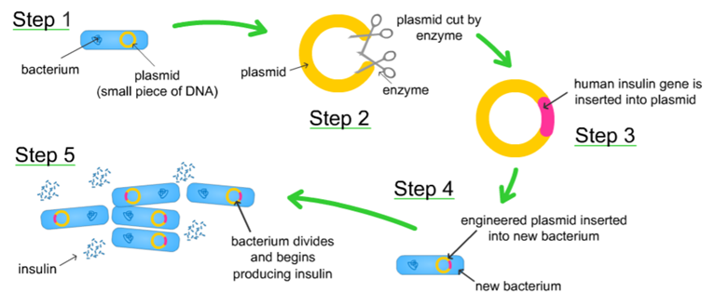
2.7.A2 Production of human insulin in bacteria as an example of the universality of the genetic code allowing gene transfer between species.
All living things use the same bases and the same genetic code.
Each codon produces the same amino acid in transcription and translation, regardless of the species.
So the sequence of amino acids in a polypeptide remains unchanged.
Therefore, we can take genes from one species and insert them into the genome of another species.
“The
Genetic Code
is Universal”
restriction
We already make use of gene transfer in industrial production of insulin:
http://www.abpischools.org.uk/res/coResourceImport/modules/hormones/en-flash/geneticeng.cfm

Slide 44
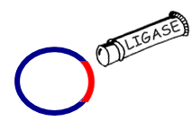
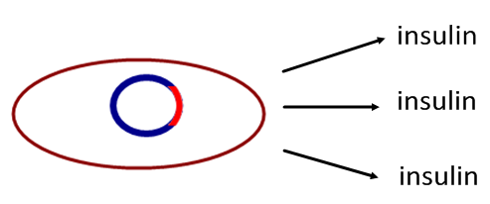
2.7.A2 Production of human insulin in bacteria as an example of the universality of the genetic code allowing gene transfer between species.
E. coli bacteria contain small circles of DNA called plasmids.
These can be removed.
Restriction enzymes ‘cut’ the desired gene from the genome.
The same restriction enzyme cuts into the plasmid.
Because it is the same restriction enzyme the same bases are left exposed, creating ‘sticky ends’
Ligase joins the sticky ends, fixing the gene into the E. coli plasmid.
The recombinant plasmid is inserted into the host cell. It now expresses the new gene. An example of this is human insulin production.

Slide 45
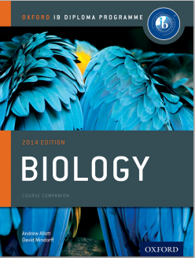
Bibliography / Acknowledgments
Jason de Nys

