Slide 1

2015

Slide 2
“Alcohol is the most commonly used and abused drug among youth in the United States, more than tobacco and illicit drugs, and is responsible for more than 4,300 annual deaths among underage youth.” -CDC.gov

Slide 3
Objectives for Today!
-Identify effects of alcohol on your body and health
-Recognize signs of alcohol poisoning

Slide 4
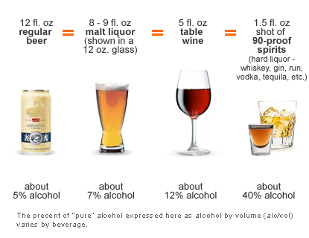
What is Alcohol?
Ethanol or Ethyl -The type of alcohol in alcoholic beverages
Can be produced synthetically or naturally by fermenting fruits and grains

Slide 5
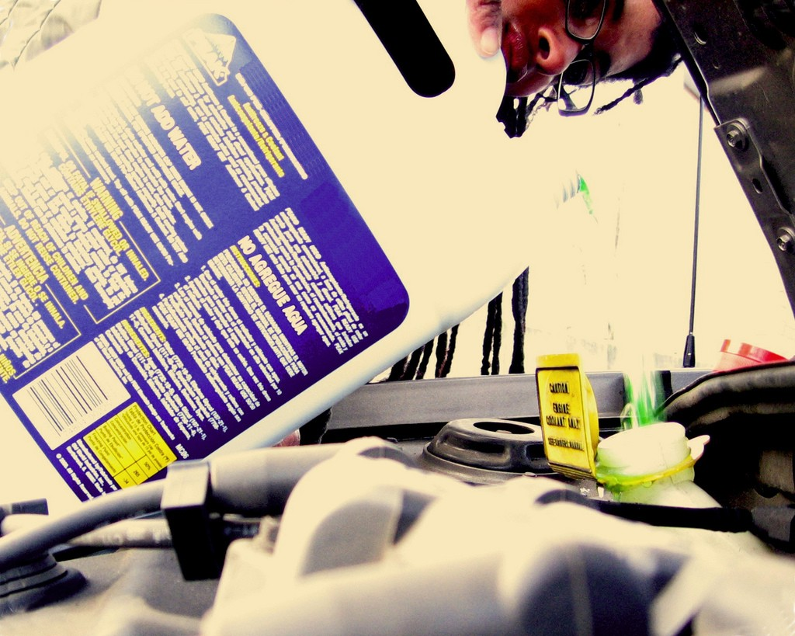
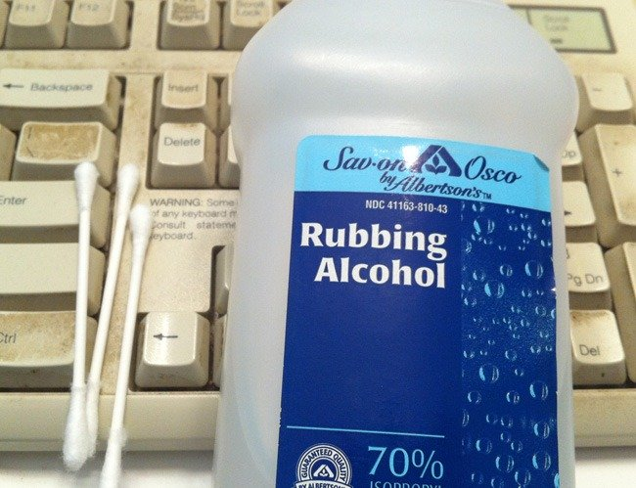
Kinds of Alcohol
Methyl
◦Highly Flammable material
◦Poisonous
Examples are Antifreeze, Wood spirits, fuel, and formaldehyde
Isopropyl
◦Also known as rubbing alcohol
◦Bad for the body
◦Ethyl
◦Form drinking alcohol comes in
◦Safe for drinking, in moderation

Slide 6
What is Alcohol Cont.
An addictive depressant
Causes intoxication- the state in which the body is poisoned by alcohol or other substance
Level of intoxication depend on a variety of things...

Slide 7
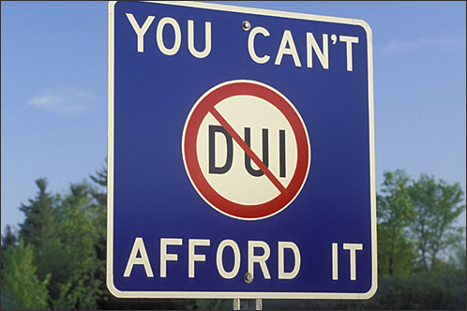
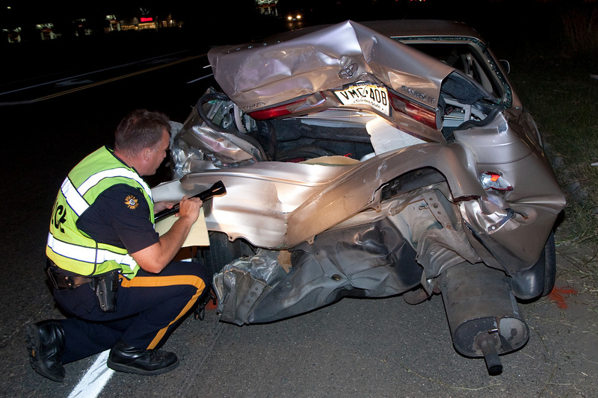
How are you getting home?
Not a Drop! Law
Walking, biking scootering can still be dangerous when intoxicated!
Legal limit- 0.08
http://www.facesofdrunkdriving.com/jacqui

Slide 8

Short Term Effects
Depending on how much is taken and the physical condition of the individual
Slurred speech
Drowsiness
Vomiting
Diarrhea
Upset stomach
Headaches
Breathing difficulties
Distorted vision and hearing
Impaired judgment
Decreased perception and coordination
Unconsciousness
Coma
Blackouts

Slide 9
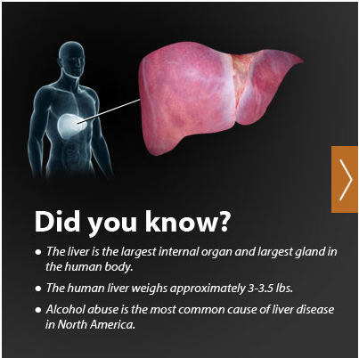
Long Term Effects
Binge drinking and continued alcohol use in large amounts are associated with many health problems, including:
Alcohol poisoning
High blood pressure, stroke, and other heart-related diseases
Liver disease-Cirrhosis
Nerve damage
Increased risk of unprotected sex-STIs
Unplanned pregnancies

Slide 10
Factors that affect your BAC
Weight
Gender
Time
Amount
Food
Other medications/drugs

Slide 11
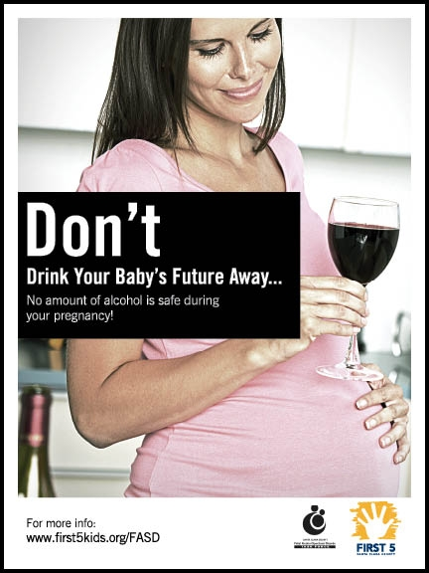
Other Consequences of Drinking
Fetal Alcohol Spectrum Disorders (FASD)
The range of effects that can occur in an individual whose mother drank alcohol during pregnancy. These effects may include physical, mental, behavioral, and/or learning disabilities with possible lifelong implications.
Fetal alcohol syndrome (FAS)
Alcohol-related neurodevelopmental disorder (ARND)
Alcohol-related birth defects (ARBD)
Fetal alcohol effects (FAE)
What do people know?

Slide 12
Binge Drinking
What is it?
The consumption of an excessive amount of alcohol in a short period of time. Generally 5 or more drinks in a row for men, 4 or more for females
How does it affect you?
90% of alcohol consumed by underage persons in the U.S. is in the form of binge drinking.
Alcohol has been said to have positive health consequences when consumed in moderation (About a drink a day).

Slide 13
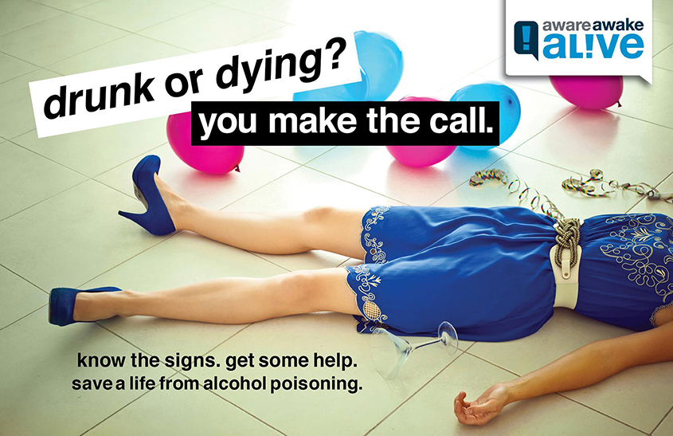
Alcohol Poisoning
Symptoms
Shallow breathing
Disorientation
Unresponsiveness
Unconsciousness
Pale or bluish tone to skin
Vomiting while unconscious
What is Alcohol Poisoning?
A condition in which a toxic amount of alcohol has been consumed, usually in a short period of time.
In other words, the blood alcohol content (BAC) is at a dangerously high level.

Slide 14
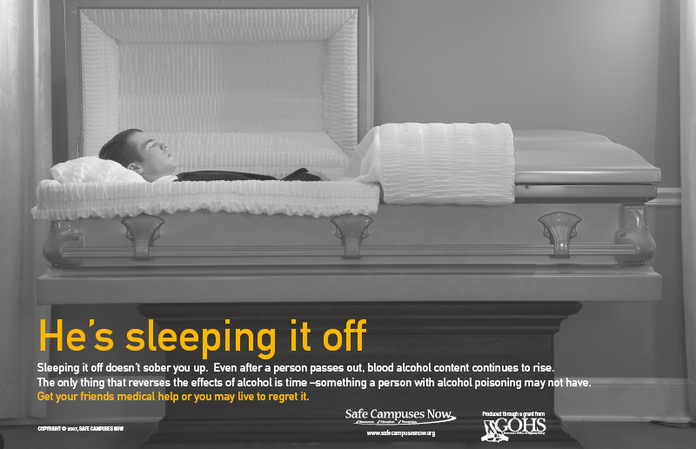
What should you do?
Turn the person on their side
Dial 911, get medical help
Stay with the person
http://www.d.umn.edu/hlthserv/health_education/services/alcohol_drugs.html

Slide 15

Addiction and Treatment
4 Levels of the Addiction Process: Addiction
1. Experimentation
2. Regular Use
3. Daily Preoccupation
4. Dependency
Community Resources/Support Groups:
AA (Alcoholics Anonymous)
Al-Anon( for family and friends of alcoholics)
Alateen (just for teenagers)
Teen Challenge(in and out patient treatment center)

Slide 16

Refusal Skills!
Come up with one way to say no to alcohol offered by a friend.

Slide 17
The Truth About Alcohol Video
http://www.drugfreeworld.org/real-life-stories/alcohol.html

