Slide 1
SPECIES
7 Dimensions of wellness

Slide 2
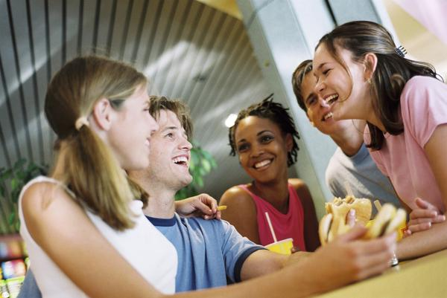
S=social
Key Word=
“relationships”

Slide 3
P= PHYSICAL
Key Word=
“body”

Slide 4
E=EMOTIONAL
Key Word=
“feelings”

Slide 5
C=CAREER
Key Word=
“job”

Slide 6
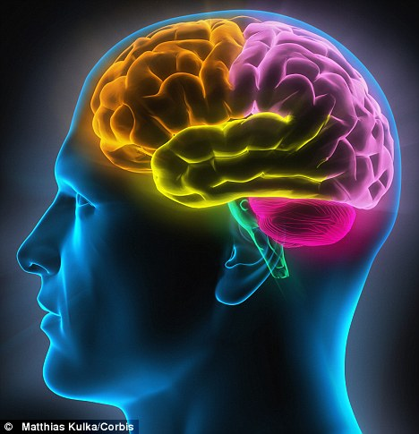
I=Intellectual
Key Word=
“mind”

Slide 7
E=environmental
Key Word=
“green”

Slide 8
S=SPIRITUAL
Key Word=
“values”

Slide 9
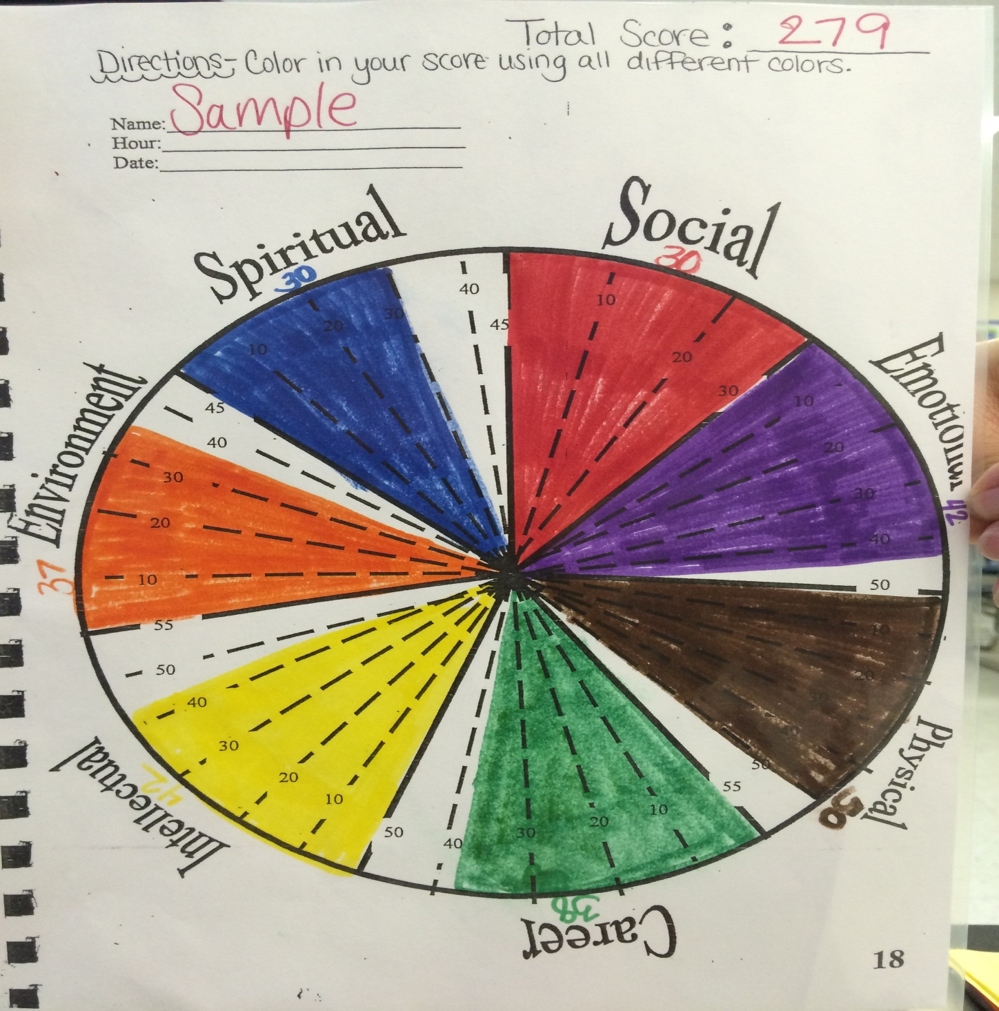
SPECIES WHEEL: Use 7 Colors & write score on top

Slide 10
KEY WORD SPECIES QUIZ
green=
Environmental
relationships=
Social
body=
Physical
values=
Spiritual
job=
Career
mind=
Intellectual
feelings=
Emotional

