Slide 1
Lifestyle Disease’s

Slide 2
Heart Disease Facts
Leading cause of death in the United States for adults
1 in 4 adults are ill with a form of this disease.
Heart disease develops slowly over a lifetime.

Slide 3
What is the difference between heart disease and cardiovascular disease?
Heart disease refers to the heart.
Cardiovascular disease refers to the heart AND blood vessels.

Slide 4
Arteriosclerosis
Arteriosclerosis means hardening of the arteries.
Accumulation of soft fat on the inner walls of the arteries.
Cuts off nutrients and oxygen.
Also leads to high blood pressure.

Slide 5
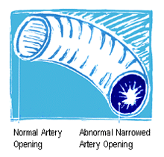

Slide 6
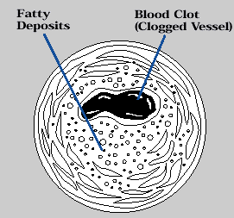
Blood Clots
Happens because platelets begin to clot the plaque that has formed on the artery walls
Some clots begin to travel in the blood stream until they become caught in an area they cannot pass through.

Slide 8
Heart Attack
When there is blockage in the arteries located in the heart.

Slide 9
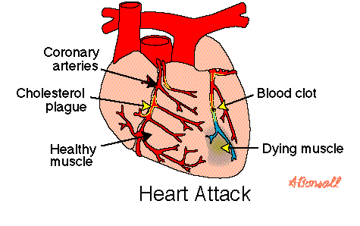

Slide 10
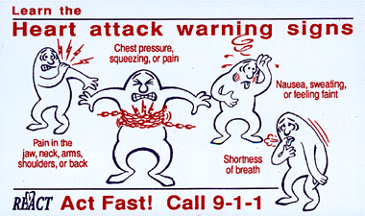

Slide 11
Stroke
Clot/blockage in the vessels that feed the brain vital nutrients and oxygen.

Slide 12
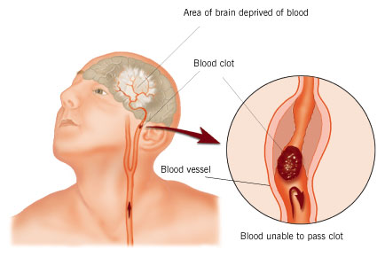
STROKE

Slide 13
He died of massive stroke at age 45 on 4/6/06: Heredity, weight gain , & stress probably played a significant role.

Slide 14
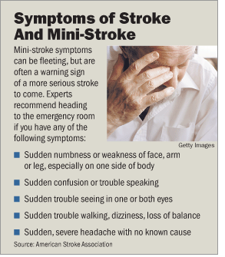

Slide 15
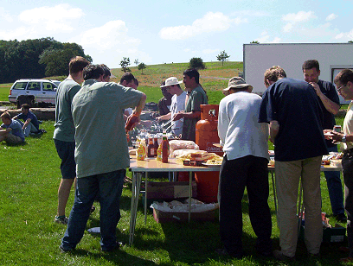
STROKE IDENTIFICATION
S: Ask the person to Smile
T: Ask the person to Talk by saying a simple sentence, “It’s sunny outside.”
R: Ask the person to Raise both arms
Call 911 IMMEDIATELY!!!!!!!!!!!!!!!!!!!!!!!!

Slide 16
Embolism
Clot breaks loose “traveling clot” reaches artery to small and suddenly blocks the vessel

Slide 17
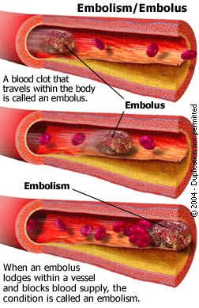

Slide 19
Obesity Trends Among U.S. Adults between 1985 and 2005
Definitions:
Obesity: having a very high amount of body fat in relation to lean body mass, or Body Mass Index (BMI) of 30 or higher.
Body Mass Index (BMI): a measure of an adult’s weight in relation to his or her height, specifically the adult’s weight in kilograms divided by the square of his or her height in meters.
http://www.nhlbisupport.com/bmi/

Slide 20
http://www.cdc.gov/nccdphp/dnpa/obesity/trend/maps/

Slide 21
Obesity Is Related to Many Chronic Health Problems
Type 2 diabetes
Hypertension
Heart disease
Stroke
Breast cancer
Colon cancer
Arthritis
Gallbladder disease
Physical disability
Sleep disturbances
Breathing problems
Notes:
With obesity comes a whole series of health conditions and diseases, including Type 2 diabetes, hypertension, heart disease, stroke, breast cancer, colon cancer, arthritis, gallbladder disease, physical disability, sleep disturbances, and breathing problems.

Slide 22
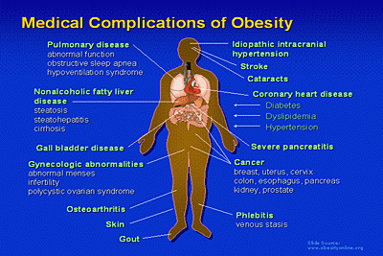

Slide 23
Overweight Has Important Health Consequences in Children
70% chance of being overweight as adults
Childhood onset of type 2 diabetes
Face future risk of serious complications: kidney disease, blindness, amputations
Children born in 2000 have a high risk of getting diabetes in their lifetimes:
33% of males
39% of females
Risk factors for heart disease
61% of overweight 5-10-year olds have at least one risk factor
26% have two or more risk factors
Notes:
Children who are overweight are at increased risk of becoming overweight and obese adults. In fact, overweight children have a 70 percent chance of being overweight as adults.
Overweight children have their own health problems. We’re seeing children suffering from so-called “adult diseases” tied to overweight, such as Type 2 diabetes.
Overweight children with Type 2 diabetes are at risk of suffering the serious complications of diabetes as adults, such as kidney disease, blindness, and amputations.
In fact, more than one out of three children born in 2000 – 33% of boys and 39% of girls – are estimated to get diabetes in their lifetimes.
Just as striking, 61 percent of overweight 5-to-10-year-olds already have at least one risk factor for heart disease, and 26 percent have two or more risk factors.

Slide 24
Costs Associated with Obesity are High and Growing
A 2009 study by the Centers for Disease Control and Prevention, along with RTI International (a nonprofit research group), found that the direct and indirect cost of obesity "is as high as $147 billion annually." The study was based on figures collected in 2006.
Notes:
The costs to society of obesity and overweight are high and growing.
The direct health costs attributable to obesity were estimated to be $52 billion in 1995, increasing to $75 billion in 2003.
Hospital costs related to childhood obesity alone have tripled in the last 20 years.

Slide 25
Three Key Factors Are Related to the Onset of Obesity
Poor dietary practices
Decreased physical activity
Increased inactivity
Notes:
There are three key reasons for today’s obesity epidemic:
Poor dietary practices
Decreased physical activity
Increased inactivity

Slide 26
Americans’ Food Practices are Shifting Dramatically
Reduced frequency of family meals
Increased fast food consumption
Increased portion size
Increased consumption of soft drinks (from 27 to 50 gallons/year from 1972-1999)
Restrained eating, meal skipping
Notes:
Americans’ food practices are shifting dramatically:
Reduced frequency of family meals
Increased fast food consumption
Increased portion size
Increased consumption of soft drinks – from 27 to 44 gallons per year from 1972 to 1992
Restrained eating, meal skipping
Increased food products in supermarkets – about 30,000 now

Slide 27
Scientists Agree on Steps to Reduce Obesity and Promote Health
Eat a healthy diet
(e.g., 2 cups fruit and 2 and 1/2 cups vegetables each day, based on 2,000-calorie diet)
Get regular physical activity
(e.g., for adults, at least 30 minutes of moderate-intensity activity 5 days per week, or at least 20 minutes of vigorous activity 3 days a week)
Go for regular visits to the doctor
to monitor risk factors
if you have an obesity-related condition and are trying to lose weight
Notes:
Scientists agree on the major steps to be taken to address the health risks tied to obesity and overweight:
Eat a healthy diet. For example, the average person should eat 2 cups of fruit and 2 and 1/2 cups of vegetables each day (based on a 2,000-calorie diet) for optimum health.
Get regular physical activity. The CDC regards adults as meeting current physical activity recommendations if they do at least 30 minutes of moderate-intensity activity 5 days per week, or at least 20 minutes of vigorous activity 3 days a week.
Go for regular visits to the doctor to monitor risk factors. And, if you have an obesity-related disease or condition and are trying to lose weight, be sure to check first and consult regularly with your doctor.

Slide 28
Abnormal cells multiply out of control and spread into surrounding tissues and other body parts. Cancer disrupts normal functions of 1 or more organs.

Slide 29
Benign / Malignant / Metastasized
Benign is non-cancerous, not harmful, and unable to spread
Malignant is cancerous, is harmful, and ready to spread to other parts of the body.
Metastasized cancer has moved from one part of the body to the other and starts new growth just like the original.

Slide 30
The four different classes cancer can be assigned to:
Lymphomas- immune system organs
Leukemia's- blood-forming organs
Carcinomas- glands and body lining (skin, digestive tract)
Sarcomas- connective tissues (bones, ligaments, and muscles)

Slide 31
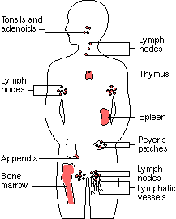
Immune System

Slide 32
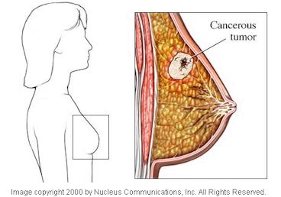
Breast Cancer: Sarcoma

Slide 33
This little girl has Leukemia

Slide 34
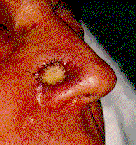
Skin Cancer: Carcinoma

Slide 35
Skin Cancer Facts
Cancer risk is just as high in tanning beds as in the sun.
By 18 years of age most people have accumulated most of their lifetime sun exposure.
Melanin-is the pigment in dark-skinned individuals that protect them against UV damage
SPF of 30 or higher is recommended

Slide 36
How does Cancer develop?
Exposure to a carcinogen
Entry of a carcinogen into the body
Change of cells genetic material
Out-of-control multiplication of the cells
Tumor formation

Slide 37
Cancer Risks You Can Control:
1) Tobacco Use
2) Alcohol Abuse
3) Poor Physical Activity

Slide 38
CAUTIONS-things to watch for
Change in bowel or bladder habits
A sore that does not heal
Unusual bleeding or discharge
Thickening or lump that suddenly appears anywhere
Indigestion or difficulty swallowing
Obvious change in a wart or mole
Nagging cough or hoarseness
Sudden weight loss

Slide 39
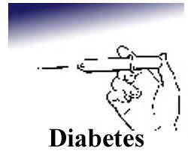

Slide 40
Diabetes
Diabetes is a condition of abnormal use of glucose, usually caused by too little insulin or lack of response to insulin.

Slide 41
Diabetes Facts
The 6th leading cause of death in the U.S.
Leading cause of blindness in the U.S.
Contributes greatly to heart disease.
Type 2 accounts for 80% of the cases, and most often affects those individuals middle age and older.
Type 2 is recently on the rise in children.
$175 billion spent annually on Diabetes Diabetes Awareness Month Sheds Light on Alarming Trends11/1/10 Dr. Amy Criego……Kare 11.com)

Slide 42
Type 1 Type 2
Usually sets in during adulthood, but is now prevalent in children
Pancreas makes enough or too much insulin
Insulin shots generally not required, but other drugs may be of help
body fatness
Lifestyle related
Usually sets in during childhood or adolescence with no controlling factors
Pancreas makes too little or no insulin
Insulin shots required
Low to average body fatness

Slide 43
The pancreas performs 2 main functions:
To produce digestive juices, which aid digestion.
To produce the hormone insulin, which controls blood glucose.
Considered to be in both the digestive and hormonal systems.

Slide 44
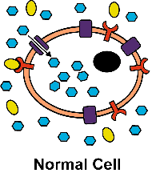
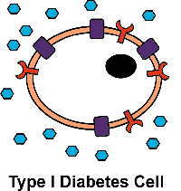
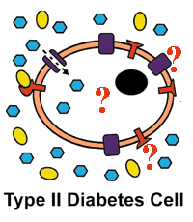
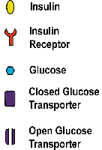

Slide 45
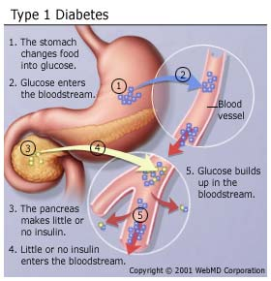

Slide 46
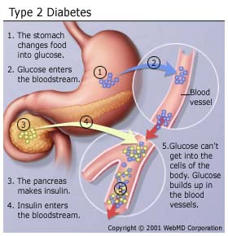

Slide 47
The Dangers of Diabetes….
Diabetic Coma- a loss of consciousness due to uncontrolled diabetes and the resulting buildup of toxic ketones in the blood.
Ketones- fragments formed by the tissues during incomplete use of fat for energy, and released into the blood.
Insulin Shock- the result of too much insulin, which causes a dangerous drop in blood glucose. Also called hypoglycemia.

Slide 48
Possible long-term effects of Type 2 Diabetes.
Impaired circulation
Disease of the feet and legs that often leads to amputation
Kidney disease that often requires hospital care or kidney transplant
Impaired vision or blindness due to cataracts and damaged retinas.
Nerve damage
Skin damage
Strokes and heart attacks

