Slide 1
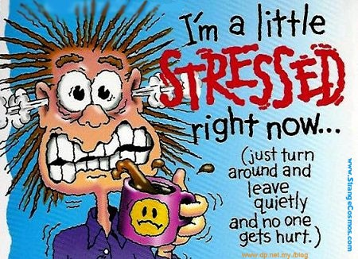
STRESS

Slide 2
40% !!!!!!!!
of All Teenagers say they experience mild or severe stress in their life.

Slide 3
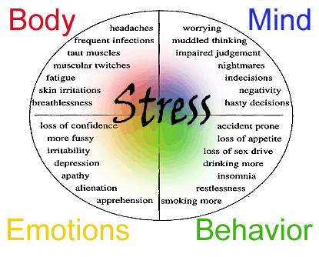
Definitions:
Stress: Your mind and body’s response or reaction to a real or imagined threat, event or change.

Slide 4
Stressor:
The threat, event or change which can be internal (thoughts, beliefs, attitudes) or external (loss, tragedy, change).
~ grades ~money
~homework ~looks
~teachers ~tests
~parents ~dating
~future plans ~friends/peers

Slide 5
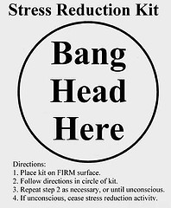
Distress
Negative stress that occurs when your level of stress is either too high or too low and your body and/or mind begin to respond negatively to the stressors. (difficult work environment, overwhelming sights or sounds, etc.)

Slide 6

Eustress
Good Stress
  New significant other
  New Job
  New sibling
  New car!

Slide 7
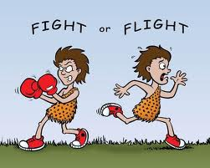
STRESS RESPONSE
The response to a demand or stressor. Also called the FIGHT or FLIGHT.
Three Phases: alarm, resistance, recovery or exhaustion

Slide 8
ALARM STAGE
As you begin to experience a stressful event or perceive something to be stressful, physiological changes occur in your body. This experience or perception disrupts your body’s normal balance and immediately your body begins to respond to the stressor(s) as effectively as possible.

Slide 9
EXAMPLES
Cardiac - heart rate increases
Respiratory - increased respiration
Skin - decreased temperature
Hormonal - increased stimulation of adrenal genes which produce an adrenal rush.

Slide 10
RESISTANCE STAGE
We may feel too much tension. Reactions are overreacted, overdone, excessive. People may smoke too much, drink more coffee, or drink more alcohol, use drugs, feel driven, pressured, tired and bad.
Usual reaction is anxiety, memory loss, overreacting (rude, worries) or depression.
Organism (mind-body occurs) are very vulnerable and can get sick very easy (weak immune system).

Slide 11
EXAMPLES

Slide 12
RESISTANCE STAGE
MORE EXAMPLES:
Emotional indicators include:
tearfulness
fear
anxiety
panic
guilt
agitation
depression
overwhelmed.

Slide 13
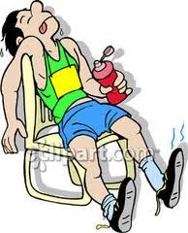
EXHAUSTION STAGE
During this stage the stressor is not being managed effectively and the body and mind are not able to repair the damage.

Slide 14
EXAMPLES
Digestive disorders, withdrawal, headaches, tension, insomnia, loss of temper.

Slide 15
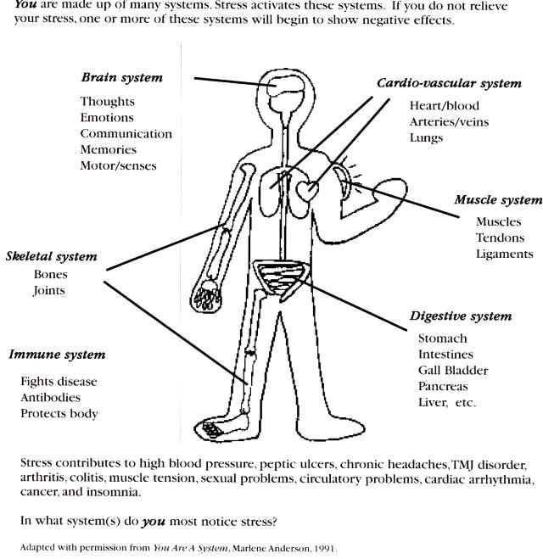

Slide 16
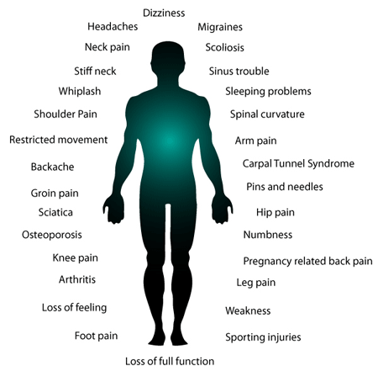

Slide 17
Relaxation Techniques
IMAGERY

Slide 18
Relaxation Techniques 3-2-1 Relax
3 “I See……”
3 “I Hear….”
3 “I Feel…..”
2 “I See…...”
2 “I Hear….”
2 “I Feel…..”
1 “I See…...”
1 “I Hear….”
1 “I Feel…..”

Slide 19
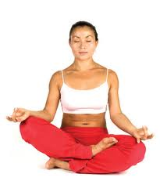
Muscle Relaxation
Relax & Tense muscles
Yoga, Pilates
Massage
Stretch

Slide 20
Strategies to Manage Stress in Your Life
Simplify Your Life
Ask for help
Practice Time Management
Minimize Alcohol Use
Humor--Take Time to Play
Relaxation Techniques
Get Counseling If Needed
Color or draw
Exercise daily
Eat healthy
Get enough sleep
Cultivate high self esteem
Release tension by crying, laughing, relaxing, etc.
Identify stressors you can control & take action
Music, journal, read, write

Slide 21
