Slide 1
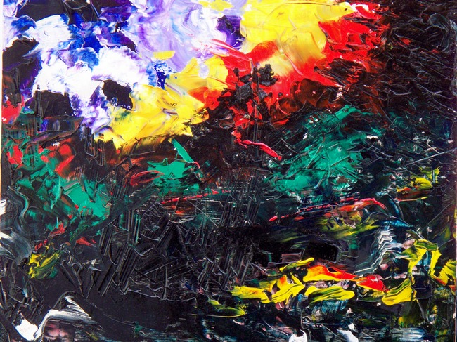
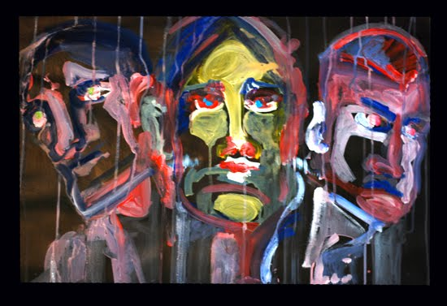
Mental Health
“Same world, different view”
https://www.youtube.com/watch?v=ltun92DfnPY&index=5&list=WLLaUTAc57_NnUCft-DaMjMvaryDdD7-wJ

Slide 2
What is mental/emotional health?
It’s a state of emotional and psychological well-being.
Feels good about yourself
Feels comfortable with other people
Able to meet the demands of life
Notes:
1 in 4 13-24 year olds experiences a mental health disorder

Slide 3
Characteristics of GOOD mental health
Expresses emotions in healthy ways
Is optimistic (positive)
Uses health skills
  Stress management
  Decision making
  Conflict resolution
Copes/adapts with change
Assertive
Active listener
Can be part of a team/group

Slide 4
Characteristics of poor mental health
Does NOT share feelings--PASSIVE
Emotions control behaviors
Is pessimistic (negative)
Ignores/denies problems
Can not accept change
Lets stress control life
“You” messages (blame and escalate)
Aggressive and passive
Depressed
Runs from conflict
Close minded
Needs to “run” the group

Slide 5
Personality
Everything about a person combined, makes them unique
Heredity
Environment
  Influences on personality
Self-Concept
Culture

Slide 6
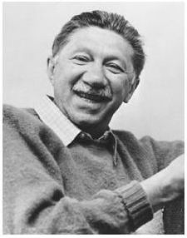
Abraham Maslow
American humanistic psychologist
Created the hierarchy of human needs (some needs are more basic or powerful than others)
Physiological needs are at the base because we need those in order to survive (dominant to other needs)
Notes:
Maslow believed that the higher, more fragile needs are expressed only after we satisfy our physiological needs. This is also true of needs for safety and security. Until they are met, we may have little interest in higher pursuits. (Example – a person who is really hungry might have little interest in playing sports or doing homework).
The first four levels are described as basic needs. Other basic needs include love and belonging (family, frienship, caring) and needs for esteem and self-esteem (recognitiion and self respect)
Top of pryamid is considered growth needs, which are expressed as a need for self-actualization. It is a positive, life-enhancing force for personal growth. **He believed that if our basic needs are met, we will tend to move on to actualizing our potentials.

Slide 7
Maslow's Hierarchy of Needs
Belonging and Love
Safety and Security:
Security, protection
Physiological Needs:
Air, food, water, sleep, etc.
Self-Esteem and Esteem
Self-Actualization
1-2% of overall population
Notes:
Social Needs: sense of belonging and love
Self-esteem & esteem: need recognition and status
Self-actualization:
Love needs must be satisfied first**

Slide 8
What is a mental disorder?
Patterns of THINKING or behavior, that cause a person significant EMOTIONAL pain or prevents normal functioning

Slide 9
General Causes of Mental Disorders
Inherited traits
Negative life experiences (traumatic)
Environmental exposures before birth
  Viruses, toxins, alcohol or drugs
Brain chemistry
  Hormonal imbalances
  Affects: daily functioning; thinking, feeling, mood & ability of a person to relate to others

Slide 10
Mental Health Quiz
Please reply saying: “true or false”
Mental illness is more common than diabetes.
Mental illness occurs in 1 out of every 4 families in the U.S.
Mental illnesses are treatable.
Being mentally impaired/challenged is very different from having a mental illness.
It can take medication, years of therapy, and counseling to treat a mental illness.

Slide 11
TRUE……..
If you answered true to all: you’re a M.I. whiz!

Slide 12
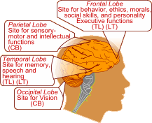
There is a chemical imbalance in the brain of a person with a mental illness.

Slide 13

Optical Illusions
“Same picture, different view”

Slide 14


Slide 15
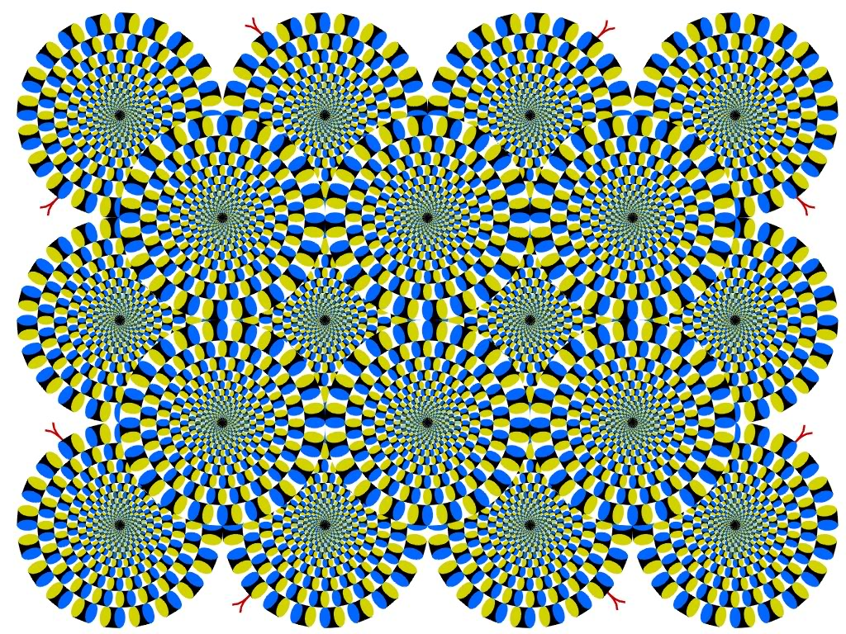
Notes:
Is it moving?

Slide 16

How many gray dots do you see?

Slide 17
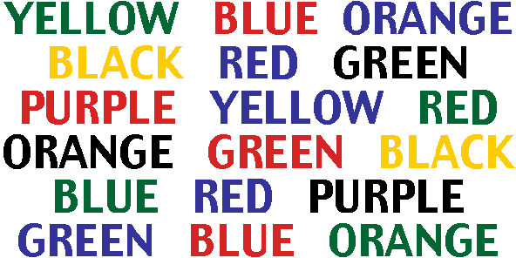
Say the color of each word

Slide 18

Are the horizontal lines straight or diagonal?

Slide 19
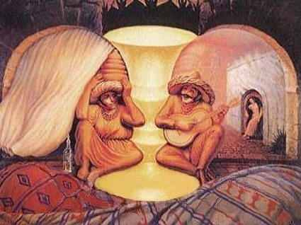

Slide 20

Notes:
Relax and concentrate on the four small dots in the middle of the picture for about 30-40 seconds
Then take a look at any smooth single surface (wall) need you)
You will see a circle of light developing, start blinking your eyes of couple of times and u will see a image emerging (what do you see? Who do you see?) Jesus

Slide 21
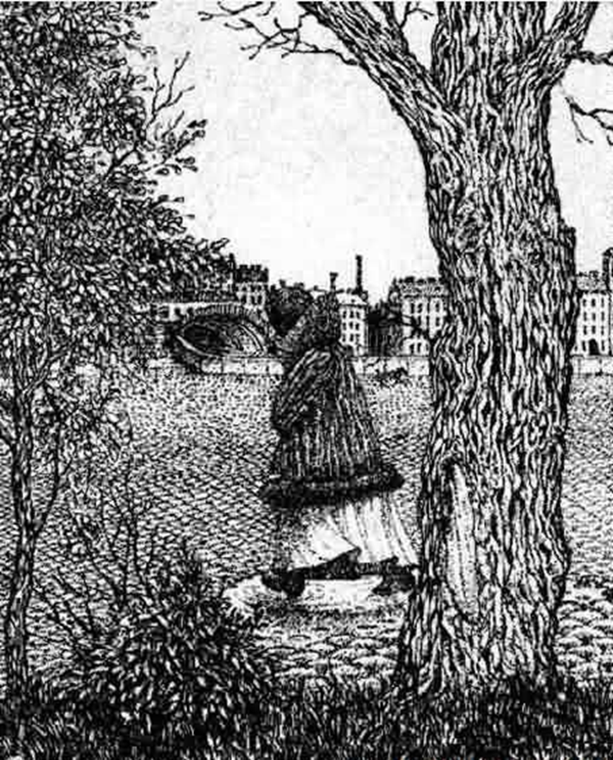

Slide 22

Do you see a face or a word?

Slide 23
Compare—HOW WOULD YOU FEEL IF YOU COULDN’T FIGURE THESE OUT?
That is how a person with mental Illness could be feeling. They do not see things like you.

Slide 24
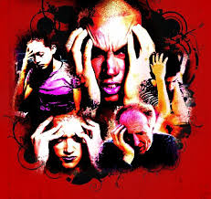
Mental Disorders
Notes:
Suicide and self-injury

Slide 25
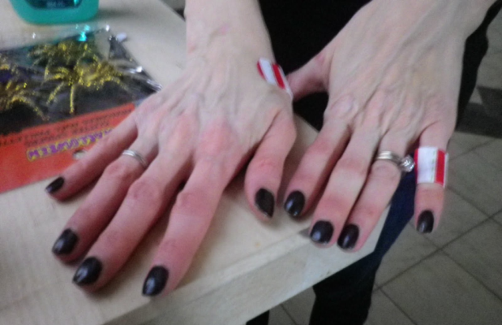
Obsessive-Compulsive Disorder (OCD)
Anxiety Disorder
Preoccupied with certain distressing thoughts and the uncontrollable need to perform certain acts (compulsions)
Compulsions help control or block out anxiety--checkers or cleaners
Compulsion become so repetitive they can not lead a normal life
  https://www.youtube.com/watch?v=--sM3h6nnus
Notes:
*As good as it gets move
Many of you have probably exerpeineces a mild obsessional thought, such as a song or jingle that repeats over and over in your mind
True obsessions are images or thoughts that force their way into awareness against the persons will.
Obsessions usually give rise to compulsions (irrational acts that a person feels driven to repeat) Often, these compulsive acts help control or block our anxiety caused by an obsession.
Many compulsive people are checkers or cleaners (I am a checker)
Compulsions interrere with individuals daily routine, which causes a dramatic affect in leading a normal life (because they are so repetative) cleanres (the feeling of being dirty or to many germs
Obsessions usually lead to compulsions (irrational acts that a person feels driven to repeat)

Slide 26
Phobias
Anxiety Disorder
An extreme or irrational fear of an object or situation
  People do everything they can to avoid the object of their fear
  Unable to live a normal life because of their intense fear
Agoraphobia (fear of open/public places)
  Arachnophobia (fear of spiders)
  https://www.youtube.com/watch?v=ZJ2HNOnoK1s
Notes:
Causes = much is still unknown about the actual cause of phobias. There does not appear to influence between phobias and phobias of your parents. Children may learn phobias by observing a family members phobic reaction
Brain chemicals, genetics and traumatic experiences can also play an influence
These factors may increase your risk of phobias:
Your age
Your sex – phobias affect both sexes, but women and girls are more likely to have specific phobias or social phobia
Your family – more likely to develop a phobia is someone in the family does
A traumatic event – experiencing a traumatic event, such as being trapped in an elevator or attacked by an animal may trigger or develop a phobia

Slide 27
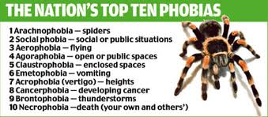

Slide 28
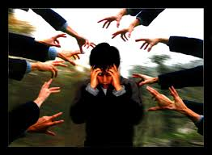
Schizophrenia
A condition of losing touch with reality accompanied by reduced ability to function.
  Loses ability to distinguish fantasy from reality
  Signs of tissue shrinkage in brain
  Some individuals inherit a potential of developing schizophrenia
  Early psychological trauma-violence, sexual abuse, death, divorce, separation, or major stressors of childhood
https://www.youtube.com/watch?v=4LScZZOkeIs
Notes:
Emotions may become blunted or very inappropriate. For example, if a person with schizophrenia is told his mother just died, he might smile or giggle or show now emotion at all.
Delusions may include the idea that the person’s thoughts and actions are being controlled, that thoughts are being brodcasted so others can hear them or that thoughts have been inserted into the persons mind or that thoughts have been removed

Slide 29
Testing…Testing…Testing…
1-Almost NEVER applies to me
2-Applies to me SOMETIMES
  3-Applies to me OFTEN
  4-Applies to me almost ALWAYS
  https://www.youtube.com/watch?v=0vvU-Ajwbok
  http://www.youtube.com/watch?v=PVHNGZ0Omx0&safety_mode=true&persist_safety_mode=1

Slide 30
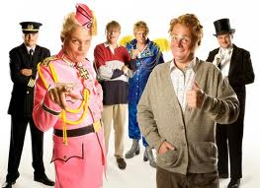
Dissociative Identity Disorder
(Multiple Personalities)
Two or more separate identities or personality traits
  Ability to control individual’s behavior and thinking
  Create alters to distance themselves from pain and trauma
  https://www.youtube.com/watch?v=TnZ0_iqv5Jw
  https://www.youtube.com/watch?feature=player_detailpage&v=i6kJ3nrdvDc
Notes:
Me, myself and irene
Sybil
The three faces of eve
Each with its own relatively enduring pattern of perceiving, relating to and thinking about the environment and self

Slide 31
Attention-Deficit Hyperactivity Disorder (ADHD)
Combination of problems, such as difficulty sustaining attention, hyperactivity and impulsive behavior
Often diagnosed before the age of 7
  As early as 2 or 3 years old
Chronic interference in more than 1 setting
  Home life, school work, sports/activities

Slide 32
Signs & Symptoms
Inattentive
Hyperactive/Impulsive
Fails to pay close attention to details
Make careless mistakes
Trouble keeping attention
Difficulty following through on instructions
Problems organizing tasks or activities
Fidgets or squirms frequently
Often leaves seat
Always seems on the go
Talks excessively or blurts out answers
Difficulty waiting turn
Interrupts conversations

Slide 33

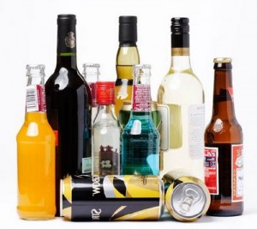

Addiction
A physiological or psychological need for something. (body/mind)
This need leads to bodily harm, social maladjustment, or economic hardship; dependence on substance, habit, or behavior
https://www.youtube.com/watch?v=jdpQir1sqiQ
https://www.youtube.com/watch?v=_u3BRY2RF5I&list=WLLaUTAc57_NnUCft-DaMjMvaryDdD7-wJ&index=11

Slide 34
Anorexia Nervosa
--not eating
An eating disorder in which the irrational fear of becoming obese results in severe weight loss from self-imposed starvation

Slide 35
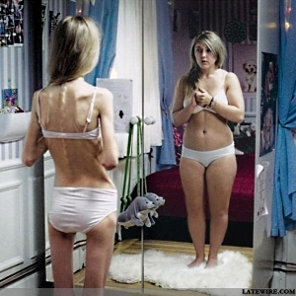
Reactions to Video
Distorted body image
False perceptions
Mirror vs. Reality
http://www.youtube.com/watch?v=qFbYW6bNViw&feature=related
Notes:
http://www.youtube.com/watch?v=qFbYW6bNViw&feature=related (youtube video)

Slide 36
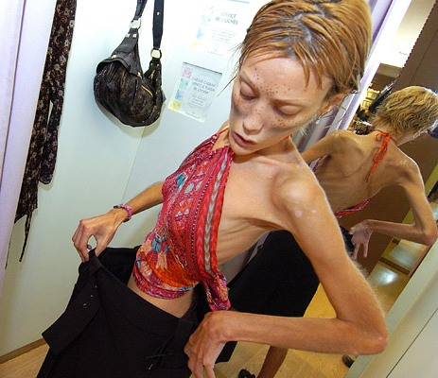
Warning Signs
Dramatic weight loss
Anxiety about gaining weight
Denial of hunger
Food rituals
Excessive exercise
Isolation
Frequent comments about being “fat”
Avoids food situations

Slide 37
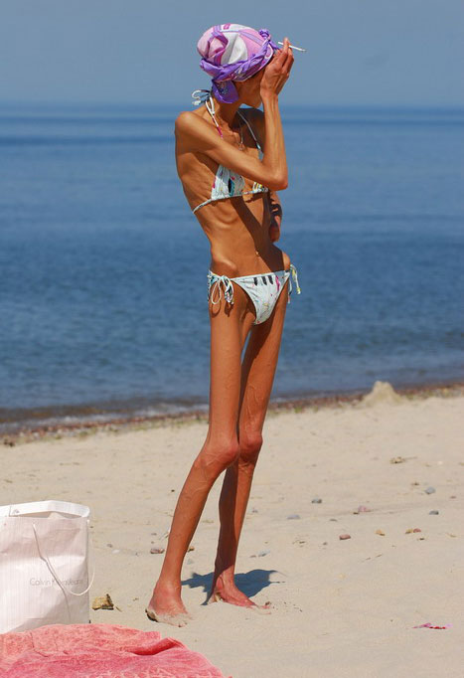
Health Risks
Muscle loss and weakness
  Reduction in bone density
Fainting, fatigue, overall weakness
Dry skin and hair, hair loss
  Growth of lanugo
Slow heart rate/blood pressure
Amenorrhea
Cold intolerance
Heart failure (death)
Notes:
Emotional/Mental:
Depression
Anger
Suicidal thoughts
Low self esteem/body image
Social:
Isolation
Loss of friends
Withdrawal from activities

Slide 38
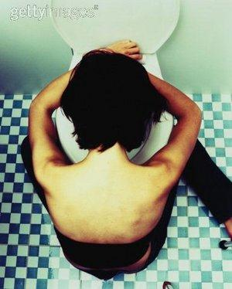

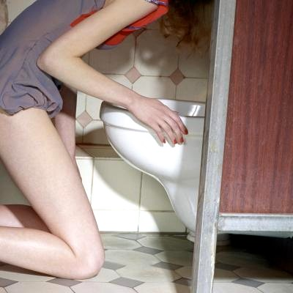
Bulimia Nervosa
-Binge and Purge (eat and puke)
An eating disorder in which some form of purging or clearing of the digestive tract follows cycles of overeating

Slide 39
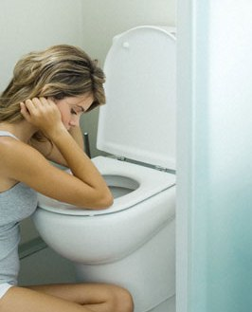
Warning Signs
Buys large amounts of food
Eats secretly, missing food, and skips meals
Weight fluctuation
Excessive use of laxative, diet pills and exercise
Uncontrolled binging
Low impulse to control
Notes:
**low self-esteem, guilt and embarrassment (especially after binge… so they purge)

Slide 40
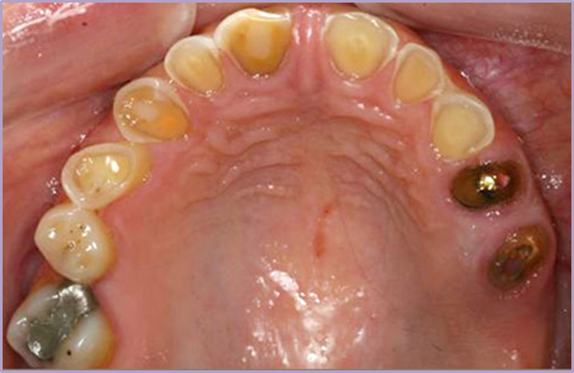
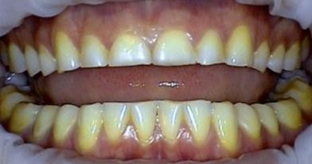
Health Risks
Stomach Rupture
Tooth decay/erosion
Loss of fluids
Risks of seizures
Esophageal inflammation
Irregular bowel movements
Chronic sore throats
Notes:
Most likely to suffer from Eds: dacners, gymnasts, runners, wrestlers, swimmers, jockeys, body builders <<< athletes are vulnerable to eating disorders because their sport has weight constrictions and/or high performance is based on the physique of their body?
**Slightly underweight

Slide 41
Depression
http://www.ted.com/talks/kevin_breel_confessions_of_a_depressed_comic?language=en
https://www.youtube.com/watch?v=S2N_uvnvGbI

Slide 42
Depression
Emotional disorders primarily involving sadness, dependency and depression
  Dejection, hopelessness, inability to feel pleasure or to take interest
  Needs medical attention
Kinds of depression:
  Bipolar Disorder/Manic Depression
  Seasonal Affective Disorder (SAD)
  Chronic depression or clinical depression
Notes:
Depression is a serious illness that needs medical attention
Left untreated, depression can lead to suicide
Can be treated and lives when symptoms are recognized

Slide 43
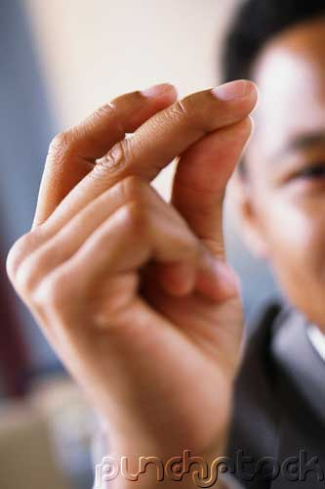
Depression
“JUST SNAP OUT OF IT!”

Slide 44
Snapping out of depression is as likely as talking yourself out of a heart attack.
*Depression is a serious illness that needs medical attention.
*Untreated depression is the #1 reason for suicide.
*Fortunately, depression can be treated and lives can be saved when symptoms are recognized.

Slide 45

Seasonal Affective Disorder (SAD)
Depression that only occurs during the fall and winter months
  Oversleeping/difficulty staying awake
  Fatigue
  Social withdrawal
  Inability to cope
Indoor tanning
Notes:
Almost everyone can get a little depressed when days are short, dark, and cold, but when a person’s systems are lasting and disabling

Slide 46

Bipolar Disorder
(Also known as Manic Depression)
Depressive Symptoms:
Manic Symptoms:
Loss of energy
Feelings of worthlessness
Difficulty concentrating
Insomnia
Loss of interest
Recurrent thoughts of death or suicide
Severe changes in mood
Increased energy
Decreased need for sleep
Increased talking (too fast or too much)
Disregard of risk
Overly-inflated self-esteem
Notes:
Disregard of risk – excessive involvement in risky behaviors or activities
Grandiose thinking (they think they are more important) example:
**The cause is not known, but it has a genetic component and can run in families.

Slide 47
Depression Symptoms
Withdrawal from family and friends
Drop in grades
Change in eating & sleeping patterns
Large weight gain or loss
Unresolved grief over a loss
Substance use
Difficulty concentrating, remembering or making decision irritability or angry outburst
https://www.youtube.com/watch?feature=player_detailpage&v=VM3XFkLA7YI
Notes:
If you or someone you know has these symptoms for more than two weweks, ask a doctor for a depression screening

Slide 48
“People with Mental Illness Enrich Our Lives!”

Slide 49

Some People Believe Mental Illness is Uncommon
https://www.youtube.com/watch?v=J8ohPJZiP1w&index=12&list=PLLaUTAc57_NnUCft-DaMjMvaryDdD7-wJ

Slide 50
Suicide
Untreated depression
3rd leading cause of death (15-24 yr. olds)
Approximately 100-200 attempts for every completed suicide
An average of one person dies every 16.2 minutes
90% of suicide victims suffer from a mental disorder

Slide 51
Suicide: Warning Signs
Giving away prized possessions
Feelings of despair, hopelessness
Threats to hurt oneself
Preoccupation with death
9 out of 10 adolescents give clues to others before the suicide attempt

Slide 52
https://www.youtube.com/watch?feature=player_detailpage&v=3BByqa7bhto
Where can I get help???
  http://www.save.org/
  http://www.suicide.org/index.html
  http://www.sprc.org/states/minnesota

Slide 53
Self-Harm
The act of attempting to alter a mood state by inflicting physical harm that is serious enough to cause tissue damage to one’s body
Temporarily relieves intense feelings, pressure or anxiety, Being a means to control and manage pain

Slide 54
Common Behaviors
Cutting
Burning
Head-banging
Carving
Scratching
Bruising or hitting
Biting
Picking of skin
Pulling of hair
Bone-breaking

Slide 55
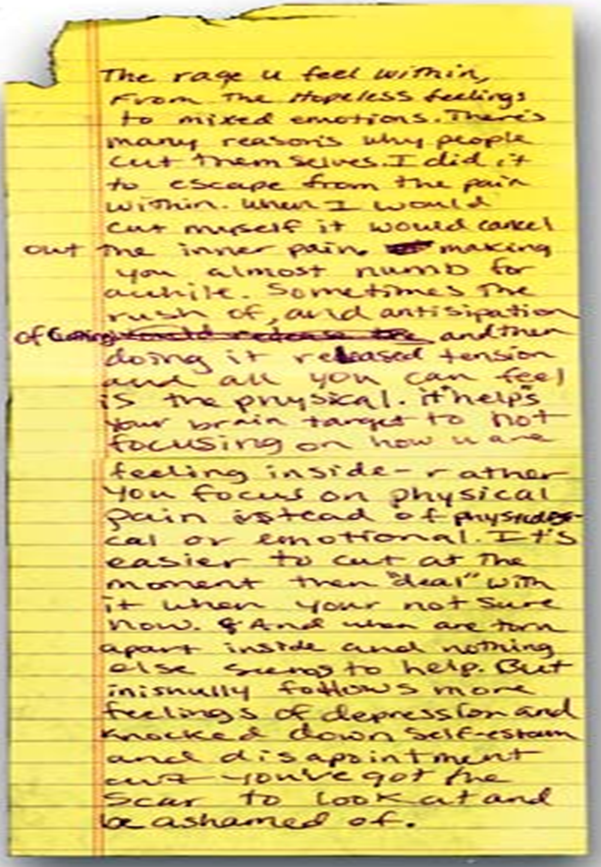
Escape from emptiness and depression
Provides relief
Relieves anger
Escapes numbness
Reality

Slide 56

https://www.youtube.com/watch?feature=player_detailpage&v=zOK7ijzywgs

Slide 57



How you can help

Slide 58
You are part of the PROBLEM if you:
Attempt to punish, threaten, bribe, or preach
Cover up or make excuses for their behavior
Take responsibility for the person
Keep the problem to yourself and chose not to tell someone
Notes:
Hide food from a binger or try to force an anorexic to eat
Argue about how much they should or should not eat

Slide 59
You are part of the SOLUTION if you:
Remain calm, unemotional and factually honest in speaking to the person about your concerns
Attend support groups
Encourage your friend to seek help
Do not cover up or avoid the situation and confront the person with your concerns

Slide 60
You are part of the SOLUTION if you:
5. Share Concern Skill
  I care/love…
  I see…
  I feel…
  Listen – I want/would like, I will…
6. Ask the tough questions
  “Are you depressed? Are you starving yourself?”
7. Tell a trusted adult
Notes:
2) Calmly tell them the specific observations that have aroused your concern.
3) Ask the question: “Are you depressed, starving yourself, hearing voices, etc.?
4) Tell a trusted adult (immediately if the person has problems that scare you!: nurse, teacher, coach, counselor)

Slide 61
Can you recover?
Mental disorders are treatable
Multidisciplinary approach is required:
  Physicians
  Therapists/Counselors
  Dieticians
  Medications

Slide 62
Prevention Strategies
Share your feelings and emotions with someone you trust
Use positive self talk
Manage stress with stress management skills
Use healthy decision making skills
Use effective communication skills
  “I Messages”
KNOW the signs and symptoms

Slide 63
Five Stages of Grief
This model describes the process by which people deal with grief and tragedy
These steps do not necessarily come in order, through a person will experience at least two

Slide 64
D.A.B.D.A
Denial
  Initial reaction to a loss
Anger
  Victim can no longer deny feelings.
Bargaining
  May involve praying, alternative treatments, or promising better behavior.
Depression
  Period of grieving for the loss
Acceptance
  Coming to terms with situation

Slide 65
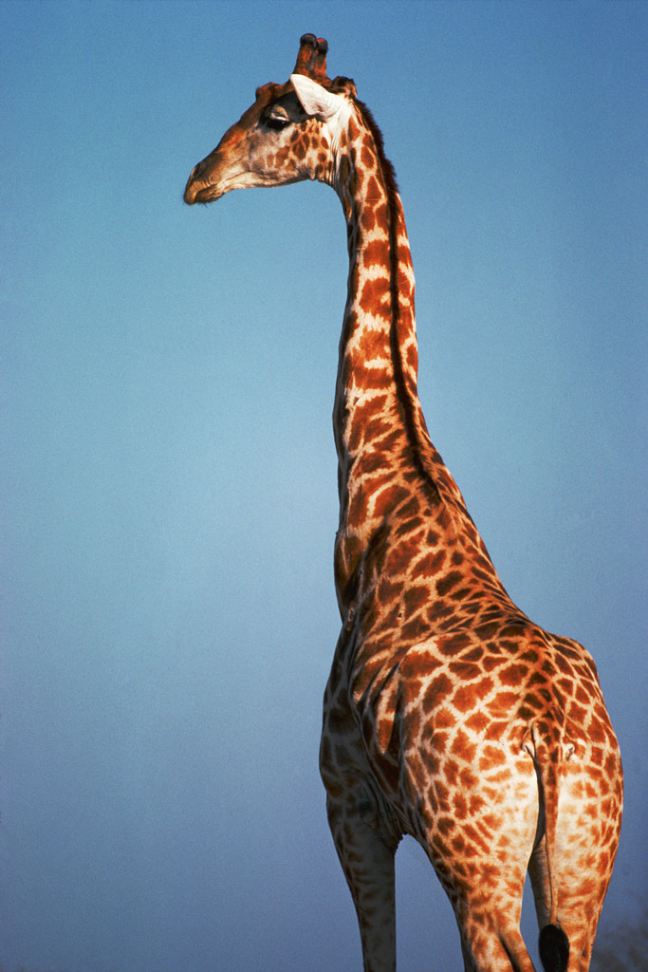
https://www.youtube.com/watch?v=G_Z3lmidmrY

