Slide 1
6th grade Speeches
How to make a presentation that ROCKS!

Slide 2
Designing an Effective
“PowerPoint Presentation”

Slide 3
Make It Big

Slide 4
Make it Big (Text)
This is Arial 12
This is Arial 18
This is Arial 24
This is Arial 32
This is Arial 36
This is Arial 44

Slide 5
Make it Big (Text)
Too Small
This is Arial 12
This is Arial 18
This is Arial 24
This is Arial 32
This is Arial 36
This is Arial 44

Slide 6
Make It Big (How to Estimate)
Look at it from 2 meters away
2 m

Slide 7
Keep It Simple

Slide 8
Keep It Simple (Text)
Too many colors
Too Many ^{Fonts} and _{Styles}
The 6 x 7 rule
  No more than 6 lines per slide
  No more than 7 words per line

Slide 9
Keep It Simple (Text)
Plate tectonics is a scientific theory that describes the large-scale motions of Earth's lithosphere. The lithosphere is broken up into tectonic plates. On Earth, there are seven or eight major plates (depending on how they are defined) and many minor plates. Where plates meet, their relative motion determines the type of boundary: convergent, divergent, or transform. Earthquakes, volcanic activity, mountain-building, and oceanic trench formation occur along these plate boundaries. The lateral relative movement of the plates typically varies from zero to 100 mm annually.
Too detailed !

Slide 10
Keep It Simple (Text)
Plate Tectonics:
A scientific theory
Describes moving tectonic plates
Determines plate boundaries
Involves Earth construction and destruction
Much Simpler

Slide 11
Falling Leaves Observed
 | Delhi | Mumbai | Goa
January | 11,532,234 | 14,123,654 | 3,034,564
February | 1,078,456 | 12,345,567 | 16,128,234
March | 17,234,778 | 6,567,123 | 16,034,786
April | 16,098,897 | 10,870,954 | 7,940,096
May | 8,036,897 | 10,345,394 | 14,856,456
June | 16,184,345 | 678,095 | 4,123,656
July | 8,890,345 | 15,347,934 | 18,885,786
August | 8,674,234 | 18,107,110 | 17,230,095
September | 4,032,045 | 18,923,239 | 9,950,498
October | 2,608,096 | 9,945,890 | 5,596,096
November | 5,864,034 | 478,023 | 6,678,125
December | 12,234,123 | 9,532,111 | 3,045,654
Too detailed !

Slide 12
Falling Leaves in Millions
In 10⁶ | Delhi | Mumbai | Goa
January | 11 | 14 | 3
February | 1 | 12 | 16
March | 17 | 6 | 16
April | 16 | 10 | 7
May | 8 | 10 | 14
June | 16 | 0 | 4
July | 8 | 15 | 18
August | 8 | 18 | 17
September | 4 | 18 | 9
October | 2 | 9 | 5
November | 5 | 0 | 6
December | 12 | 9 | 3
Much Simpler

Slide 13
Falling Leaves
Too detailed !

Slide 14
Falling Leaves
Much Simpler

Slide 15
Keep It Simple (Picture)
Art work may distract your audience
Artistry does not substitute for content

Slide 16
Keep It Simple (Sound)
Sound effects may distract too
Use sound only when necessary

Slide 17
Keep It Simple (Transition)
This transition is annoying, not enhancing
"Appear" and "Disappear" are better

Slide 18
Keep It Simple (Animation)
2 m
Too distracting !

Slide 19
Keep It Simple (Animation)
2 m
Simple & to the point

Slide 20
Make It Clear

Slide 21
Make It Clear (Capitalization)
ALL CAPITAL LETTERS ARE DIFFICULT TO READ
Upper and lower case letters are easier

Slide 22
Make It Clear (Fonts)
Sanserif Z
Serif Z
clear
busy

Slide 23
Make It Clear (Fonts)
Serif fonts are difficult to read on screen
Sanserif fonts are easier to read
Italics are difficult to read on screen
Normal or bold fonts are easier
Underlines may signify hyperlinks
Instead, use colors to emphasize

Slide 24
Make It Clear (Numbers)
Use numbers for lists with sequence
For example:
How to put an elephant into a fridge?
1. Open the door of the fridge
2. Put the elephant in
3. Close the door

Slide 25
Make It Clear (Numbers)
How to put a giraffe into a fridge?
1. Open the door of the fridge
2. Take out the elephant
3. Put the giraffe in
4. Close the door

Slide 26
Make It Clear (Bullets)
Use bullets to show a list without
Priority
Sequence
Order…

Slide 27
Make It Clear (Colors)
Use contrasting colors
Light on dark vs. dark on light
Use complementary colors

Slide 28
Make It Clear (Contrast)
Use contrasting colours
Light on dark vs dark on light
Use complementary colours
high contrast
low contrast

Slide 29
Make It Clear (Contrast)
Use contrasting colours
Light on dark vs dark on light
Use complementary colours
This is light on dark

Slide 30
Make It Clear (Contrast)
Use contrasting colours
Light on dark vs dark on light
Use complementary colours
This is dark on light

Slide 31
Make It Clear (Complement)
Use contrasting colours
Light on dark vs dark on light
Use complementary colours
These colors do not complement

Slide 32
Make It Clear (Complement)
Use contrasting colors
Light on dark vs dark on light
Use complementary colors
These colors complement

Slide 33
Make It Clear (Size)
Size implies importance

Slide 34
Make It Clear (Size)
Size implies importance

Slide 35
Be Consistent

Slide 36
Be Consistent
Differences draw attention
Differences may emphasize importance
Use surprises to attract not distract

Slide 37
Be Consistent
Differences draw attention
Differences may emphasize importance
Use surprises to attract not distract
This tick draws attention

Slide 38
Be Consistent
Differences draw attention
Differences may emphasize importance
Use surprises to attract not distract
These differences distract!

Slide 39
Be Consistent
Differences draw attention
Differences may emphasize importance
Use surprises to attract not distract
This emphasizes importance

Slide 40
Be Consistent
Differences draw attention
Differences may emphasize importance
Use surprises to attract not distract
Confusing differences!

Slide 41
Be Consistent
Differences draw attention
Differences may ephasize importance
Use surprises to attract not distract
This surprise attracts

Slide 42
Be Consistent
Differences draw attention
Differences may emphasize importance
Use surprises to attract not distract
These distract!

Slide 43
In Summary
Big
Simple
Clear
Consistent

Slide 44
Creating a PPt Presentation
in Google Docs

Slide 45
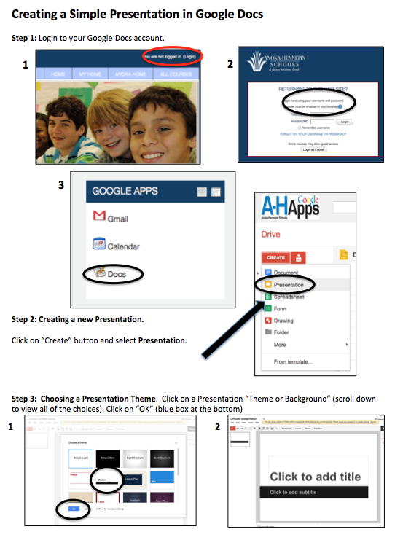

Slide 46
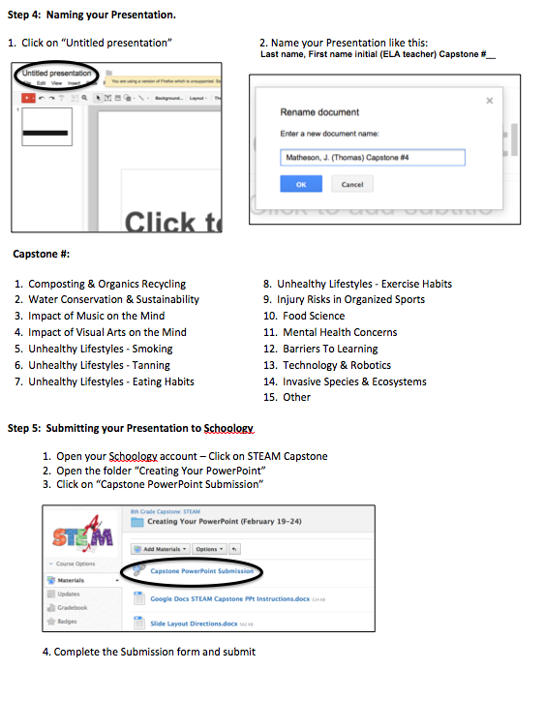

Slide 47
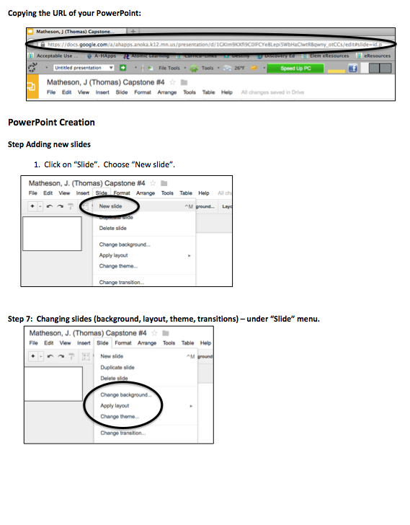

Slide 48
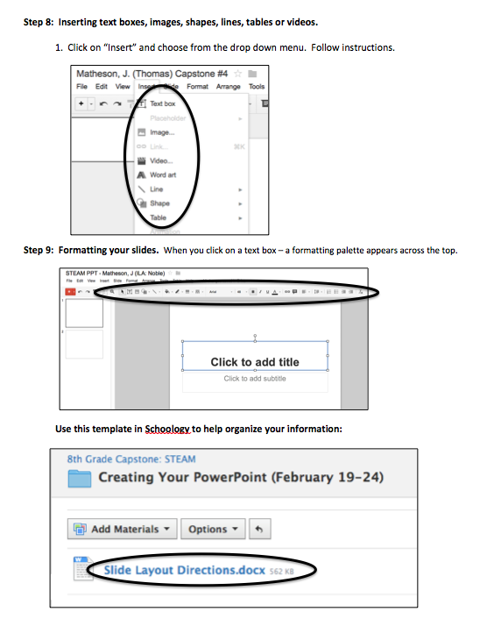

Slide 49
Information provided in part by:
Satyajeet Singh
satyajeet.singh@yahoo.com

