Slide 1
AP Language
Choice Book Unit

Slide 2
The Glass Castle by Jeannette Wells
Walls chronicles her upbringing at the hands of eccentric, nomadic parents--Rose Mary, her frustrated-artist mother, and Rex, her brilliant, alcoholic father. To call the elder Walls's childrearing style laissez faire would be putting it mildly. As Rose Mary and Rex, motivated by whims and paranoia, uprooted their kids time and again, the youngsters (Walls, her brother and two sisters) were left largely to their own devices. But while Rex and Rose Mary firmly believed children learned best from their own mistakes, they themselves never seemed to do so, repeating the same disastrous patterns that eventually landed them on the streets. (67 copies)

Slide 3
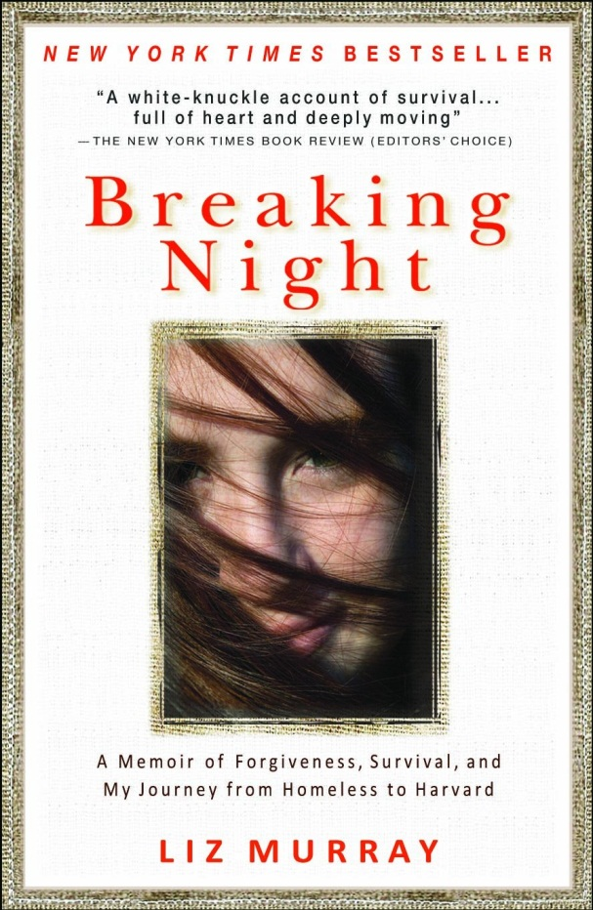
Breaking Night: …my Journey from Homeless to Harvard by Liz Murray
From runaway to Harvard student, Murray tells a story about turning her life around after growing up the neglected child of drug addicts. When Murray was born in 1980, her former beatnik father was in jail for illegally trafficking in prescription painkillers, and her mother, a cokehead since age 13, had just barely missed losing custody of their year-old daughter, Lisa. Murray writes that drugs were the "wrecking ball" that destroyed her family. By age 15, with the help of her best friend Sam and an elusive hustler, Carlos, she took permanently to the streets, relying on friends, sadly, for shelter. With the death of her mother, her runaway world came to an end. (38 copies)

Slide 4
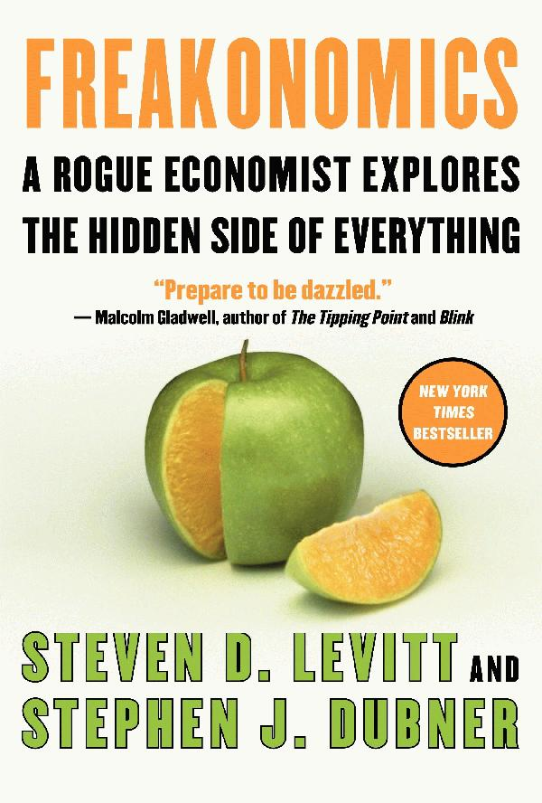
Freakonomics: by Steven Levitt & Stephen Subner
Freakonomics is a groundbreaking collaboration between Levitt and Stephen J. Dubner, an award-winning author and journalist. They set out to explore the inner workings of a crack gang, the truth about real estate agents, the secrets of the Ku Klux Klan, and much more. Through forceful storytelling and wry insight, they show that economics is, at root, the study of incentives—how people get what they want or need, especially when other people want or need the same thing. (30 copies)

Slide 5
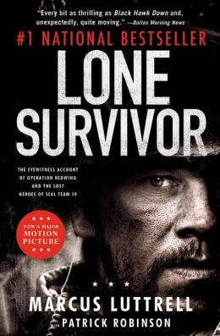
Lone Survivor: …the Lost Heroes of Seam Team 10 by Marcus Lutteral
This is the story of fire team leader Marcus Luttrell, the sole survivor of Operation Redwing, and the desperate battle in the mountains that led, ultimately, to the largest loss of life in Navy SEAL history. But it is also, more than anything, the story of his teammates, who fought ferociously beside him until he was the last one left-blasted unconscious by a rocket grenade, blown over a cliff, but still armed and still breathing. Over the next four days, badly injured and presumed dead, Luttrell fought off six al Qaeda assassins who were sent to finish him, then crawled for seven miles through the mountains before he was taken in by a Pashtun tribe, who risked everything to protect him from the encircling Taliban killers. (25 copies)

Slide 6
Columbine by Dave Cullen
In this remarkable account of the 1999 Columbine High School shooting, Cullen not only dispels several of the prevailing myths about the event but tackles the hardest question of all: why did it happen? Drawing on extensive interviews, police reports and his own reporting, Cullen meticulously pieces together what happened when 18-year-old Eric Harris and 17-year-old Dylan Klebold killed 13 people before turning their guns on themselves. Readers will come away from Cullen's unflinching account with a deeper understanding of what drove these boys to kill, even if the answers aren't easy to stomach. (28 copies)

Slide 7
American Sniper by Chris Kyle
Kyle’s riveting first-person account of how he went from Texas rodeo cowboy to expert marksman and feared assassin offers a fascinating view of modern-day warfare and one of the most in-depth and illuminating looks into the secret world of Special Ops ever written. (22 copies)

Slide 8
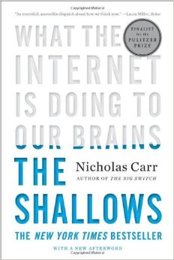
The Shallows: What the Internet is Doing to Our Brain by Nicholas Carr
Building on the insights of thinkers from Plato to McLuhan, Carr makes a convincing case that every information technology carries an intellectual ethic—a set of assumptions about the nature of knowledge and intelligence. He explains how the printed book served to focus our attention, promoting deep and creative thought. In stark contrast, the Internet encourages the rapid, distracted sampling of small bits of information from many sources. Its ethic is that of the industrialist, an ethic of speed and efficiency, of optimized production and consumption—and now the Net is remaking us in its own image. We are becoming ever more adept at scanning and skimming, but what we are losing is our capacity for concentration, contemplation, and reflection. (10 copies)

Slide 9
Zeitoun by Dave Eggers
Through the story of one man’s experience after Hurricane Katrina, Eggers draws an indelible picture of Bush-era crisis management. Abdulrahman Zeitoun, a successful Syrian-born painting contractor, decides to stay in New Orleans and protect his property while his family flees. After the levees break, he uses a small canoe to rescue people, before being arrested by an armed squad and swept powerlessly into a vortex of bureaucratic brutality. When a guard accuses him of being a member of Al Qaeda, he sees that race and culture may explain his predicament. Eggers, compiling his account from interviews, sensibly resists rhetorical grandstanding, letting injustices speak for themselves. His skill is most evident in how closely he involves the reader in Zeitoun’s thoughts. Thrown into one of a series of wire cages, Zeitoun speculates, with a contractor’s practicality, that construction of his prison must have begun within a day or so of the hurricane. (10 copies)

Slide 10
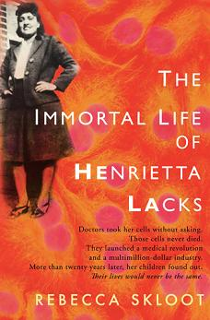
The Immortal Life of Henrietta Lacks by Rebecca Skloot
From a single, abbreviated life grew a seemingly immortal line of cells that made some of the most crucial innovations in modern science possible. And from that same life, and those cells, Rebecca Skloot has fashioned in The Immortal Life of Henrietta Lacks a fascinating and moving story of medicine and family, of how life is sustained in laboratories and in memory. Henrietta Lacks was a mother of five in Baltimore, a poor African American migrant from the tobacco farms of Virginia, who died from a cruelly aggressive cancer at the age of 30 in 1951. A sample of her cancerous tissue, taken without her knowledge or consent, as was the custom then, turned out to provide one of the holy grails of mid-century biology: human cells that could survive--even thrive--in the lab. Known as HeLa cells, their stunning potency gave scientists a building block for countless breakthroughs, beginning with the cure for polio. Meanwhile, Henrietta's family continued to live in poverty and frequently poor health, and their discovery decades later of her unknowing contribution--and her cells' strange survival--left them full of pride, anger, and suspicion. (9 copies)

Slide 11
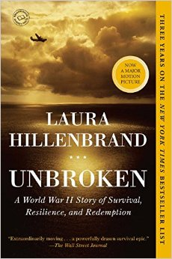
Unbroken: A World War II Story of Survival… by Laura Hillenbrand
In boyhood, Louis Zamperini was an incorrigible delinquent. As a teenager, he channeled his defiance into running, discovering a prodigious talent that had carried him to the Berlin Olympics. But when World War II began, the athlete became an airman, embarking on a journey that led to a doomed flight on a May afternoon in 1943. When his Army Air Forces bomber crashed into the Pacific Ocean, against all odds, Zamperini survived, adrift on a foundering life raft. Ahead of Zamperini lay thousands of miles of open ocean, leaping sharks, thirst and starvation, enemy aircraft, and, beyond, a trial even greater. Driven to the limits of endurance, Zamperini would answer desperation with ingenuity; suffering with hope, resolve, and humor; brutality with rebellion. His fate, whether triumph or tragedy, would be suspended on the fraying wire of his will. (9 copies)

Slide 12
Overview
4 Reading Dates
Wednesday, 2/11: _____________
Wednesday, 2/18: _______________
Monday, 2/23:_____________
Thursday, 2/26:_______________
2 Commentaries
Wednesday, 2/18: _______________
Thursday, 2/26:_______________
1 Panel Presentation

