Slide 1
Art Department
Course Offerings

Slide 2
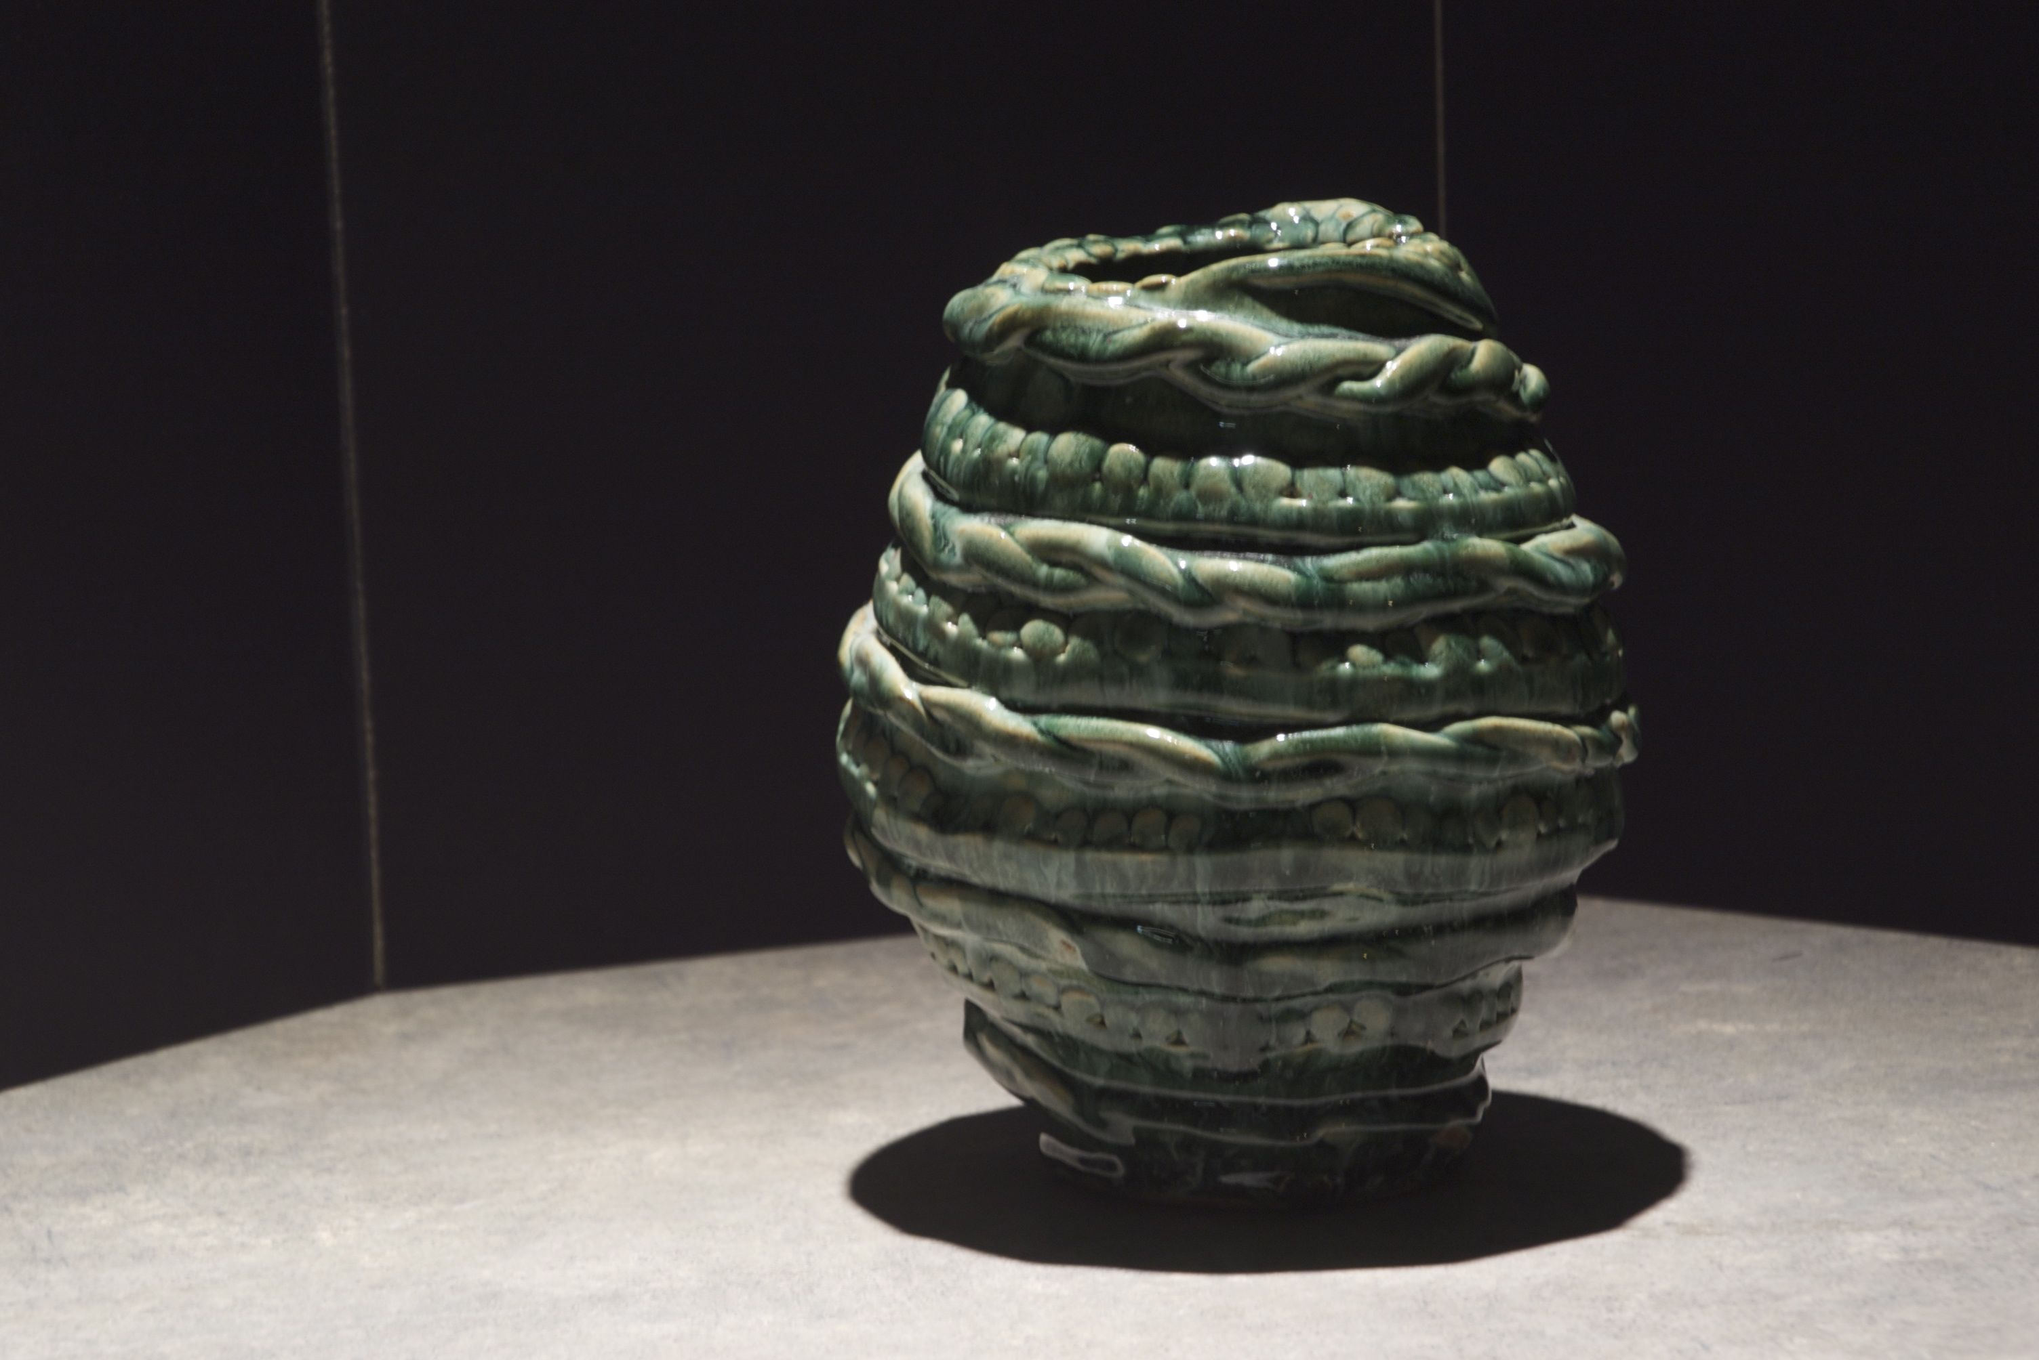
Ceramics

Slide 3
Ceramics
Major Projects
  Textured Sphere
  Candleholder
  Coil Vase
  Slab Mug
  Slab Vase
  Teapots
  Wheel thrown cups, mugs, bowls
  Hamada Bottle
  Tiles
  Raku and Alternative Firing

Slide 4
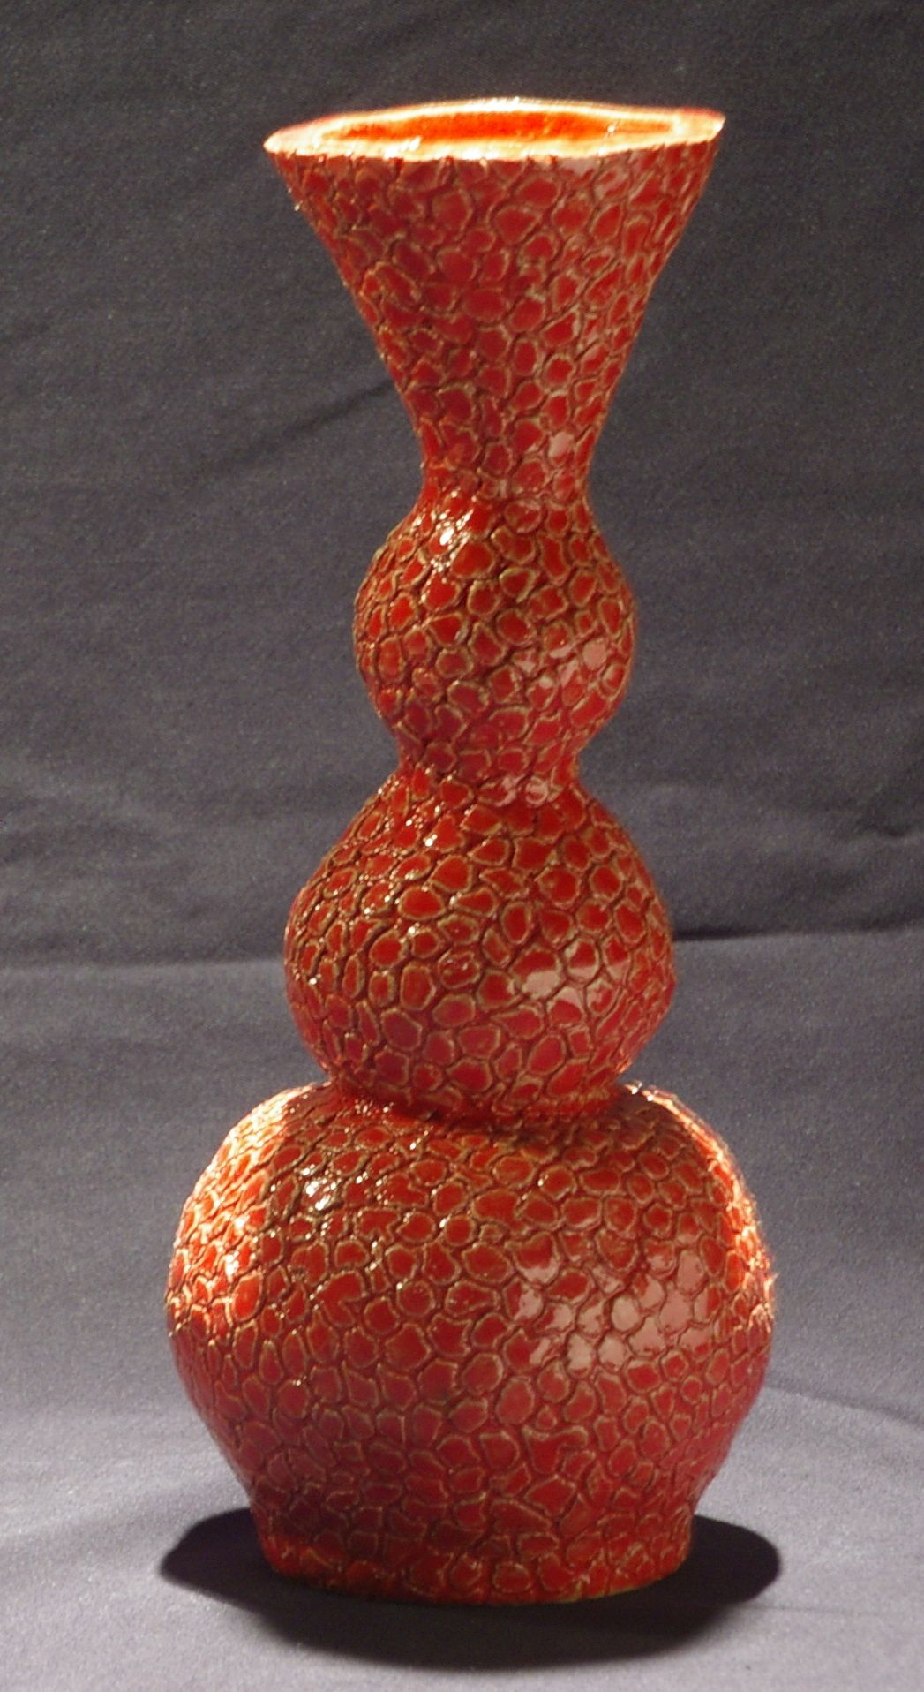
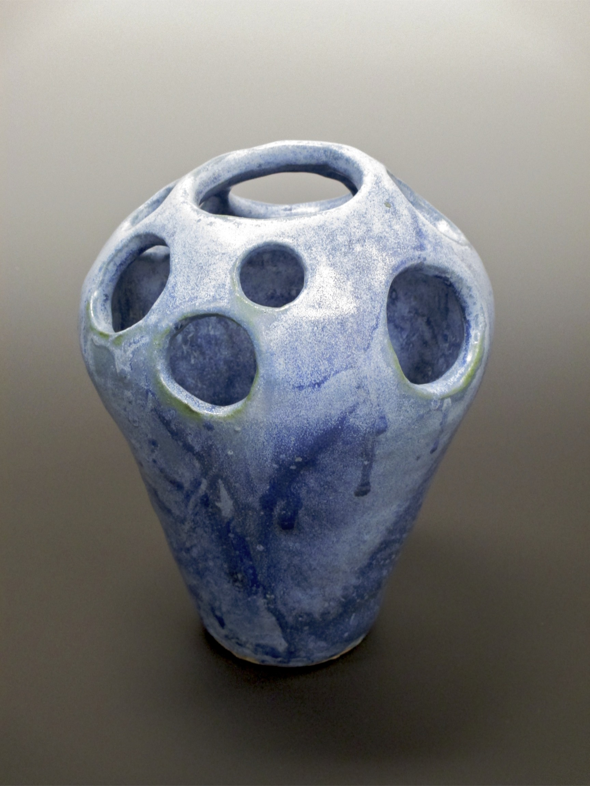
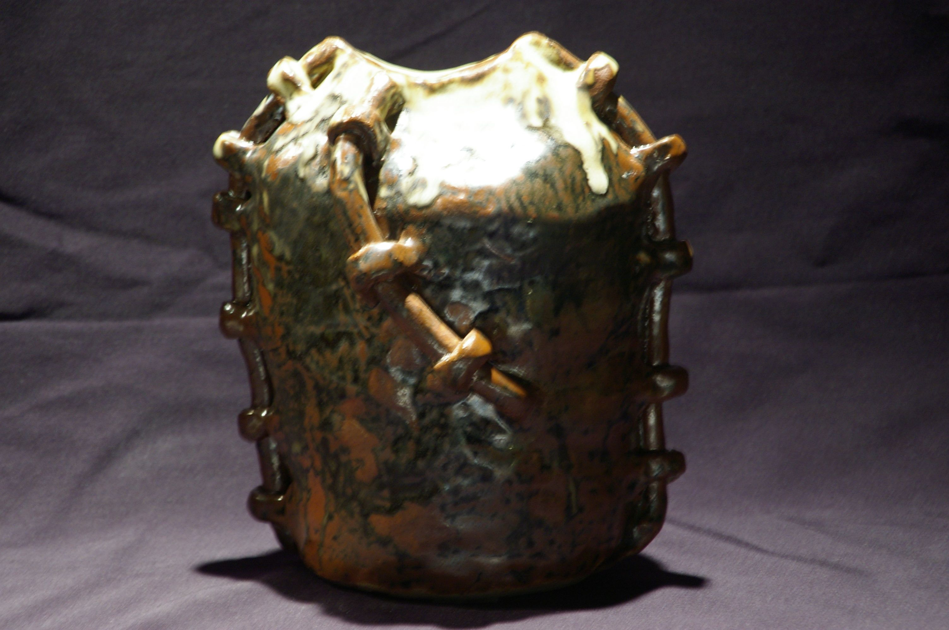
Final Coil
Project

Slide 5
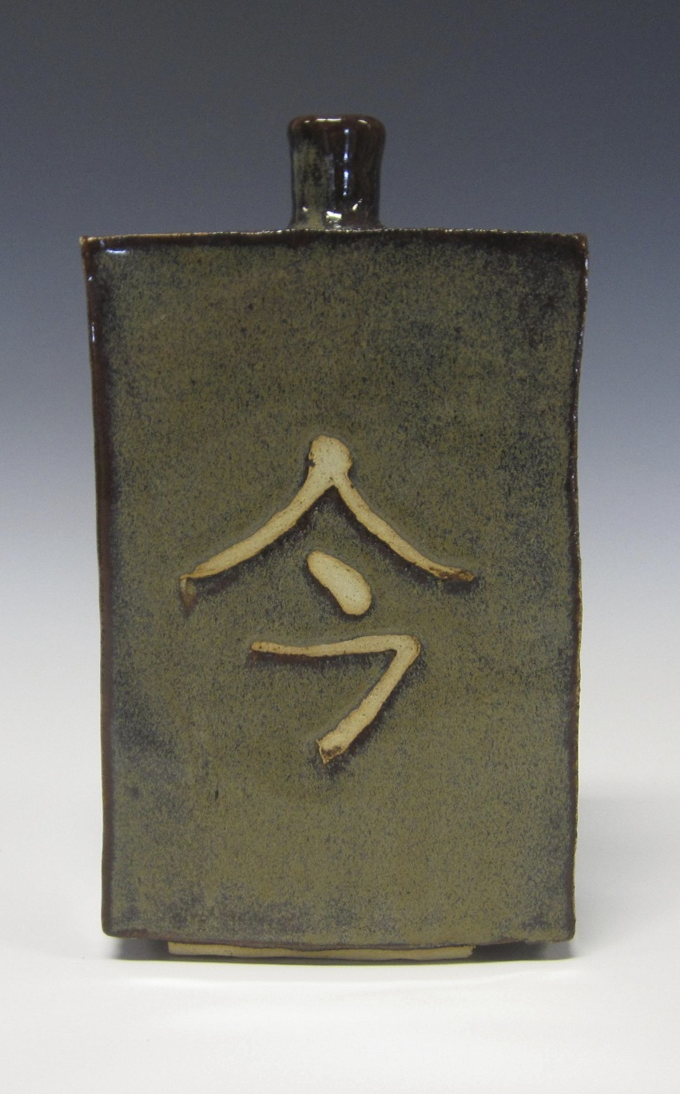
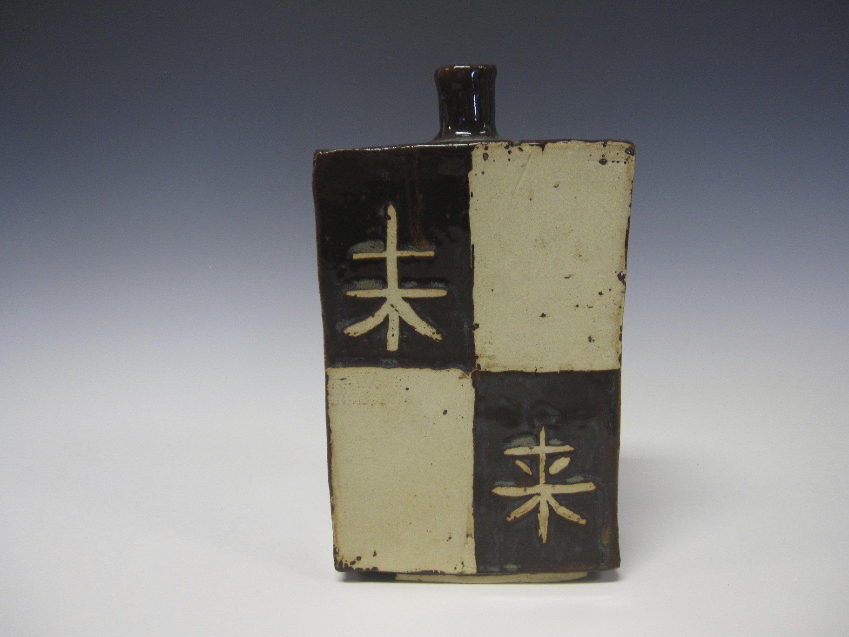
Hamada Bottle

Slide 6
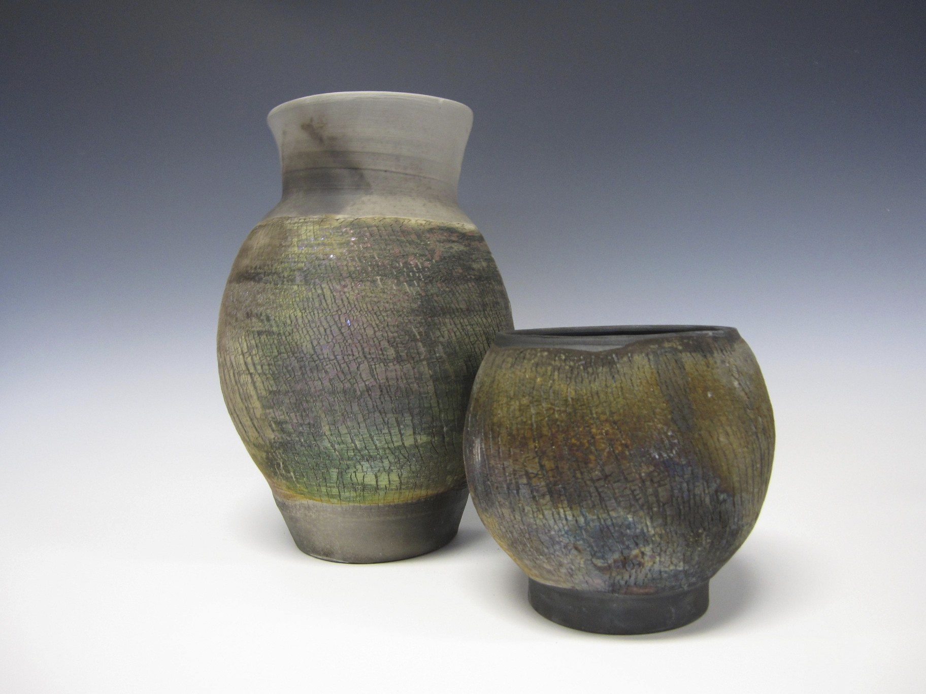
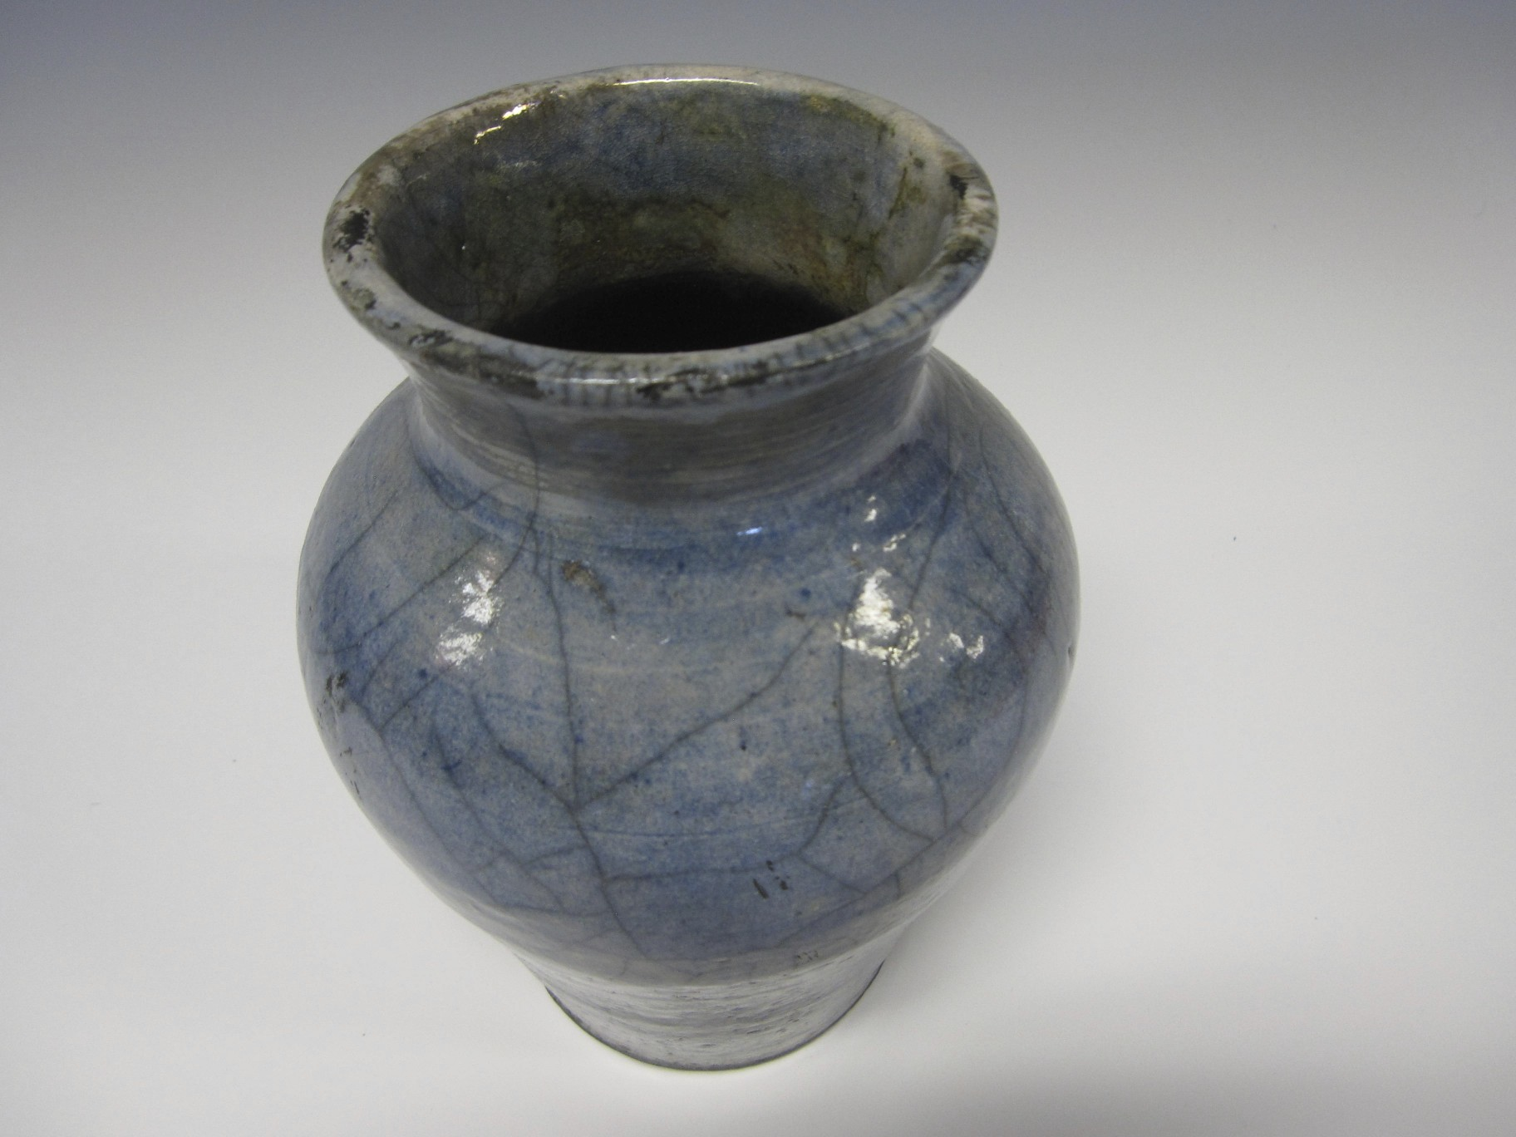
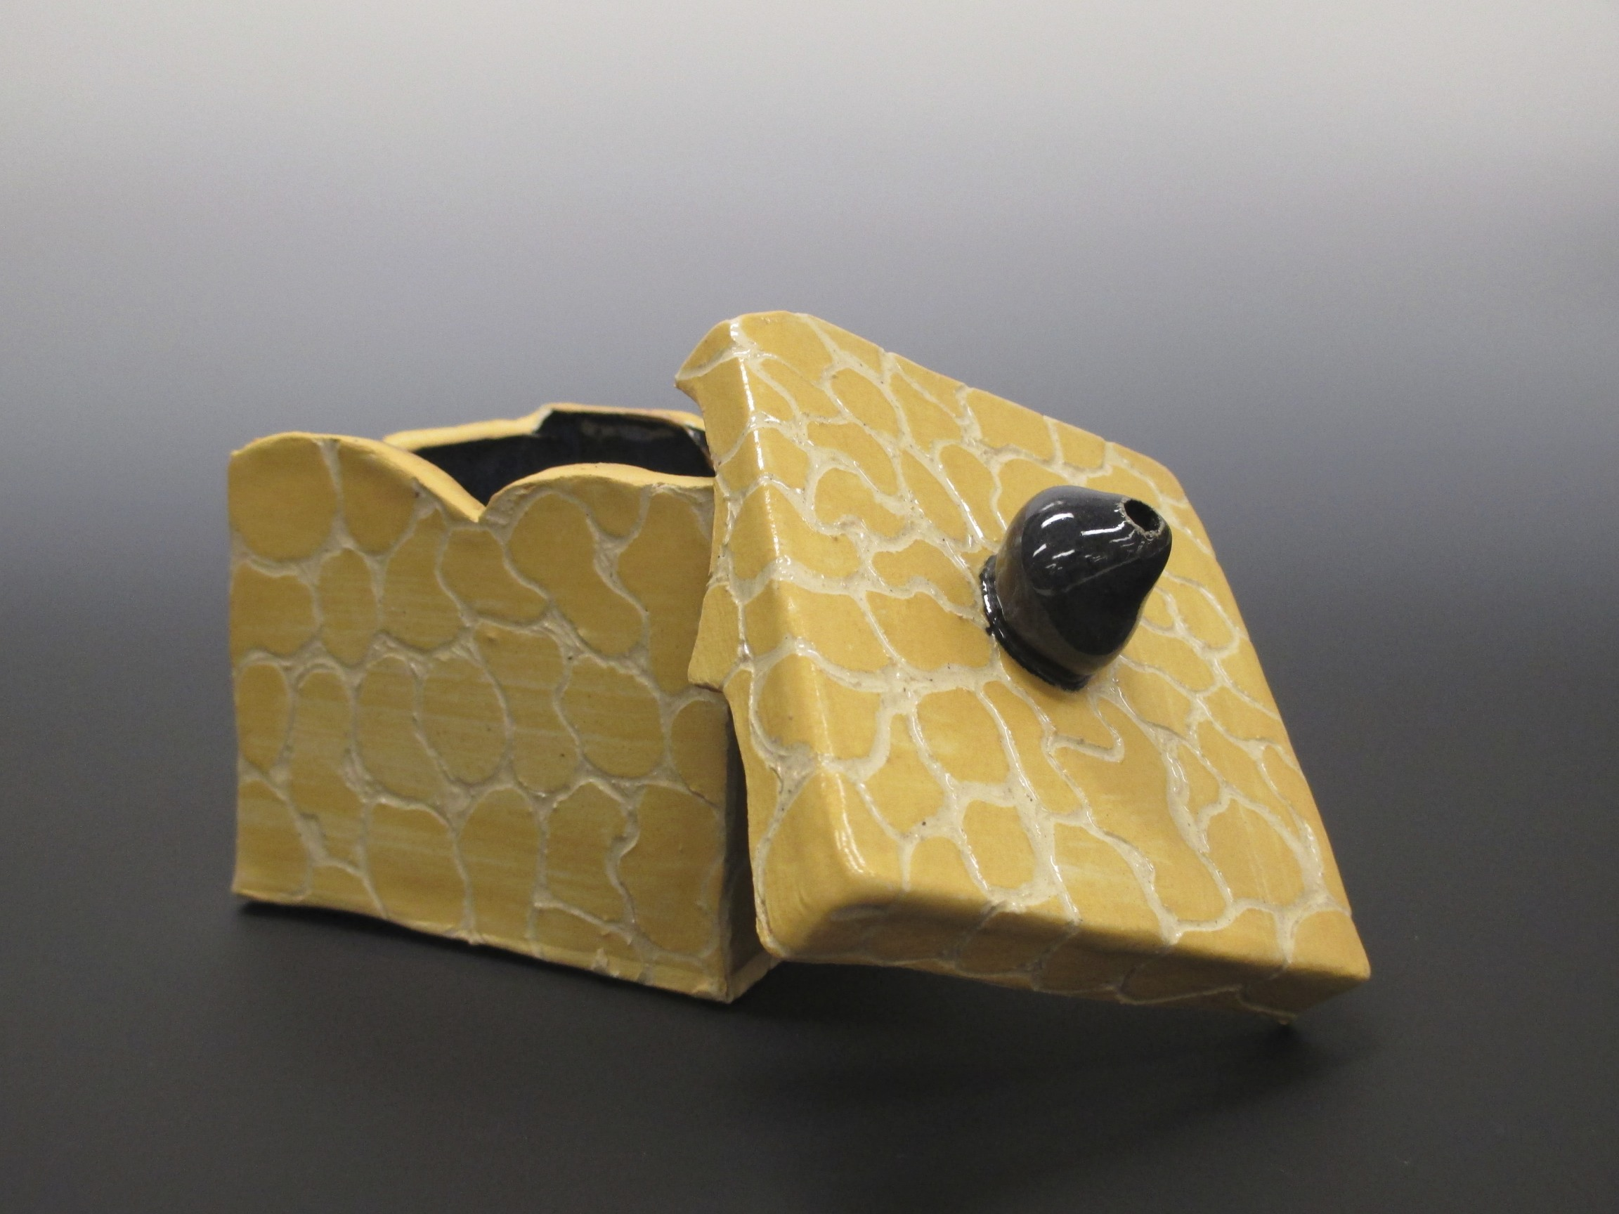

Slide 7
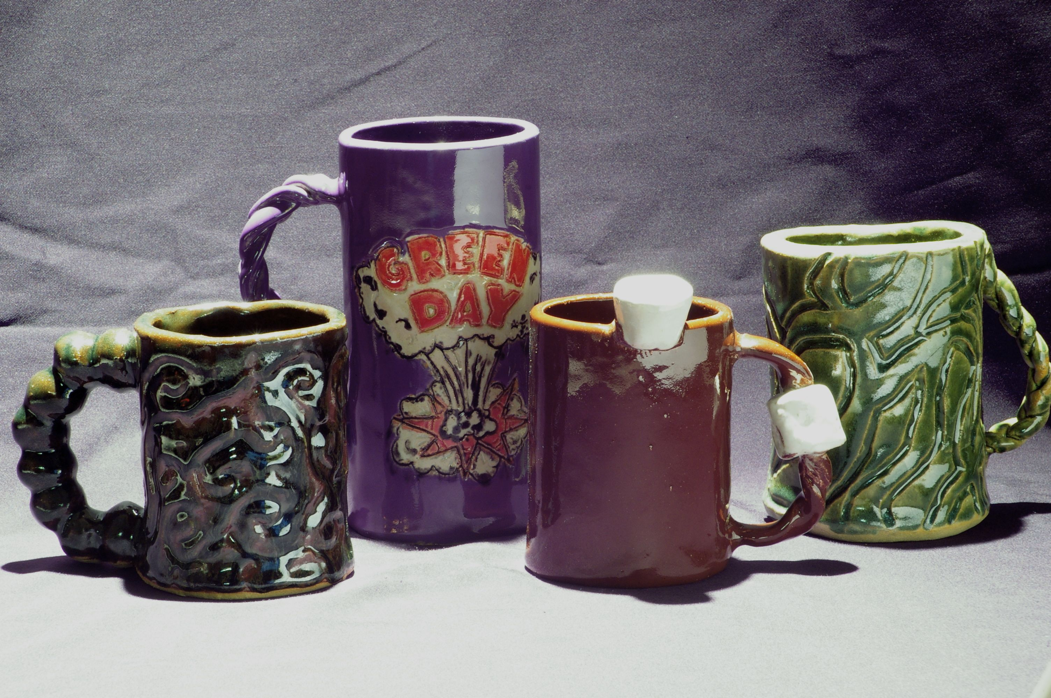
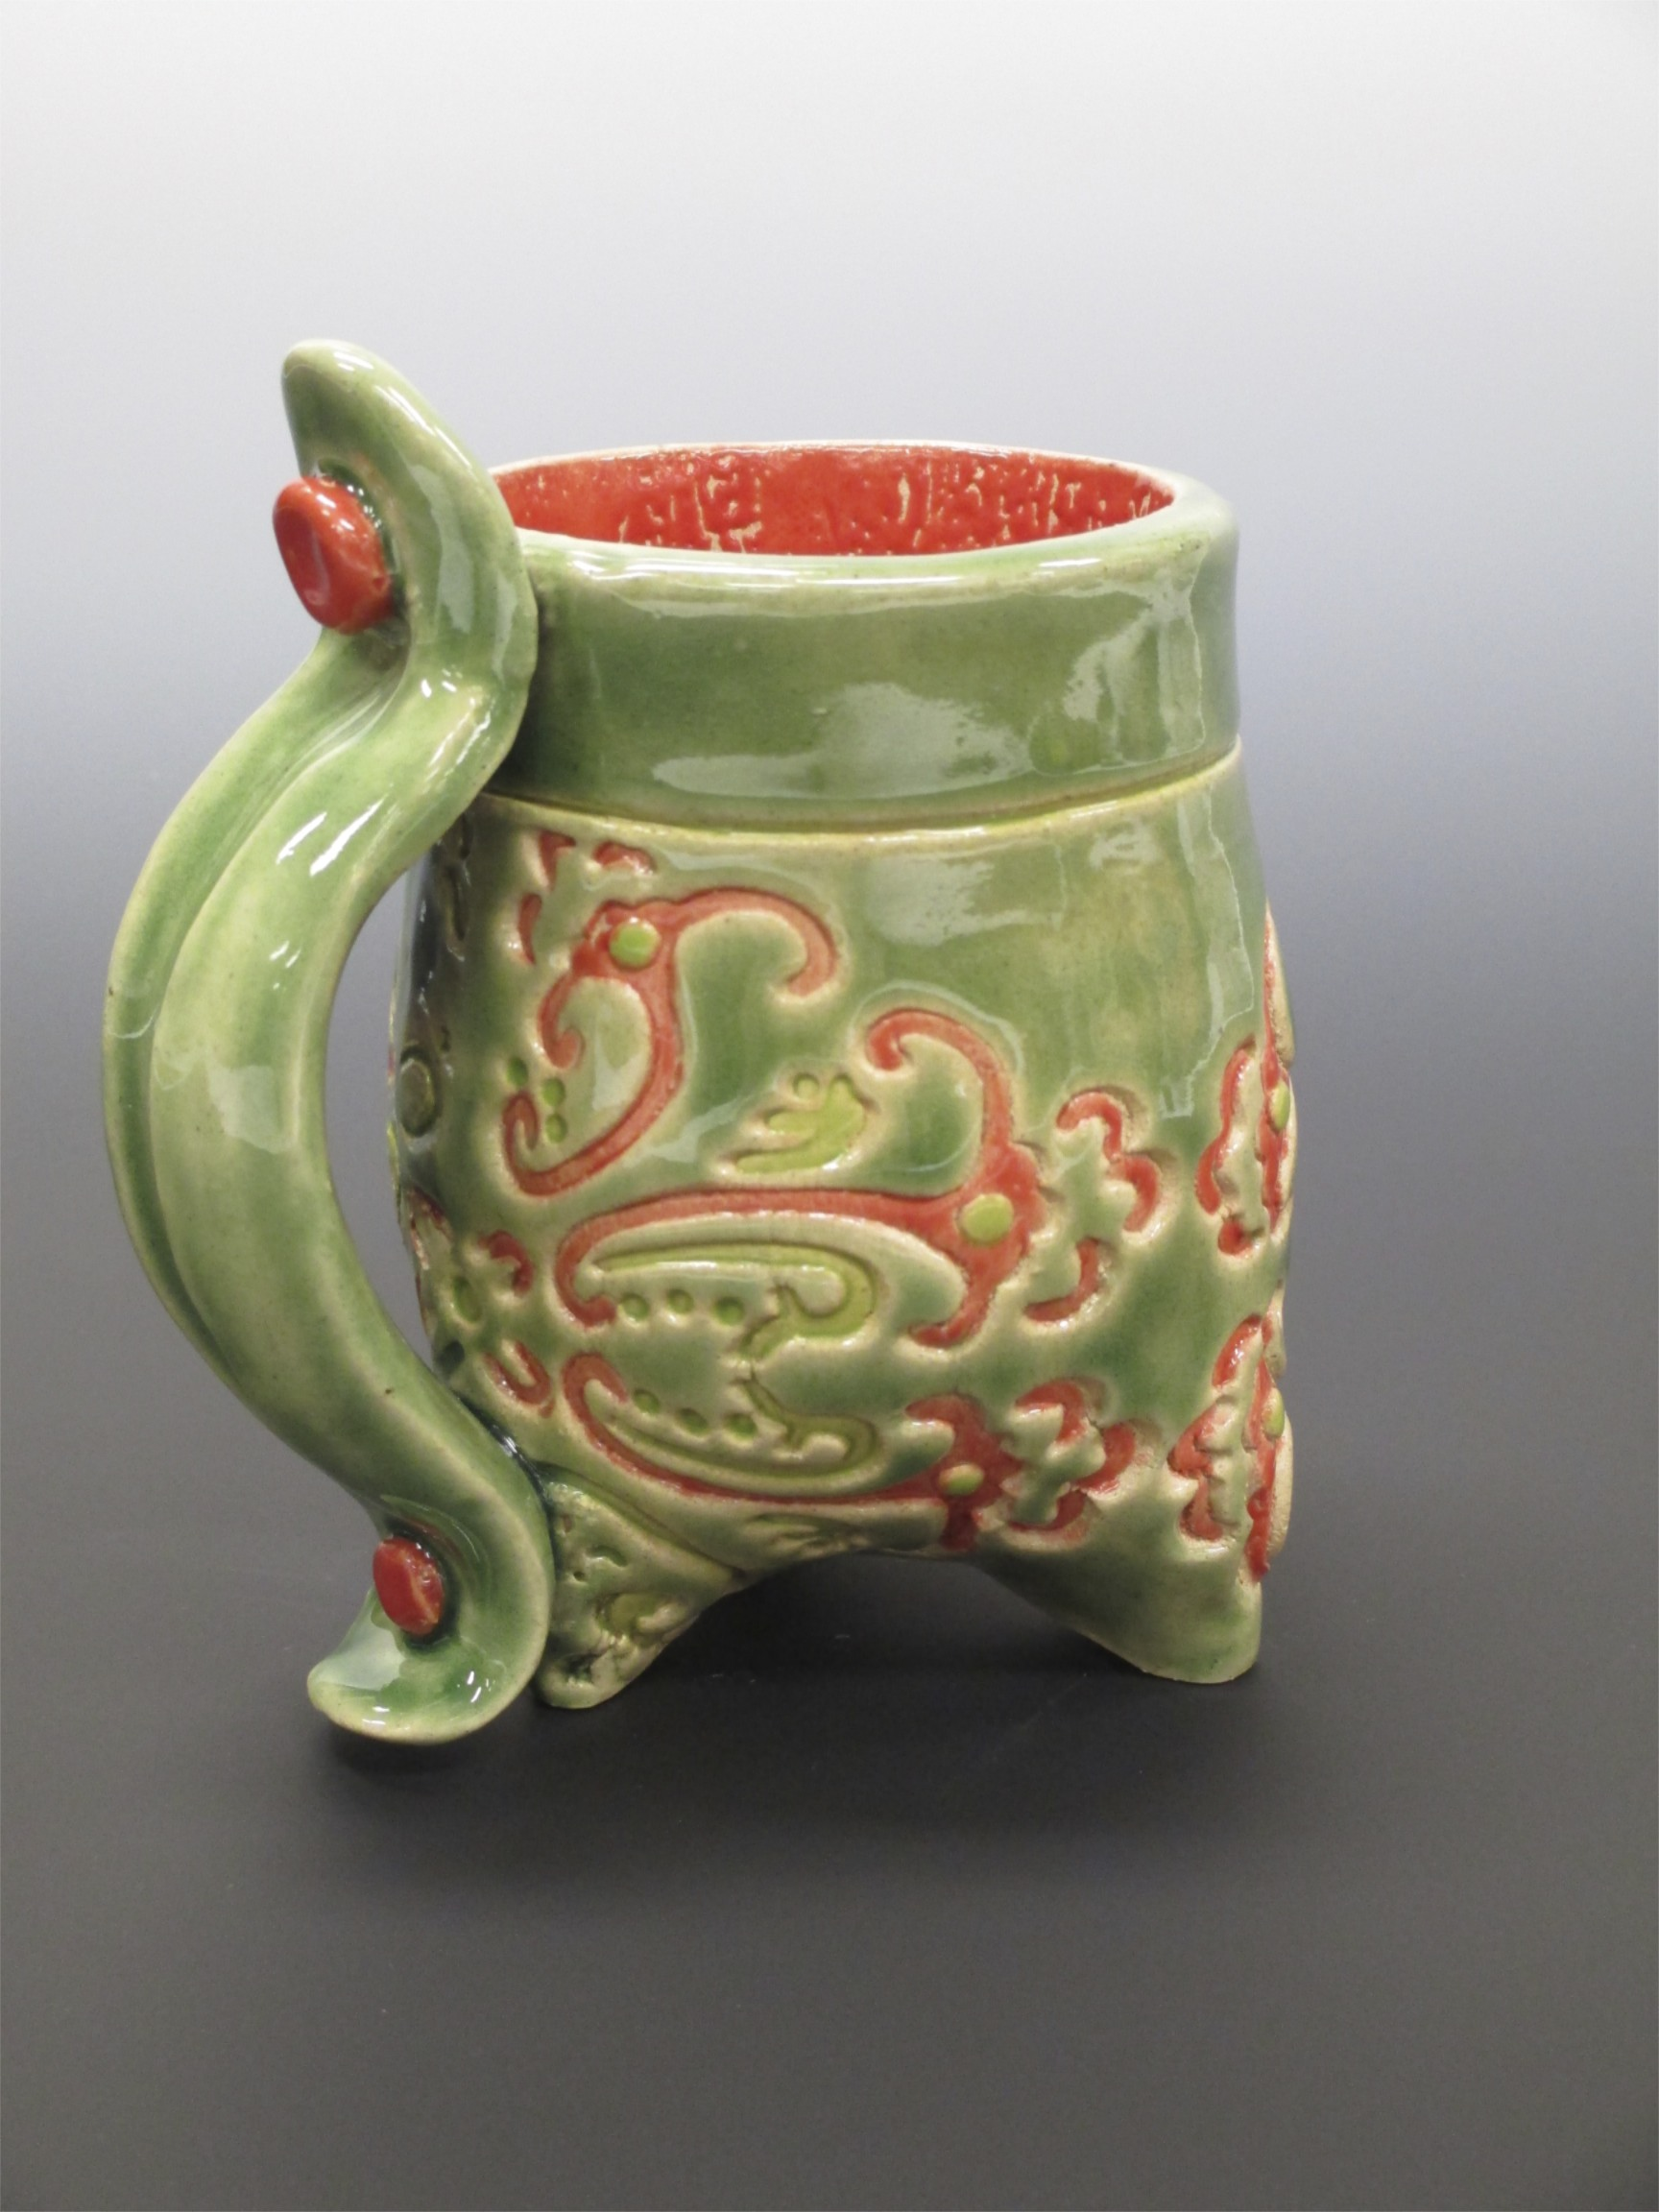
Ceramic Mug

Slide 8
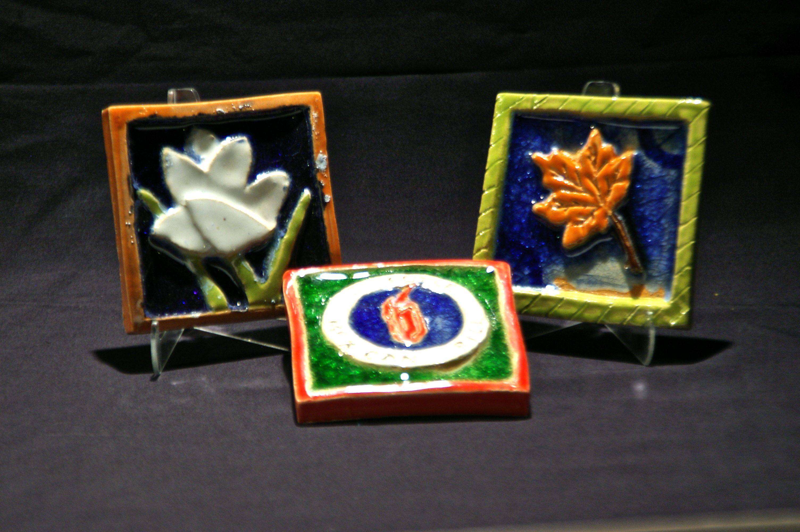
Ceramic Tile Project

Slide 9
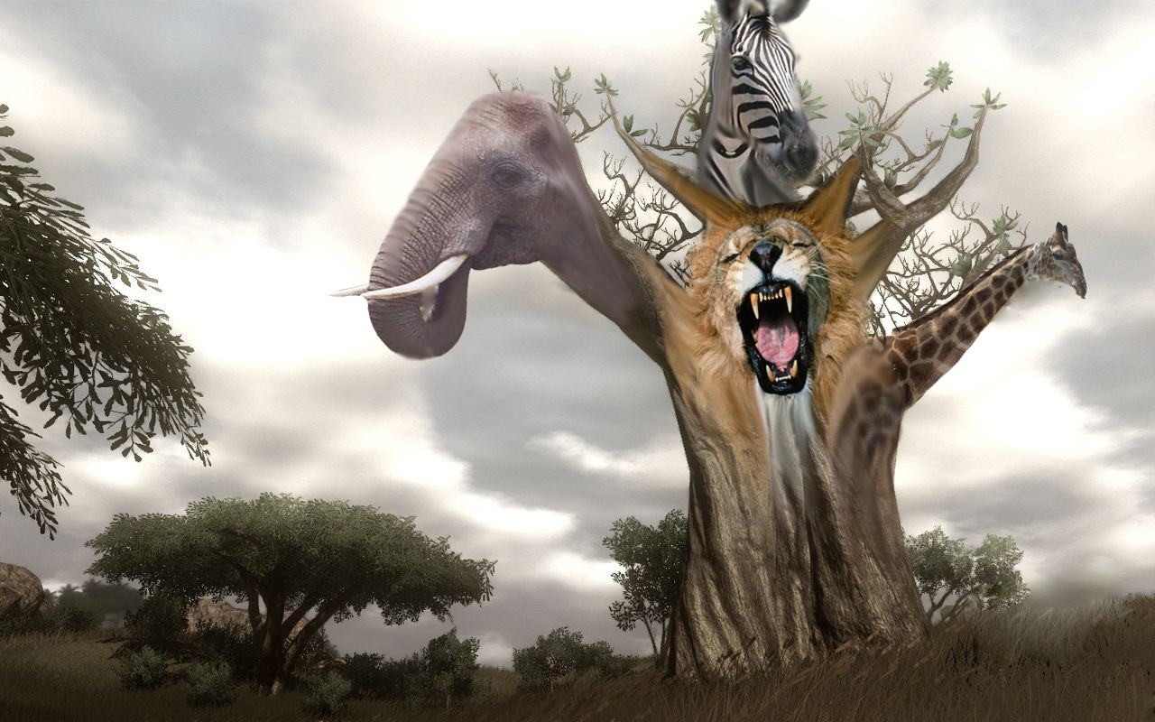
Computer Art

Slide 10
Computer Art
Major Projects
  Zombie Illustration
  Andy Warhol Digital Portrait
  Celebrity Digital Painting
  Animated GIF’s
  Fantasy Landscape
  Fantasy Portrait

Slide 11

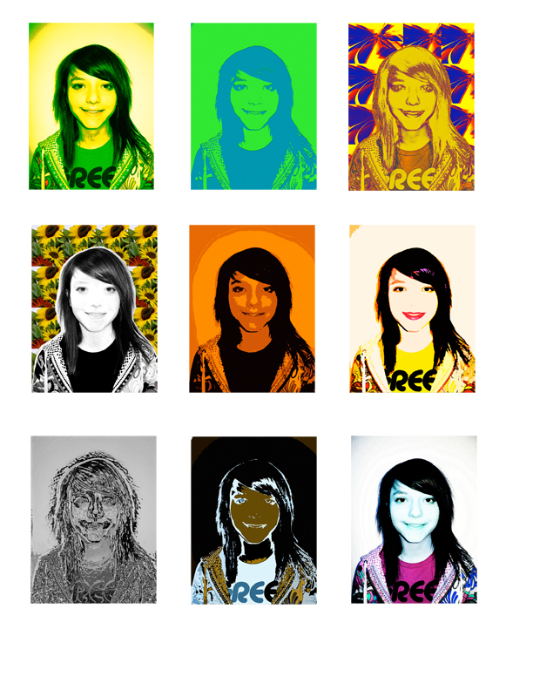
Andy Warhol Self Portrait

Slide 12
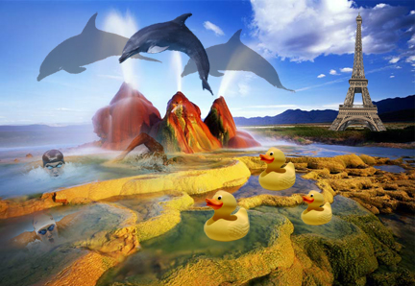

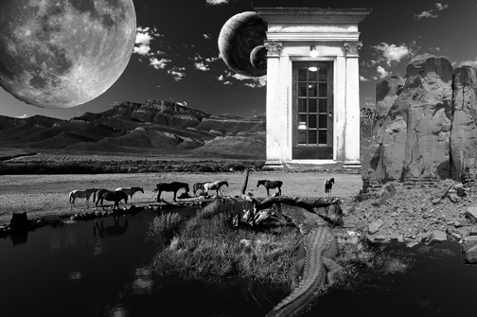
Photoshop Fantasy Landscape

Slide 13


Book Cover Design

Slide 14
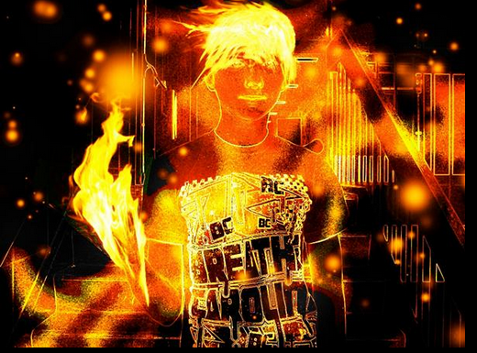

Slide 15
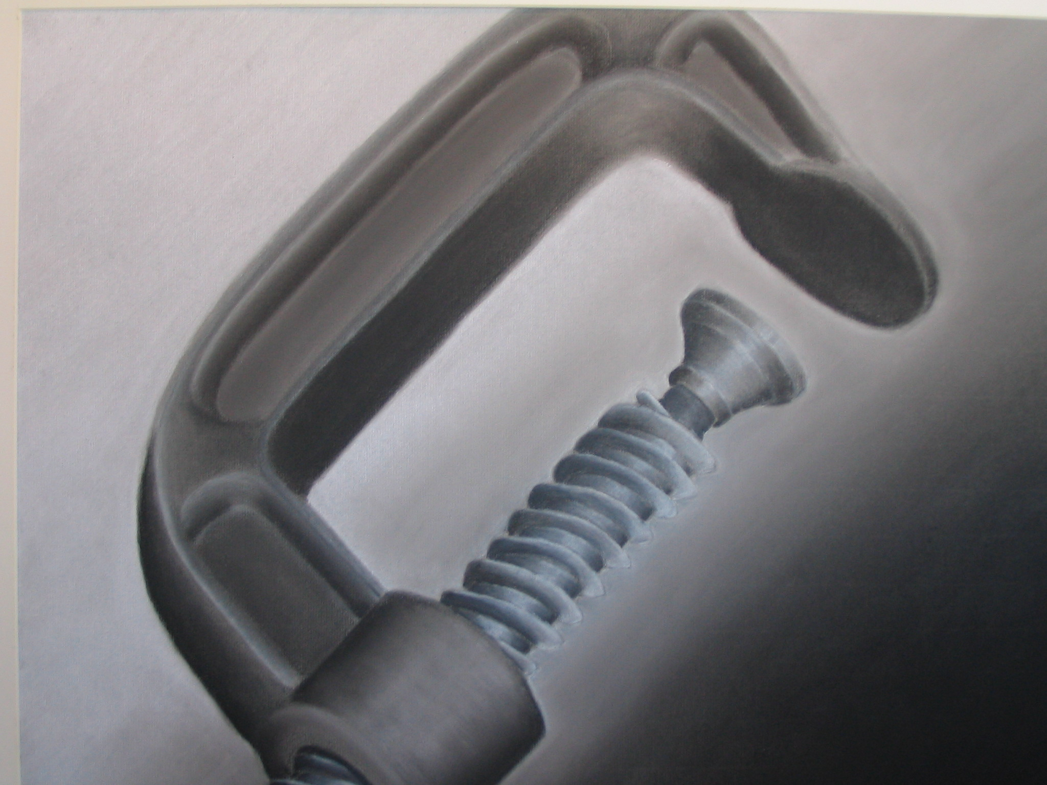
Drawing

Slide 16
Drawing
Major Projects
  Self Portrait
  Contour Line Drawing
  Still Life in Pencil, Charcoal, Pastel
  Landscapes
  Tribute Drawing
  Expressive Portrait

Slide 17
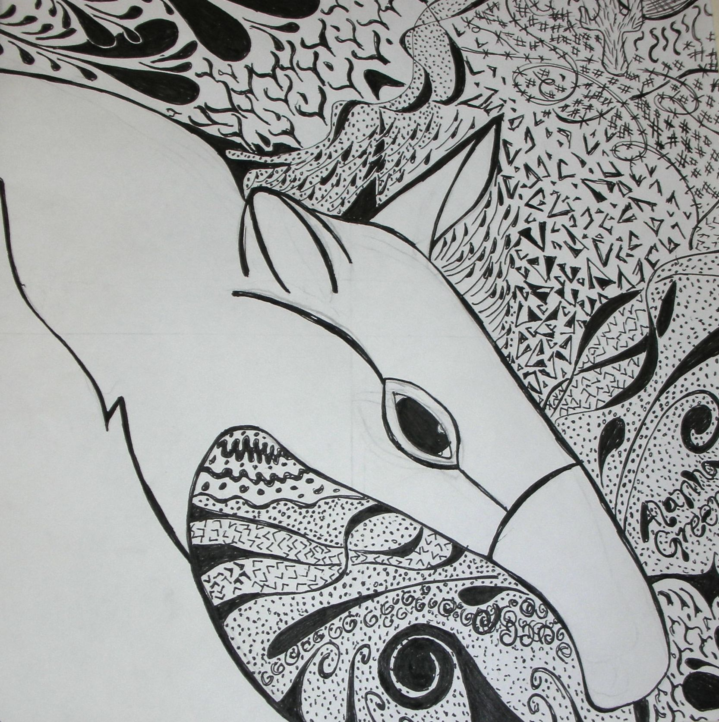
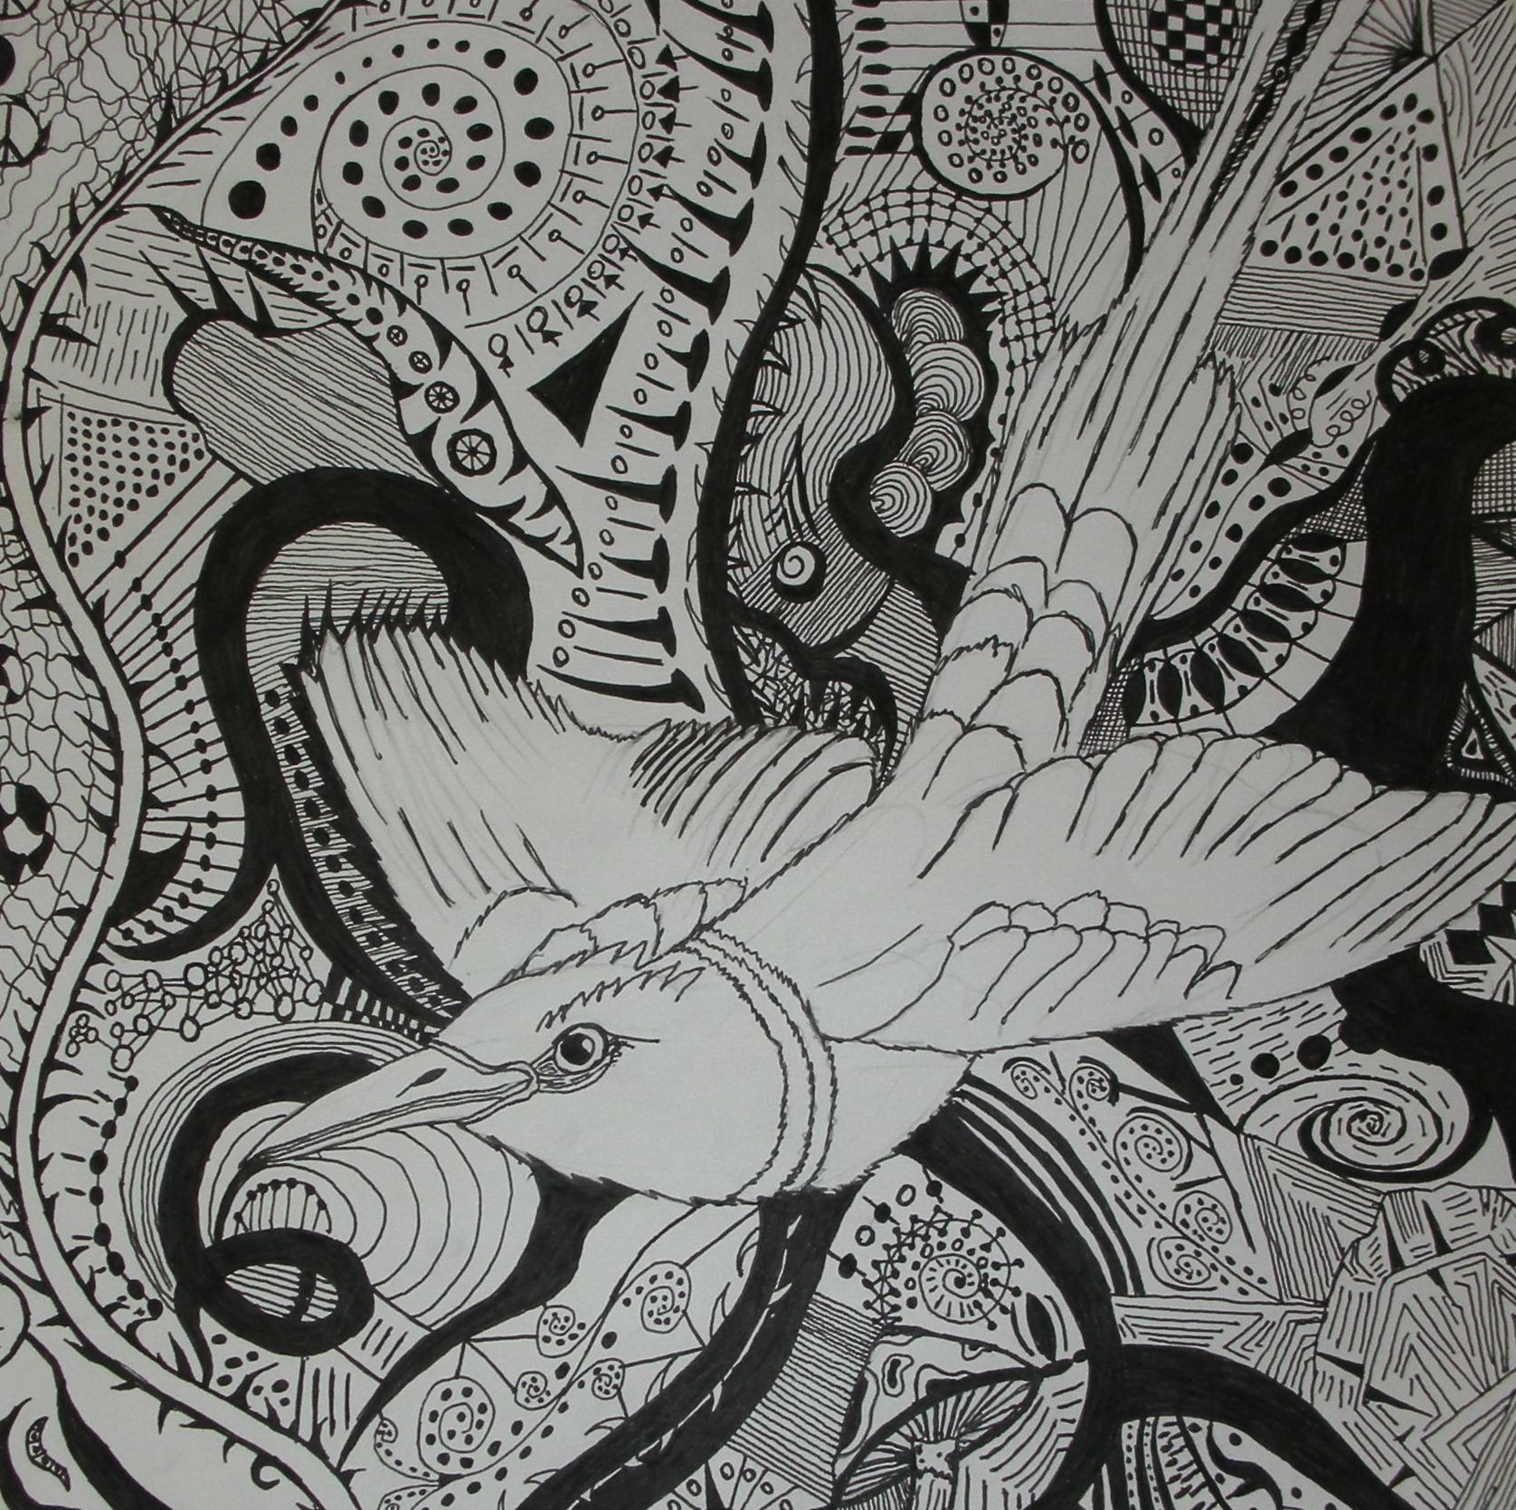
Contour Line

Slide 18
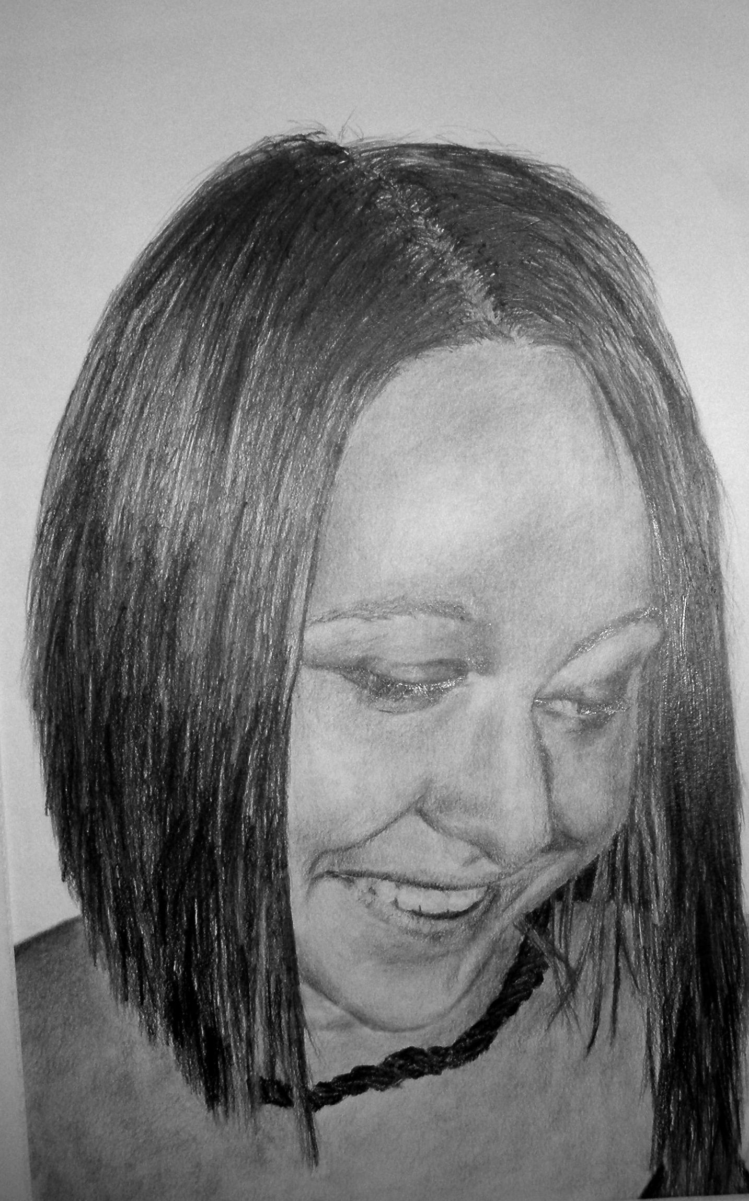
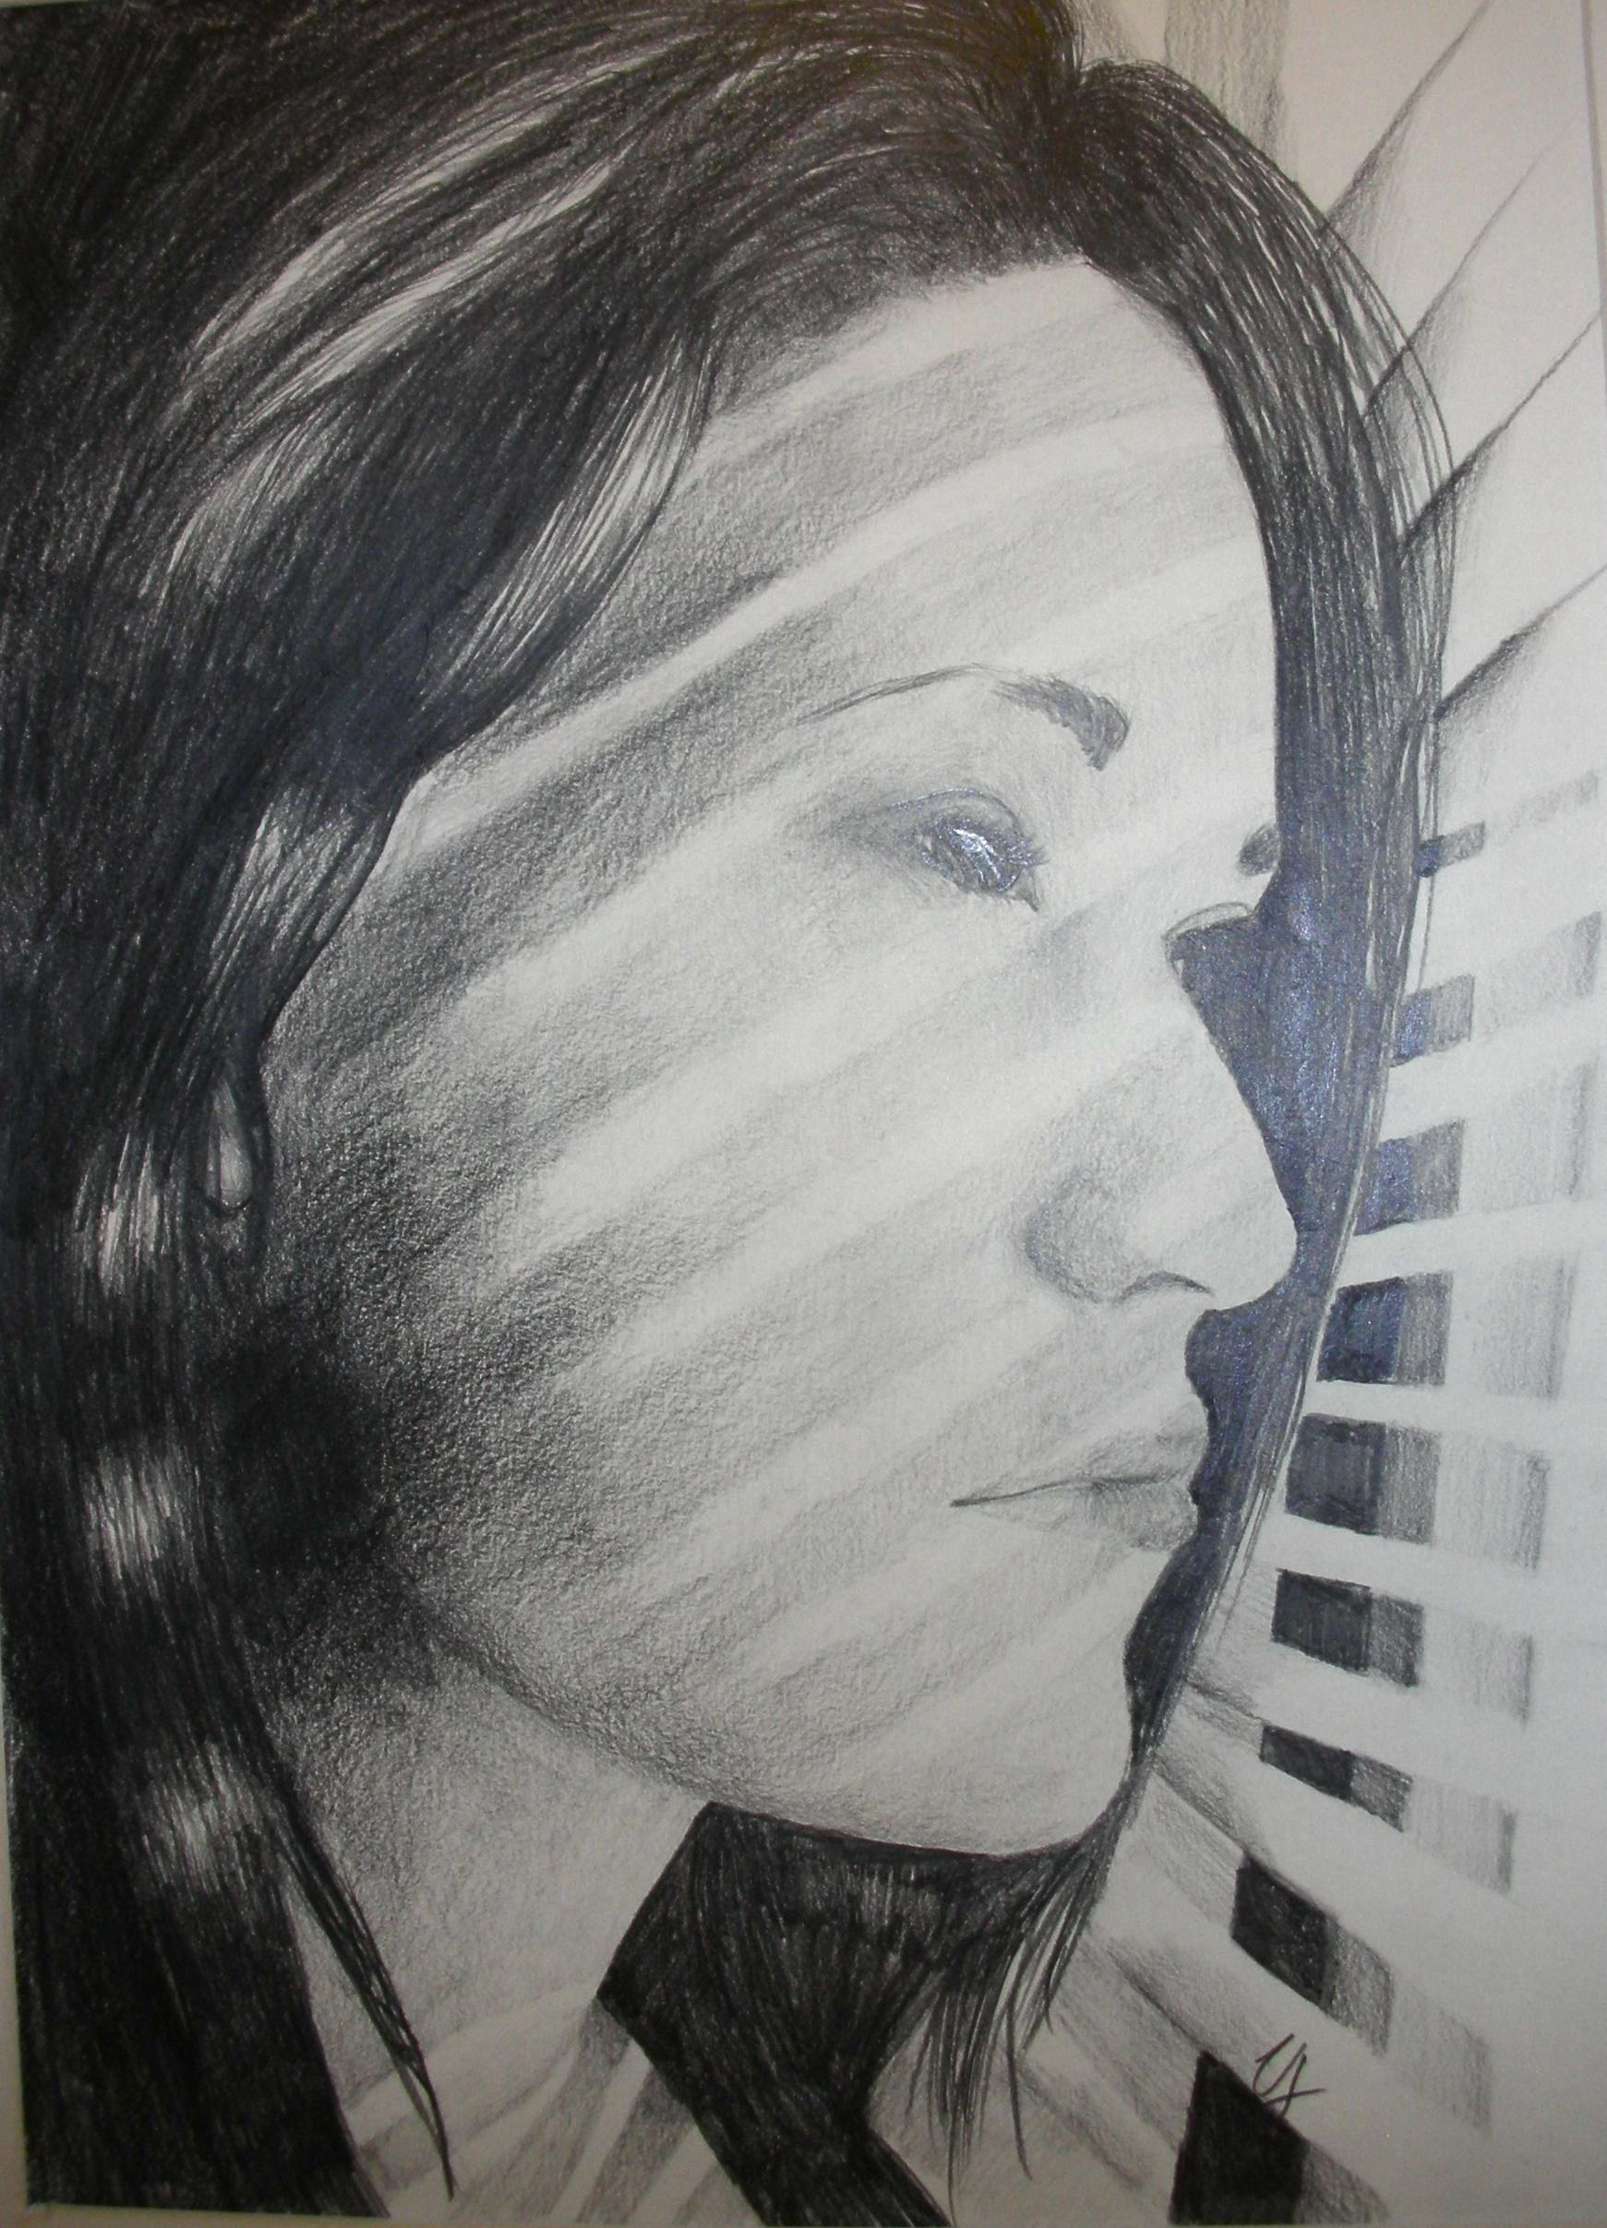
Self Portrait

Slide 19
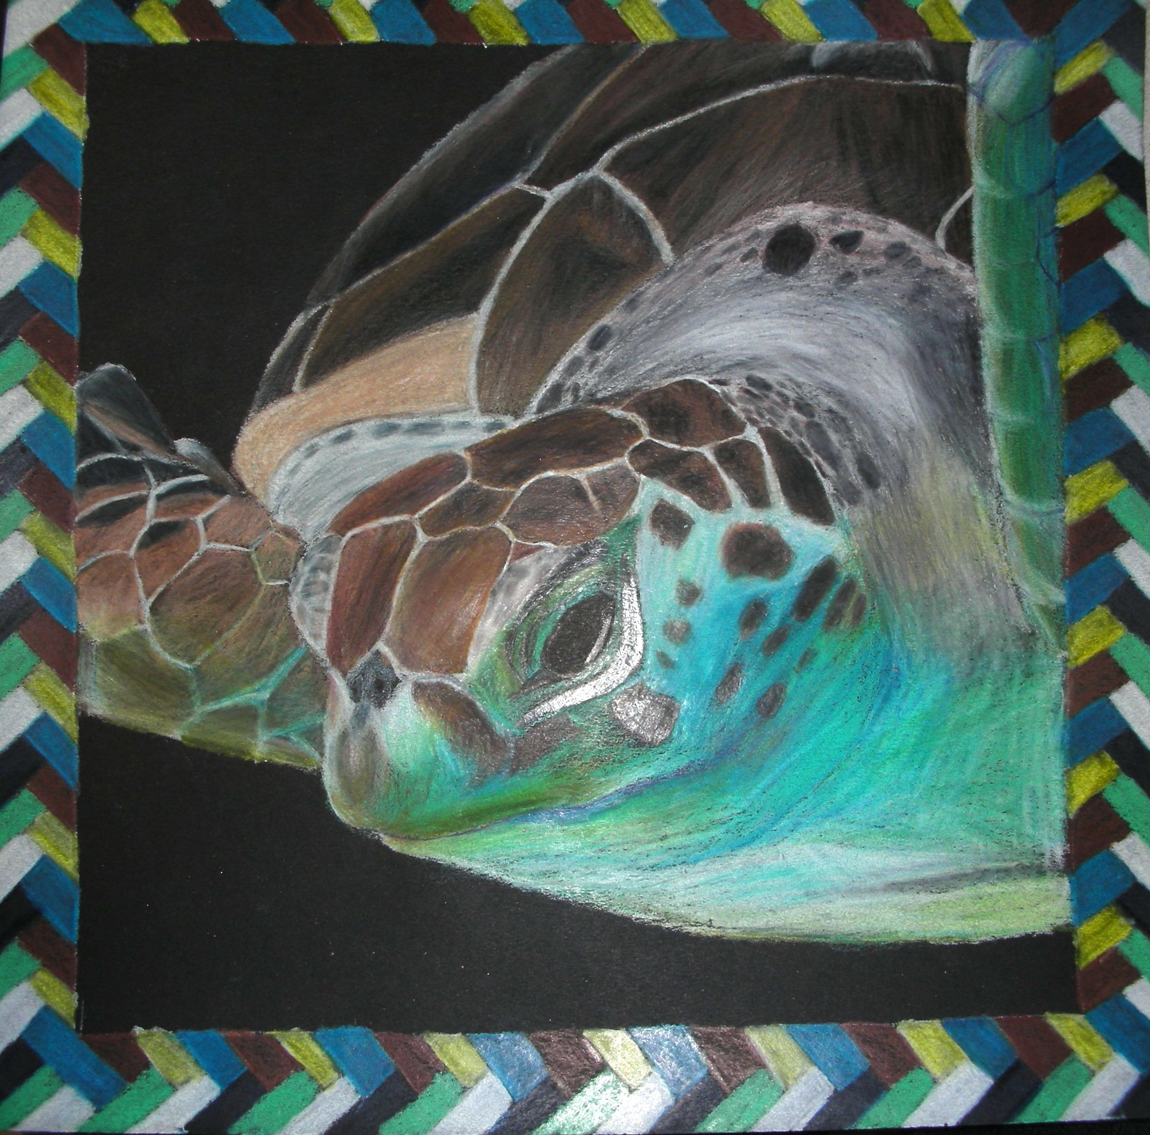
Colored Pencil

Slide 20
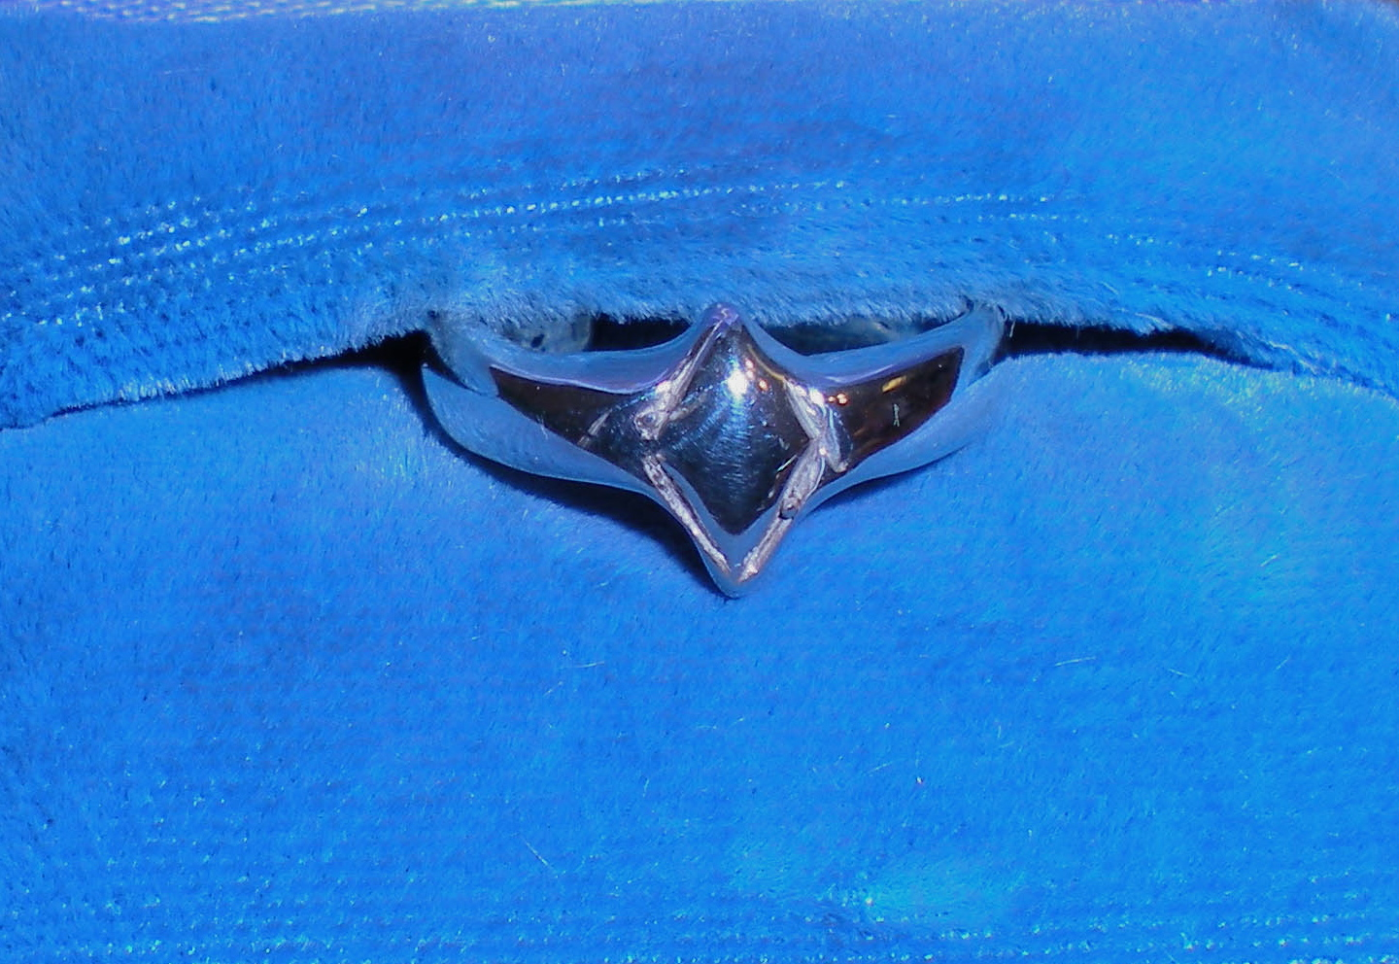
Jewelry and Craft Design

Slide 21
Jewelry and Craft Design
Major Projects
  Cast Silver Ring
  Wire Rings
  Handmade Books
  Clay Jewelry
  Fibers
  Fabricated Jewelry

Slide 22
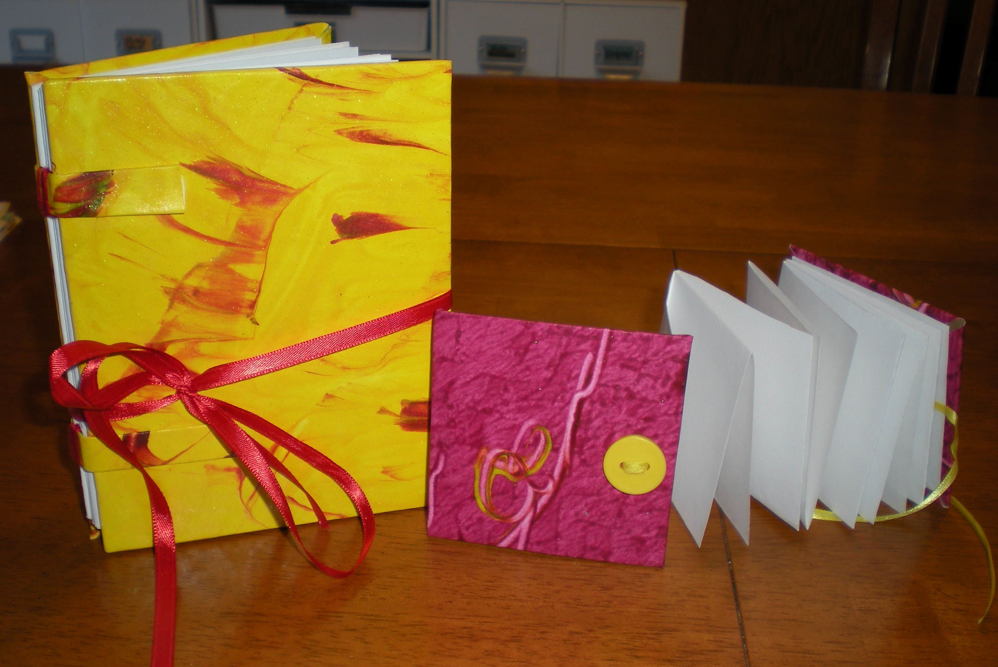
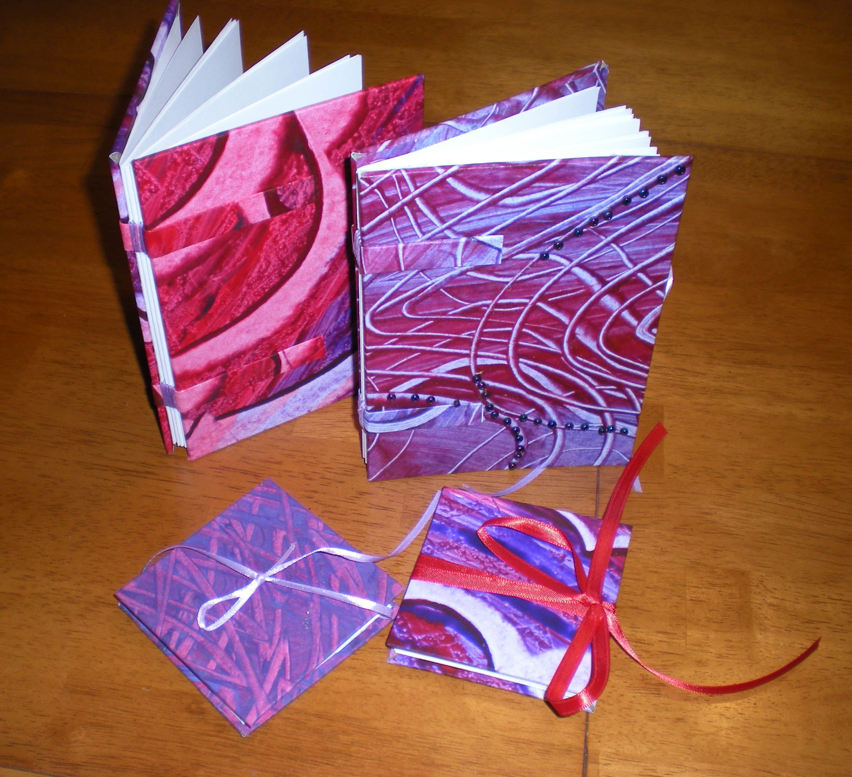
Bookmaking

Slide 23
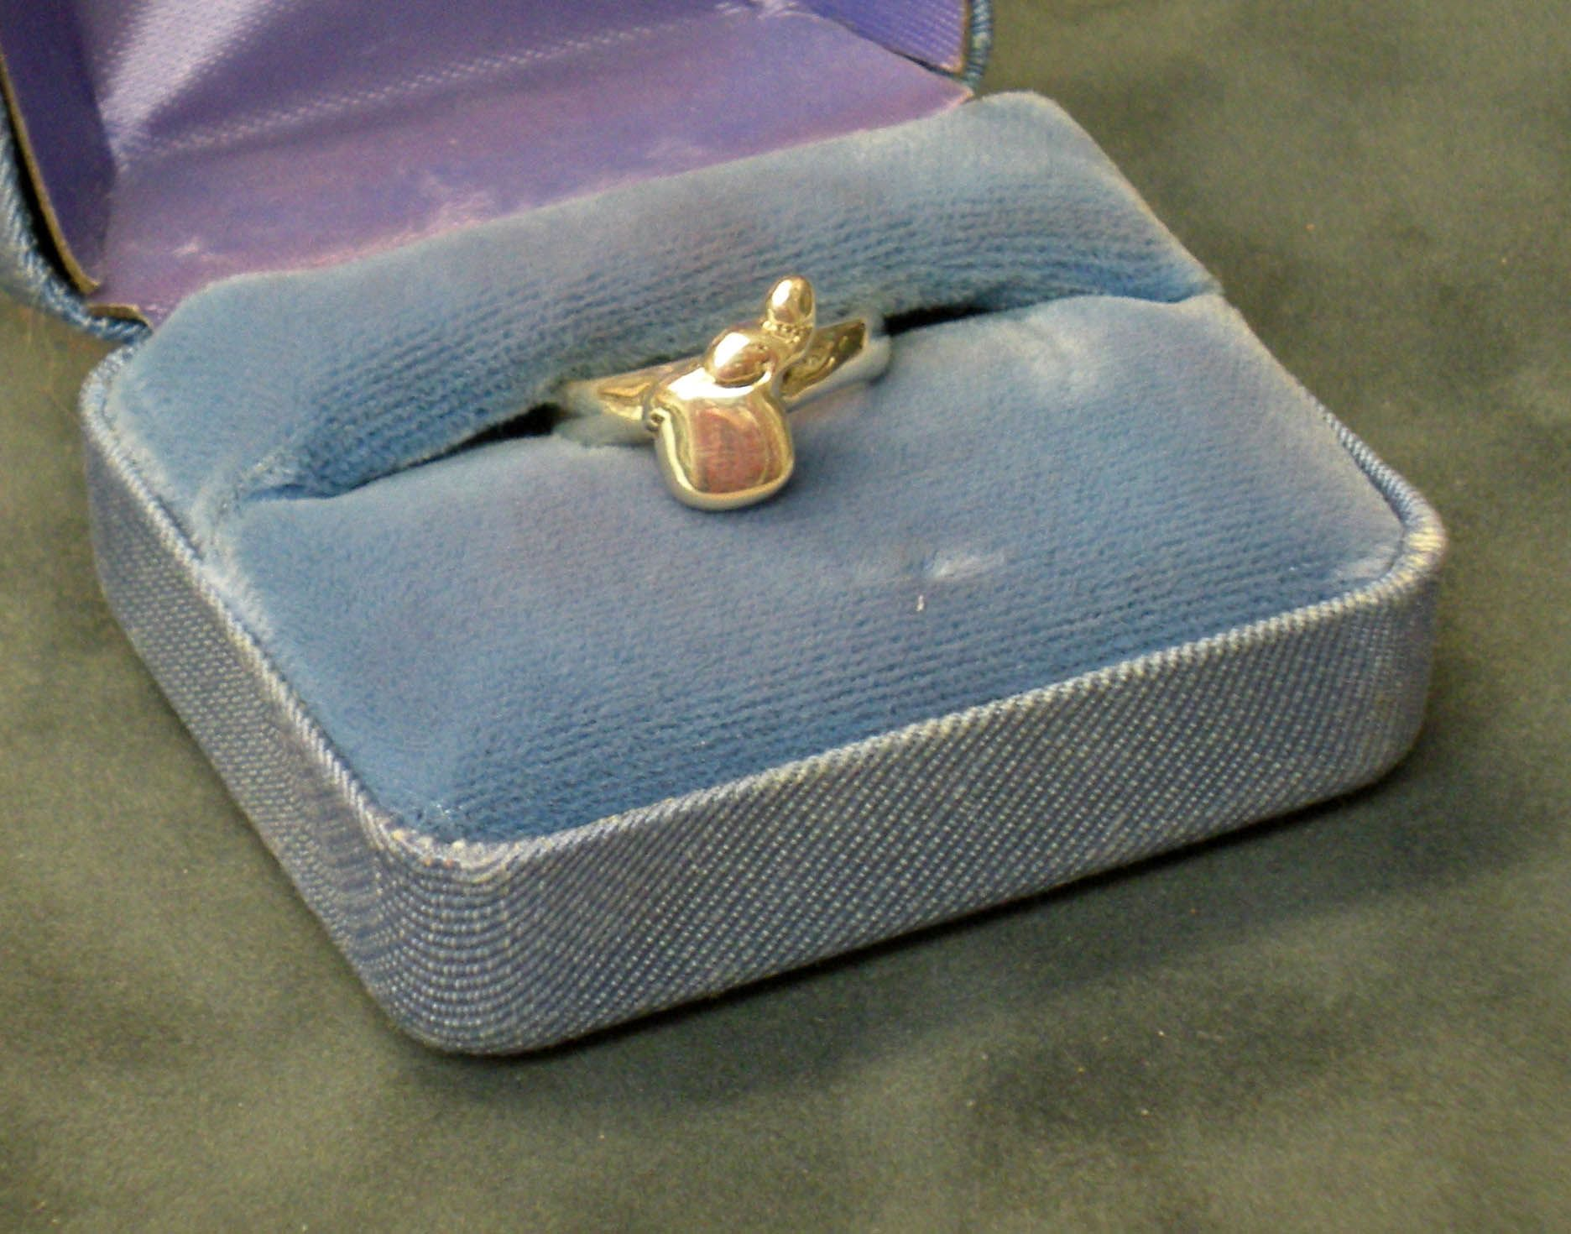
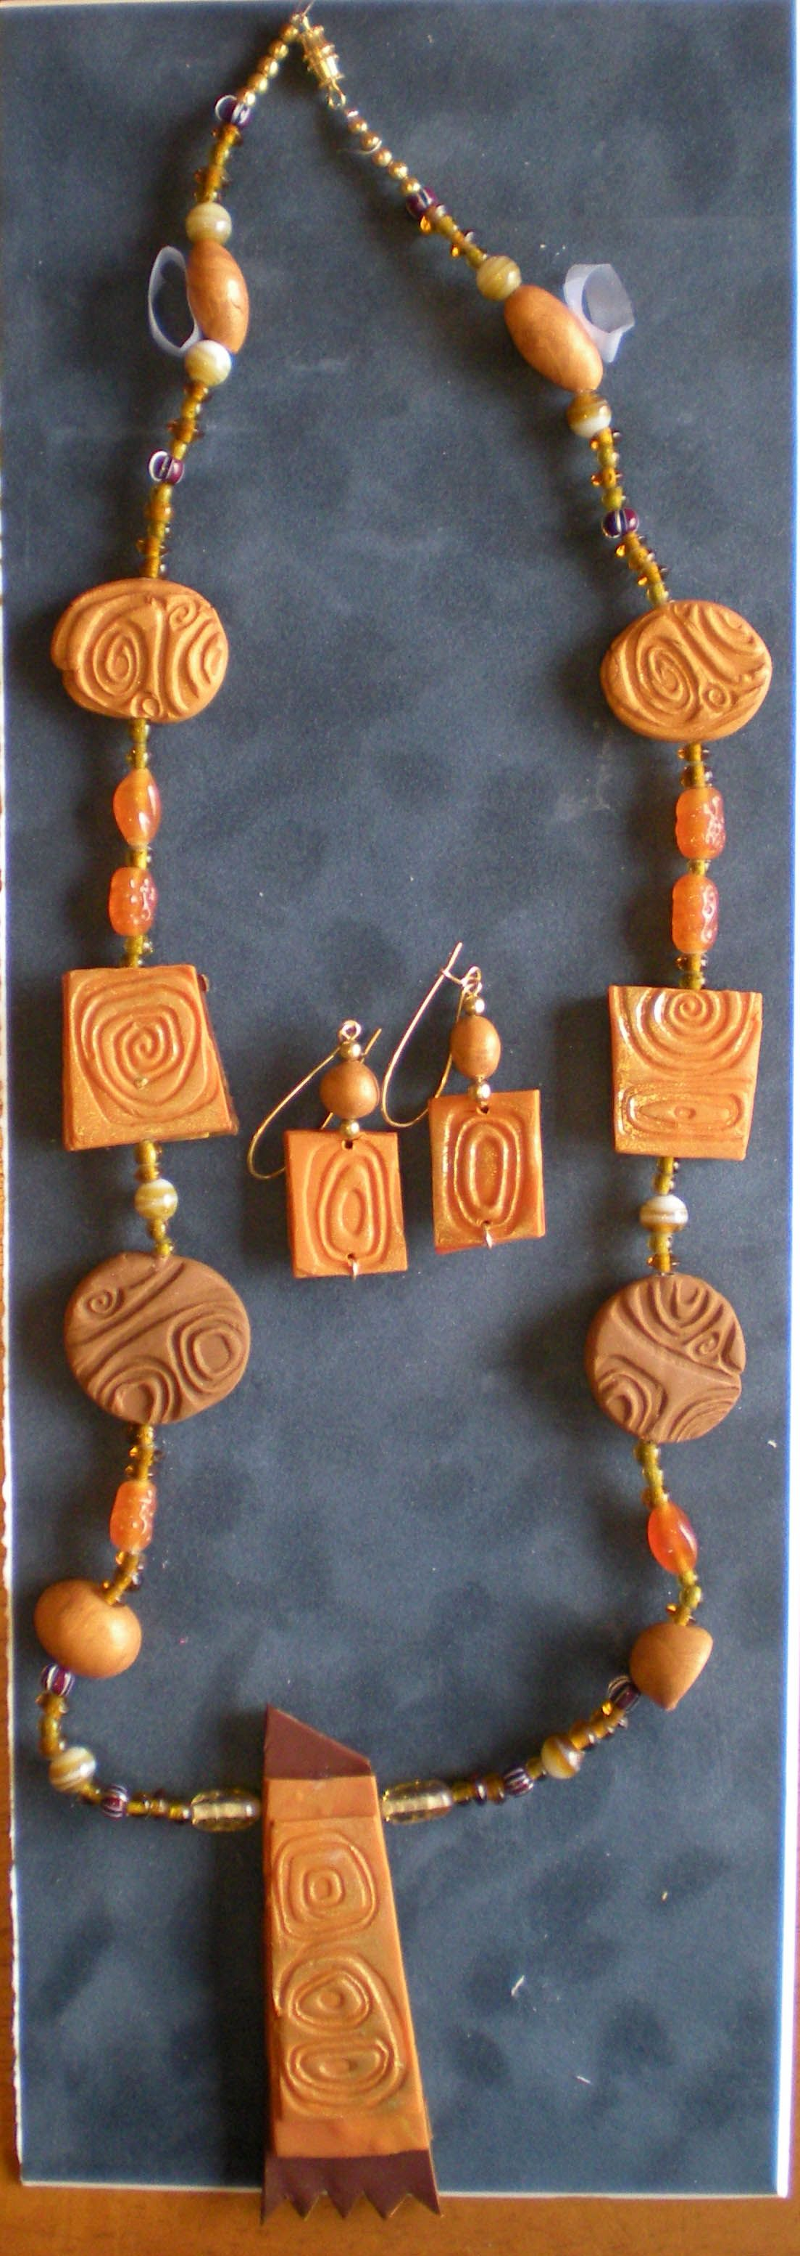
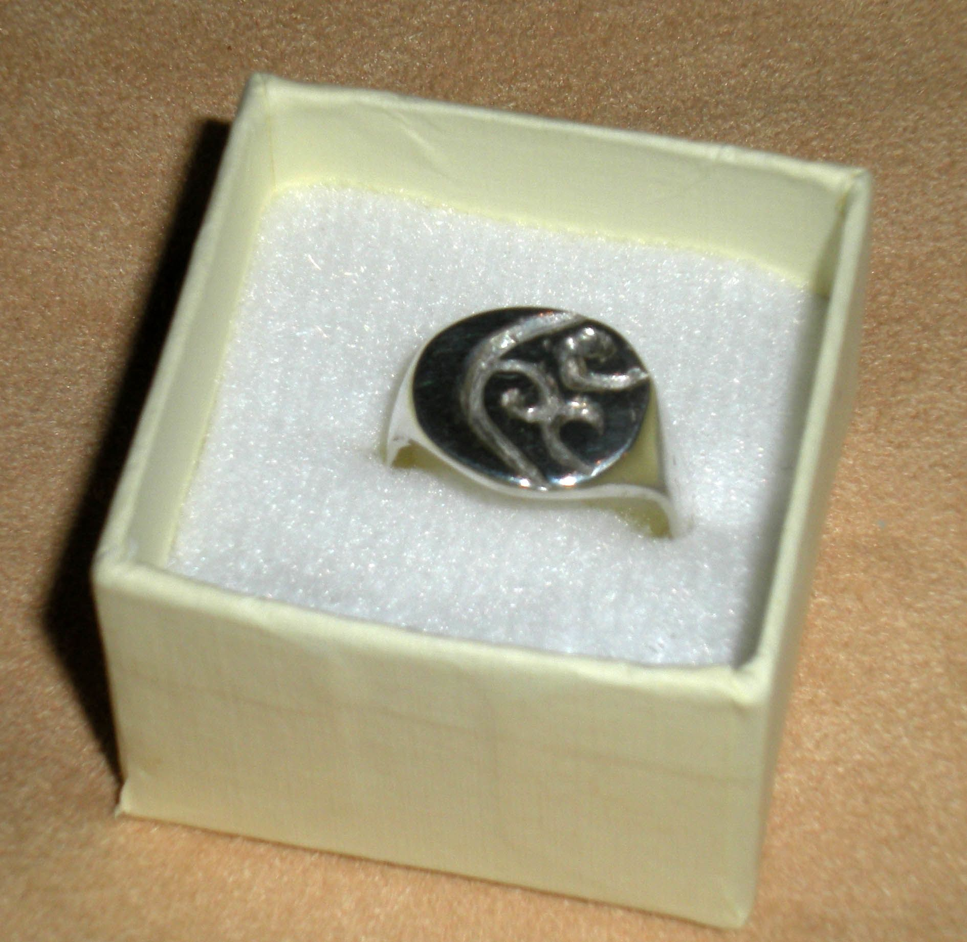
Jewelry
And
Cast Rings

Slide 24
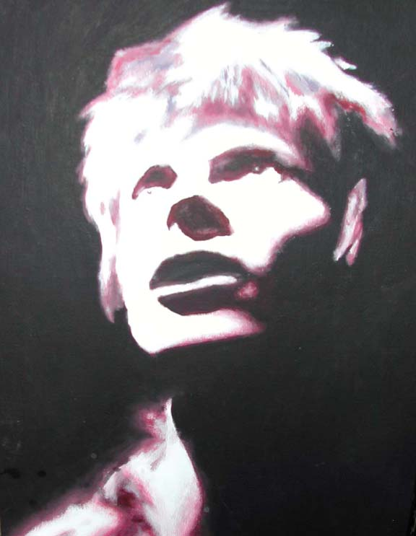
Painting

Slide 25
Painting
Major Projects
  Watercolor Landscapes
  Portraits in Watercolor
  Acrylic Painting
  Oil painting
  Murals

Slide 26
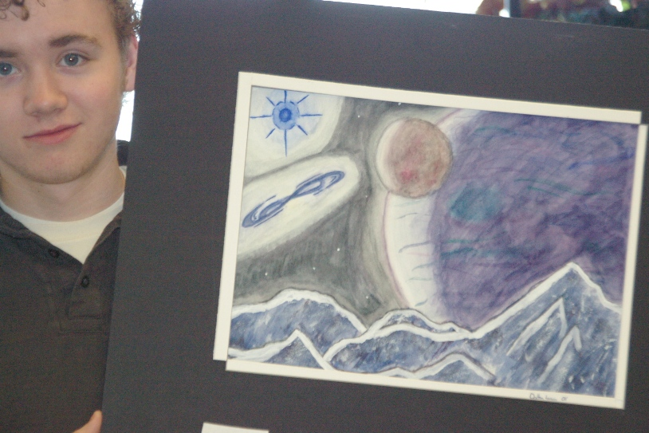
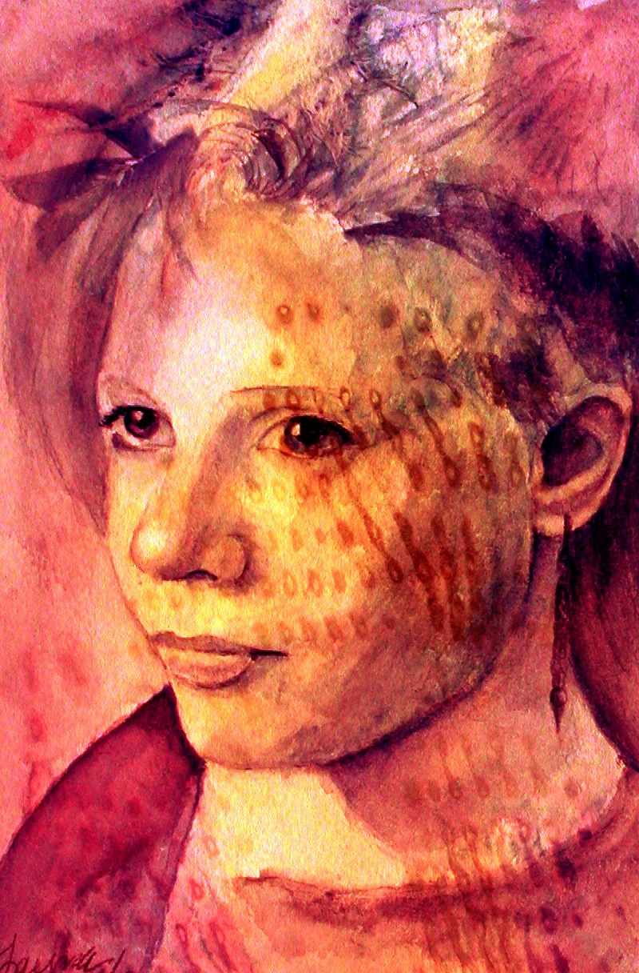
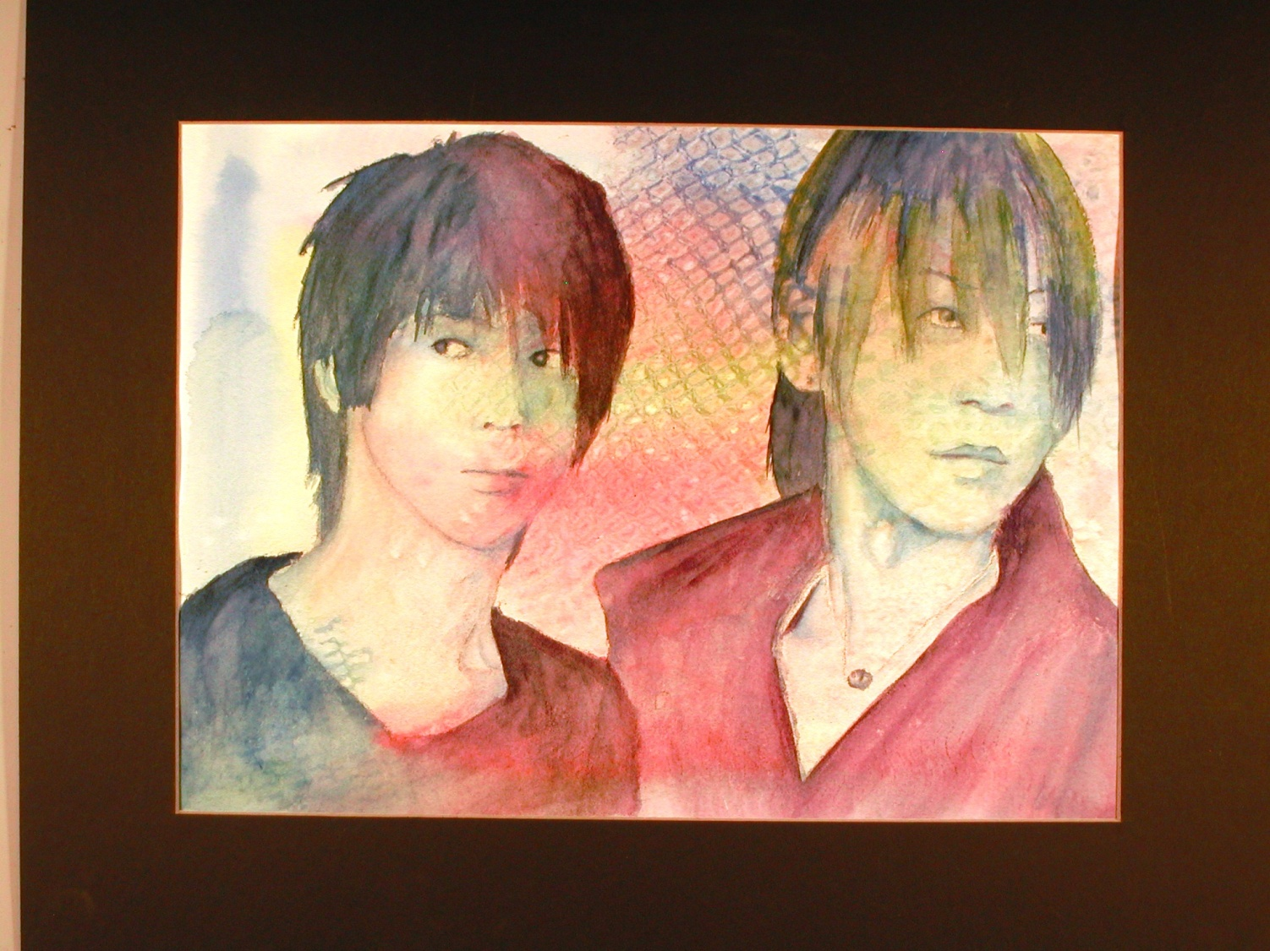
Final Watercolor

Slide 27
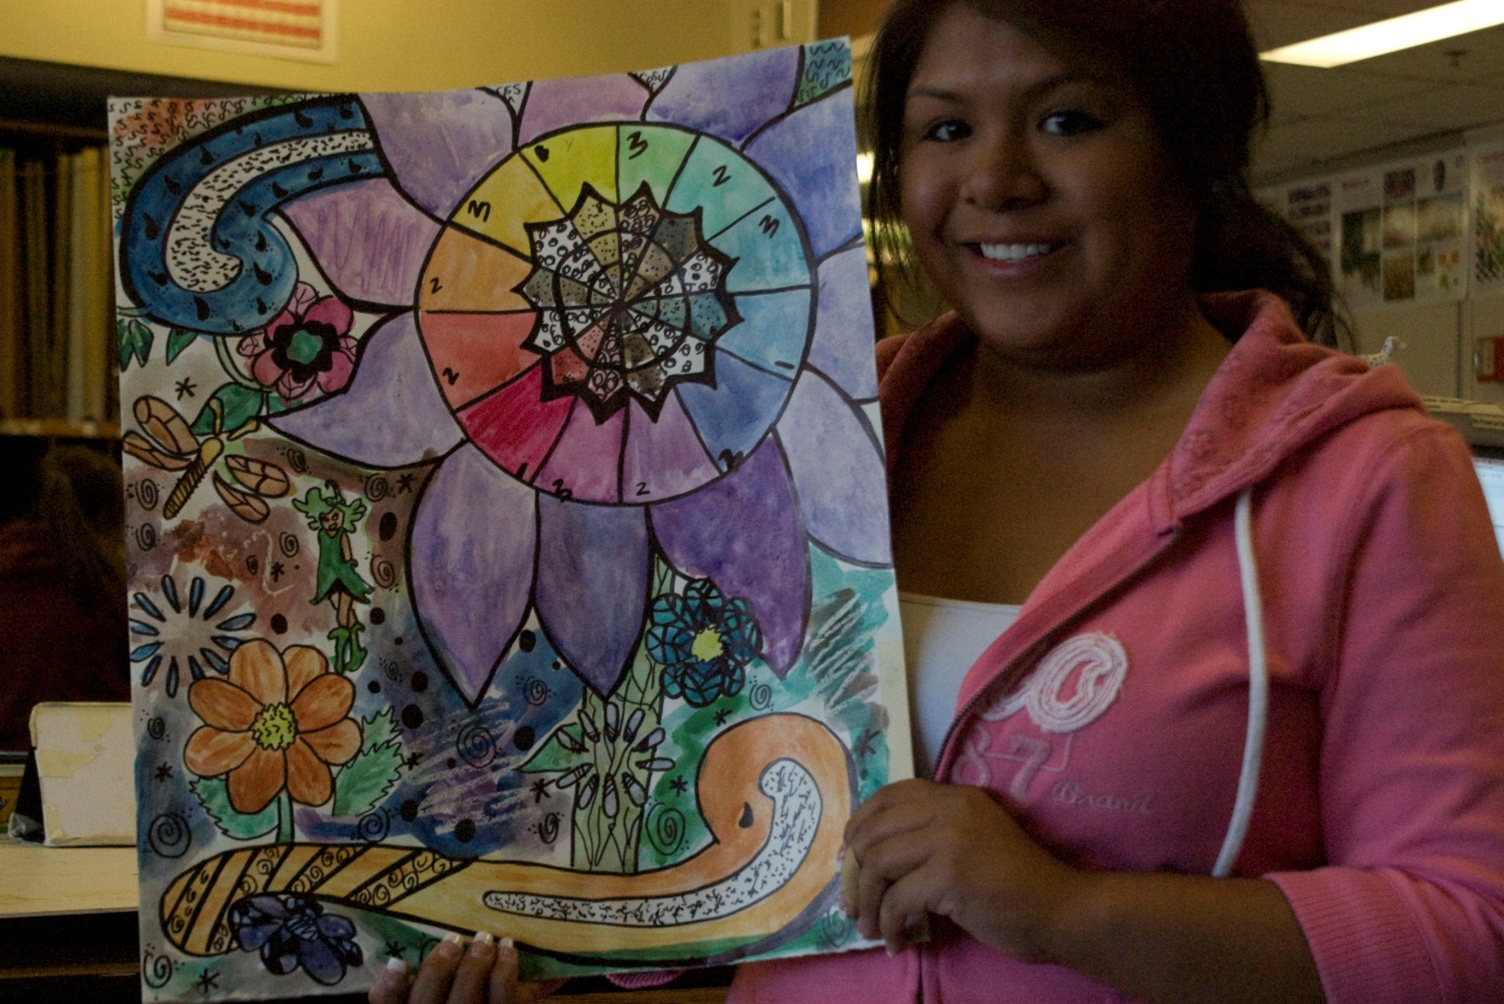
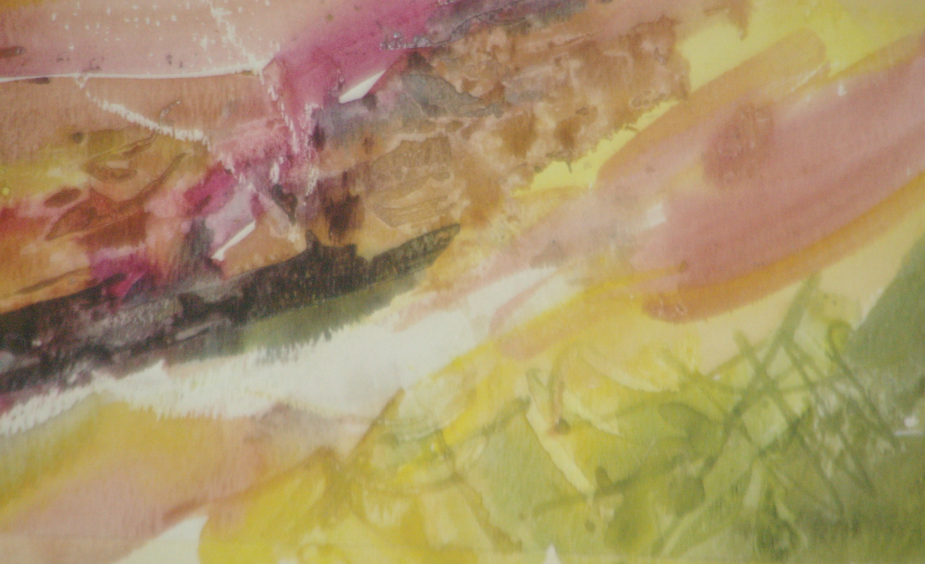
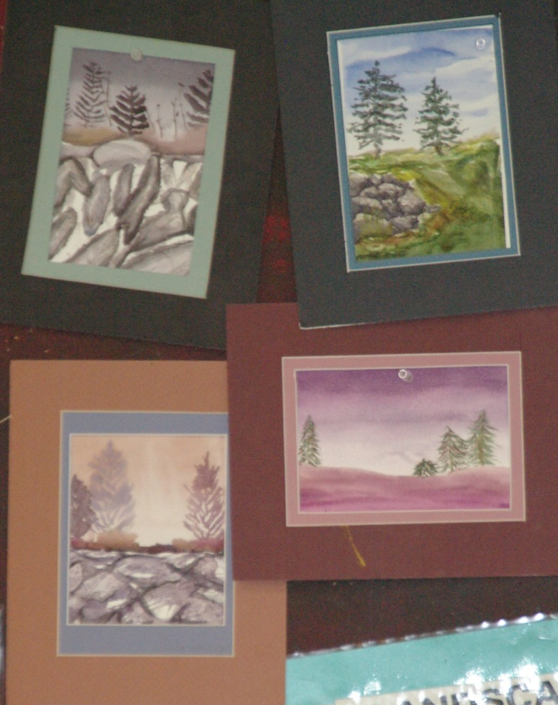
Color Wheel
Abstract Design
Final Watercolor

Slide 28
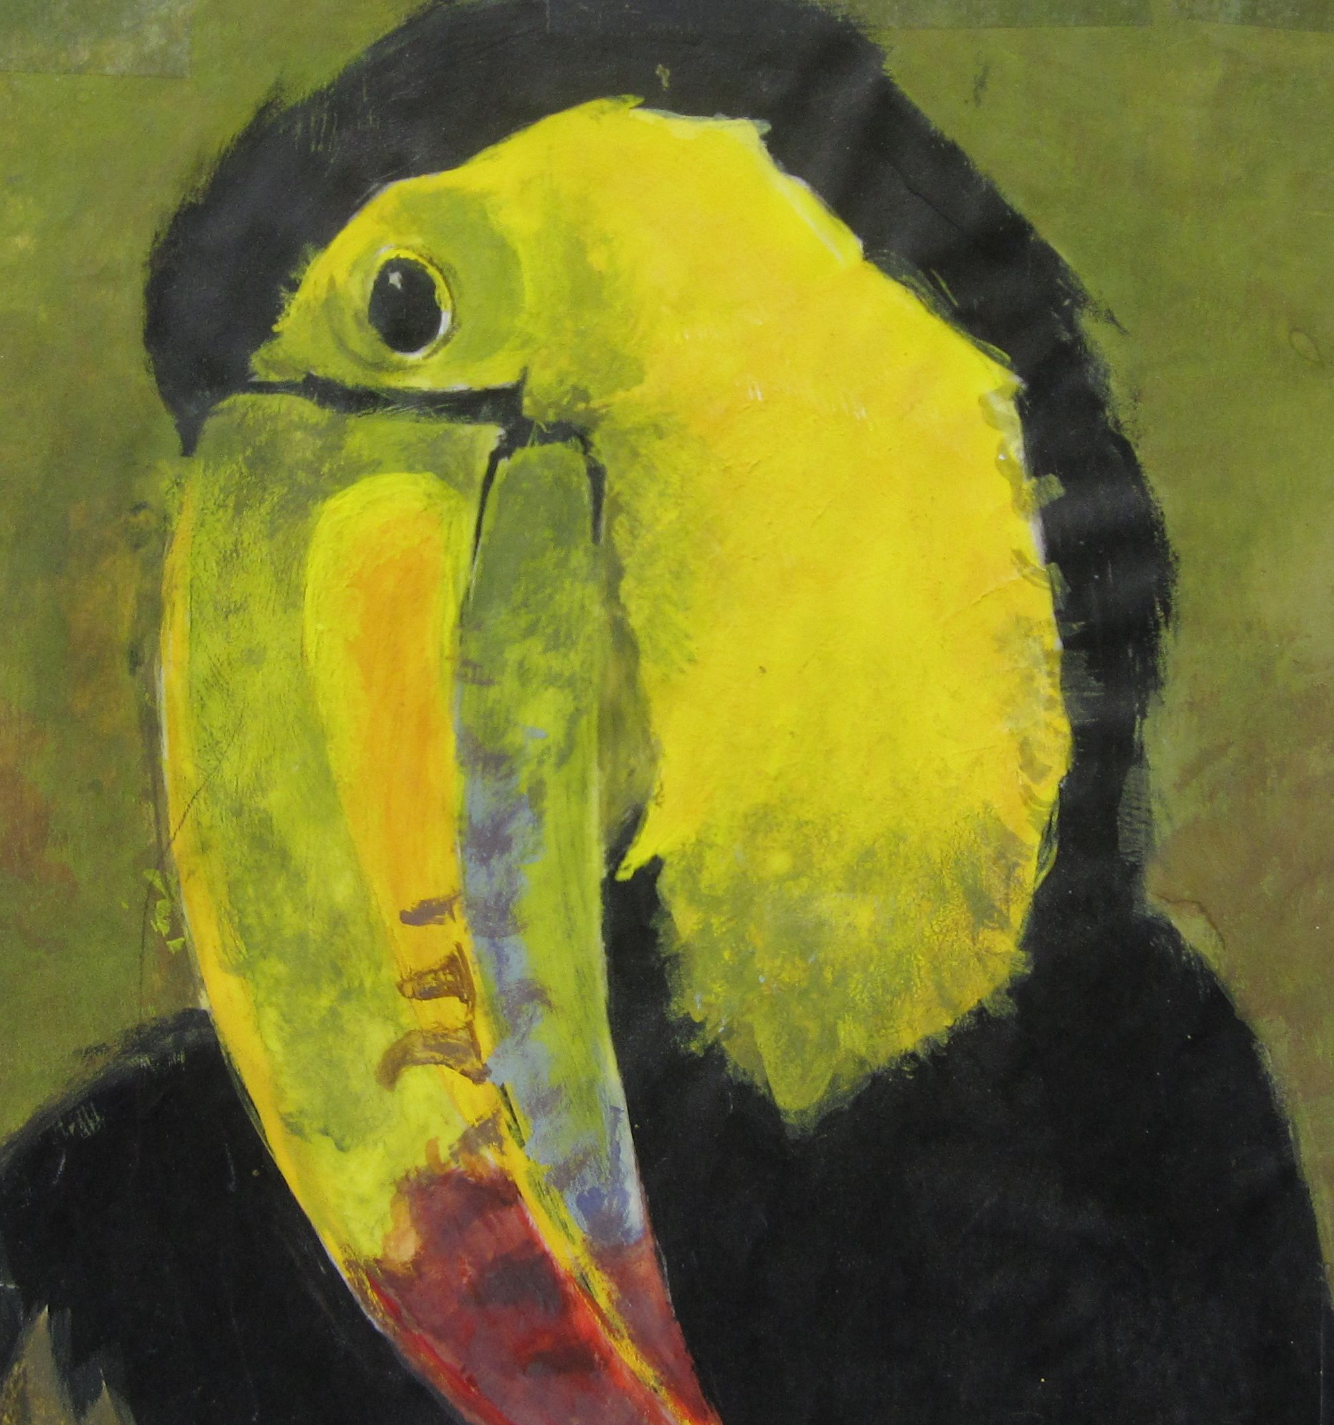
Acrylic Painting

Slide 29
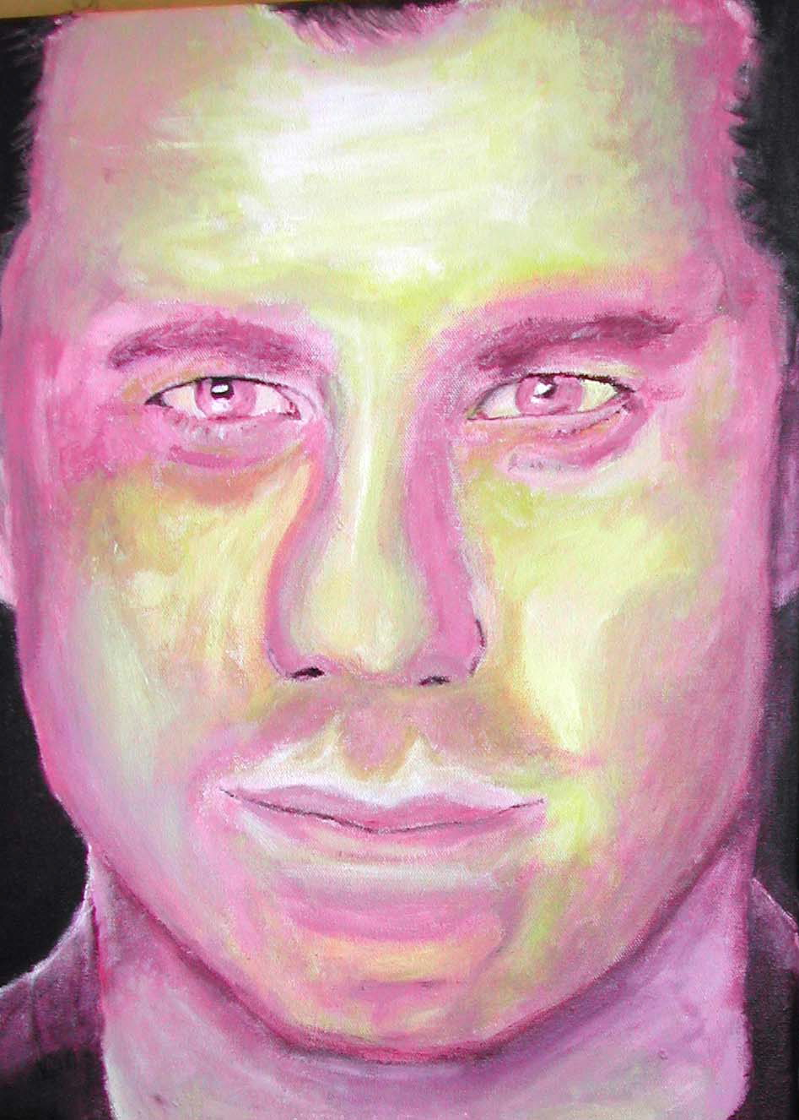
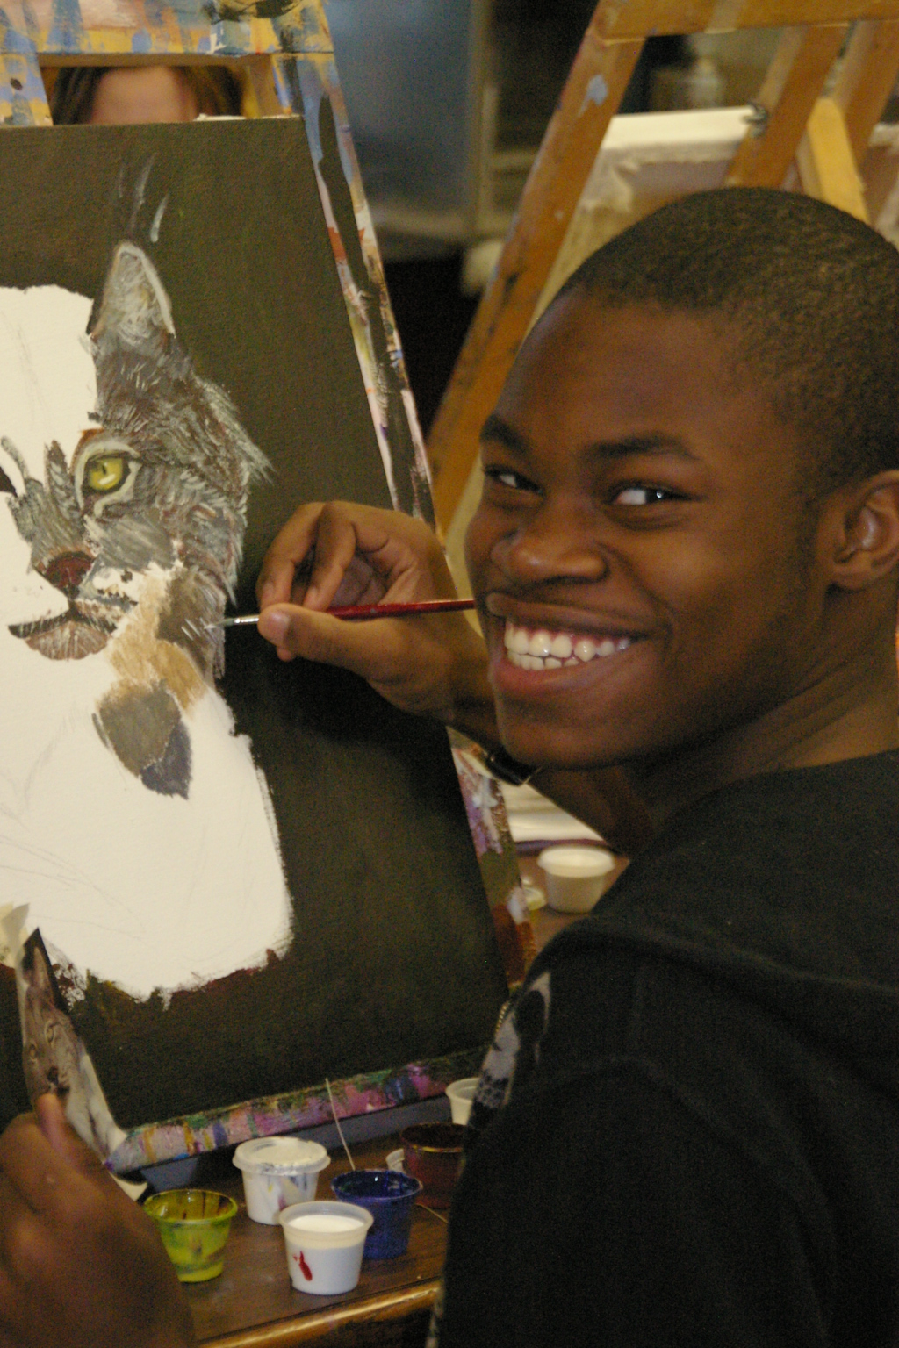
Final Acrylic

Slide 30
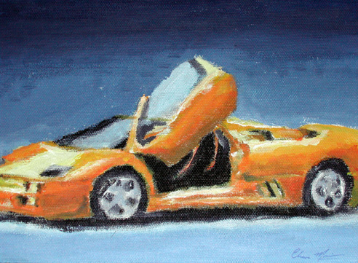

Slide 31
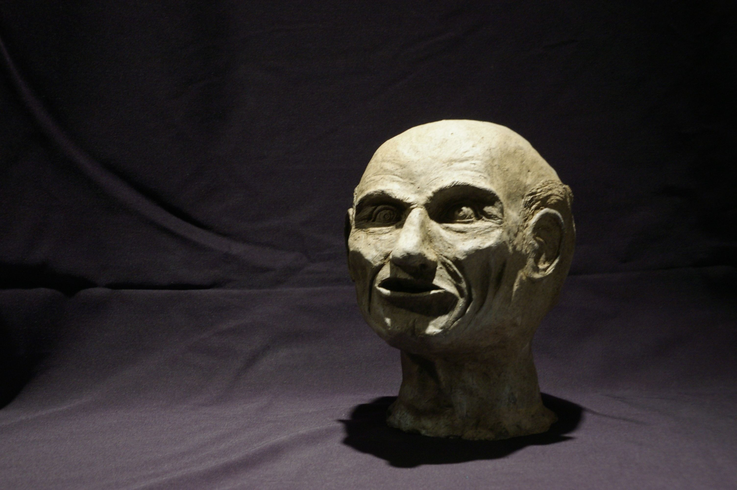
Sculpture

Slide 32
Sculpture
Major Projects
  Human Head in Clay
  Narrative Clay Sculpture
  Paper Mache Food
  Cardboard Sculpture
  Wire Animal
  Found Wood Animal
  Public Art
  Stone Carving
  Metal Sculpture

Slide 33
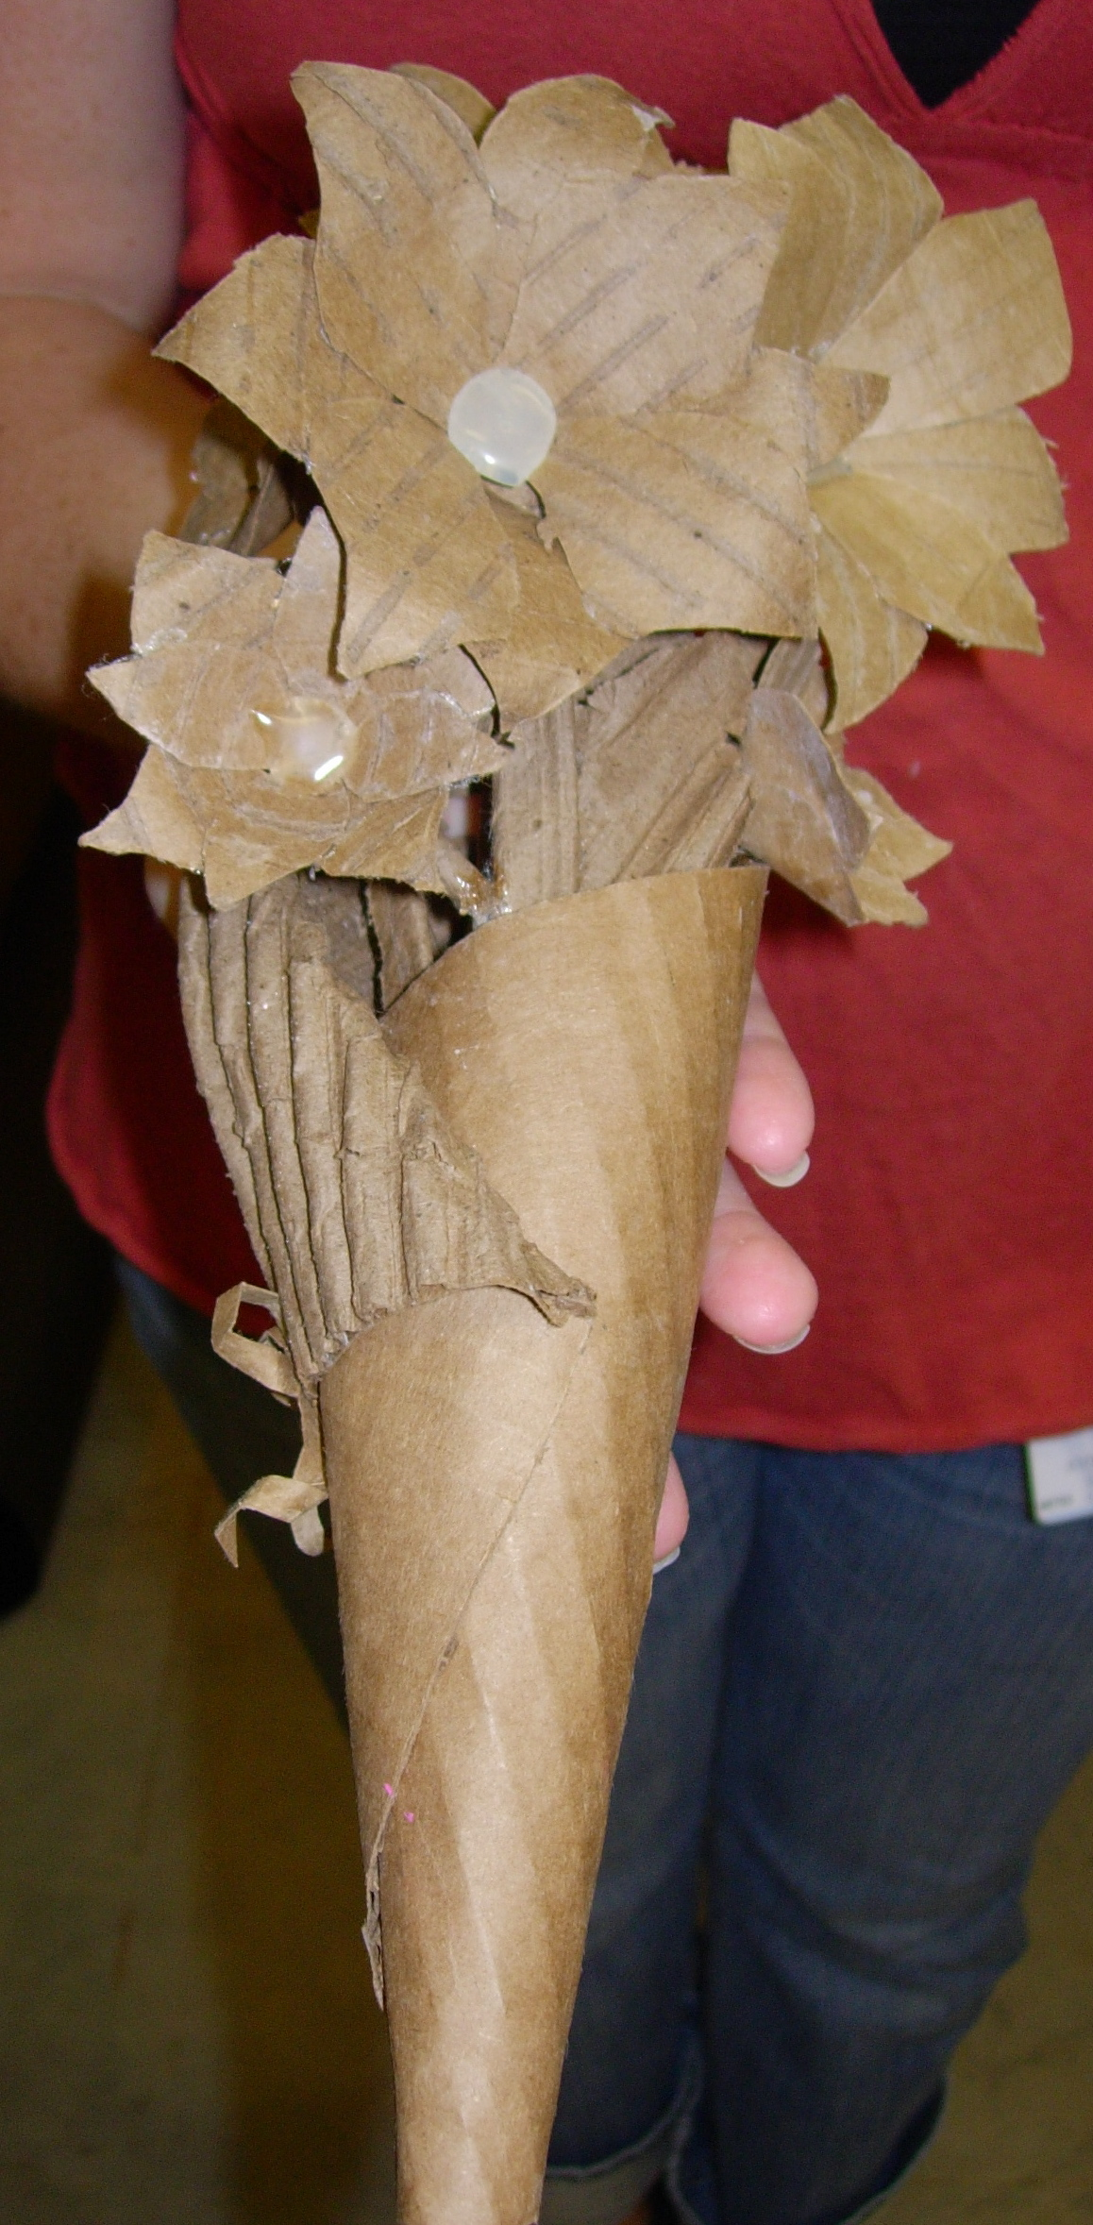
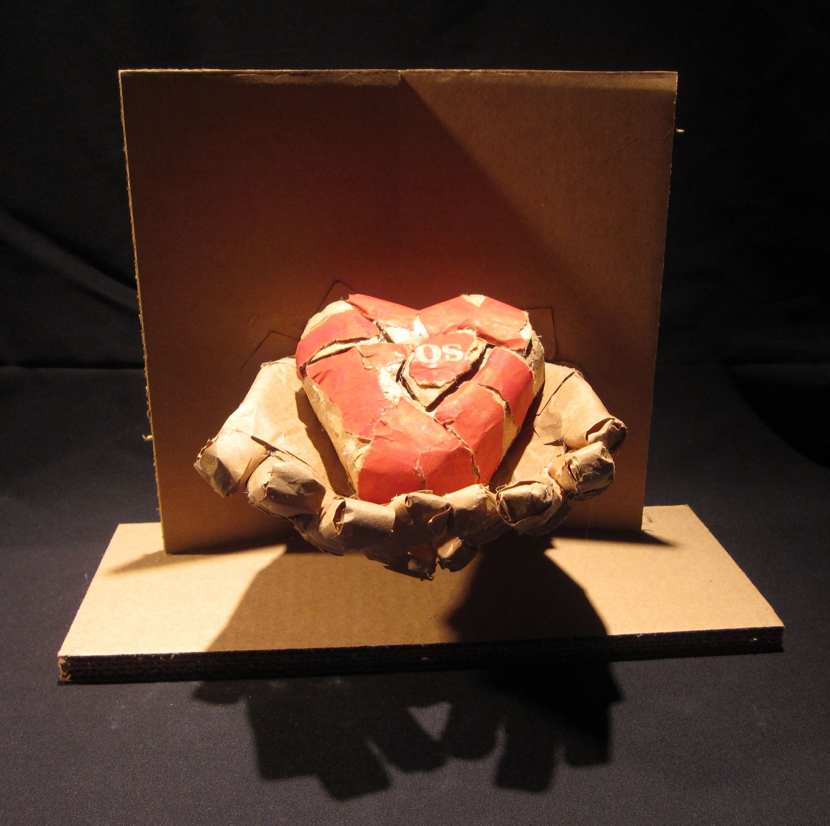
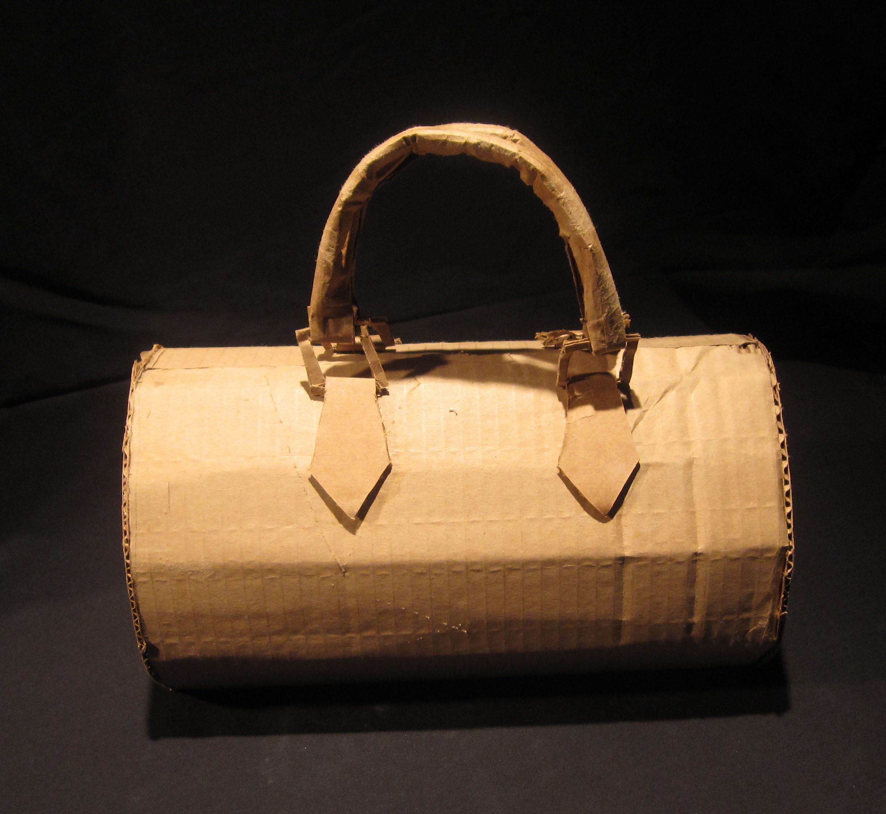
Cardboard
Sculpture
Project

Slide 34
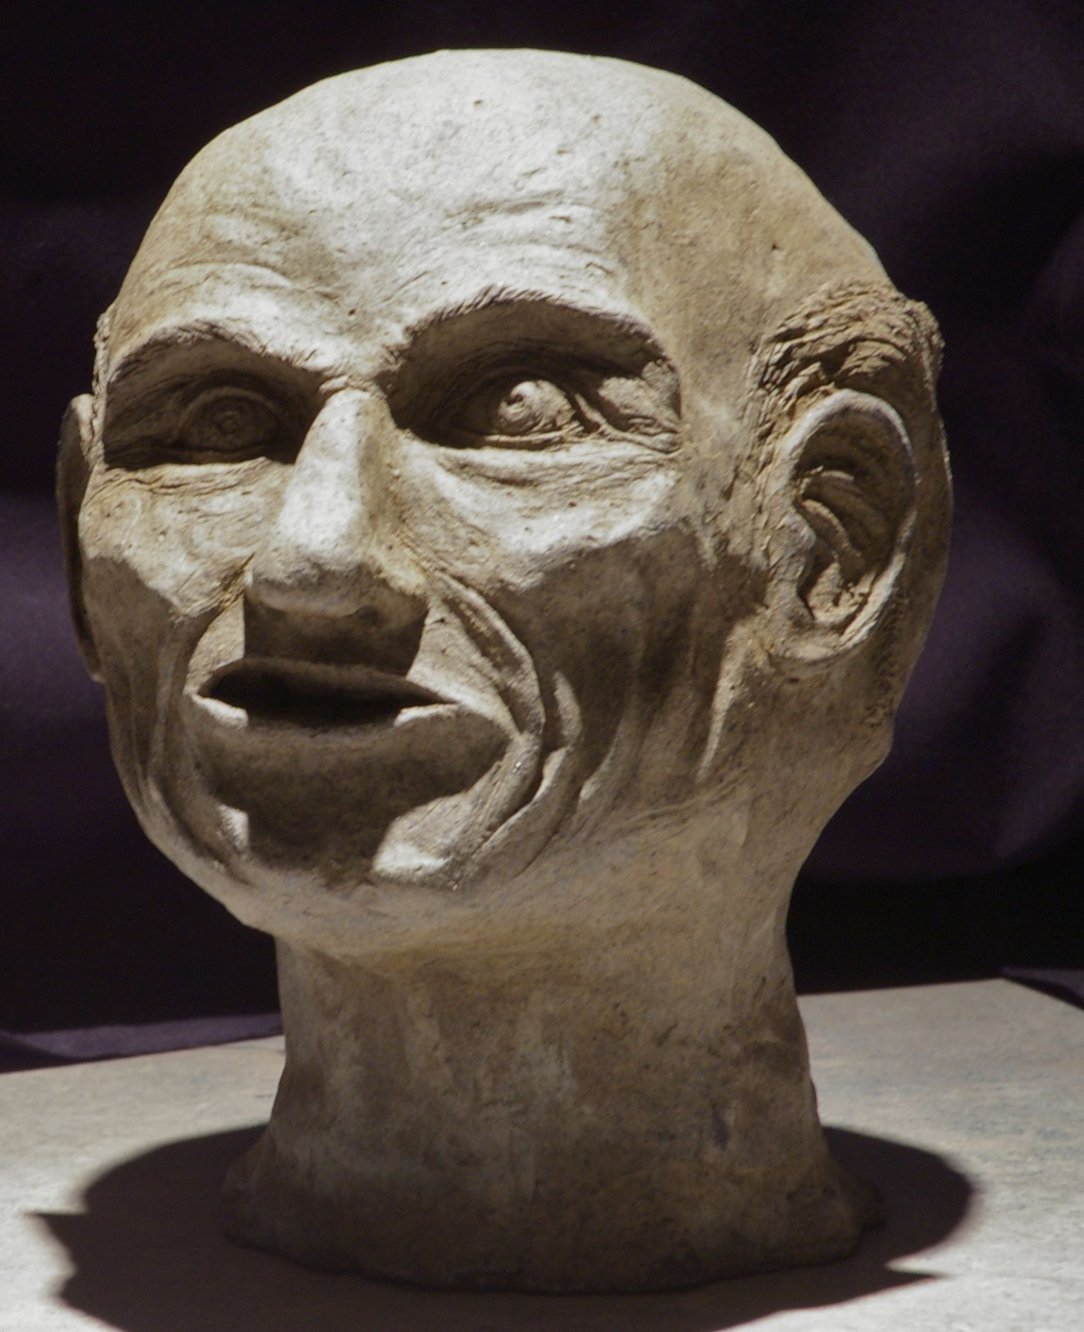
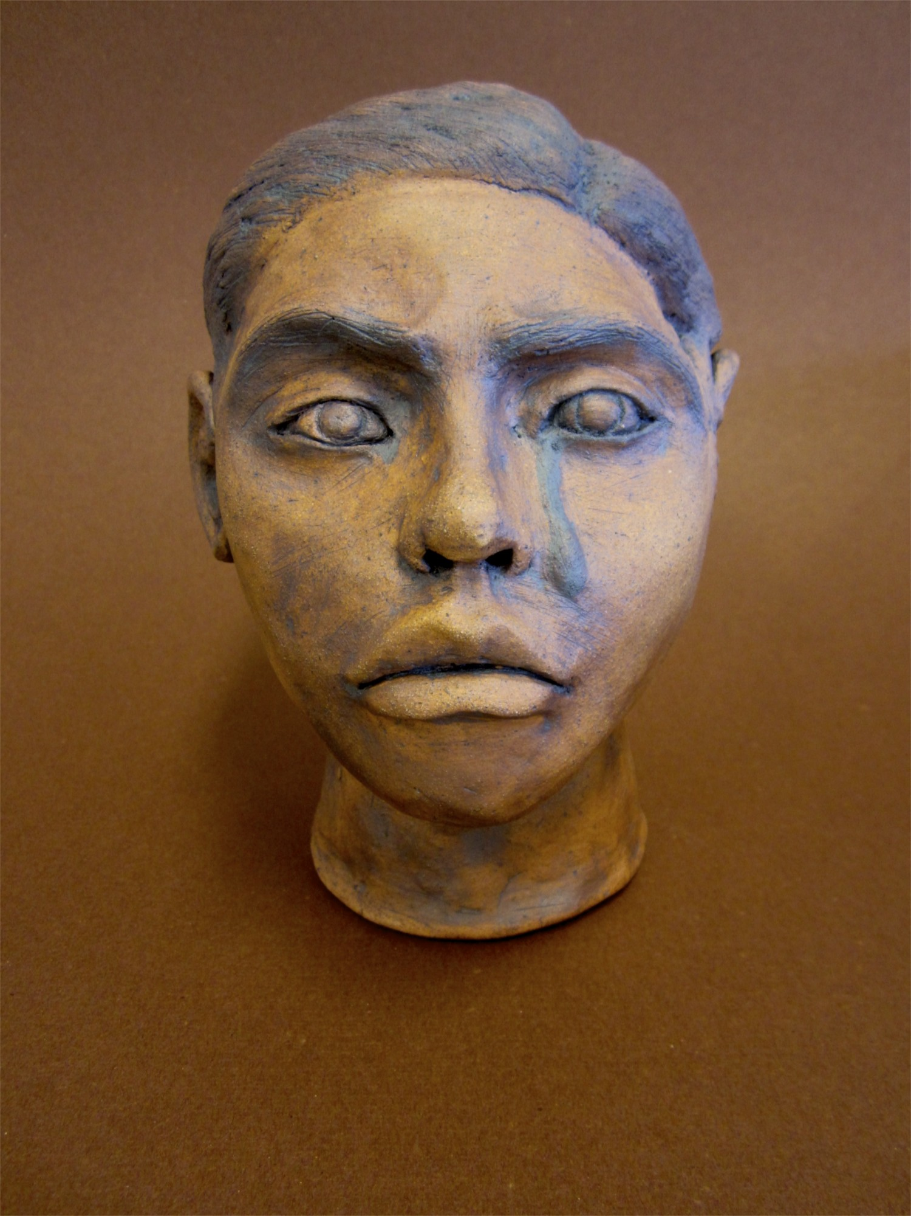
Ceramic Head Sculpture

Slide 35
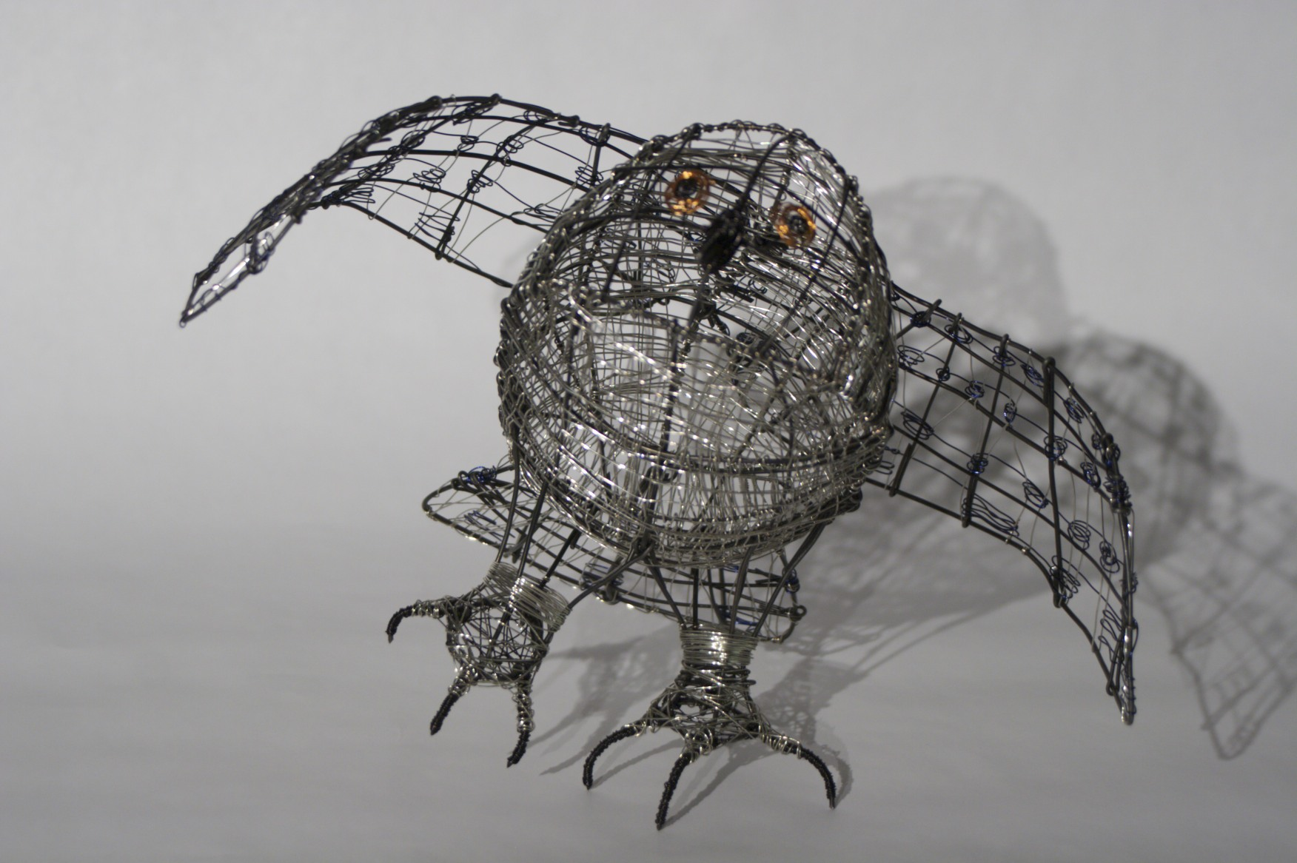
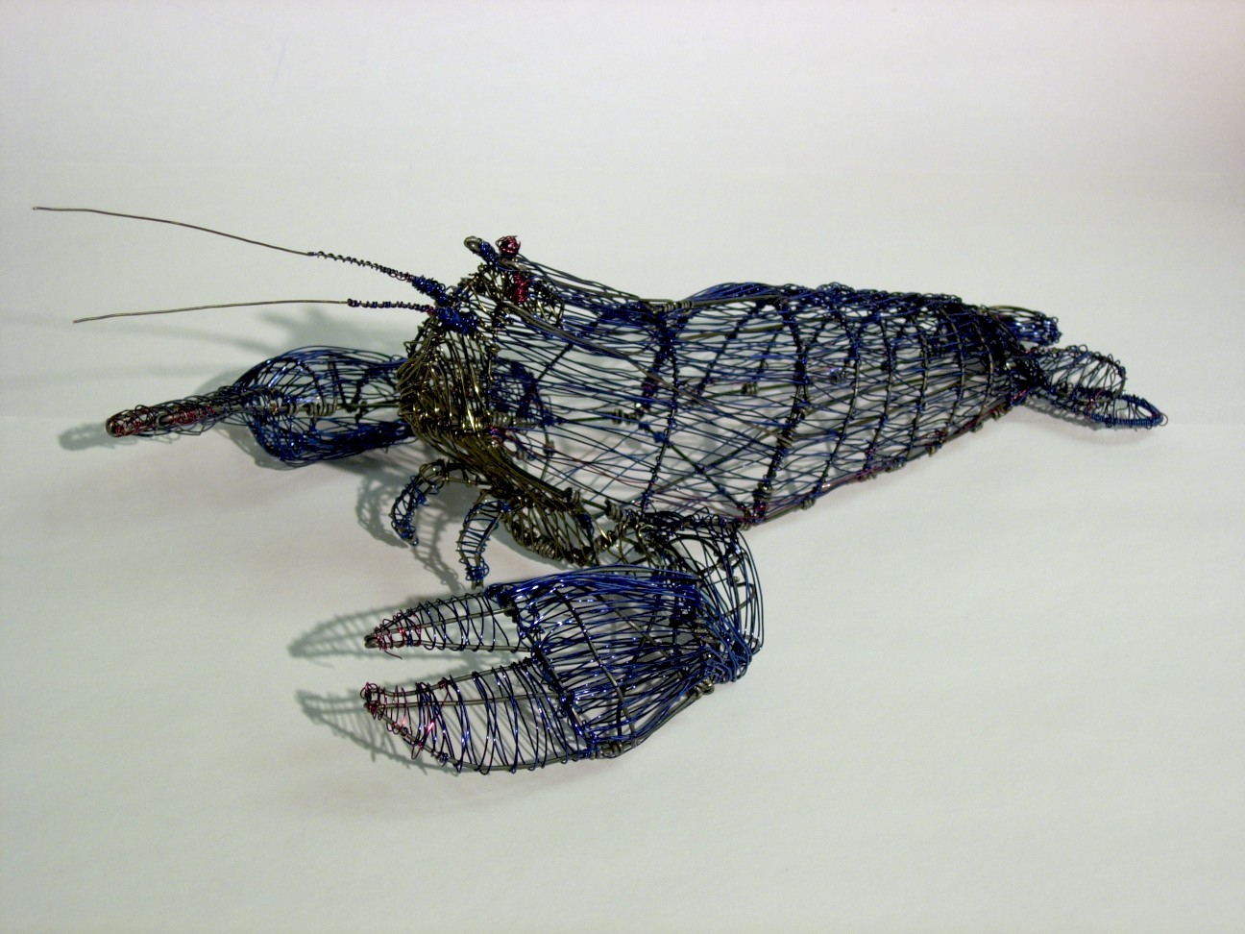
Wire
Sculpture

Slide 36
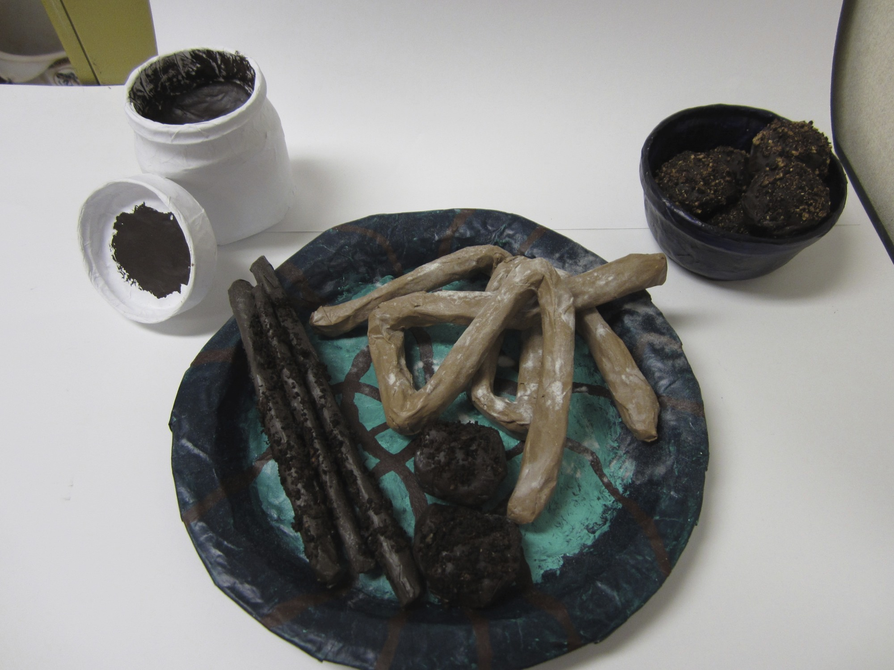
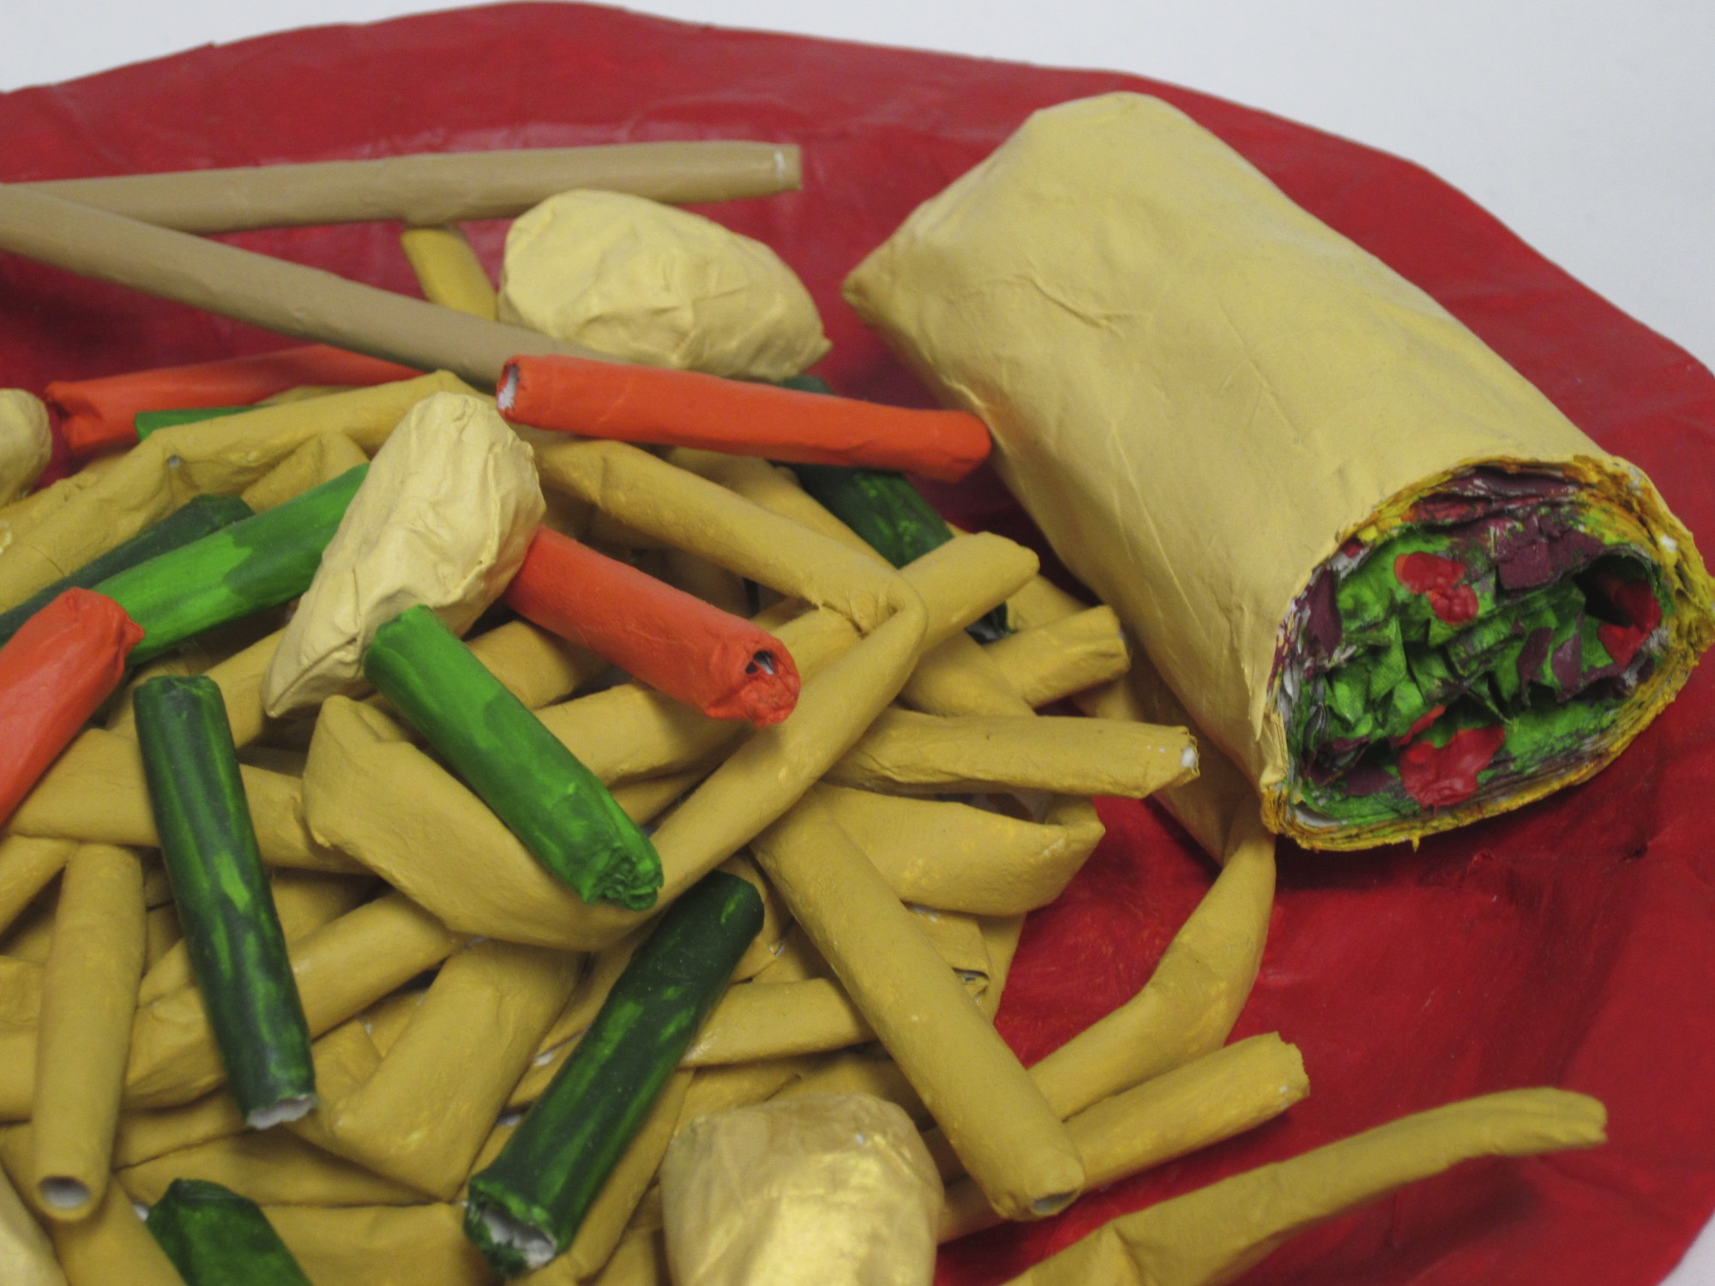

Paper Mache Food Sculpture

Slide 37


Found Wood Animal

Slide 38




Slide 39

Video Art

Slide 40
Video Art
Major Projects
  Flipbook
  Animated Flipbook
  5x5 Video
  Vine Visual Pun
  Scripts
  Narrative Sound Project
  Experimental Video
  Narrative Film
  Photomotion
  Production Book

Slide 41


Slide 42


Slide 43

Animation

Slide 44



Slide 45

AP Studio Art
2D Design, 3D and Drawing Portfolio

Slide 46
AP Studio Art
This course offers the same content as an introductory college course in studio art. You are required to develop a theme based portfolio of 15 pieces of artwork. You are required to choose either 2-D design, 3-D design or drawing. Your learning experience will include art history, criticism, aesthetic and art production. An artist statement will be included. Contact the advanced placement teacher regarding the formal presentation of the portfolio and the submission deadline.

Slide 47



Slide 48



Slide 49

More Information
More information can be found on the Blaine High School Website located under the Academic pages > Classroom pages.
Click the link titled Art Classes Offered.

Slide 50

BHS Art on Twitter
Follow us on Twitter
For all the cool things
Happening in ART
@blaineHSArt
See YOU in ART!!!

Slide 51
Meet the Art Department
https://www.youtube.com/watch?v=uPXi6gJp5Ck&feature=youtu.be&safety_mode=true&persist_safety_mode=1
Thanks for Watching.
Mrs. Blevins, Mr. Mesick, Mrs. Schenk, and Mrs. Undis.

