Slide 1
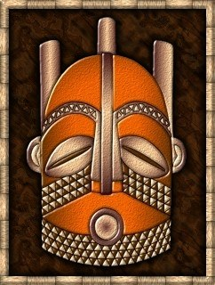
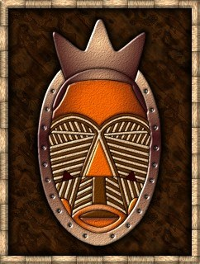
African Masks

Slide 2
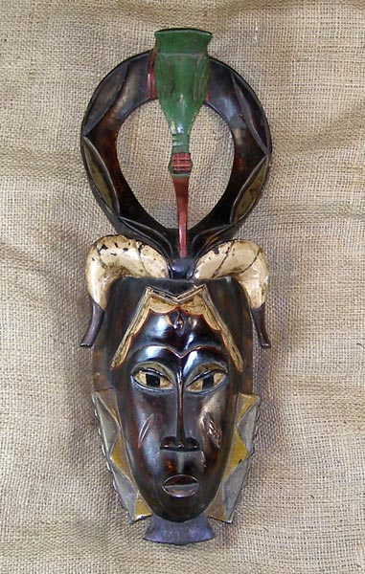
In Africa, masks can be traced back to well past Paleolithic times. These art objects were and still are made of various
materials, including leather,
metal, fabric, and wood.

Slide 3
African masks are considered amongst the finest creations in the art world and are highly sought after by art collectors.

Slide 4
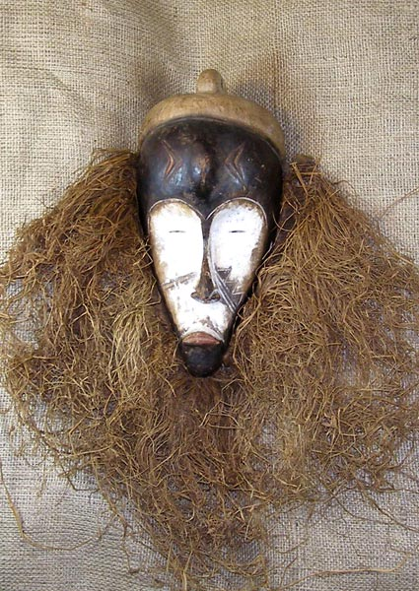
Masks had many different uses. In ancient times they were used in celebrations, crop harvesting, tribal initiations, war preparations, and dances in honor of ancestors.
African masks often represent a spirit and it
is believed that the spirit of the
ancestors possesses the wearer.

Slide 5
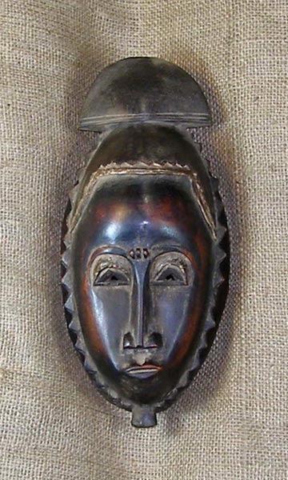
Masks were, and still are, worn by people in Nigeria, Liberia, and other regions of Africa.

Slide 6
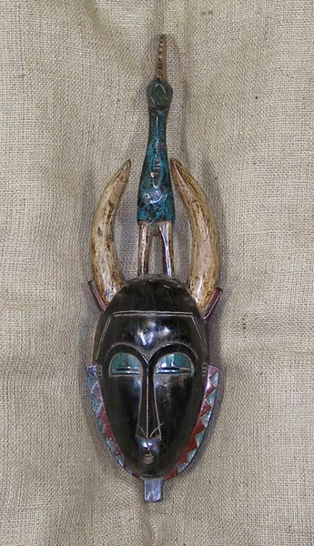
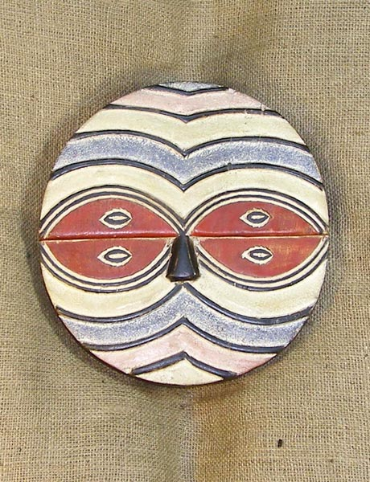
Mask were made to be worn in three different ways: to cover the face, the entire head, or to be placed on top of the head.

Slide 7
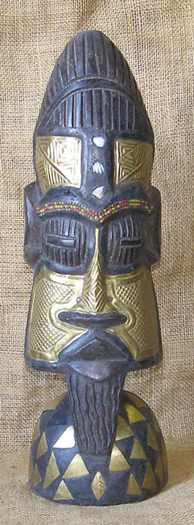
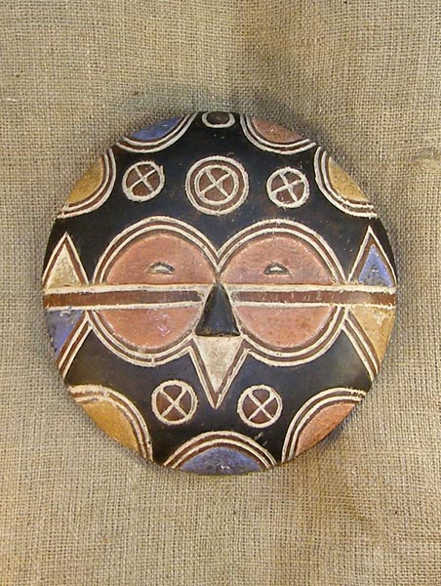
Long and square, short and round, the faces of African masks are as varied as the faces of people.

Slide 8
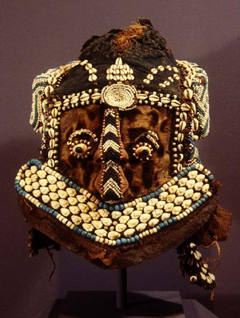
Mask carvers often used soft wood from young trees to make masks. Strips of animal skin, rough leaves, or pieces of bone were rubbed over the surface of the finished masks to make them smooth.

Slide 9
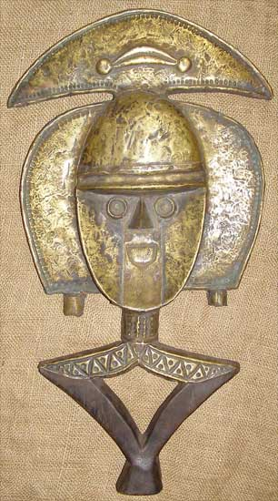
Most masks were carved from wood, however
some contained brass, metal, mirrors, and
copper.

Slide 10
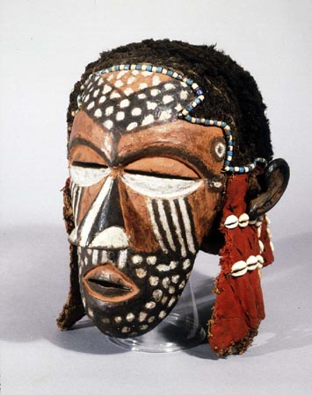
Masks were embellished with a variety of materials including shells, beads, cloth, feathers, and animal fur.

Slide 11
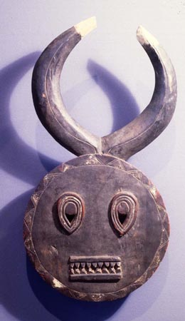
Some masks are used as icons of power to ward off evil spirits.

Slide 12
Bold, contrasting colors and geometrical patterns are common in African Masks

Slide 13
Masks are also used to celebrate and thank the ancestors during crop harvesting.

Slide 14
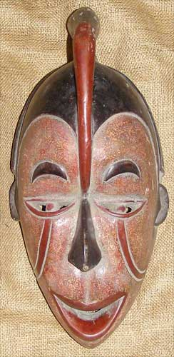
Masks were made to represent both men and women.

Slide 15
Masks made for battle may have scary eyes and big teeth.

Slide 16
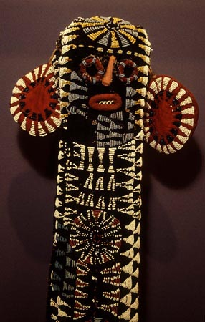
In America today, African masks are sold to hang on the wall as decorative artworks.

Slide 17
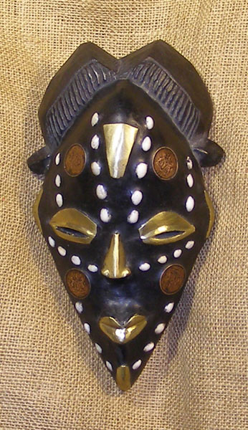
Museums all around the world exhibit masks from all provinces of Africa.

Slide 18
Student examples made with Tin, Raffia, Feathers & Beads

Slide 19
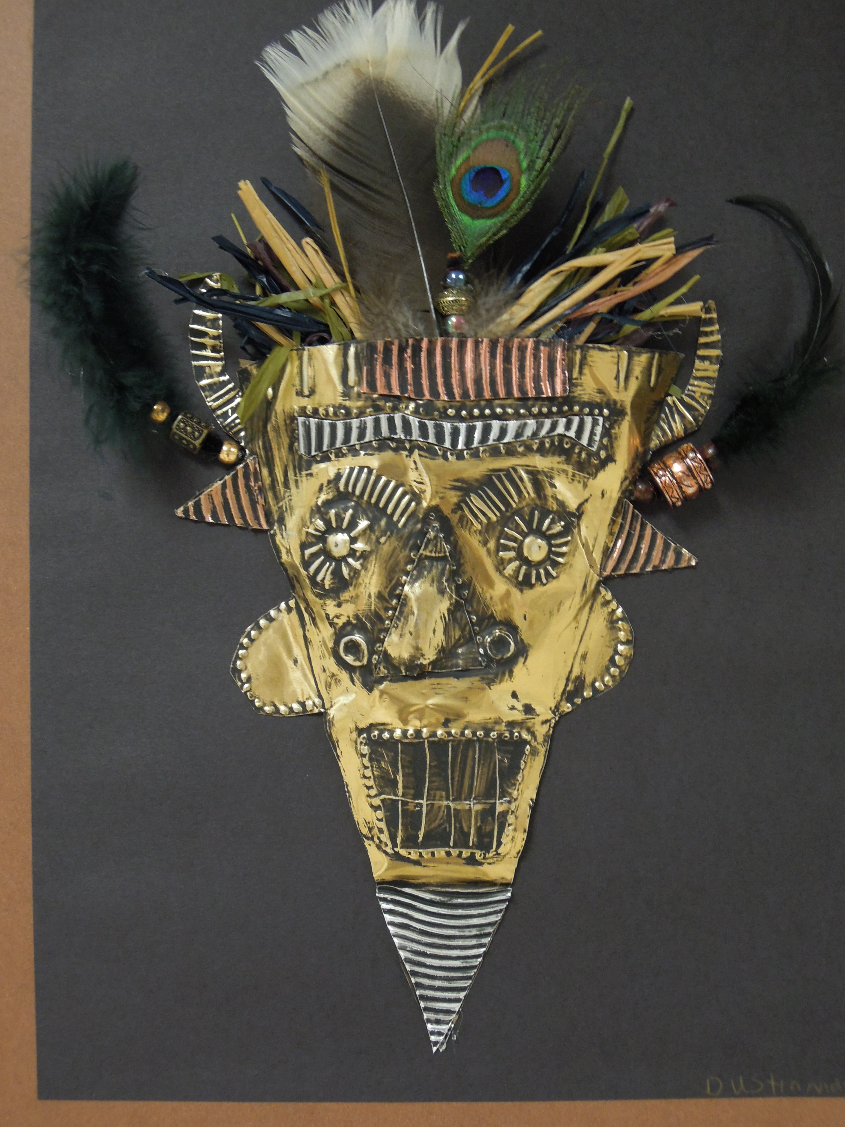
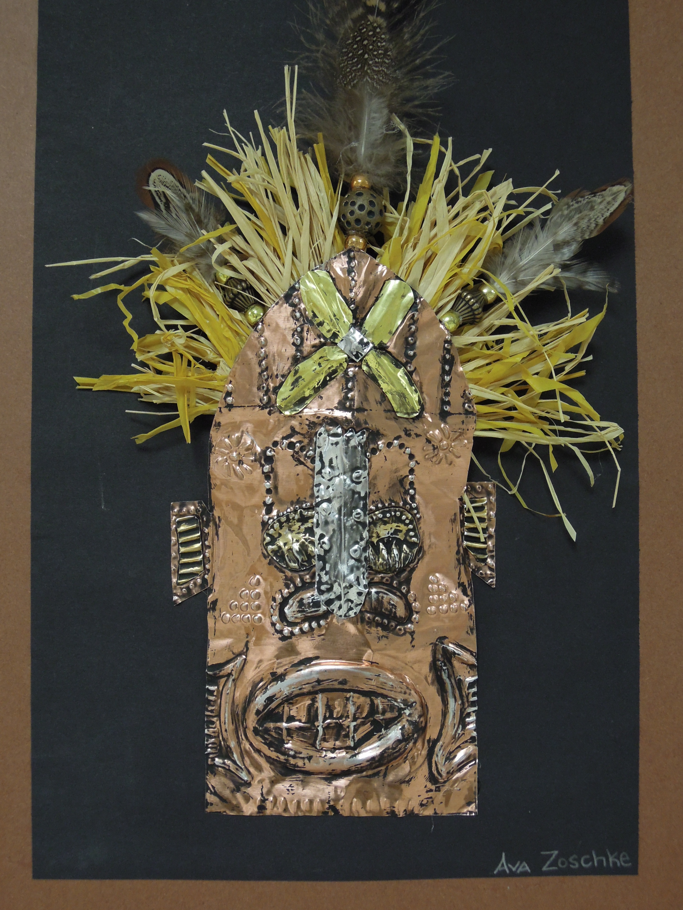

Slide 20
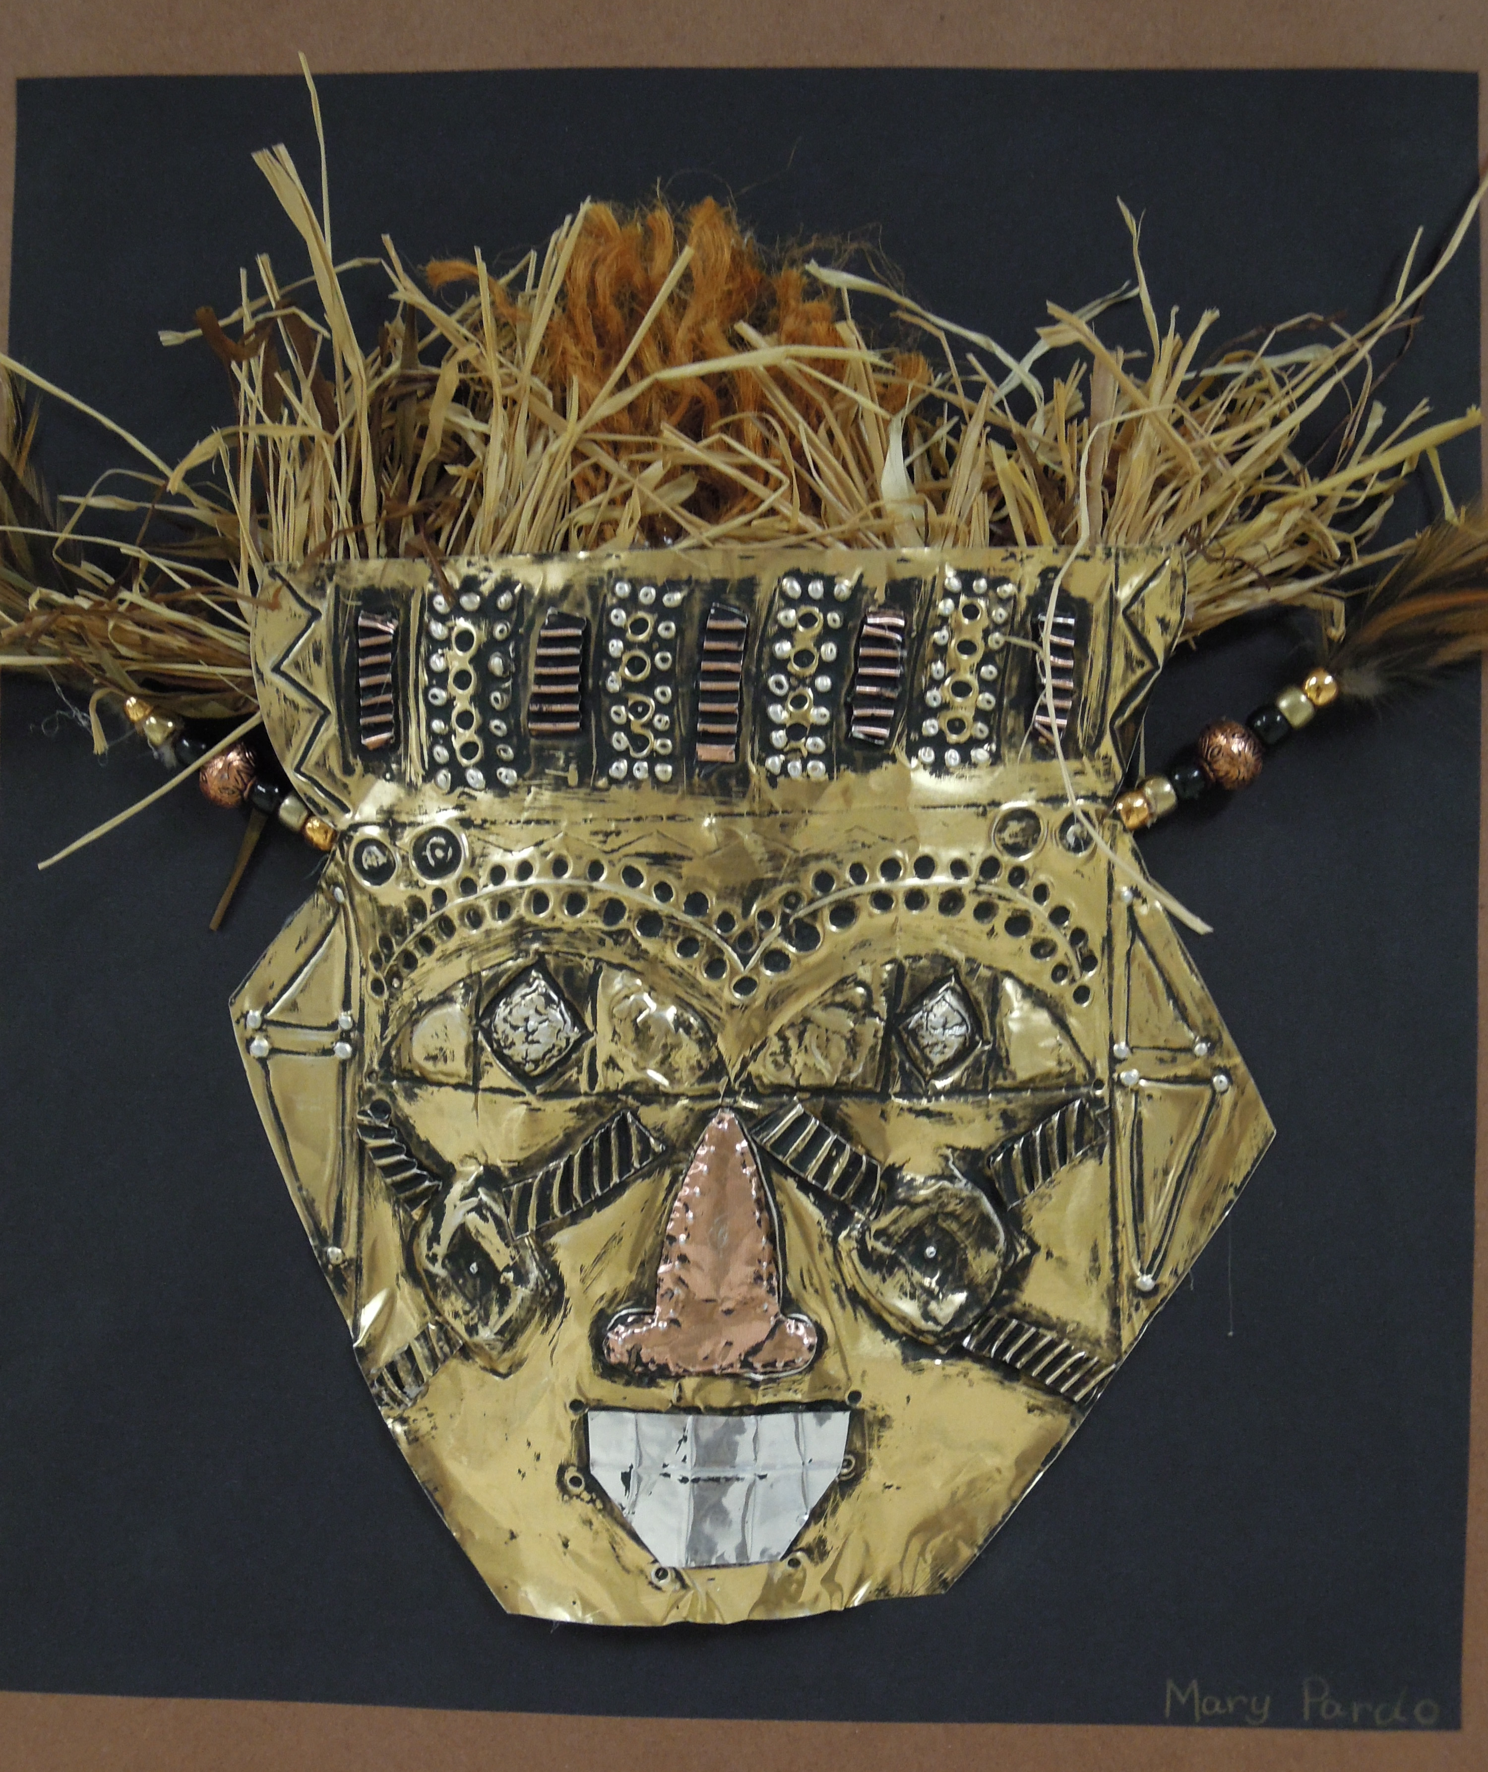

Slide 21
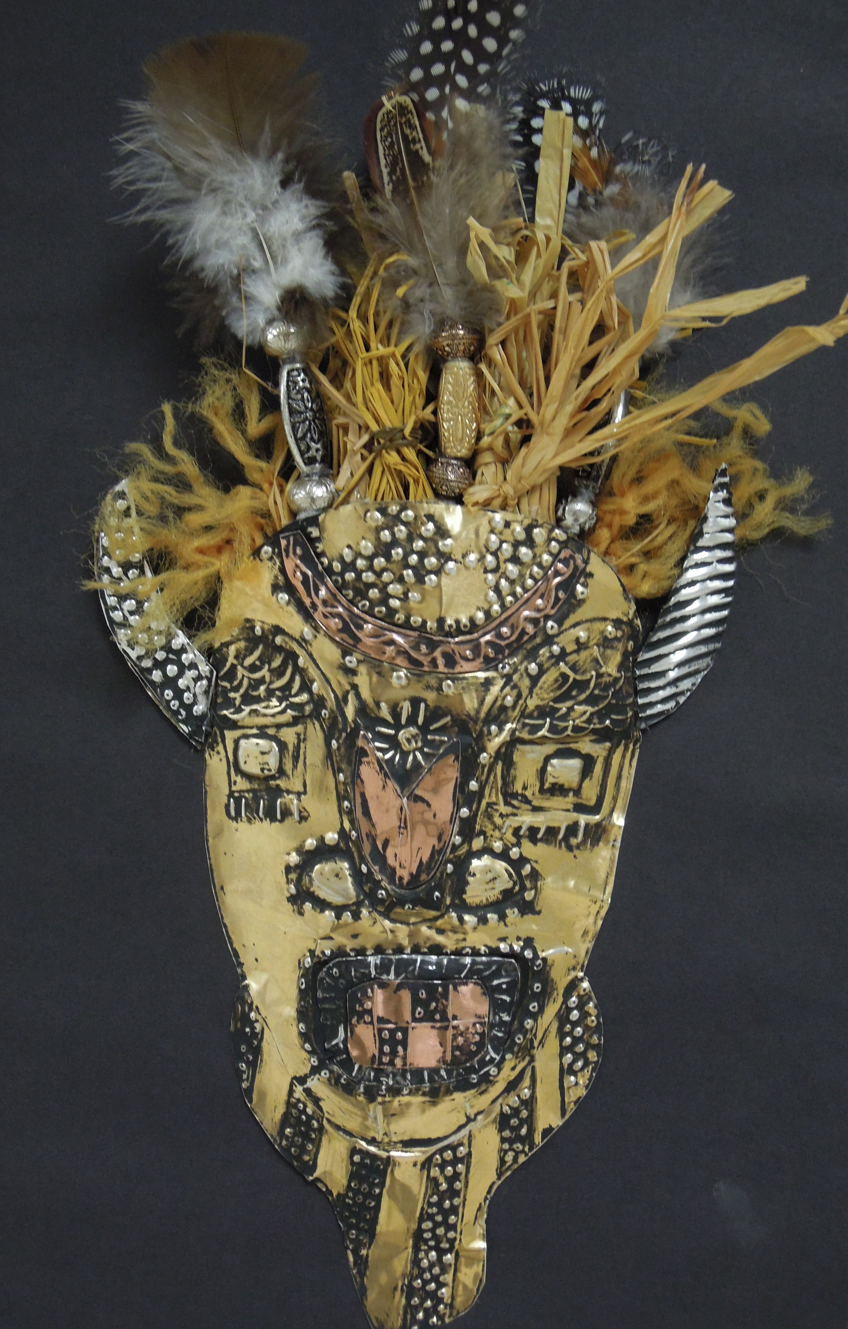
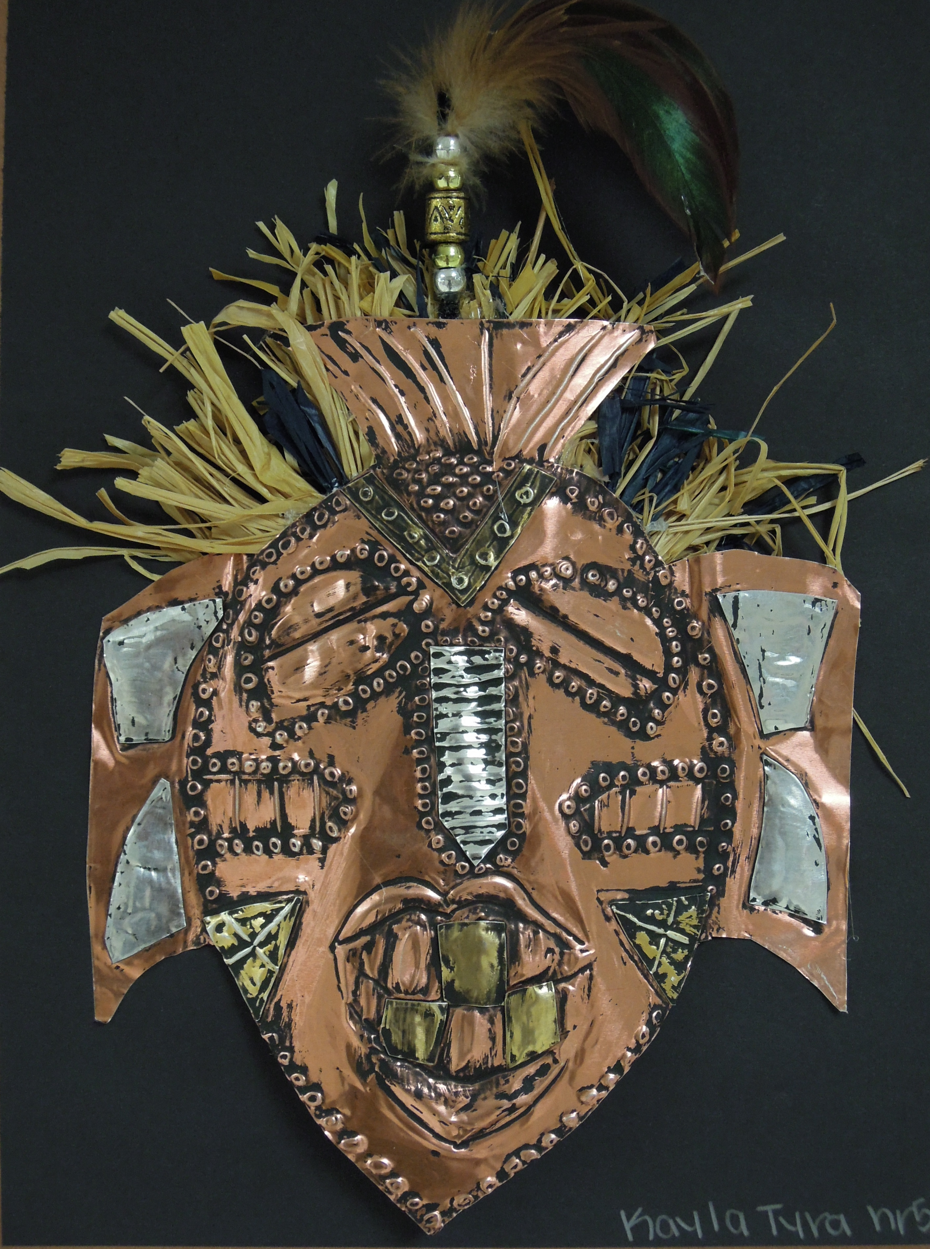

Slide 22
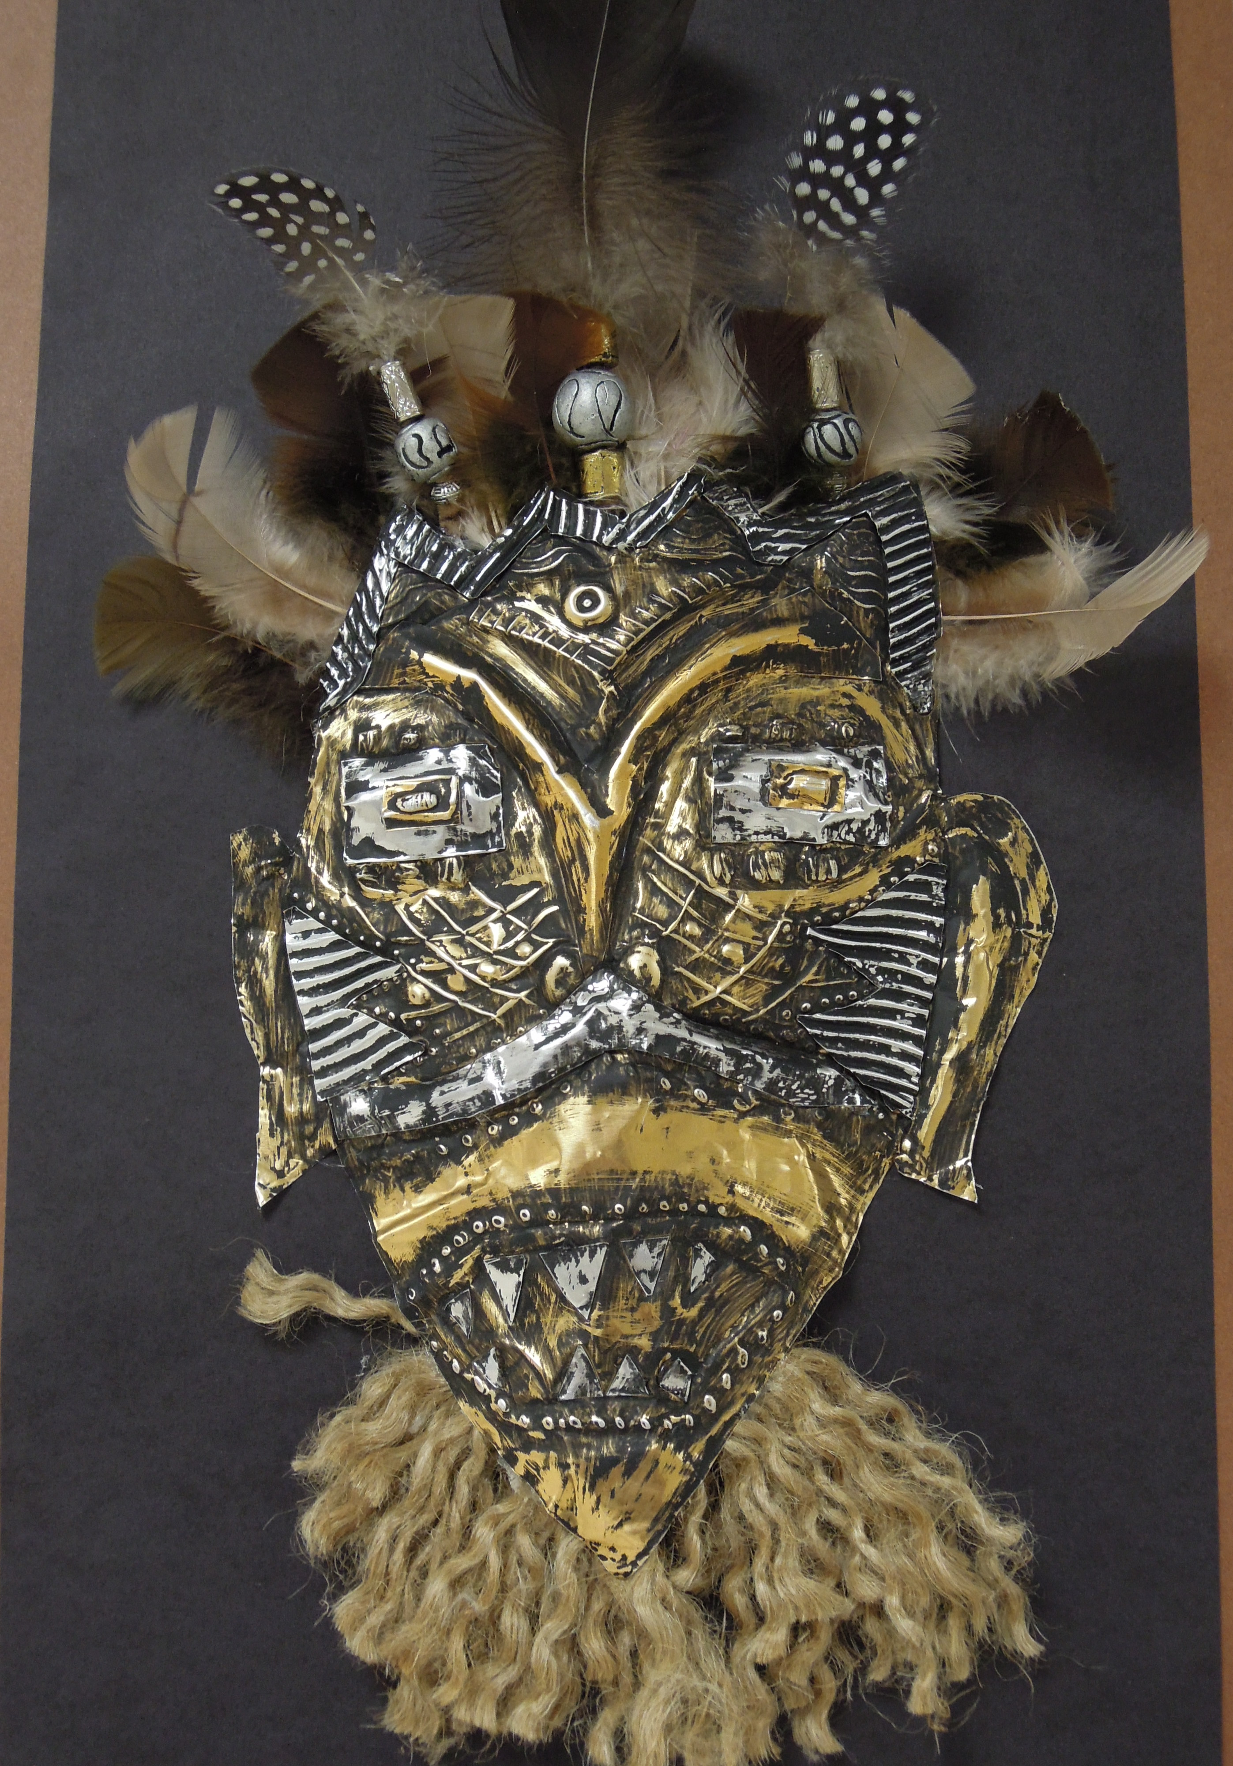
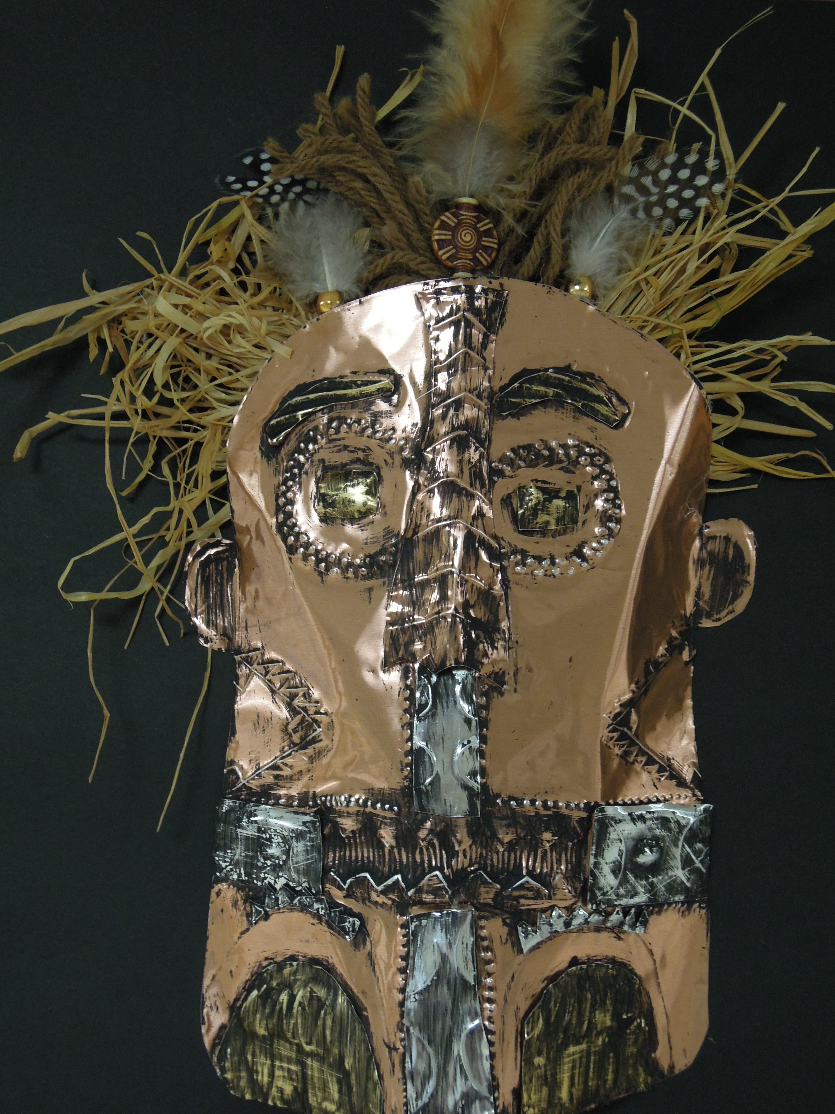

Slide 23
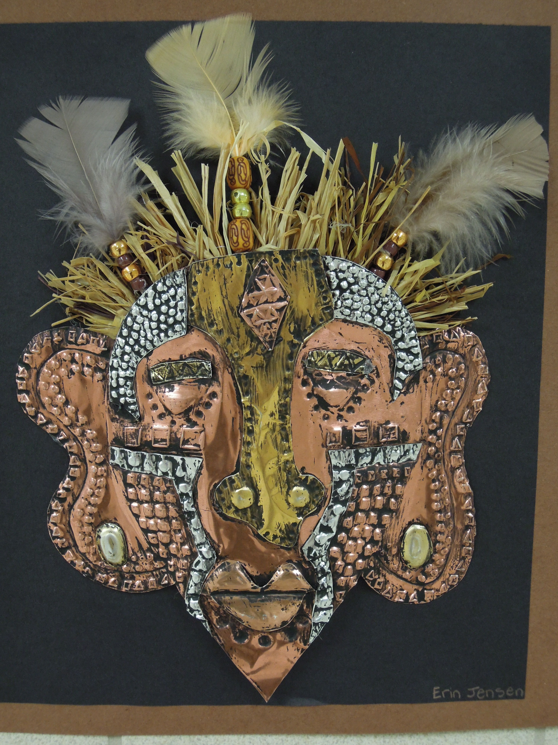

Slide 24
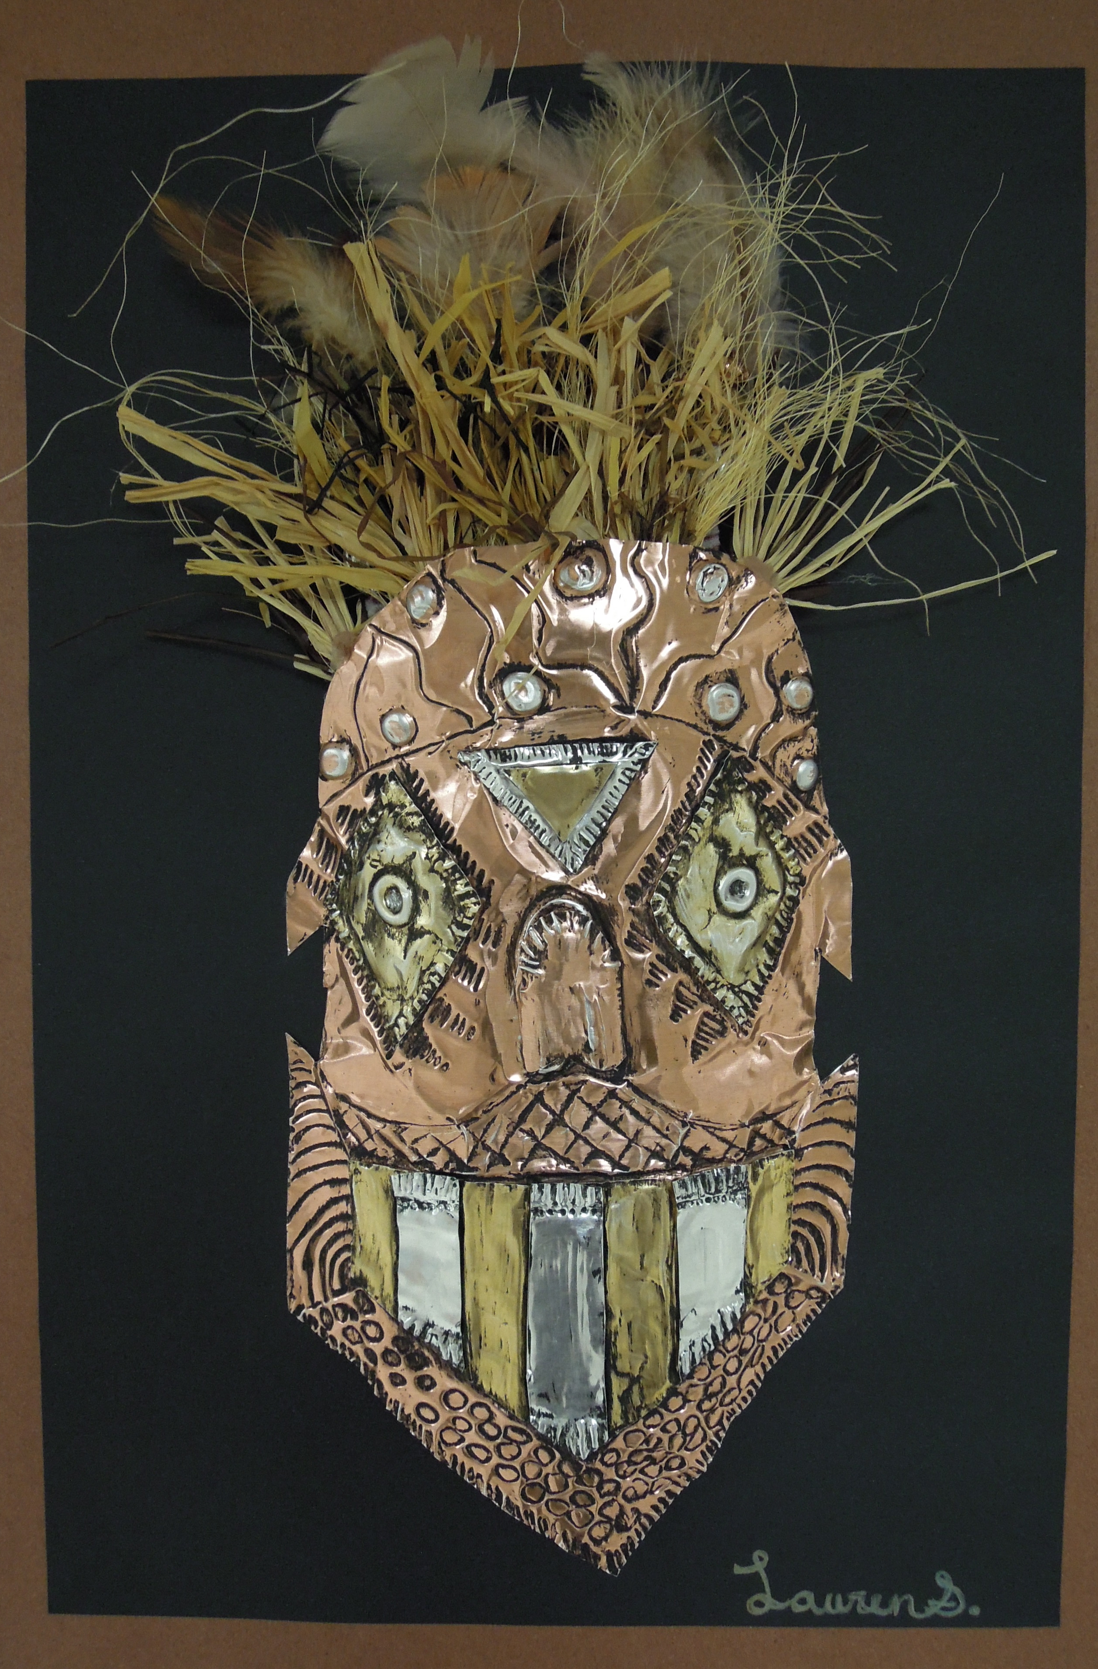
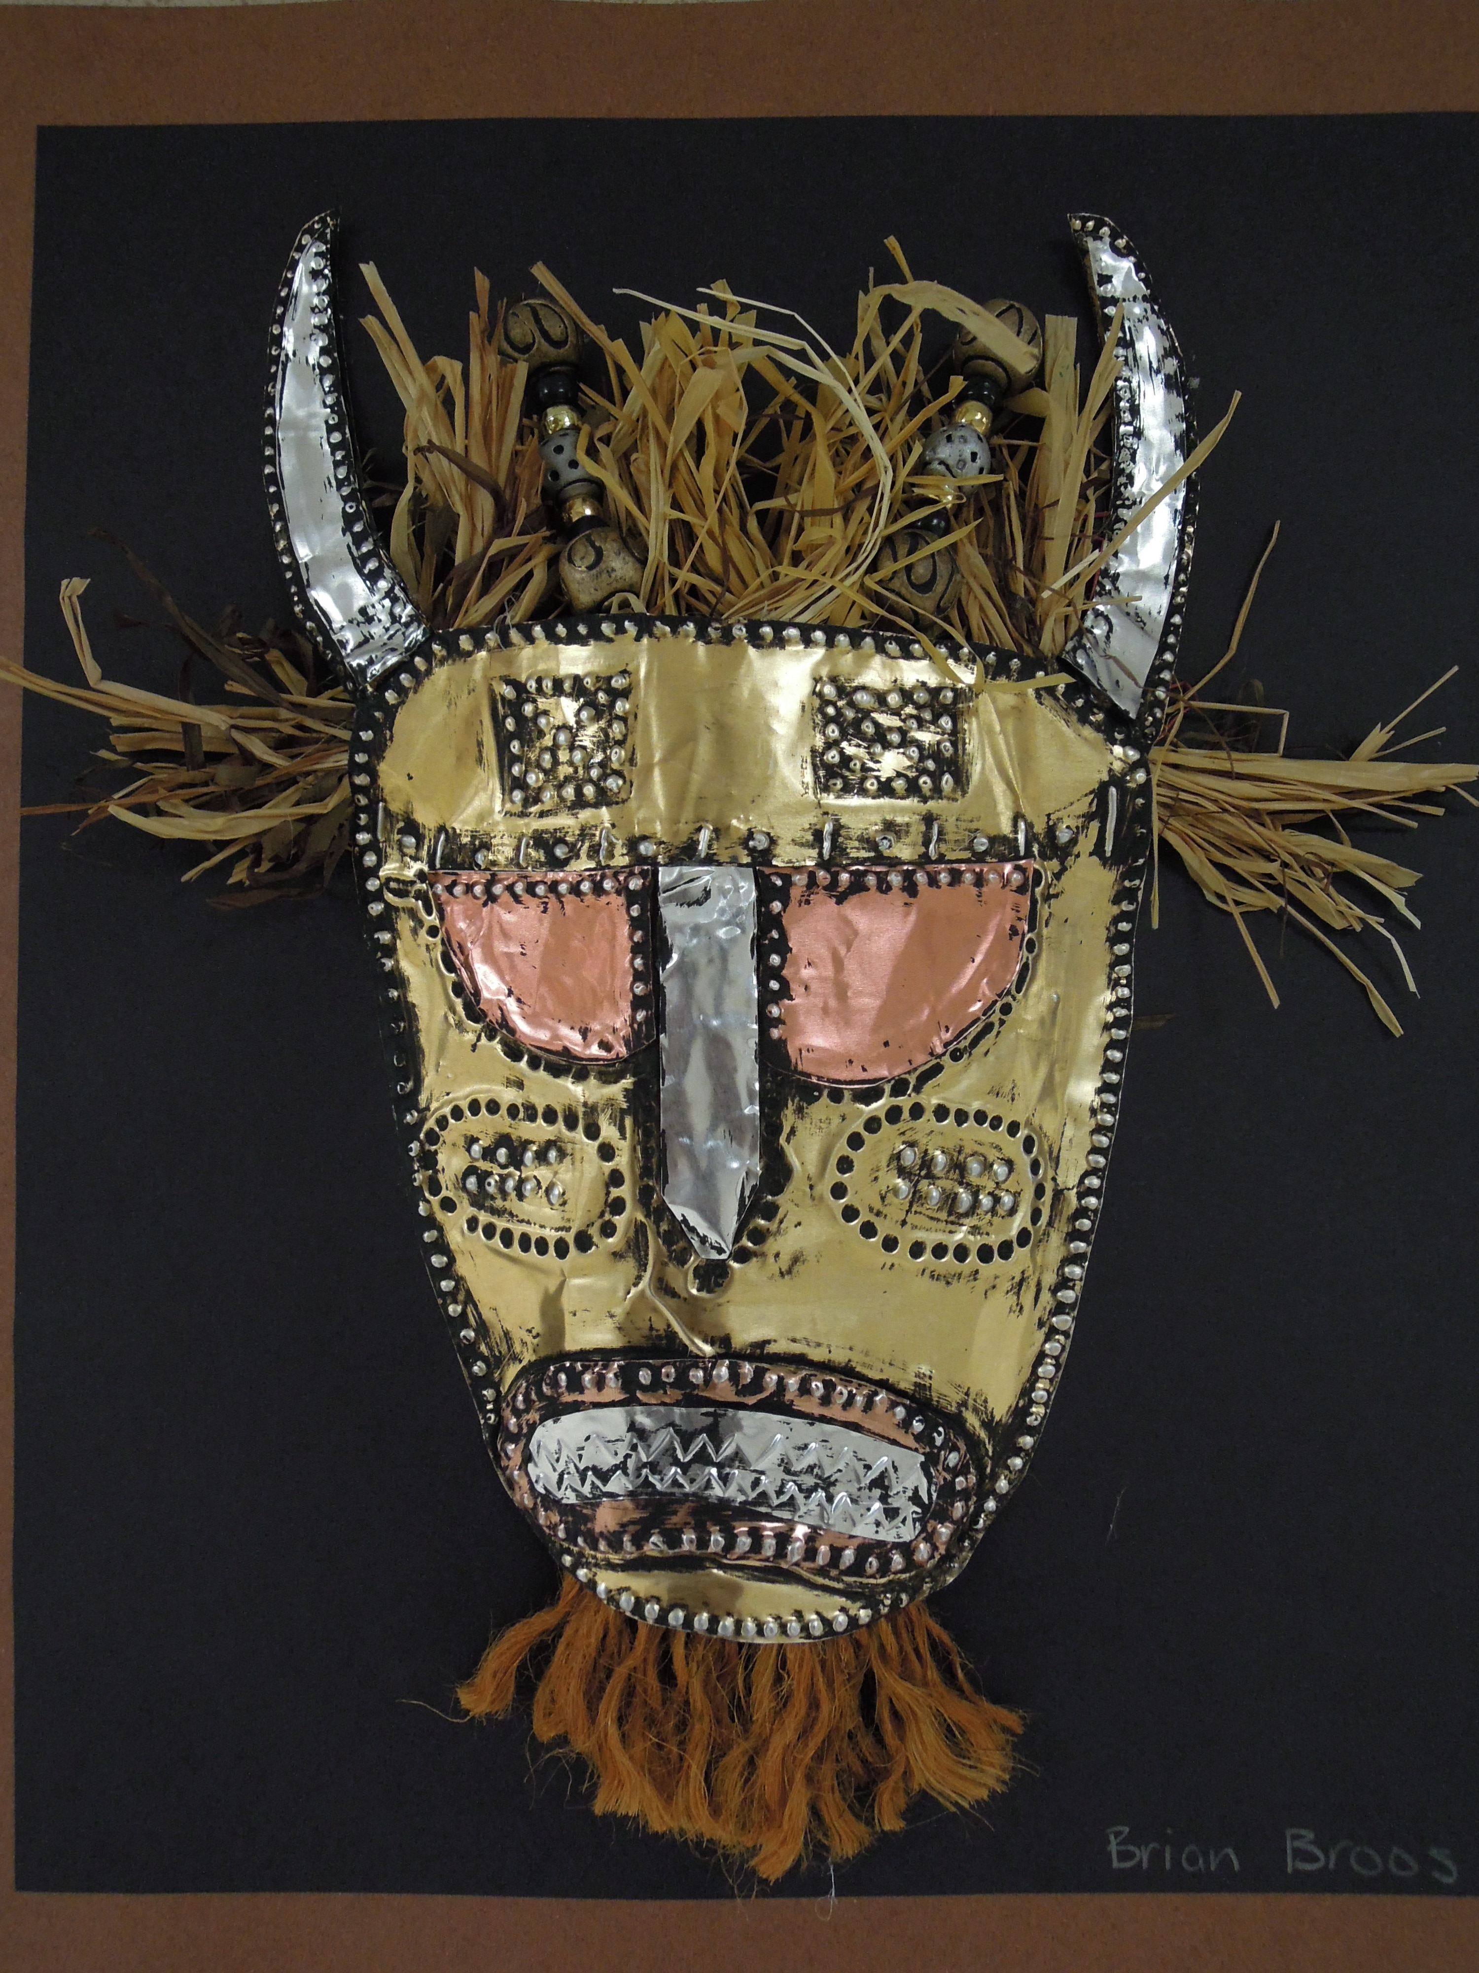

Slide 25
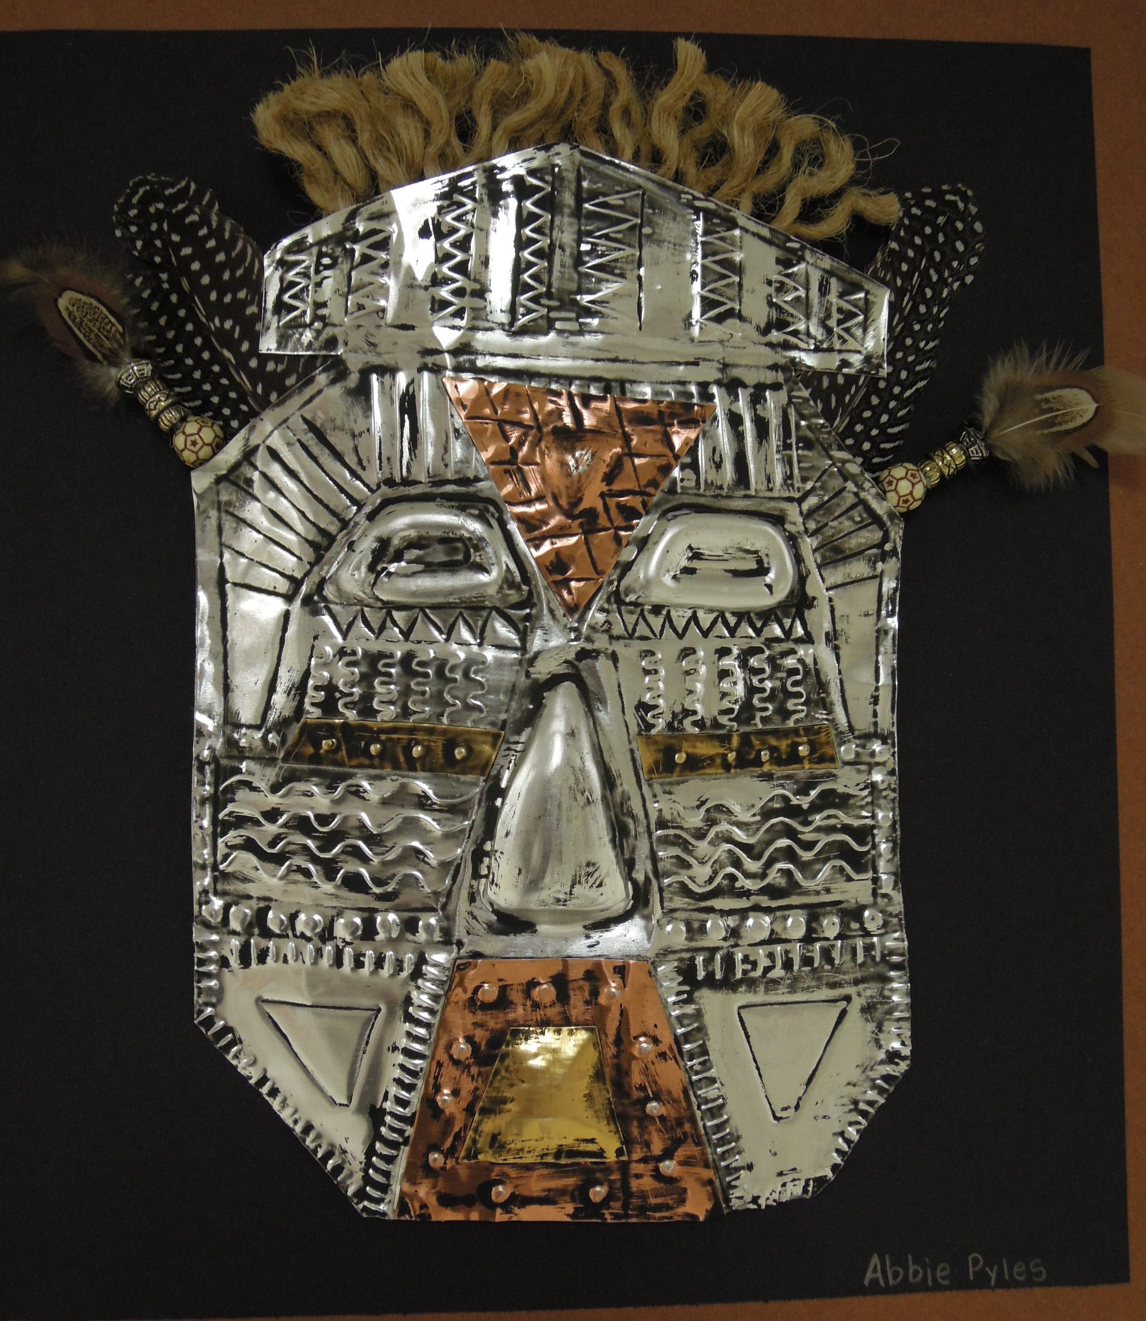

Slide 26
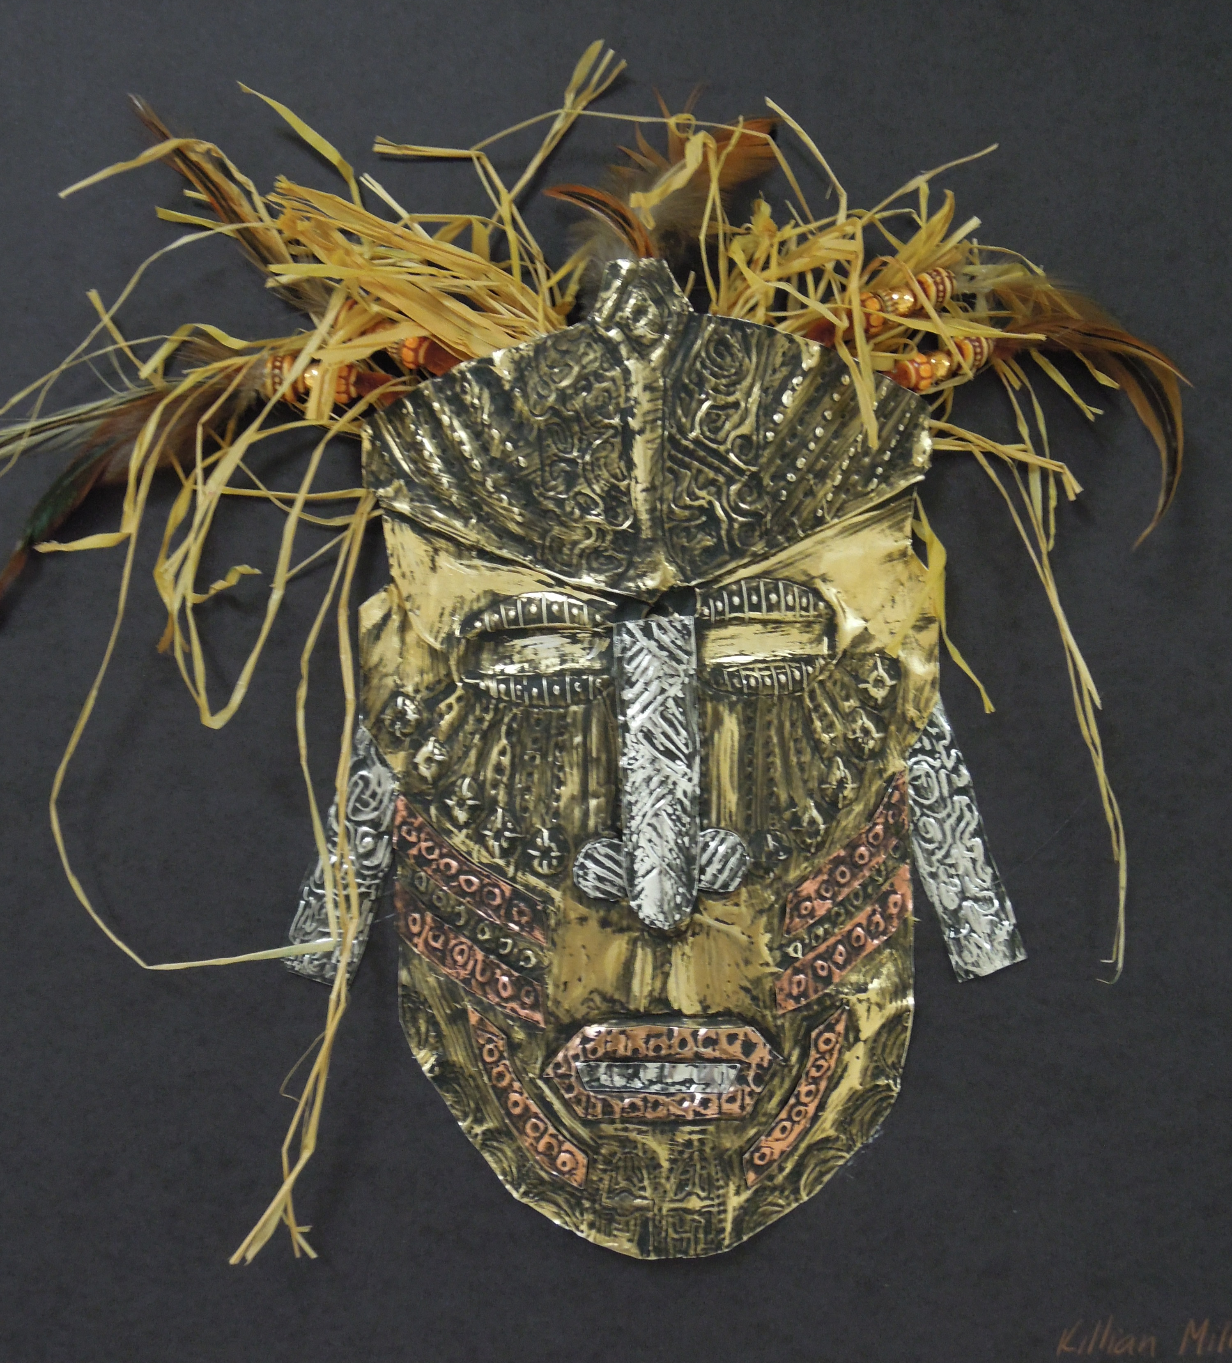

Slide 27
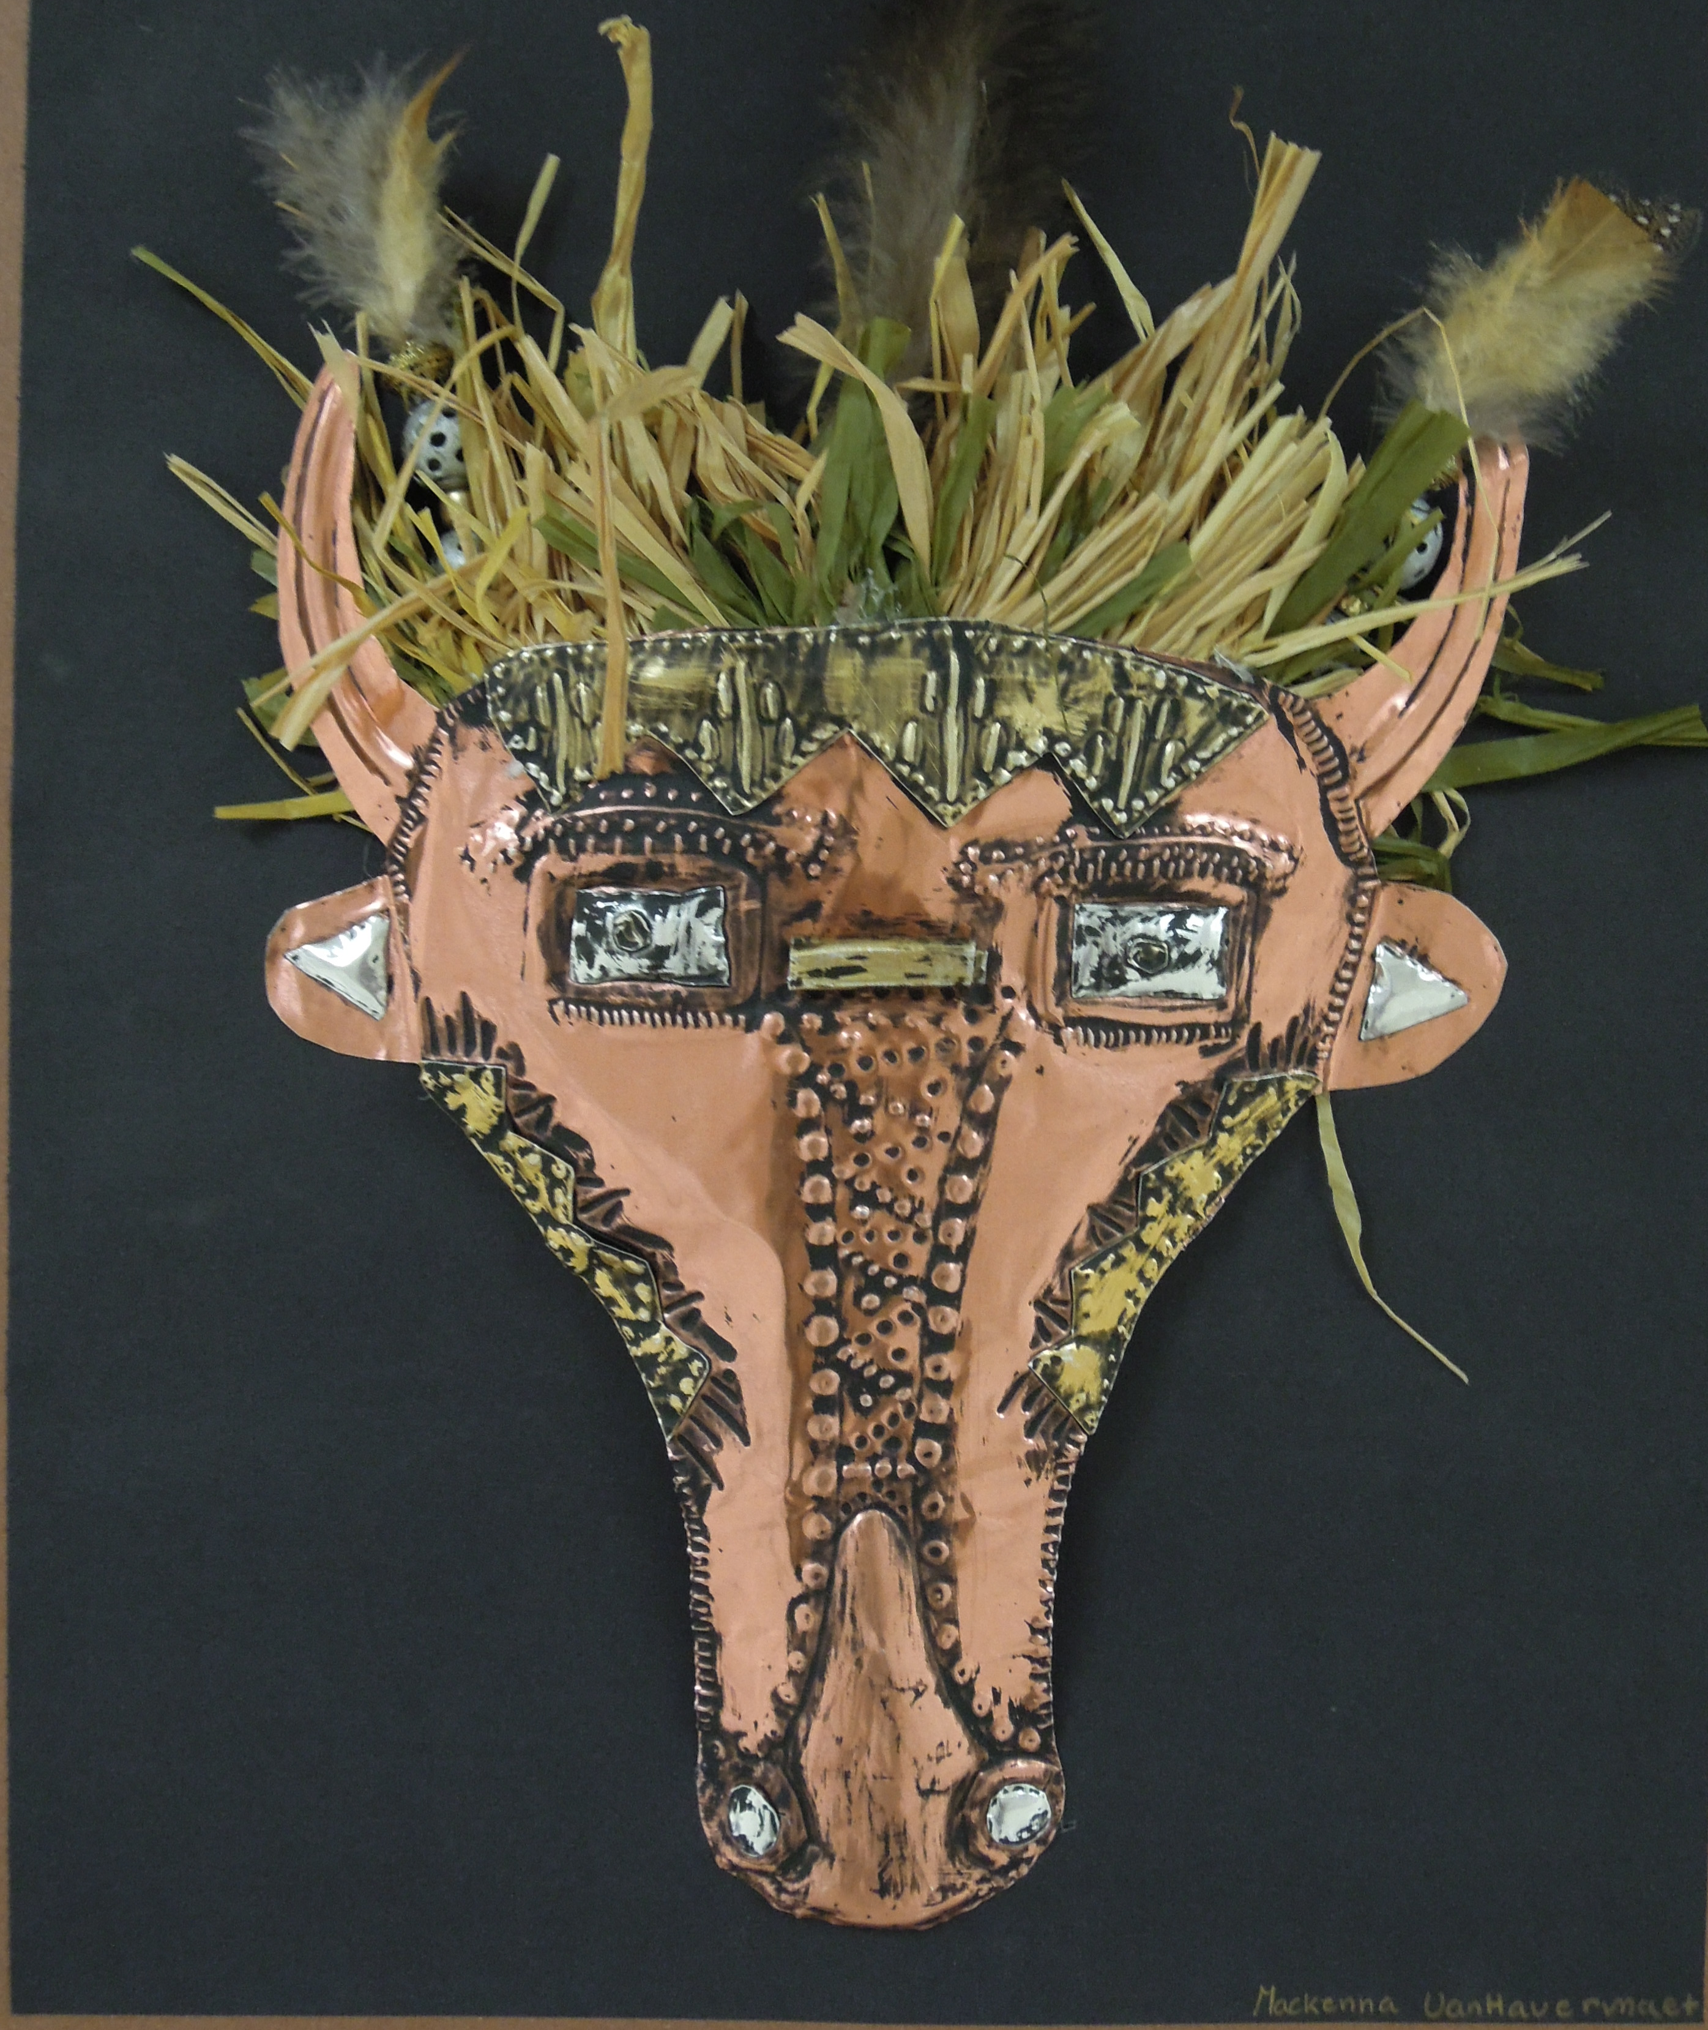

Slide 28
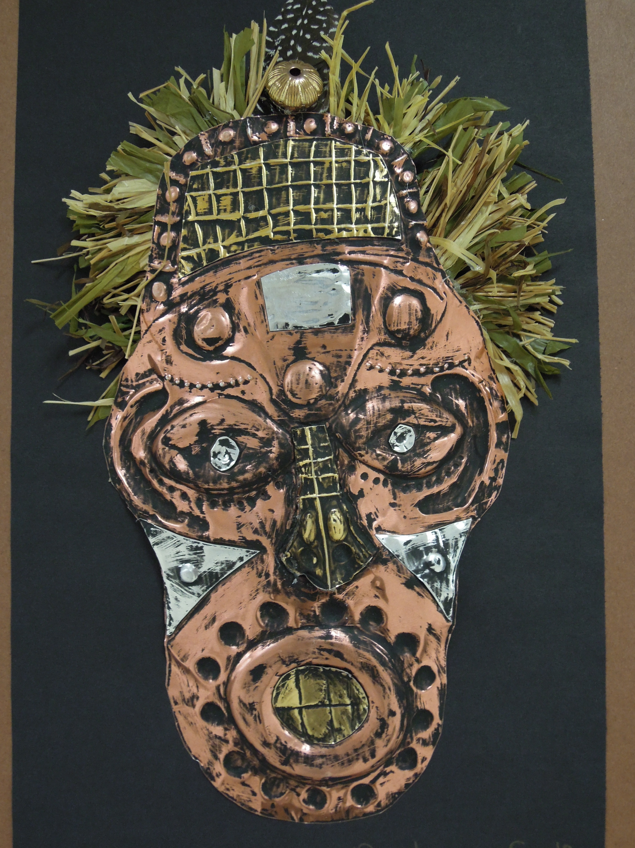
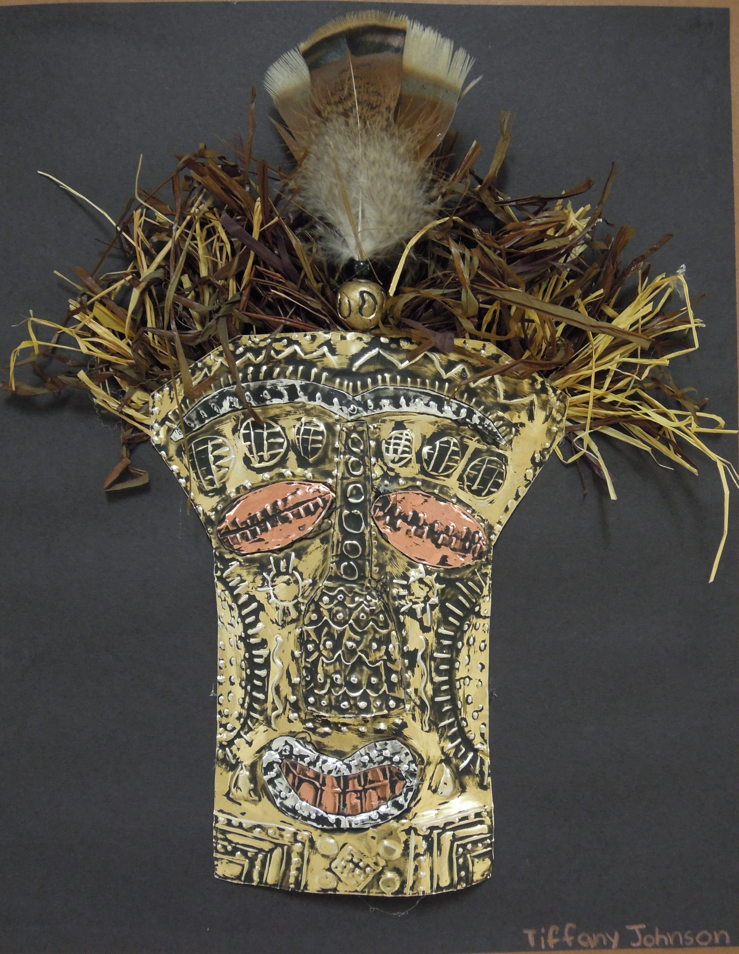

Slide 29
