Slide 1
Cave Art:
6th Grade Student Work
Learning Targets:
* Space
* Color
* Changes in Technology

Slide 2
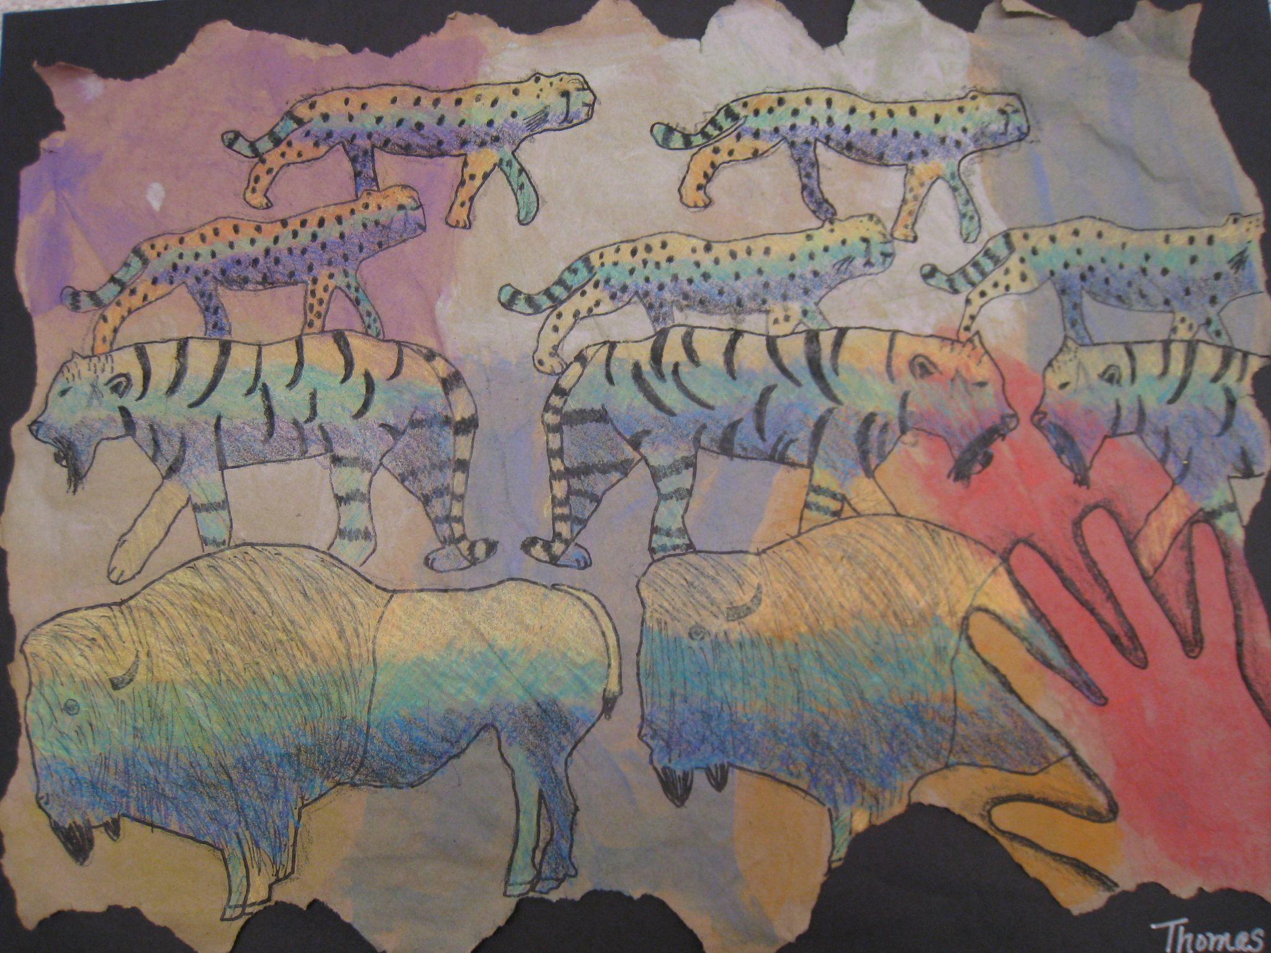

Slide 3
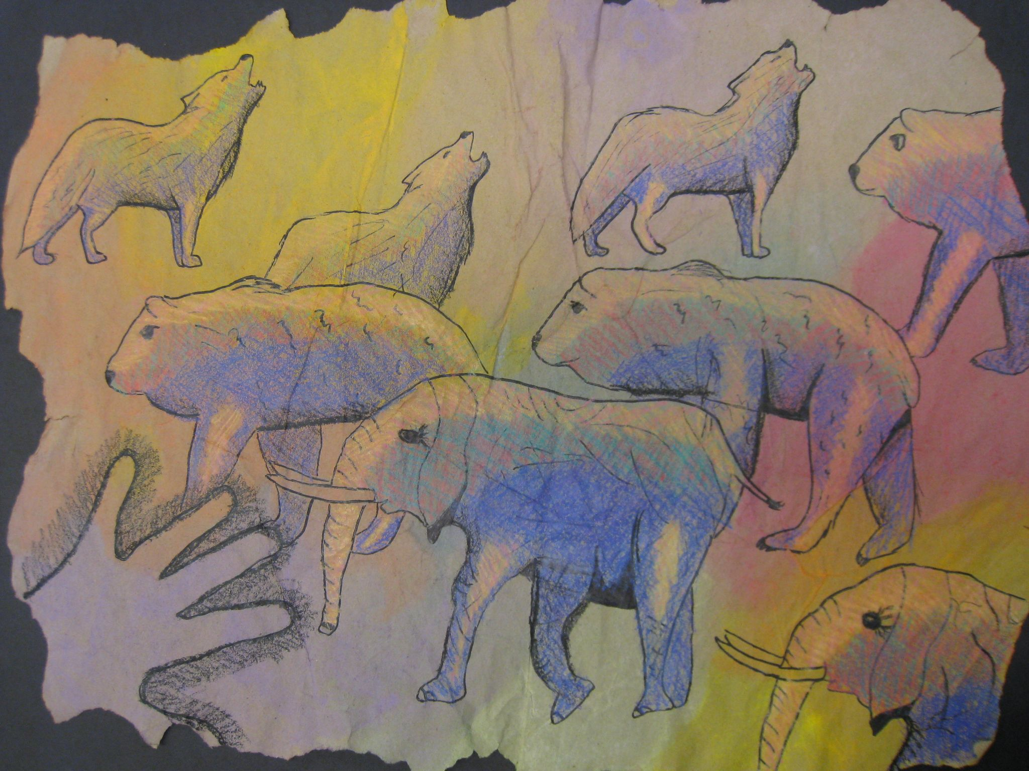

Slide 4
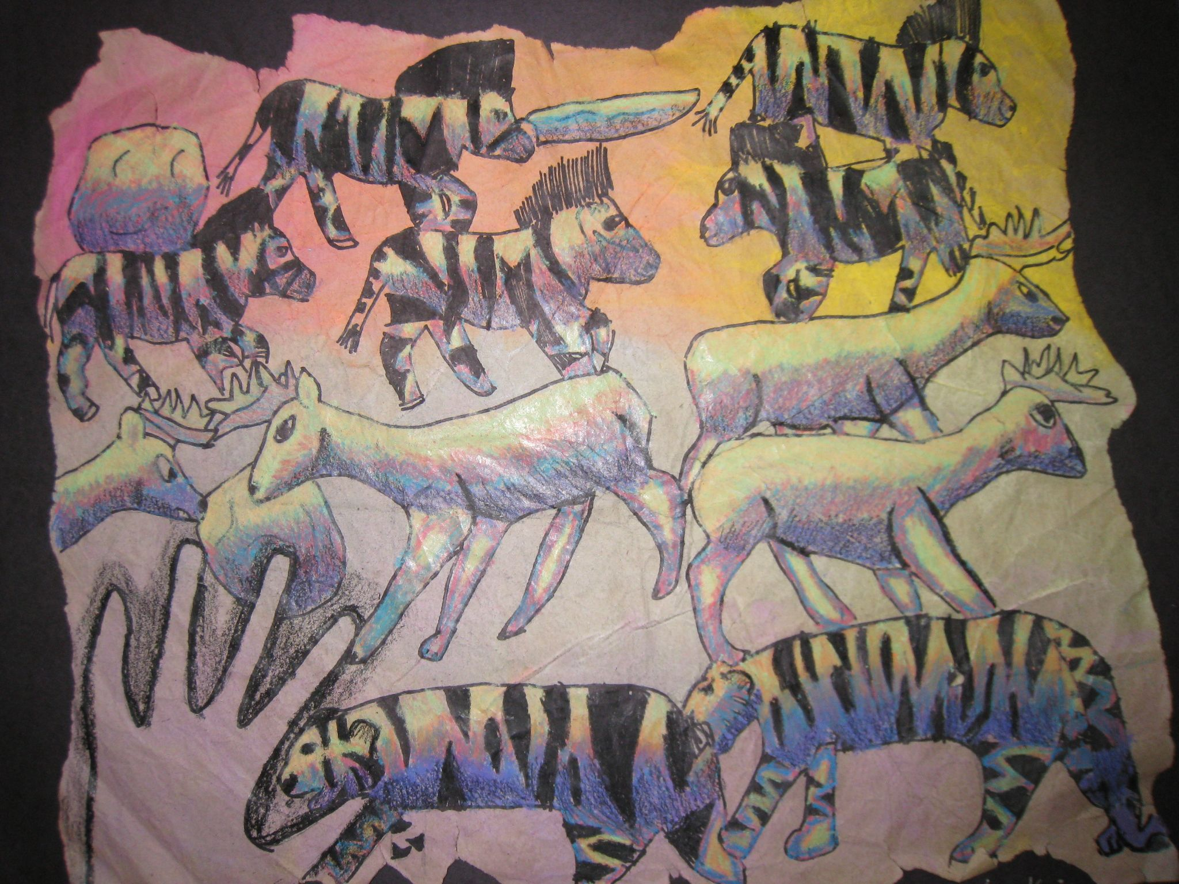

Slide 5
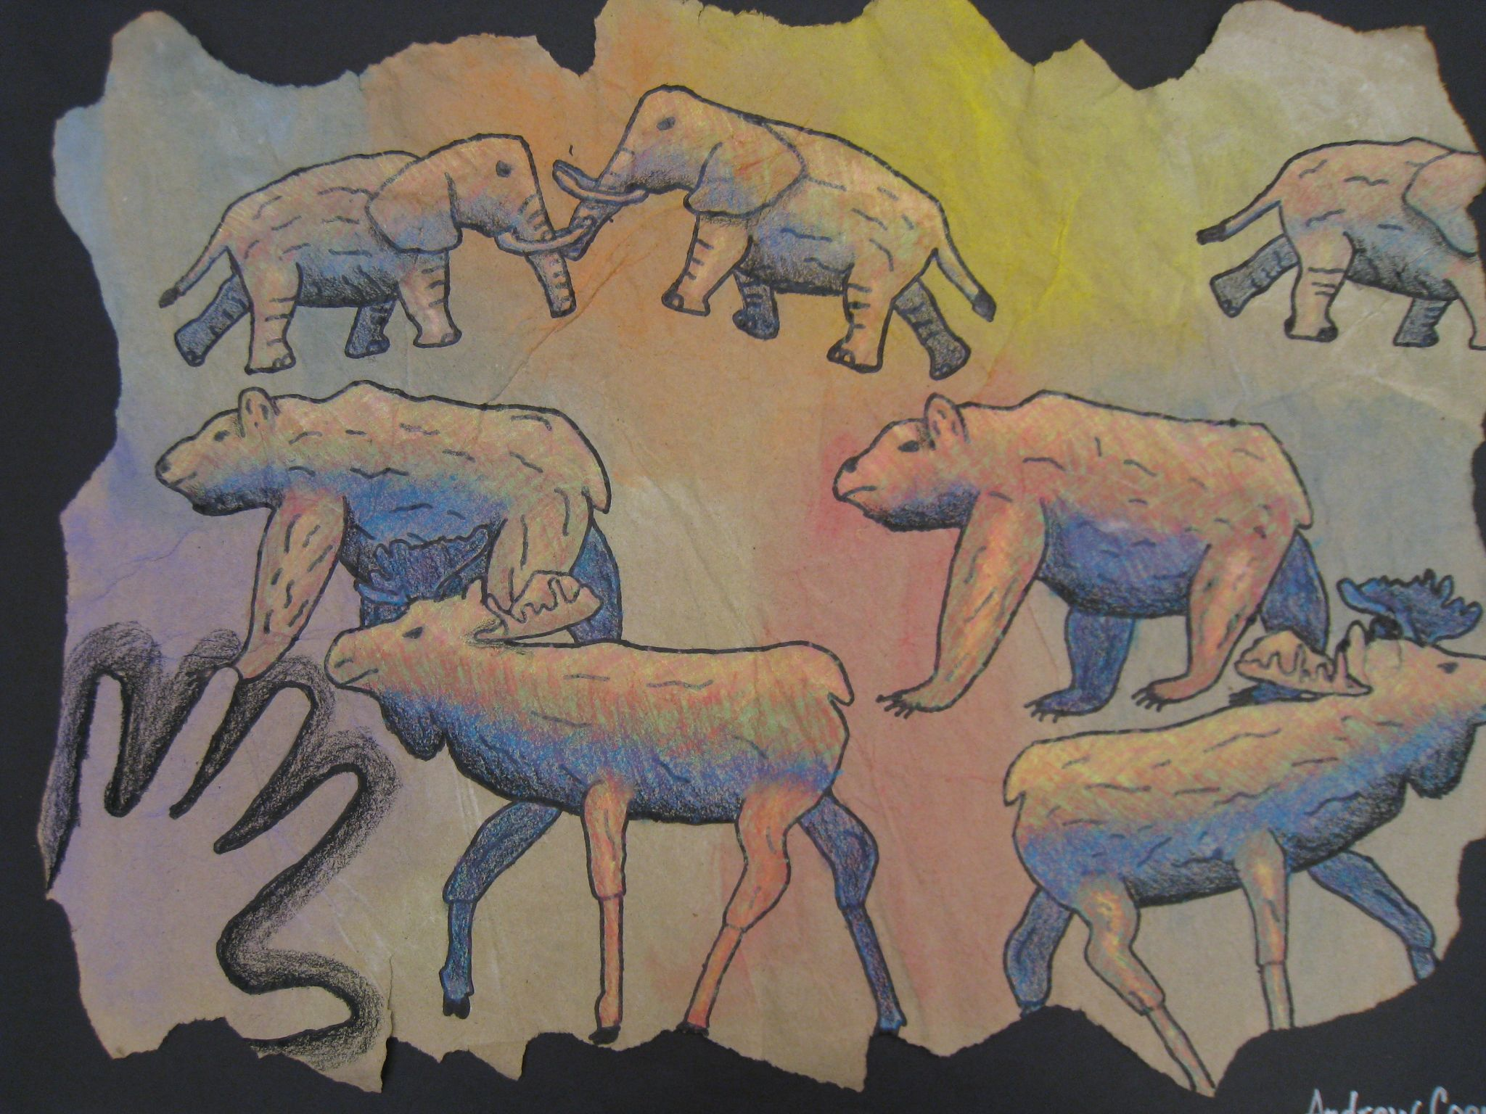

Slide 6
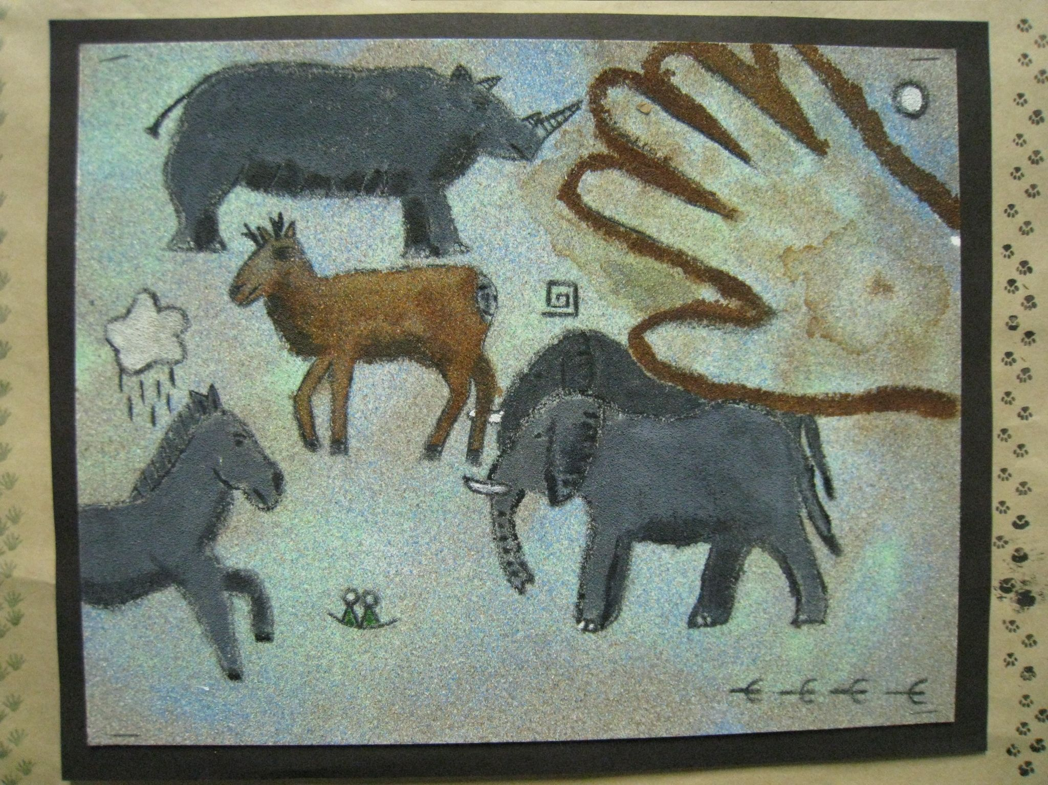

Slide 7
