Slide 1
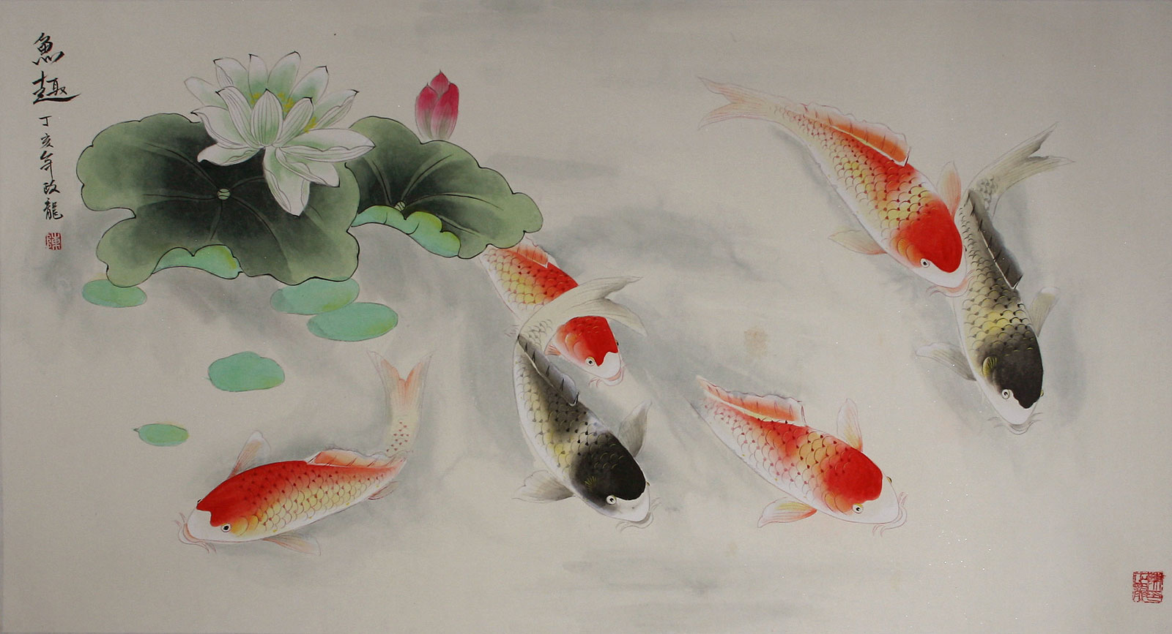
Art of Asia: Koi Fish Paintings

Slide 2
Chinese Koi Fish Meaning: Koi Fish are kept in ponds all over the world, but they have a special meaning in Asia.

Slide 3
Because of their special meaning in the Asian culture, they are a popular subject for many paintings

Slide 4
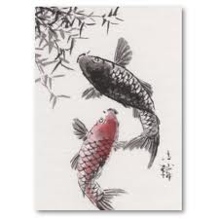
The Koi paintings vary from black pen and ink, to vivid watercolors done on scroll paper.

Slide 5
A couple thousand years ago, a legend in China was formed that told how the carp (koi) that swam up a waterfall and through the dragon gate were magically transformed into dragons.

Slide 6
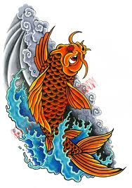
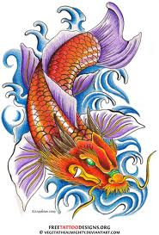

Slide 7
Through perseverance and endurance, the carp were able to become mythical beings. Two thousand years later, the Koi fish still symbolize perseverance and endurance. The Koi fish meaning is always linked with worldly ambition and achievement.

Slide 8
In Japan, Koi are known for their masculine and positive qualities. They are the official symbol for the Children’s Day (May 5) festival in Japan. On Children’s day, families hang a Koi windsock for every member of their family.

Slide 10
Another quality that the Japanese Koi symbolize is strength, for overcoming life’s difficulties. By persevering in life’s endeavors, one can better him or herself.

Slide 11
Koi fish are costly and breeding the fish would entail expenses. Affluent people in eastern cultures have large gardens with Koi ponds. For this reason, Koi fish meaning is also associated with prosperity and good luck.

Slide 12
Many contemporary Artists use Koi as their subject matter. Can you find Line, Pattern, Shape, and Movement in this painting?

Slide 16
Student Art Work inspired by Asian Koi Fish Paintings

Slide 17
Student used watercolor paint and black marker

Slide 18
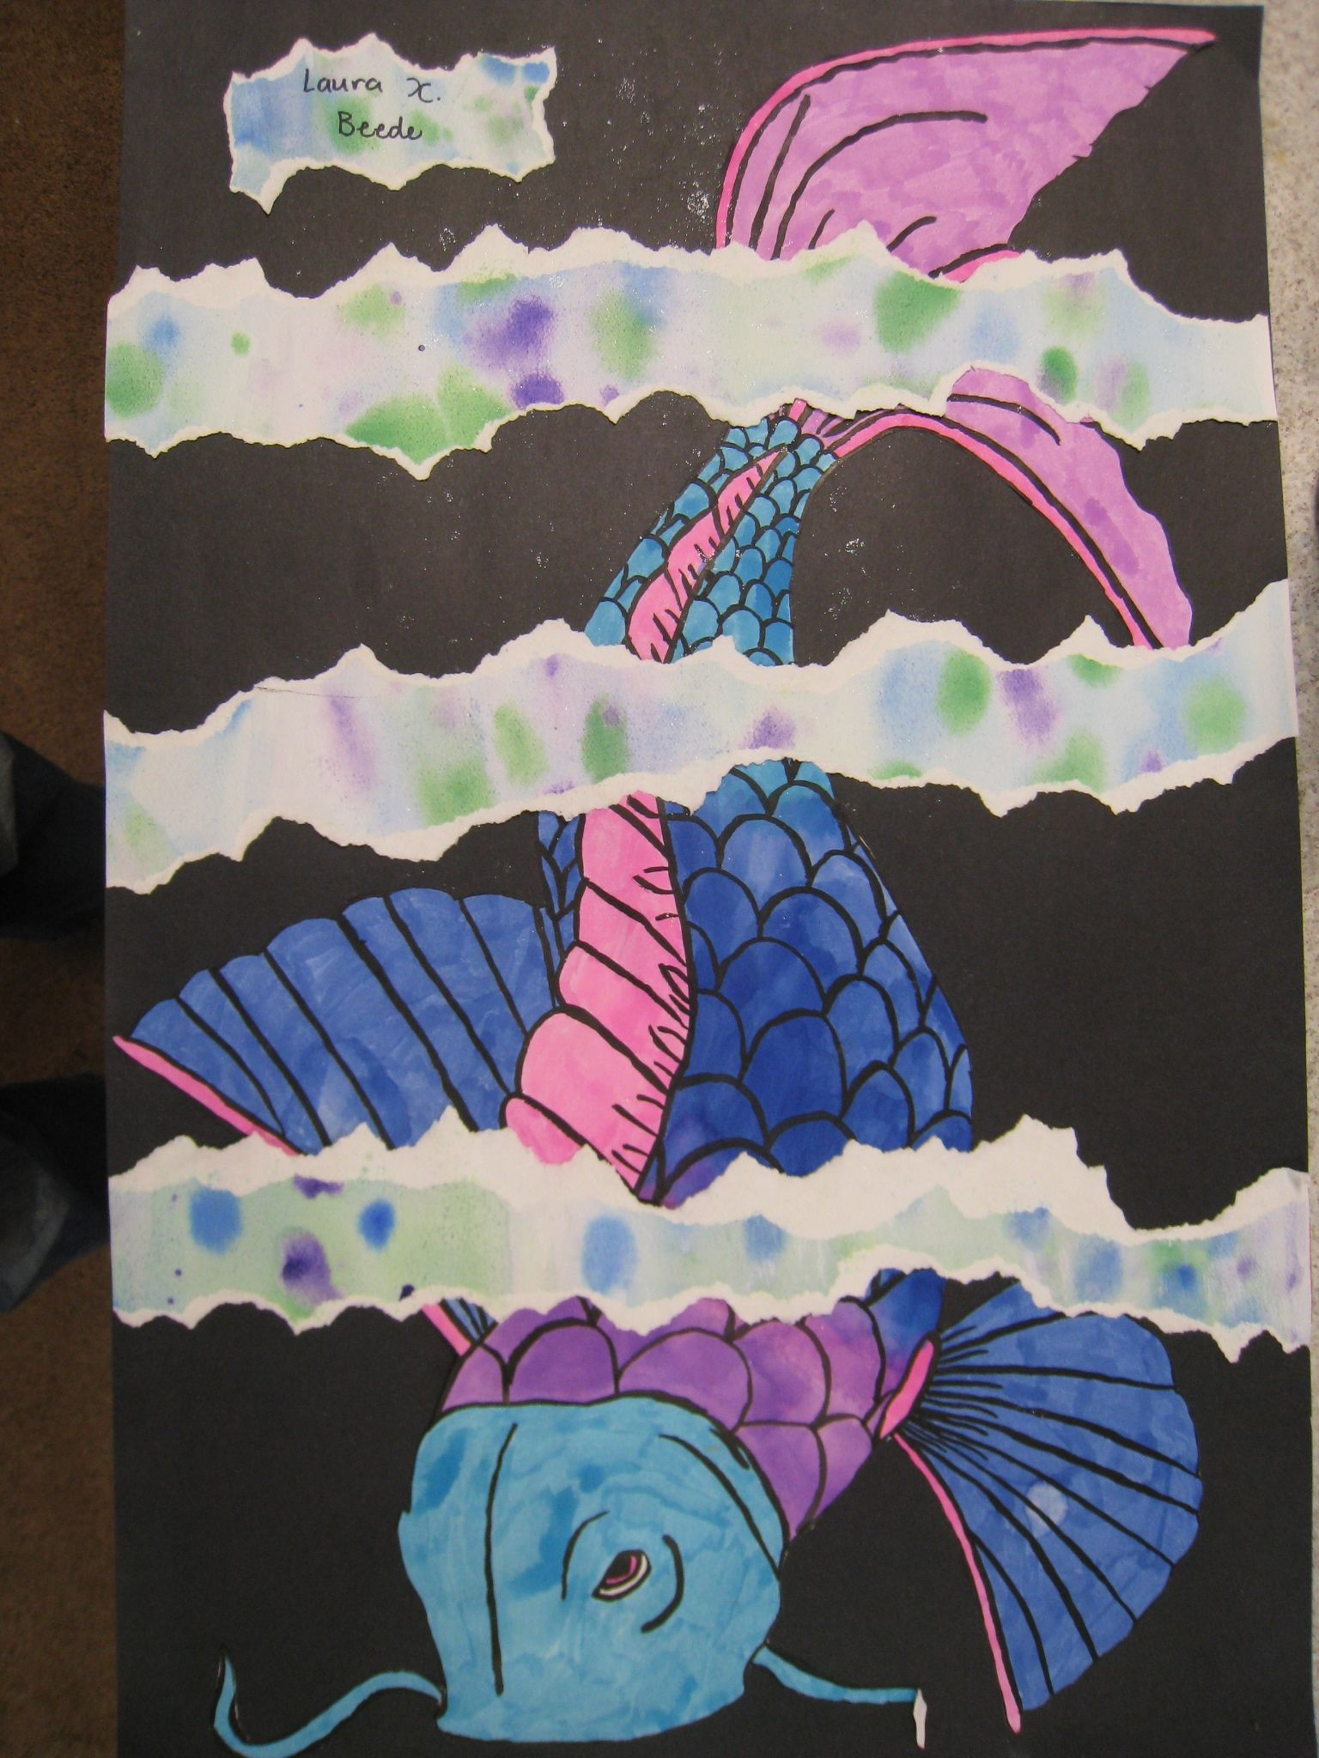
Learning Targets:
*Line
*Pattern
*Movement
*Shape

