Slide 1
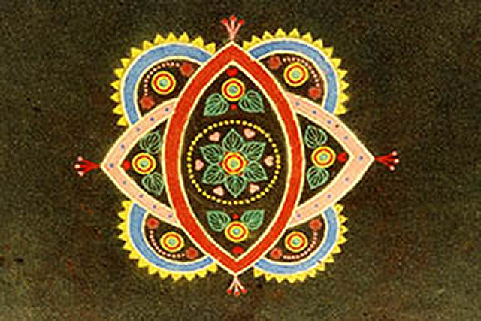
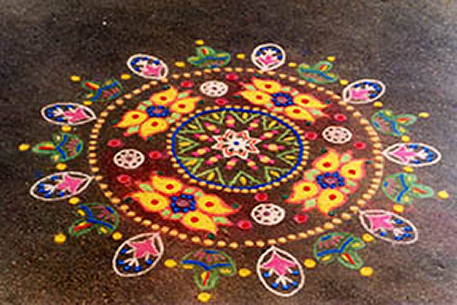
Rangoli
Rangoli is a very popular and traditional art form in India. It is generally created on the floor in the entrance of homes to welcome guests, or outside on some festive occasions, such as weddings and religious festivals like Diwali

Slide 2
Can you find India?

Slide 3
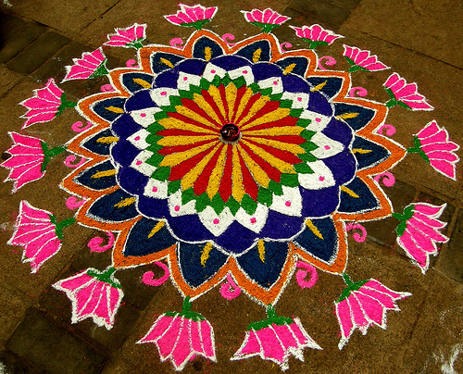
Rangoli is a creative expression of art by means of colors. It is derived from the words rang (color) and aavalli (colored creepers, or rows of colors)

Slide 4
In ancient times, Rangoli designs were made on the entrances of Indian homes for beautifying them, welcoming guests, and welcoming the Goddess Laxmi, the Goddess of Wealth

Slide 6
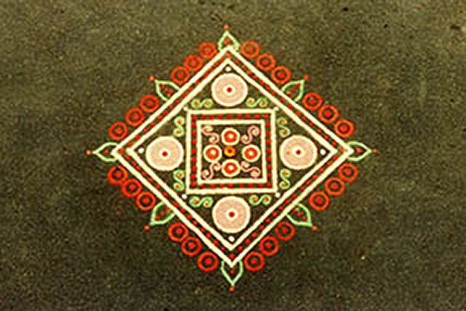
Besides a creative expression of art, they were also considered a symbol of good luck and prosperity.

Slide 7
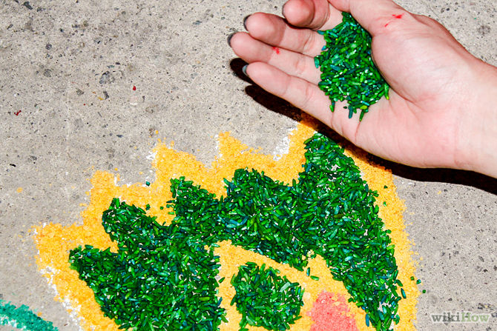
Traditional Indian Rangoli is made from natural materials such as flower petals, colored rice, chalk, plants, beads, and finely ground white stone powder.

Slide 8
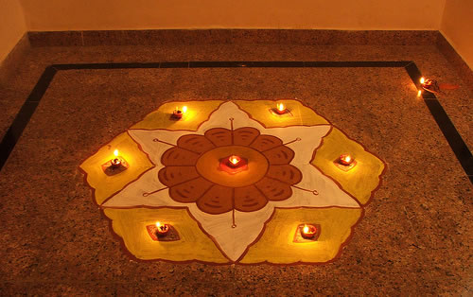
Rangoli can be of any size, from the size of a doormat to the size of an entire room.

Slide 9
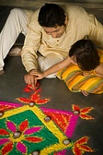
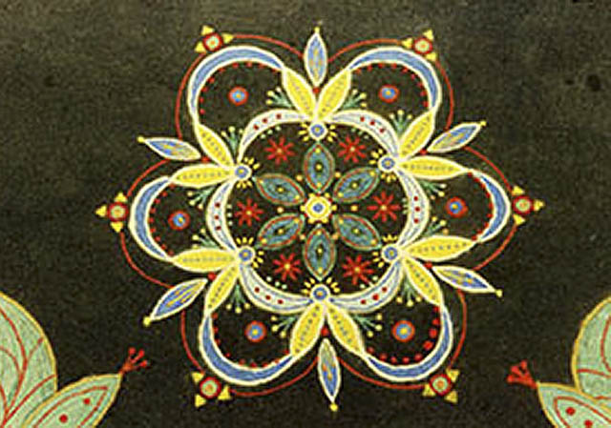
The designs are passed down through generations. Generally they are symmetrical and circular but the overall theme is left up to the individual creating them.

Slide 10
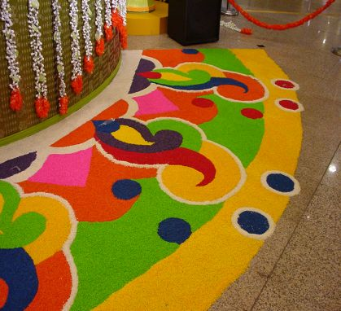
One important point is that the entire pattern must be an unbroken line, with no gaps. In ancient times it was believed that evil spirits could enter through such gaps if they find one

Slide 11
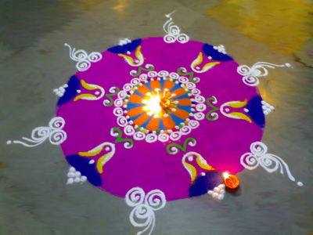
Many colors are used as a symbol of bringing color into one’s life. Black is never used.

Slide 12
Patterns can be floral, geometrical, or have images of the sun, moon, stars, fish, dancing figures, & birds.

Slide 14
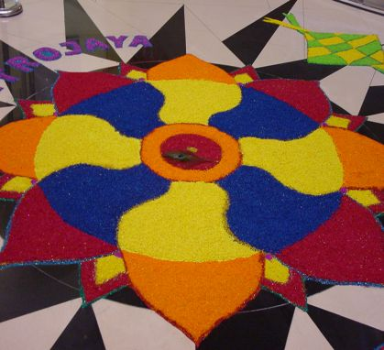
The theme and design of a rangoli is very open to the imagination and creativity of the individual.

Slide 15
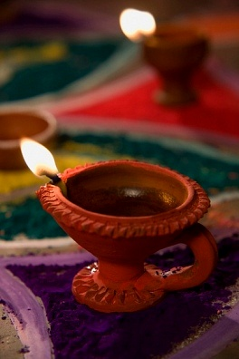
During Diwali, a major Hindu religious festival in India, rangolis are created and oil lamps are placed on the designs. The oil lamps signify the triumph of good over evil within the individual.

Slide 16
During festivals or holidays, Rangolis may be started before dawn, and completed as the sun rises.

Slide 18
The art of Rangoli is practiced all over the country today such as this example from Asia.

Slide 19
The Navajo also create Rangoli with fine sand grains.

Slide 20
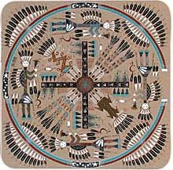

Slide 21
How does this Rangoli show Pattern?

Slide 22
What does Radial Design mean? What does Symmetrical Balance mean?

Slide 23
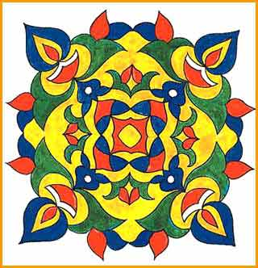
Which Rangoli is more Organic? Which is more Geometric?

Slide 24
Student Work
Students created their own Rangoli using colored pencils, sand, beads, colored rice, and gemstones.
Learning Targets:
Shape
Pattern

Slide 25
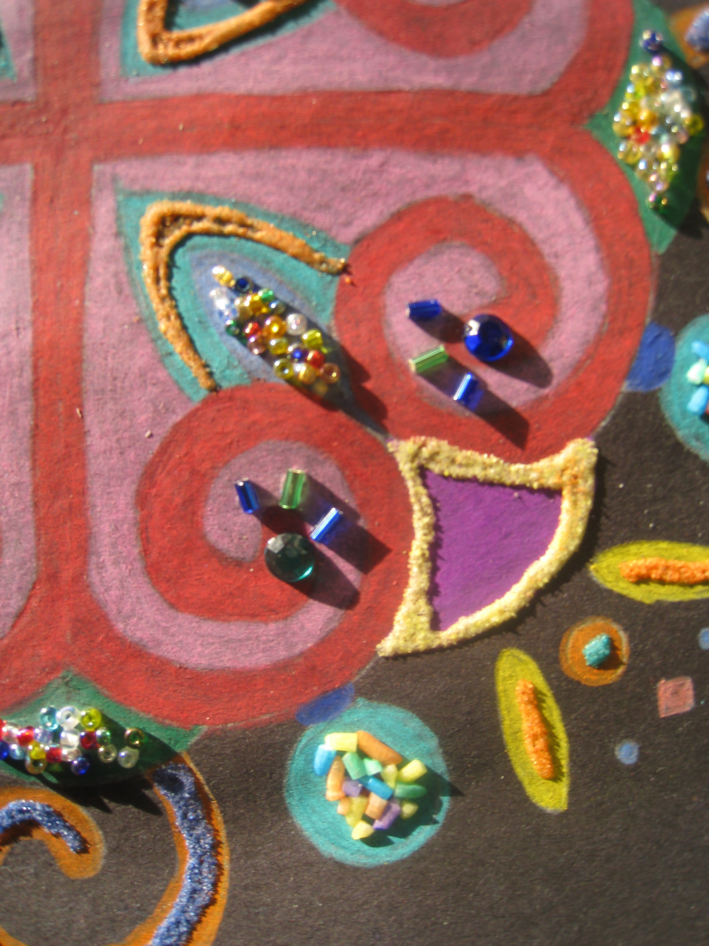

Slide 26
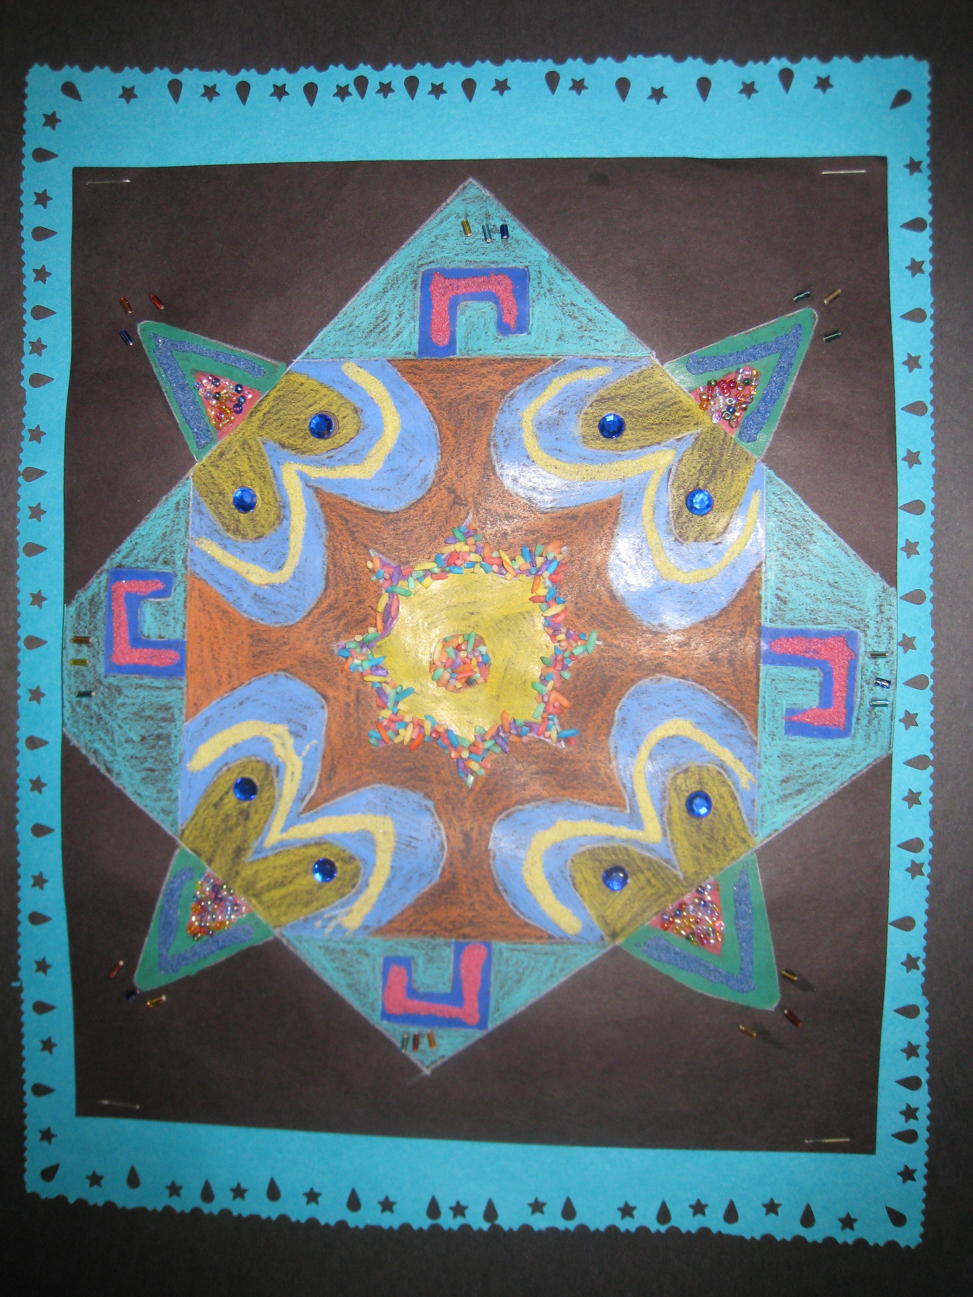

Slide 27
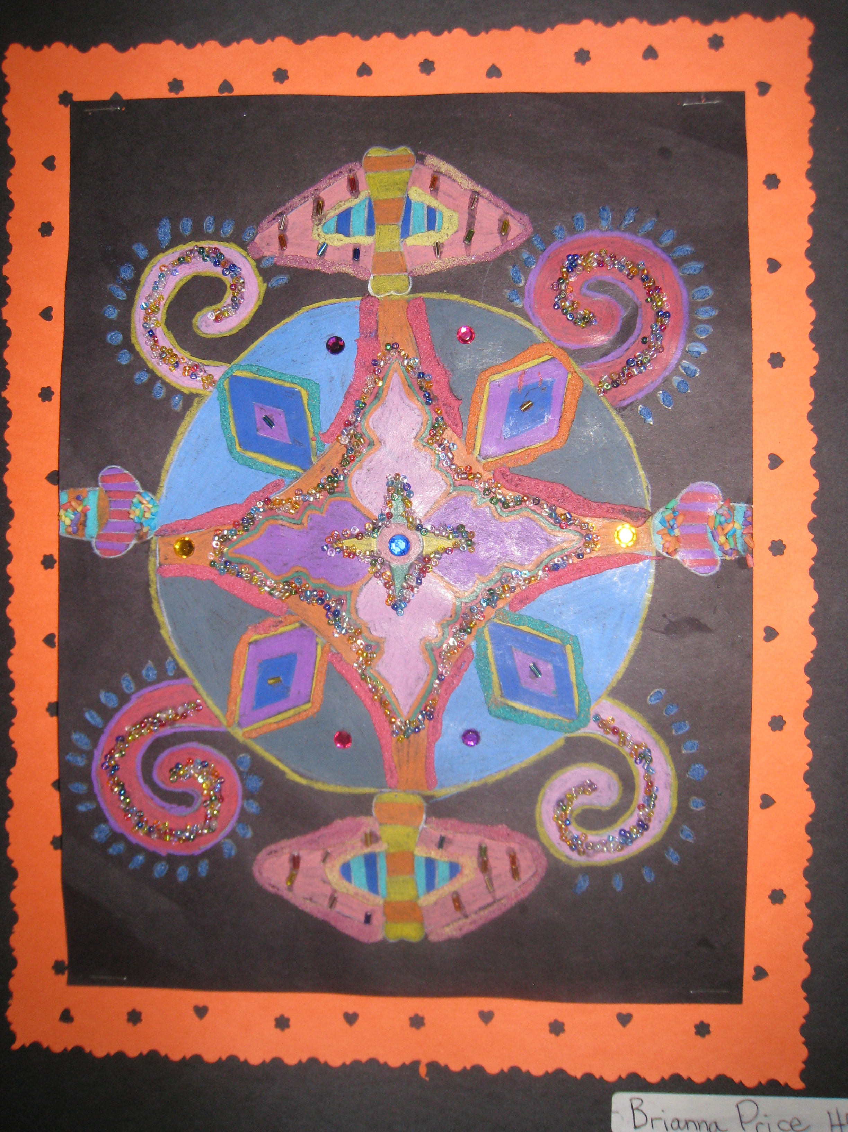

Slide 28
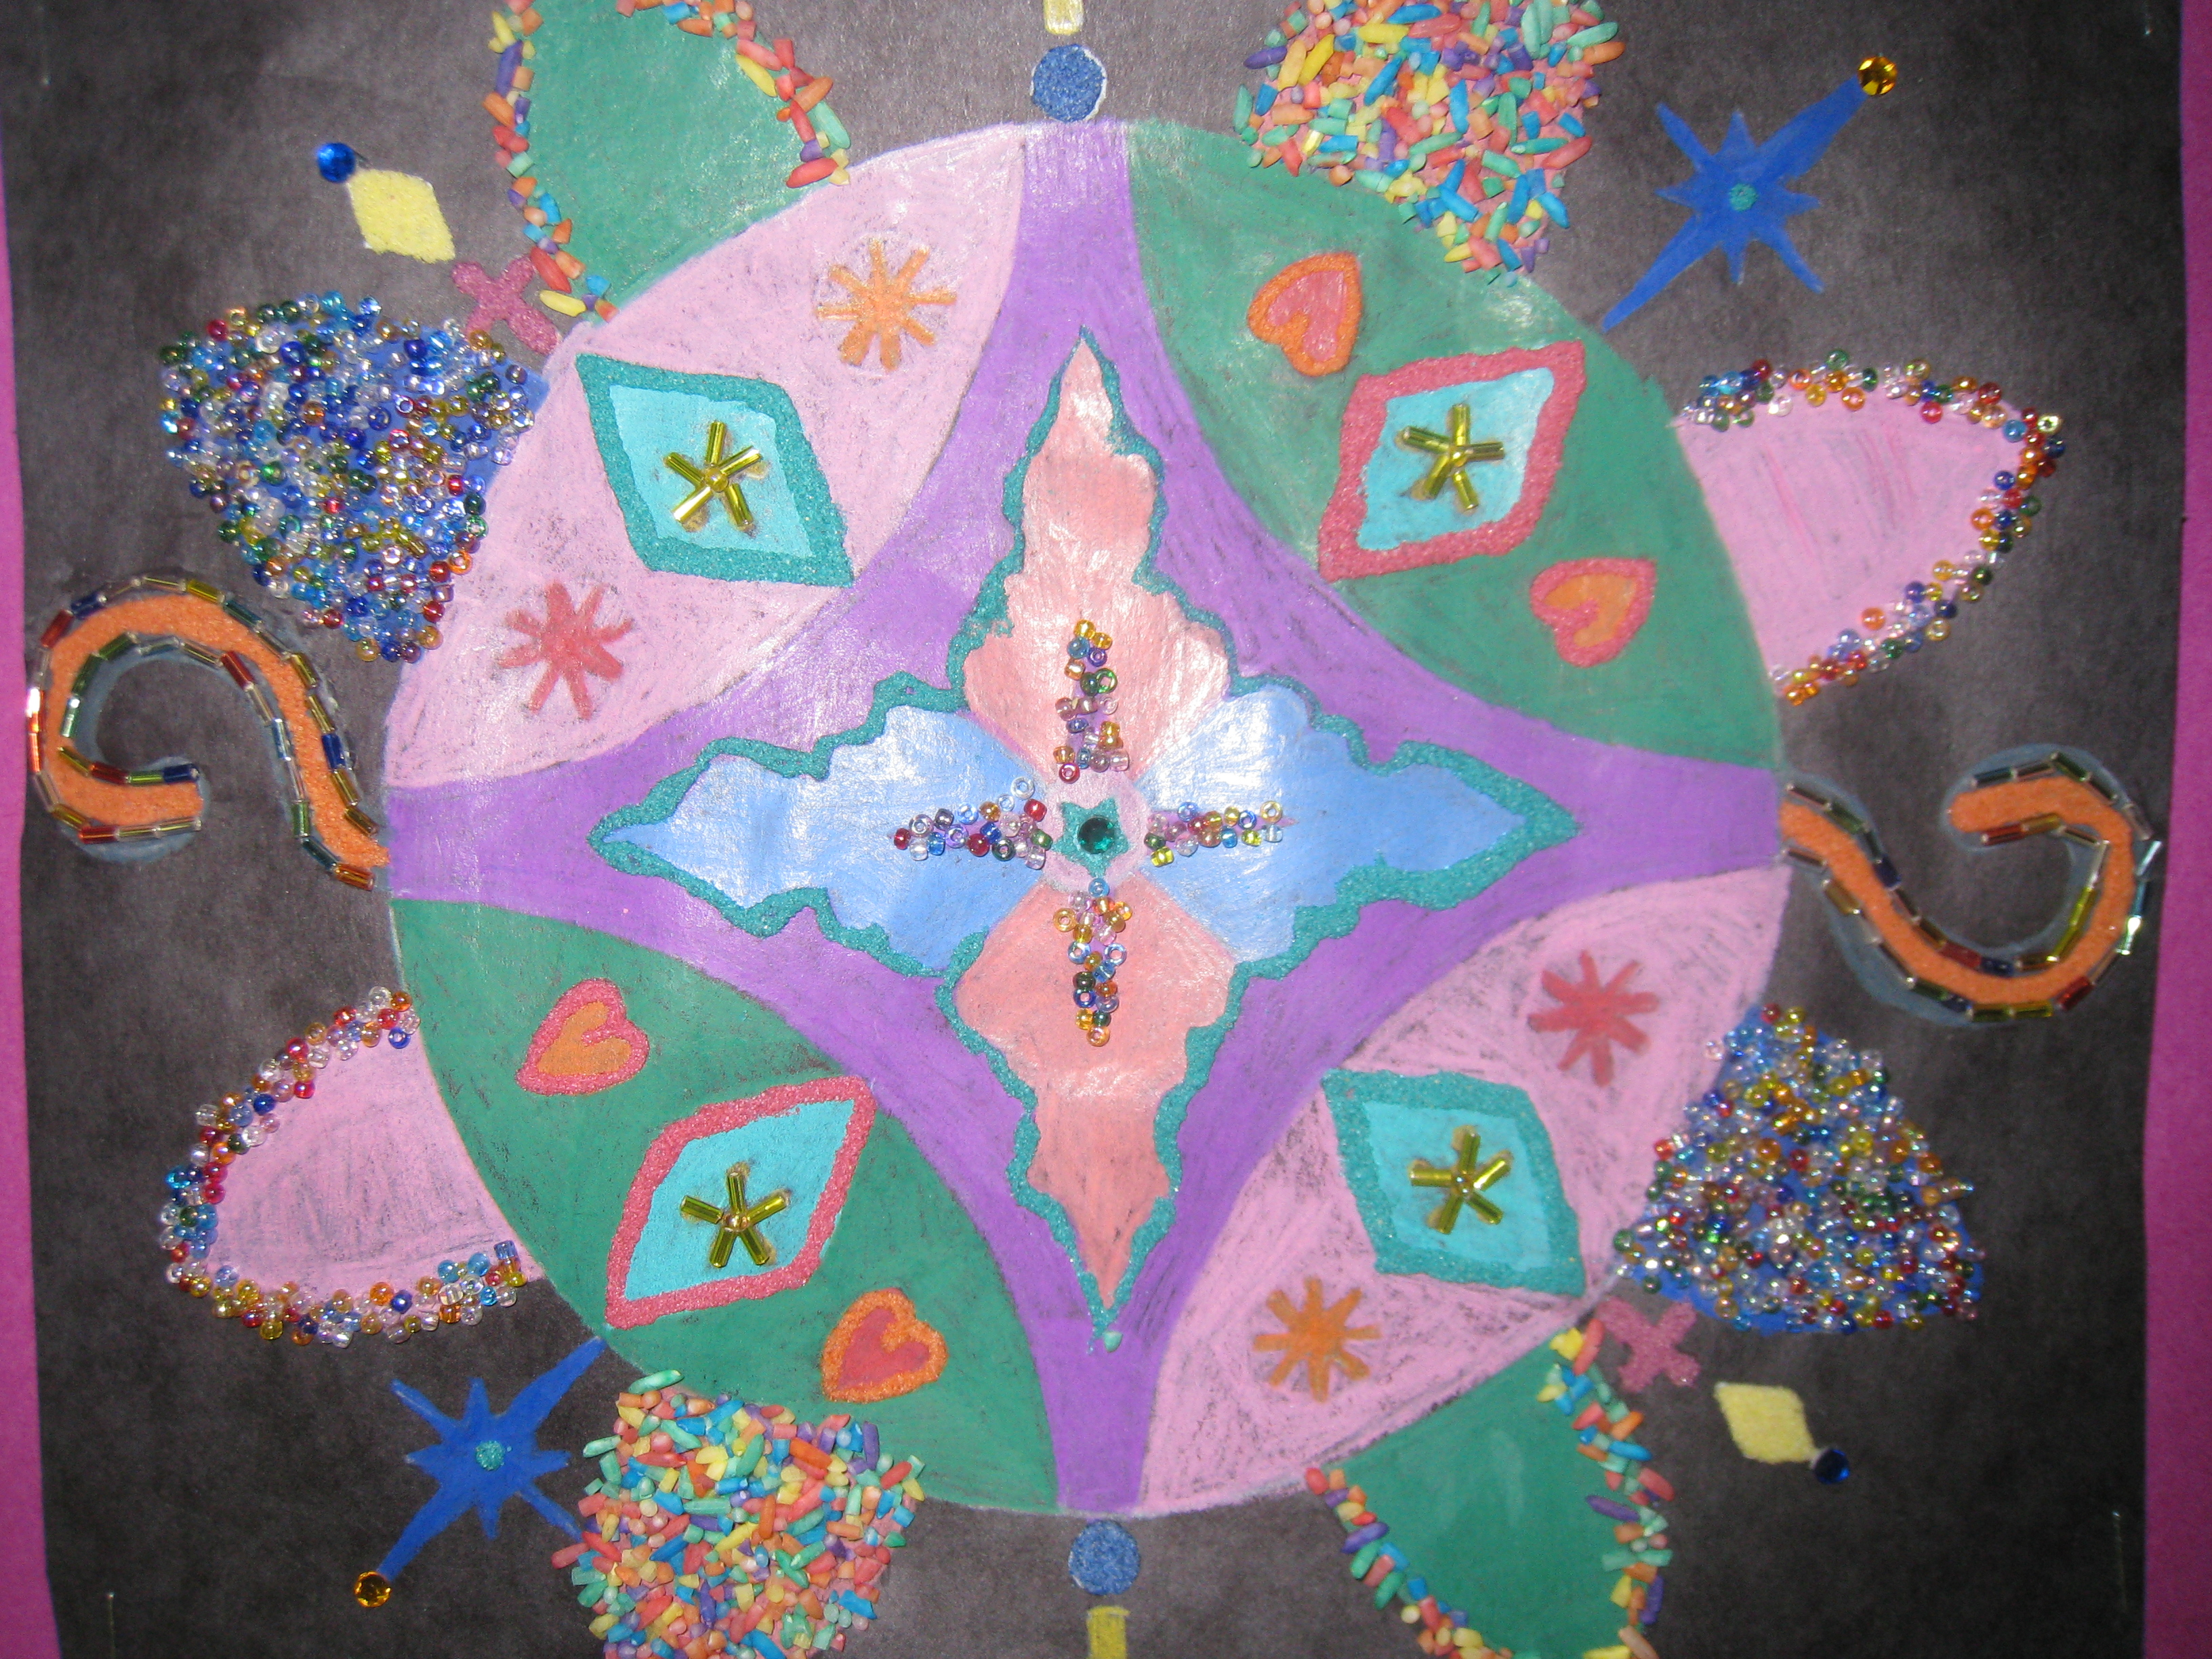

Slide 29
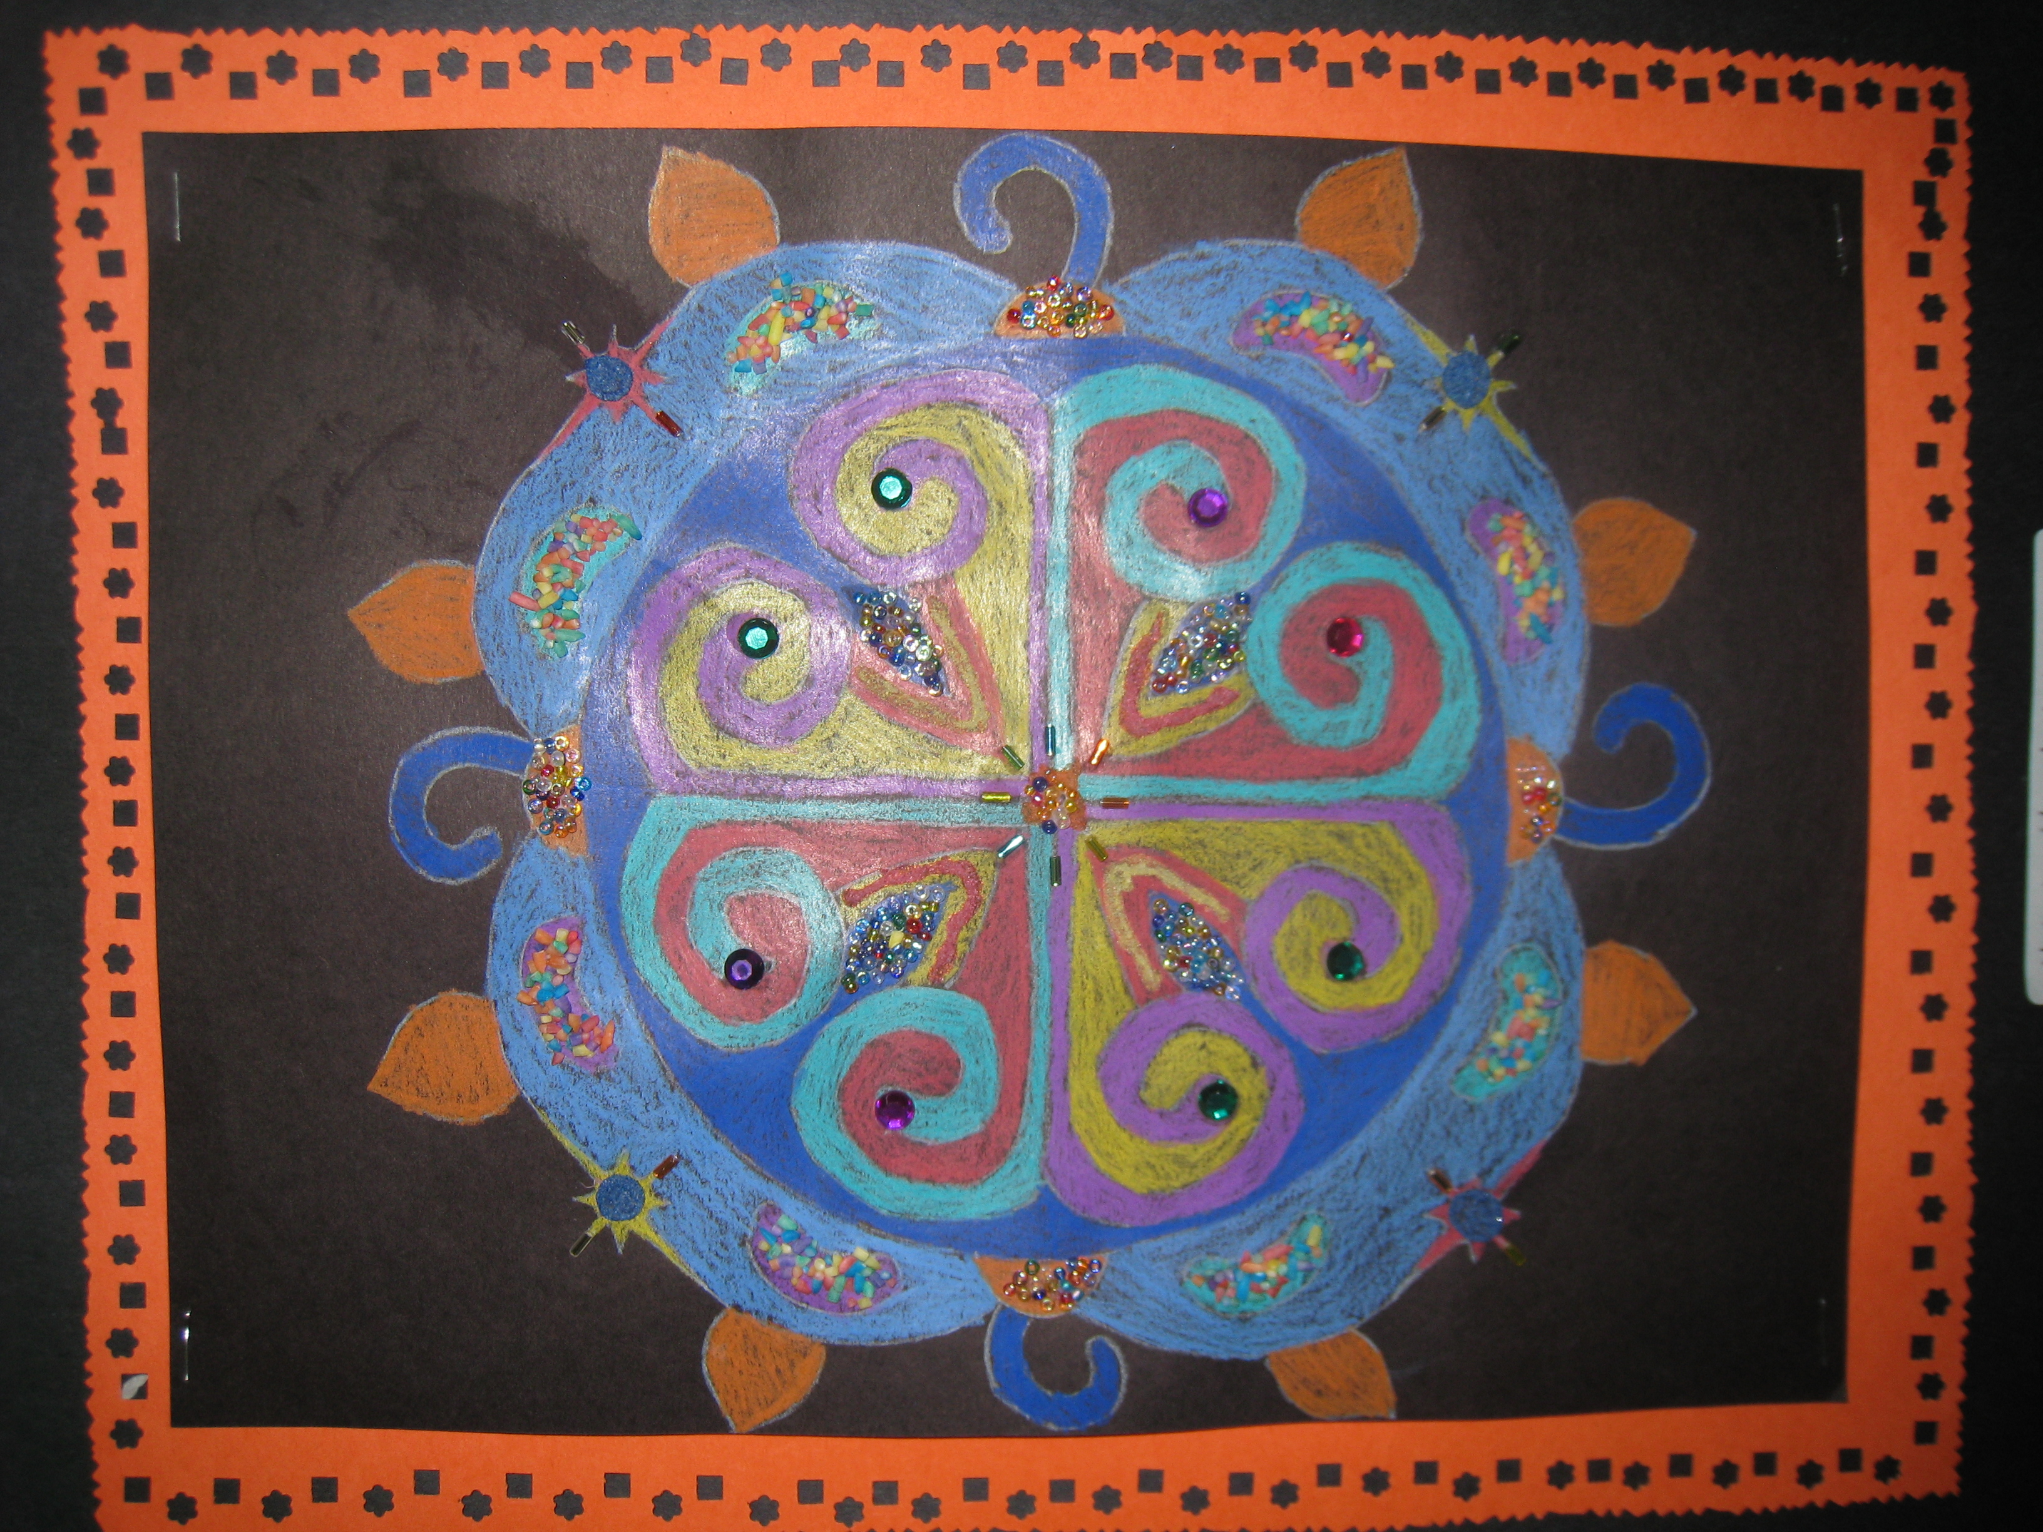

Slide 30
