Slide 1
Jackson’s Student Koi Fish Watercolors
Learning Targets:
Line
Shape
Pattern
Movement

Slide 2
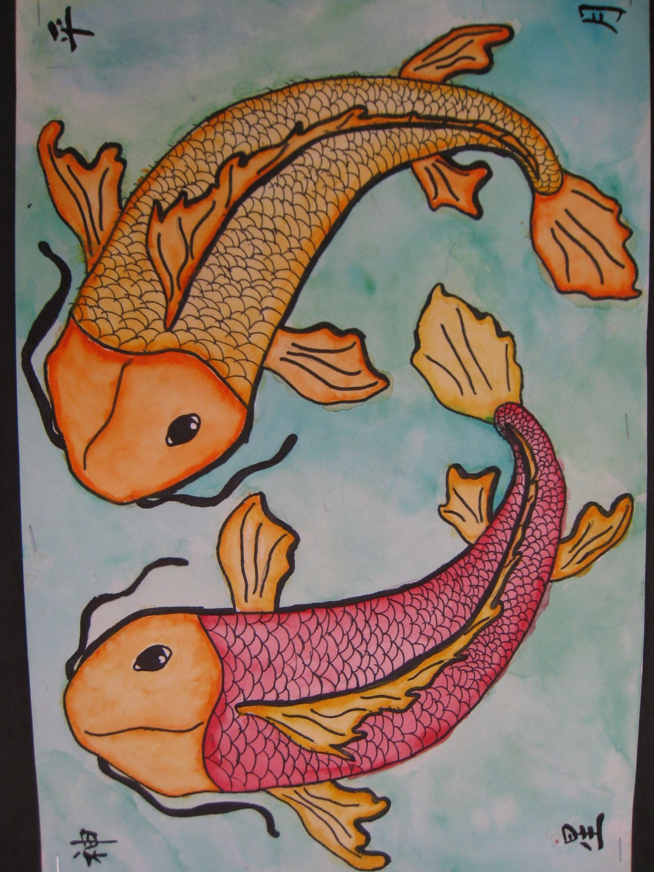

Slide 3
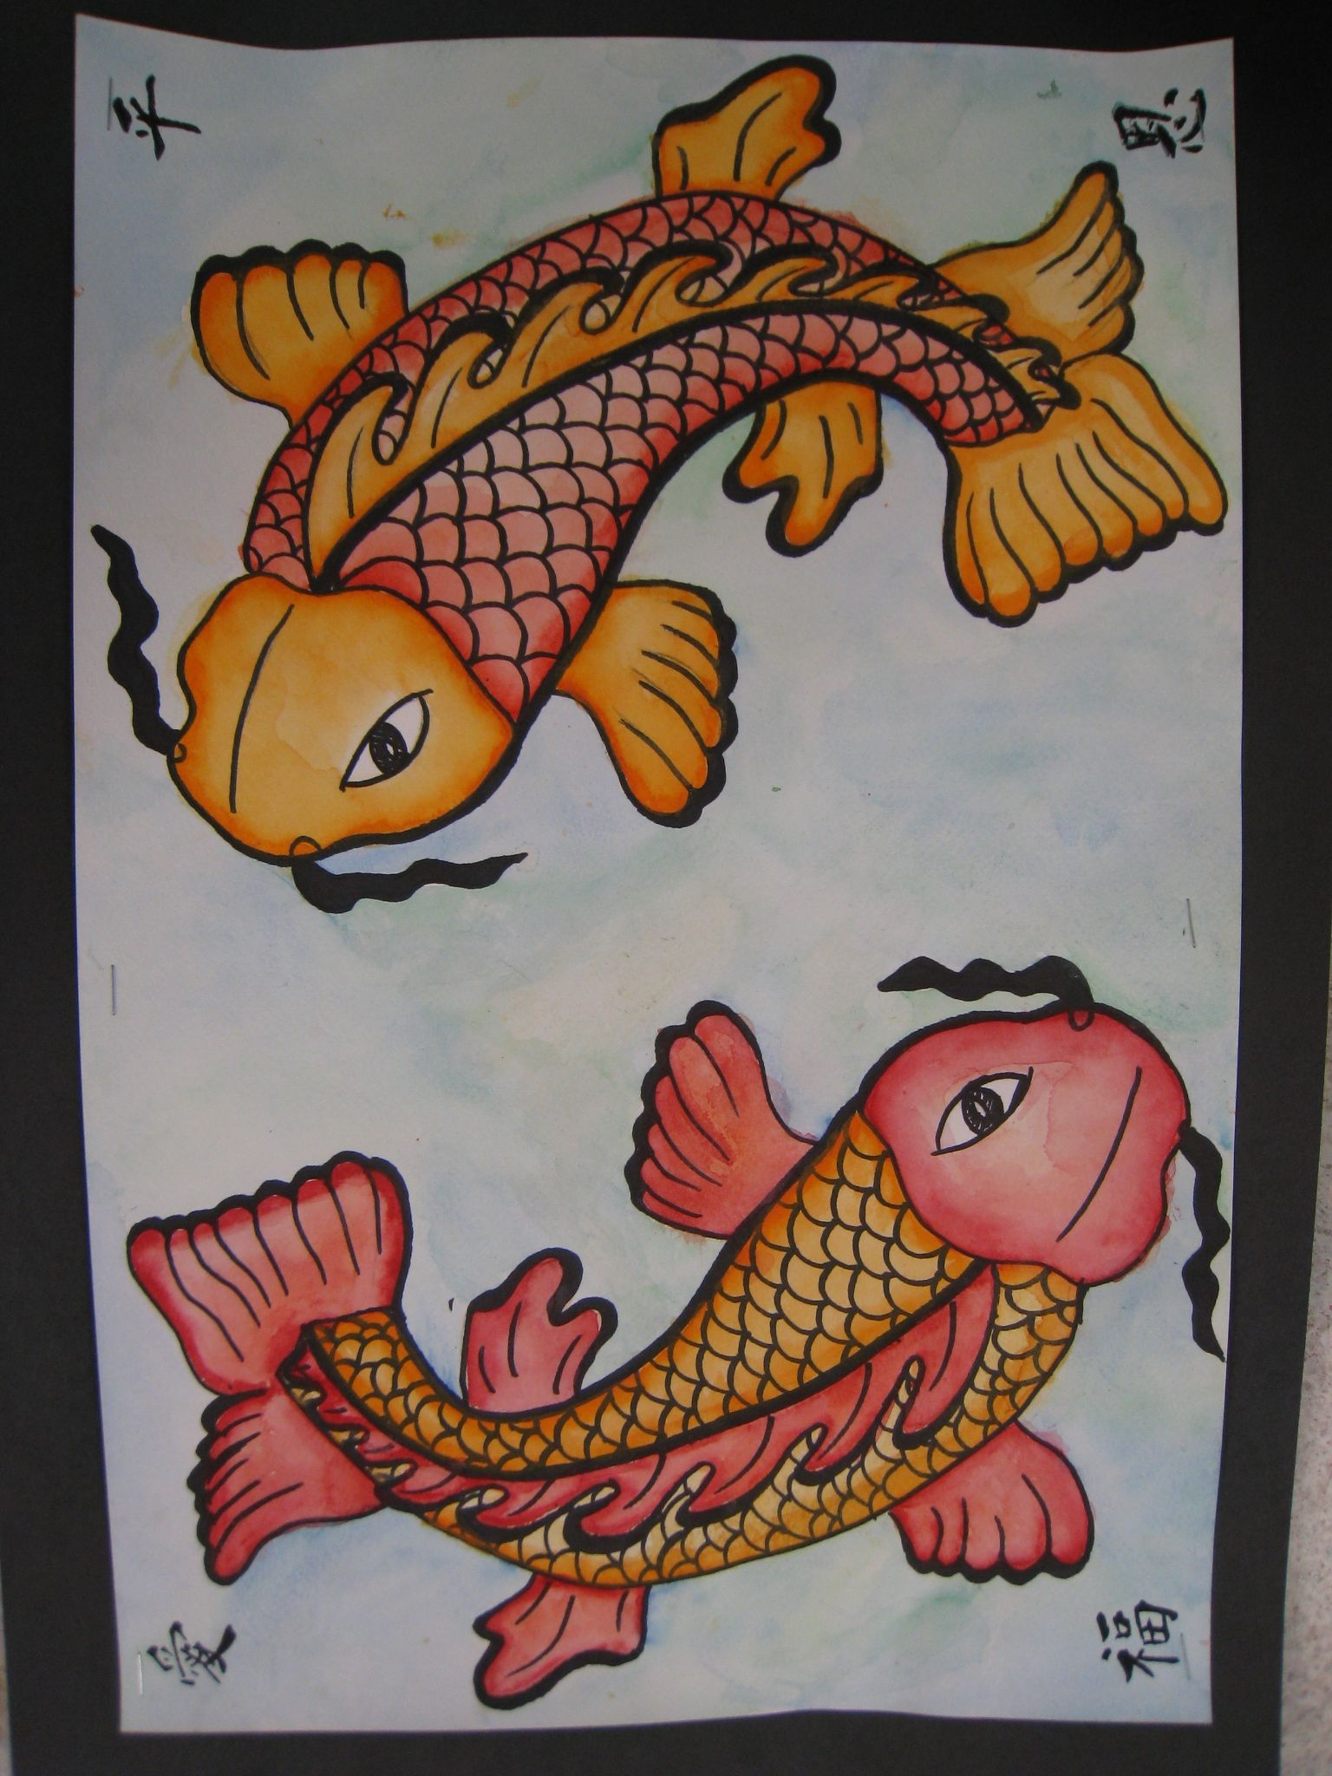

Slide 4
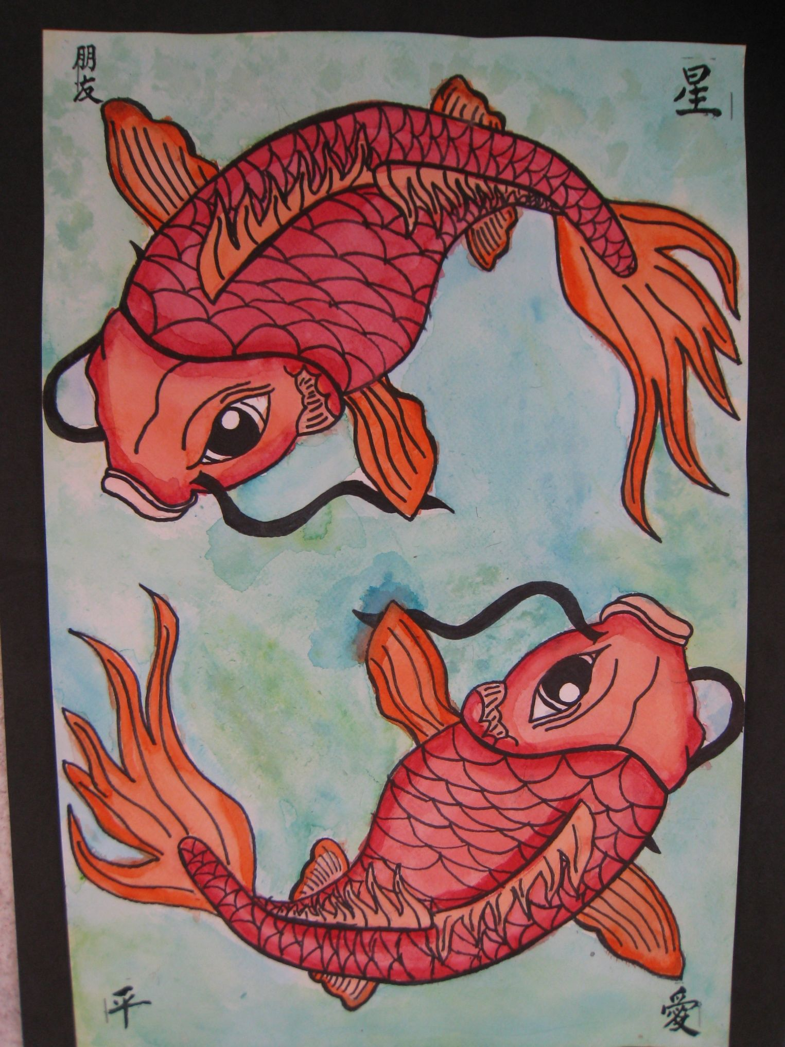

Slide 5
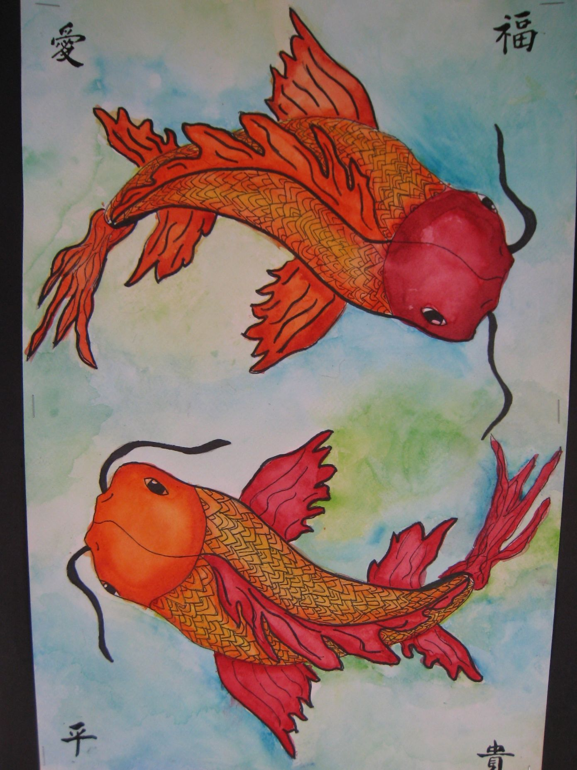

Slide 6
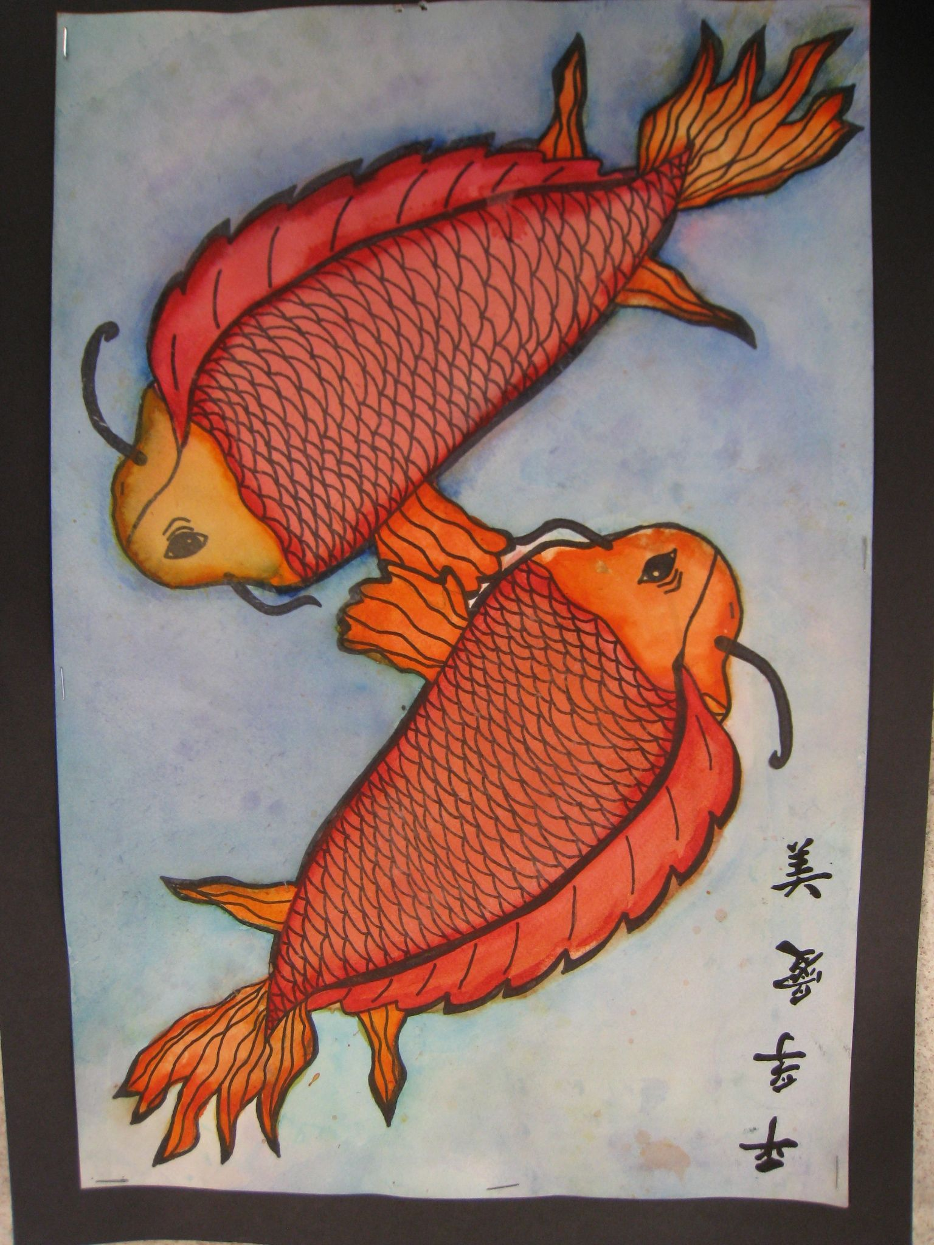

Slide 7
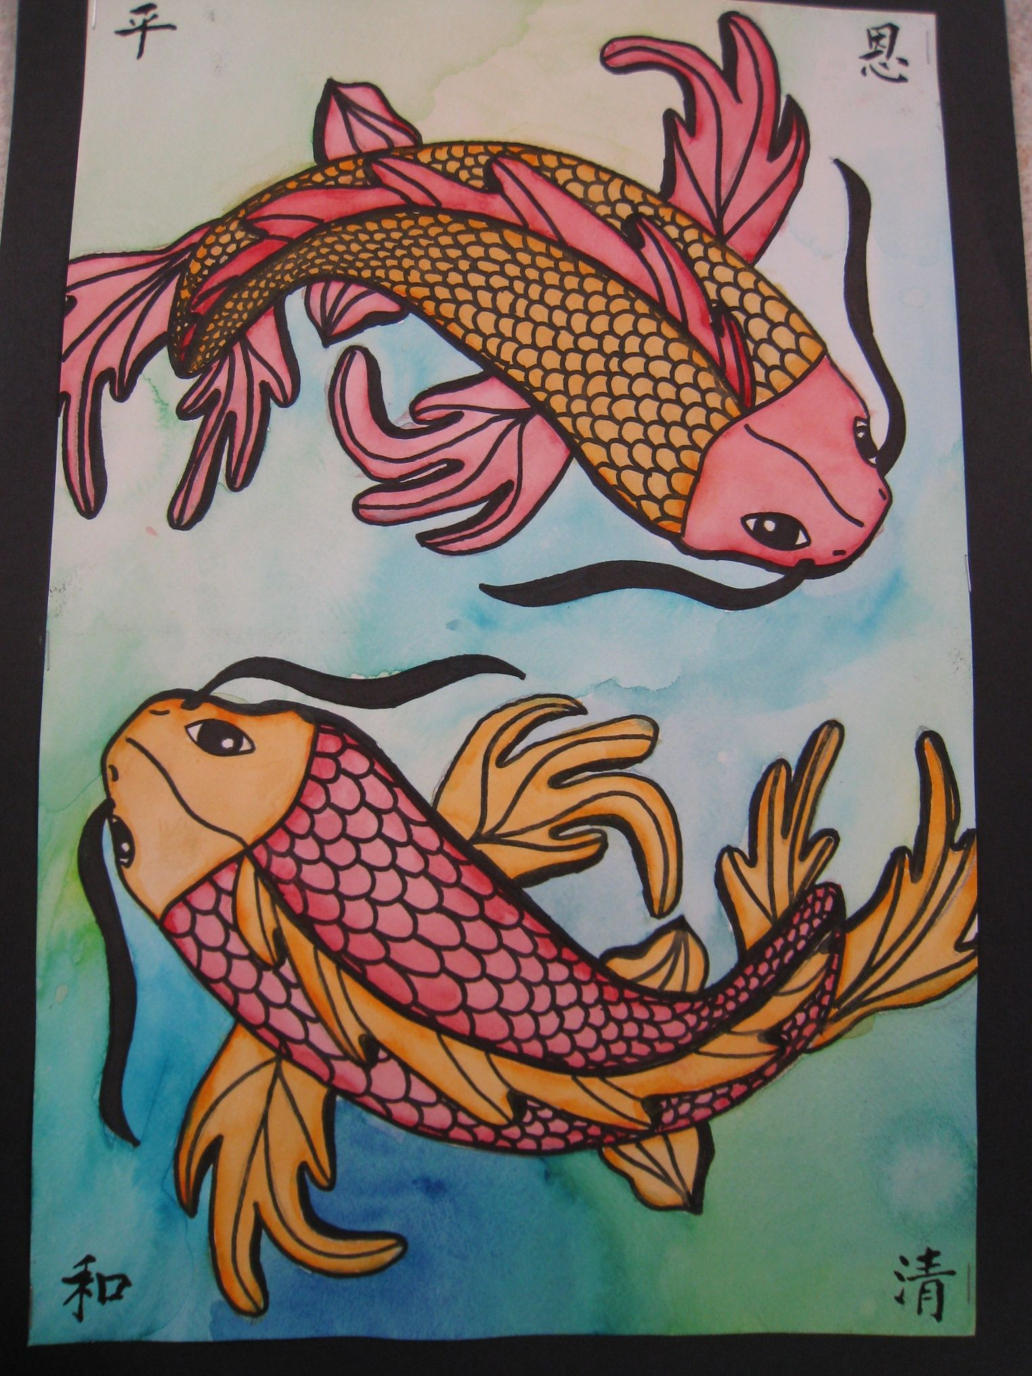

Slide 8
