Slide 1
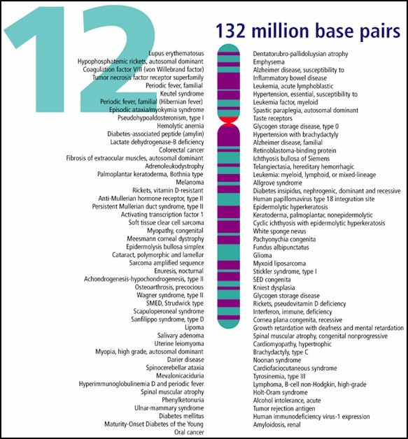
Human Genome Project
13-year project completed in 2003
Project goals:
identify all the approximately 20,000-25,000 genes in human DNA
determine sequences of the 3 billion chemical base pairs that make up human DNA

Slide 2
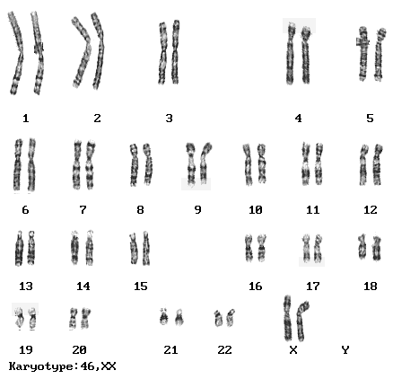
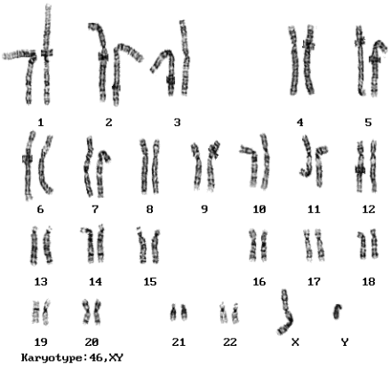
Karyotype

Slide 3
Genetic Disorders
Major types of genetic disorders:
  Autosomal
    Single genes
    Multiple genes
  Sex-linked
  Chromosome abnormalities

Slide 4
Levels of Genetic Disorders
Level 1 Single gene
  mutation affecting a single gene
Level 2 Chromosomes
  entire chromosomes, or large segments of them, are missing, duplicated, or otherwise altered
Level 3 Multifactor
  mutations in multiple genes, often coupled with environmental causes

Slide 5
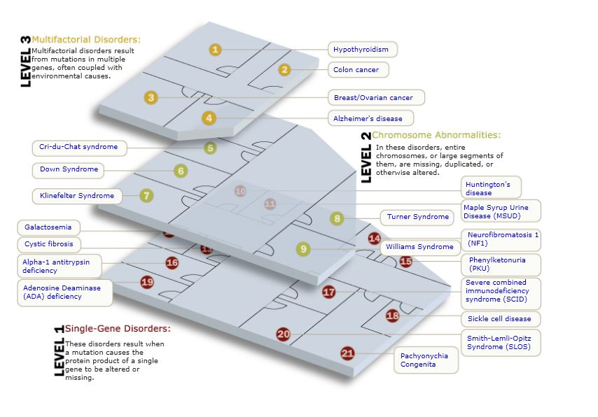
http://learn.genetics.utah.edu/content/disorders/whataregd/

Slide 6
Autosomal Disorders
Autosomal genetic disorders are caused by alleles on autosomes (the non-sex chromosomes)
Most are recessive (need 2 recessive alleles)
  People with 1 recessive allele are carriers – they do NOT have the disorder but are able to pass the allele on to their children
  Ex: Cystic fibrosis (CF), sickle cell anemia
Can also be dominant (need only 1 allele to have disorder)
  Ex: Huntington’s disease

Slide 7
Other Genetic disorders
Huntington's
Dominant disorder
neurodegenerative genetic disorder
  affects muscle coordination
  leads to cognitive decline and psychiatric problems
  Noticeable in mid-adult life
  http://www.youtube.com/watch?v=65xf1olEpQM

Slide 8


Albinism
Recessive
defect of melanin production
results in little or no color in the skin, hair, and eyes

Slide 9
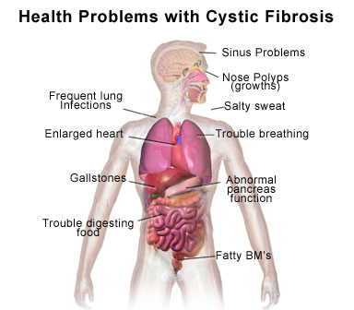
Cystic Fibrosis
Recessive - strands of DNA are deleted
Affects the lungs, pancreas, liver, and intestine
Characterized by
  accumulation of thick, sticky mucus
  coughing or shortness of breath
  poor growth and weight gain
  frequent chest infections
  Salty skin
https://www.youtube.com/user/CysticFibrosisUSA

Slide 10
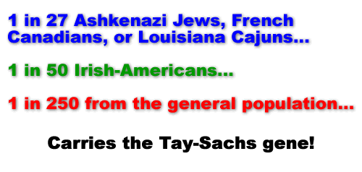
Tay-Sachs
Recessive
Deafness
decreased eye contact/blindness
decreased muscle tone
loss of muscle strength/function
delayed mental and social skills
Dementia
loss of motor skills
paralysis
Slow growth

Slide 11

Achondroplasia
common cause of dwarfism
Sporadic mutation in approximately 75% of cases (associated with advanced paternal age)
Or dominant genetic disorder
Unlikely homozygous child will live past a few months of its life

Slide 12
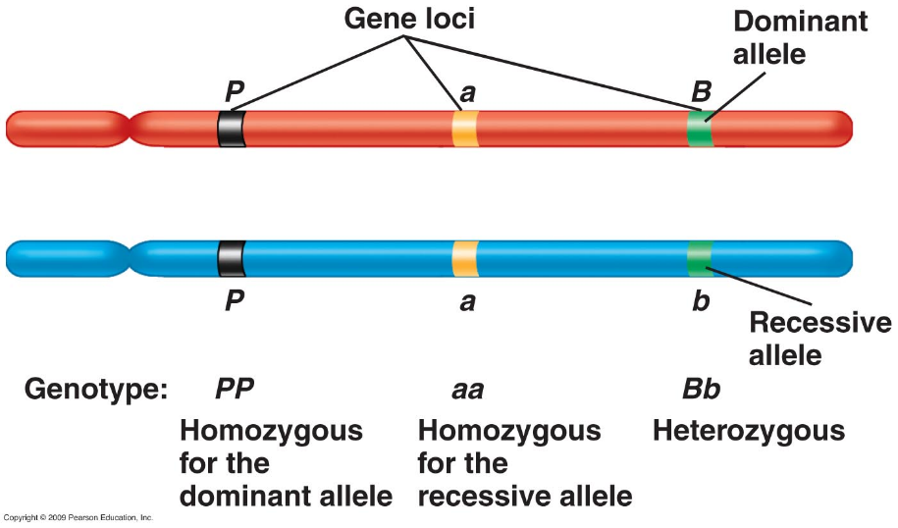
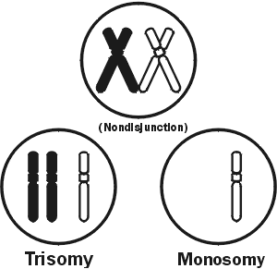
Chromosome Abnormalities
Autosomal and sex-linked genetic disorders are both caused by certain alleles
Other genetic disorders result from chromosome abnormalities caused by mistakes made during meiosis.
  May change the number or structure of chromosomes within gametes

Slide 13
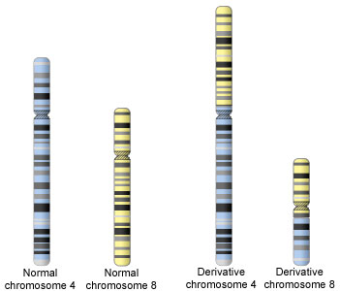
Translocation
Translocation is when a piece of one chromosome breaks off and attaches to a different chromosome
  Often happens to 2 chromosomes at once

Slide 14
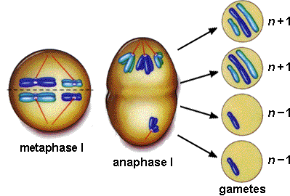
Nondisjunction
Chromosomes fail to separate during anaphase
  anaphase I = 2 cells with extra and 2 with less
  anaphase II = 2 normal cells, 1 w/ extra, 1 w/less
  Trisomy – three chromosomes
  Monosomy – 1 chromosome
http://www.sumanasinc.com/webcontent/animations/content/mistakesmeiosis/mistakesmeiosis.

Slide 15
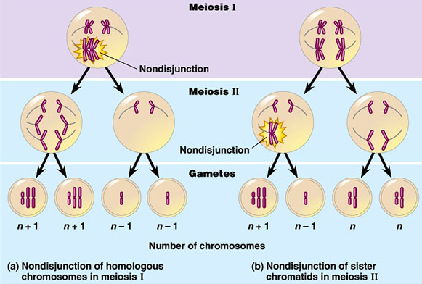

Slide 16
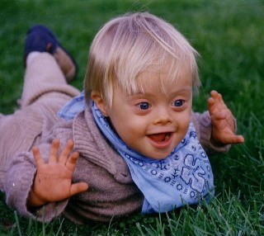
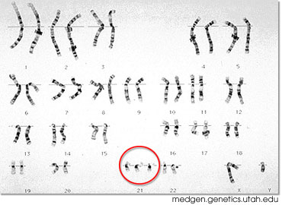
Down Syndrome (trisomy 21)
Symptoms of Down syndrome include:
  Mild to severe mental retardation
  Short stature
  Heart, vision, and intestinal problems
  Susceptibility to infections and leukemia

Slide 17
Other Nondisjunctions
Patau syndrome (trisomy 13): serious eye, brain, circulatory defects as well as cleft palate.
  Children rarely live more than a few months
Edward's syndrome (trisomy 18): almost every organ system affected
  Children with full Trisomy 18 generally do not live more than a few months

Slide 18
Nondisjunction of the sex chromosomes (X or Y chromosome)
Klinefelter syndrome: 47, XXY males.
  Male sex organs
  unusually small testes, sterile
  Breast enlargement and other feminine body characteristics
  Normal intelligence

Slide 19
47, XYY males – Jacob Syndrome
  Individuals are somewhat taller than average
  often have below normal intelligence
  Thought that these men were likely to be criminally aggressive, but this has been disproven
Trisomy X: 47, XXX females
  healthy and fertile - usually cannot be distinguished from normal female except by karyotype

Slide 20
Monosomy X (Turner's syndrome)
  the only viable monosomy in humans - women with Turner's have only 45 chromosomes
  XO individuals are genetically female
  do not mature sexually during puberty and are sterile
  Short stature and normal intelligence
  98% of these fetuses die before birth

Slide 21
How do we find disorders?
Genetic tests use blood and other tissue
Doctors use genetic tests for:
Find possible genetic diseases in unborn babies
Find out if people carry a gene
Screening embryos for disease
Test for genetic diseases before symptoms occur
Confirming a diagnosis

Slide 22
Diagnosing Genetic Disorders
There are several ways to determine whether a child will have a genetic disorder
Two main ways to diagnose:
  Analysis of fetal cells
    Amniocentesis
    Chorionic villus biopsy
  Imaging techniques
    Ultrasonography (computerized image)
    Fetoscopy (direct observation)

Slide 23
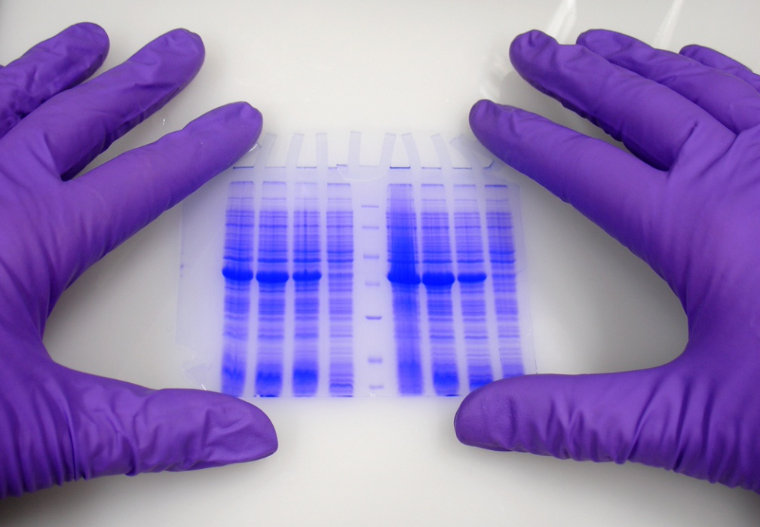
How is genetic testing done?
blood, hair, skin, amniotic fluid, or other tissue
Heel prick on newborns
Look for changes in chromosomes, DNA, proteins

Slide 24
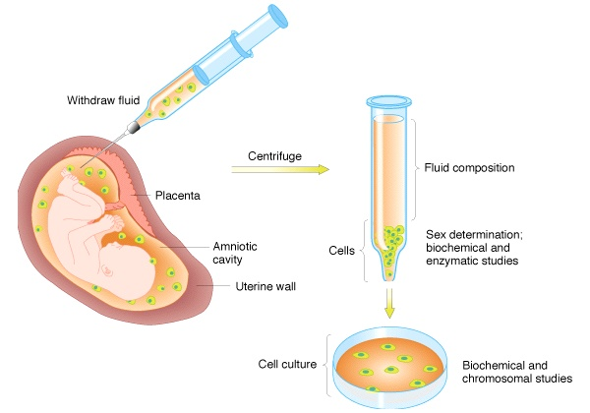
Amniocentesis
a procedure a pregnant woman can have in order to detect some genetics disorders

Slide 25
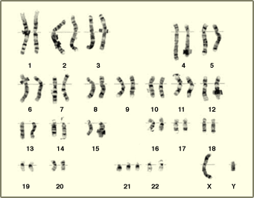
Karyotype
(picture of an individual’s chromosomes)
One of the ways to analyze the amniocentesis is to make a Karyotype
What genetic disorder does this karyotype show?
Trisomy 21….Down’s Syndrome

Slide 26
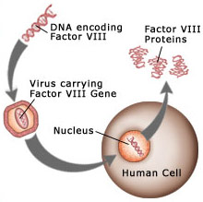
Developing Cures for Genetic Disorders
Gene therapy
  Introducing normal genes into the cells of people with defective alleles
    Using viruses to inject alleles into cells
    Enclosing alleles in droplets of fat, which are taken into cells by endocytosis
  Currently these are still experimental procedures and have had limited success

Slide 27
Genetic Dilemmas

Slide 28
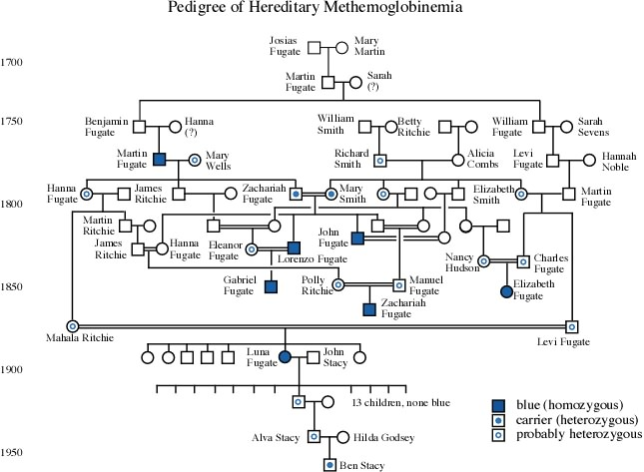
Pedigrees
Diagram that traces inheritance of a trait through several generations

Slide 29
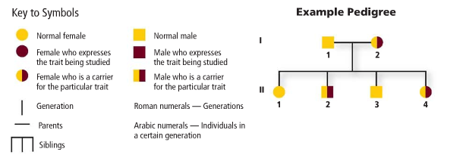
Pedigrees
Symbols

Slide 31
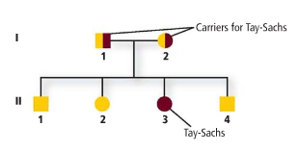
Analyzing Pedigrees

Slide 32
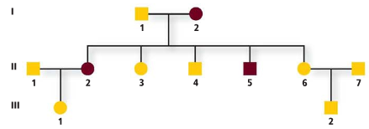
Polydactyl – Dominant Disorder

Slide 33
Questions
Is this trait dominant or recessive? Explain your answer.
Name the 2 individuals that were carriers of hemophilia
How are individuals III-1 and III-2 related?
How many children did individuals I-1 and I-2 have
How many girls did II-1 and II-2 have? How many have hemophilia?

Slide 34
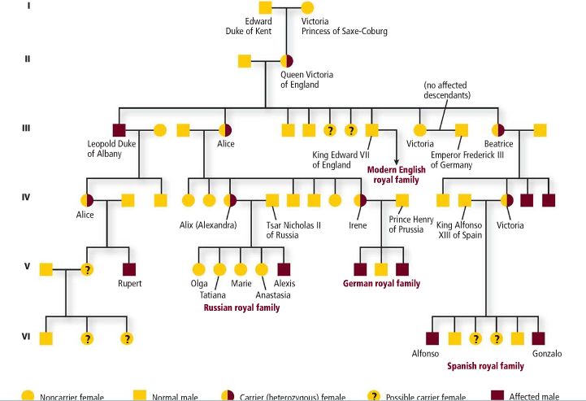

Slide 35
Book Questions
Page 276 1, 2, 4, 5
Page 282 2, 3, 4
Page 285 1, 3
Page 301 1, 3
Page 310 1-5
Page 315 1-4

Slide 36
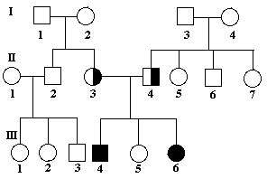
Is this a recessive or dominant trait?
How are person II2 and II3 related?
Agenda for Monday April 23rd
Review stuff
Test tomorrow

Slide 37
The pedigree to the right shows a family’s pedigree for colorblindness (a sex linked trait)
Which sex can be carriers of colorblindness and not have it?
Why does individual IV-7 have colorblindness?
Why do all the daughters in generation II carry the colorblind gene? IV

