Slide 1
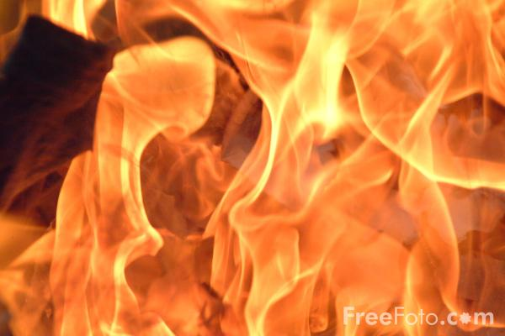
Global Warming
Global warming is the increase in the average measured temperature of the Earth's near-surface air and oceans since the mid-20th century, and its projected continuation. In media, it is synomonous with the term "climate change.
Global surface temperature increased 0.74 ± 0.18 °C during the 100 years ending in 2005.The Intergovernmental Panel on Climate Change (IPCC) concludes "most of the observed increase in globally averaged temperatures since the mid-twentieth century is very likely due to the observed increase in greenhouse gas concentrations"via an enhanced greenhouse effect.

Slide 2
Greenhouse Effect
It is the process by which absorption and emission of infrared radiation by atmospheric gases warm a planet's lower atmosphere and surface
Naturally occurring greenhouse gases have a mean warming effect of about 33 °C (59 °F), without which Earth would be uninhabitable.
On Earth, the major greenhouse gases are water vapor, which causes about 36–70 percent of the greenhouse effect (not including clouds); carbon dioxide (CO₂), which causes 9–26 percent; methane (CH₄), which causes 4–9 percent; and ozone, which causes 3–7 percent.The issue is how the strength of the greenhouse effect changes when human activity increases the atmospheric concentrations of some greenhouse gases.

Slide 3
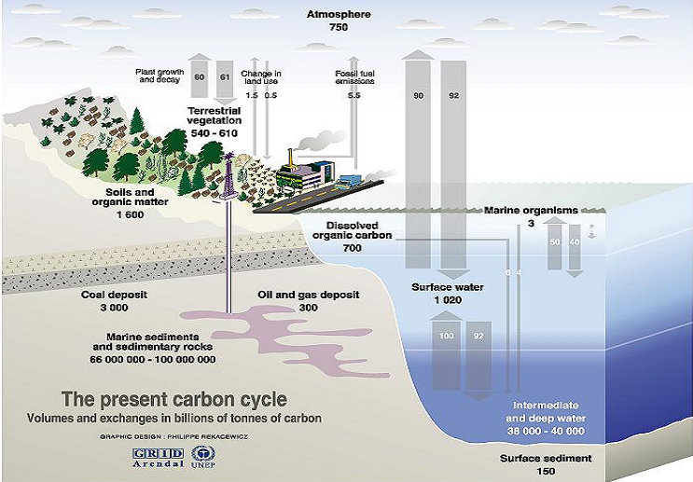
The image shows the present carbon cycle. The disruption of which leads to increased emission of carbon dioxide which ultimately leads to rise in global temperatures.

Slide 4
Causes Of Global Warming
Greenhouse Emissions
Caused due to
  Rapid Industrialization
  Population Explosion
  Depletion Of Natural Resources
  Natural Phenomena
  Modification Of Ecosystems

Slide 5
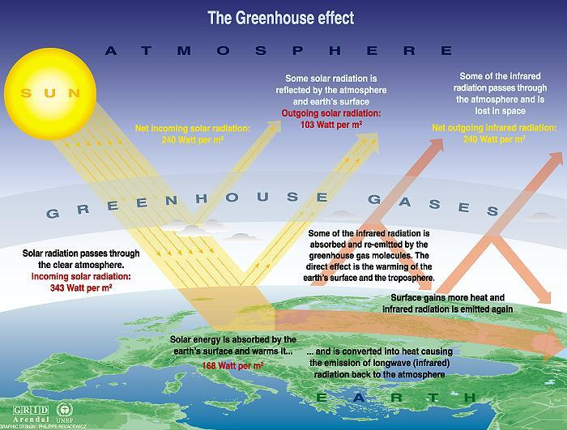
The image below describes the Greenhouse effect and the role of greenhouse gases

Slide 6
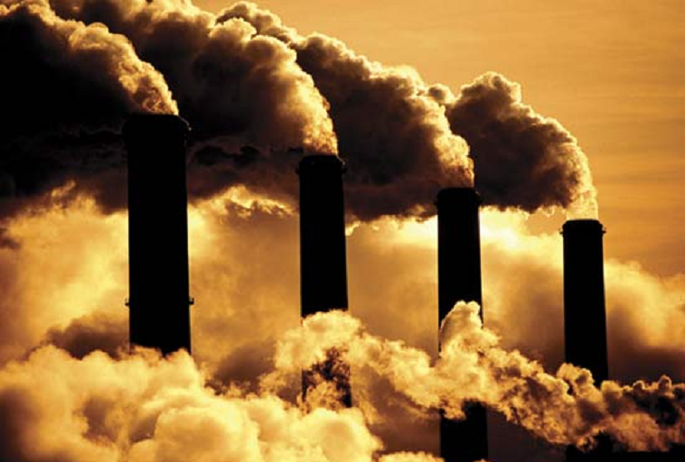
Effects Of Global Warming
Increase in sea levels.
Increase in the intensity of extreme weather events
Significant changes to the amount and pattern of precipitation
Modifications of trade routes
Glacier retreat
Mass species extinctions
Increases in the ranges of disease vectors

Slide 7
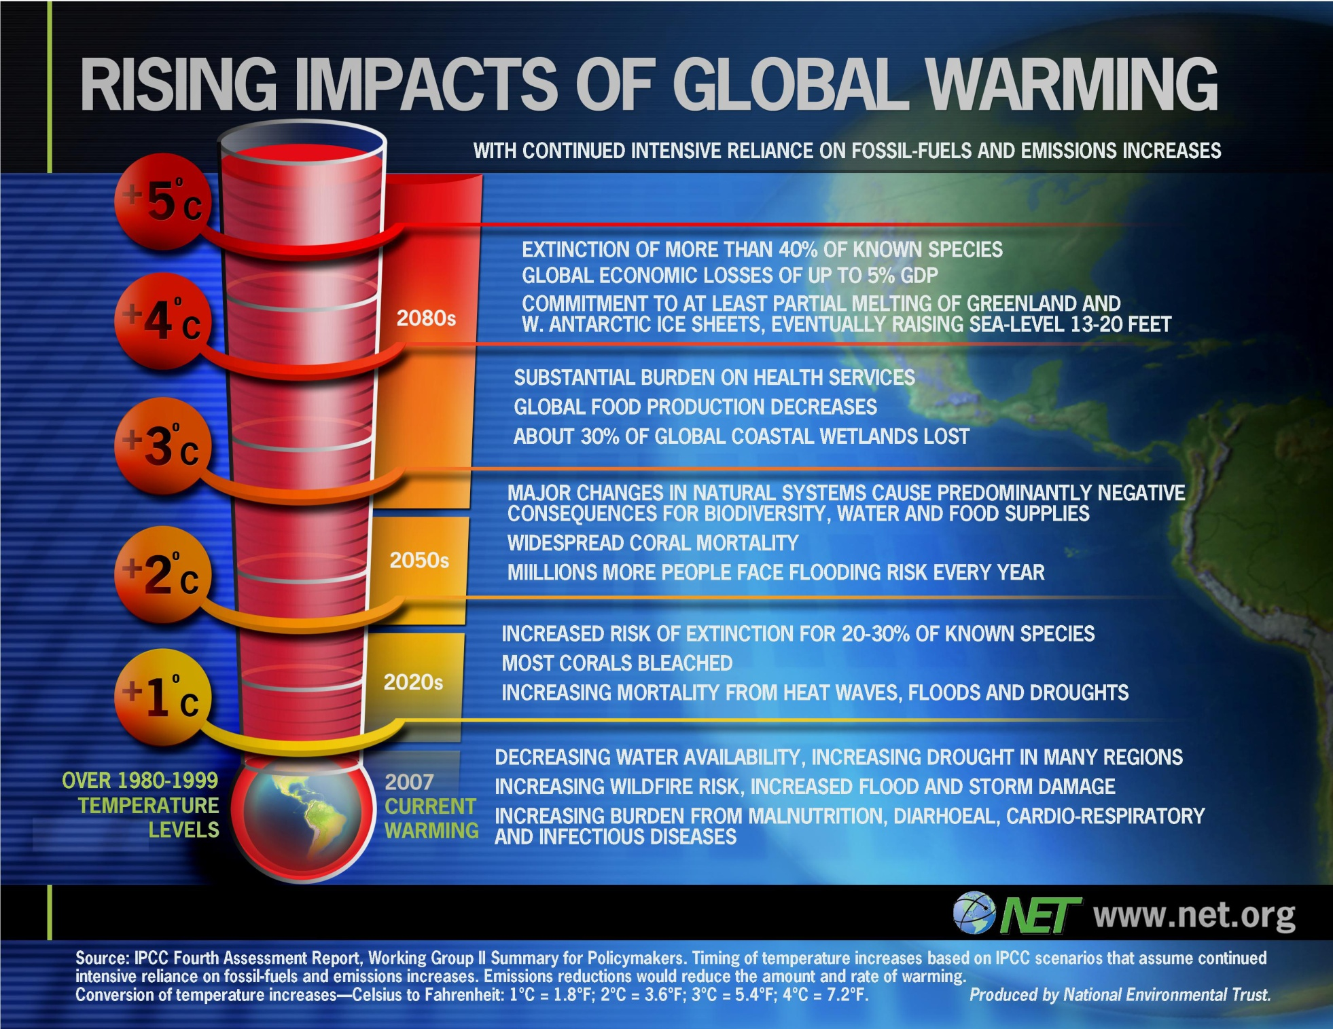

Slide 8
CO2 concentration after 50 years of unrestricted fossil fuel burning (600 ppmv)
The image shows the concentration of CO2 in the atmosphere over a period of time if emissions continue unaltered.
Present CO2 concentration (386 ppmv)
300
270
240
CO2 (ppmv)
210
180
Temp.
Proxy
800
600
400
200
0
Thousands of Years Before Present
Notes:
8

Slide 9
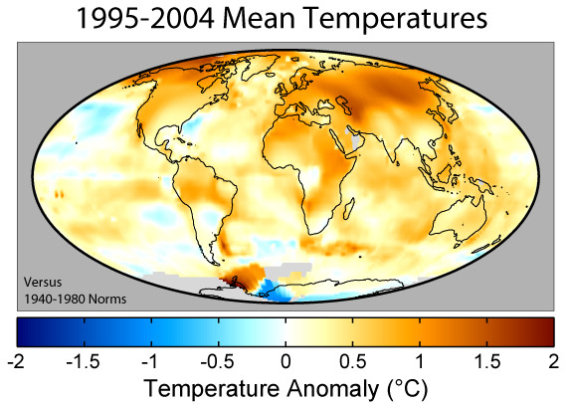
The image shows the temperature anomalies around the world attributed to global warming.

Slide 10
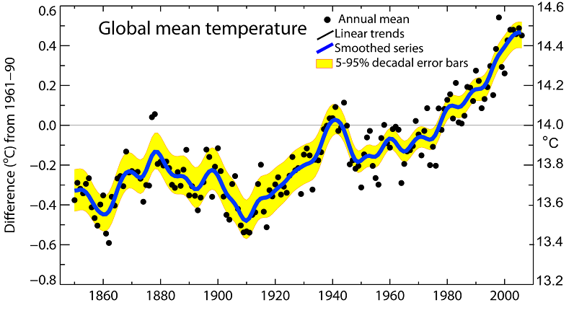
The graph shows the global mean temperature during the period 1961-90

Slide 11
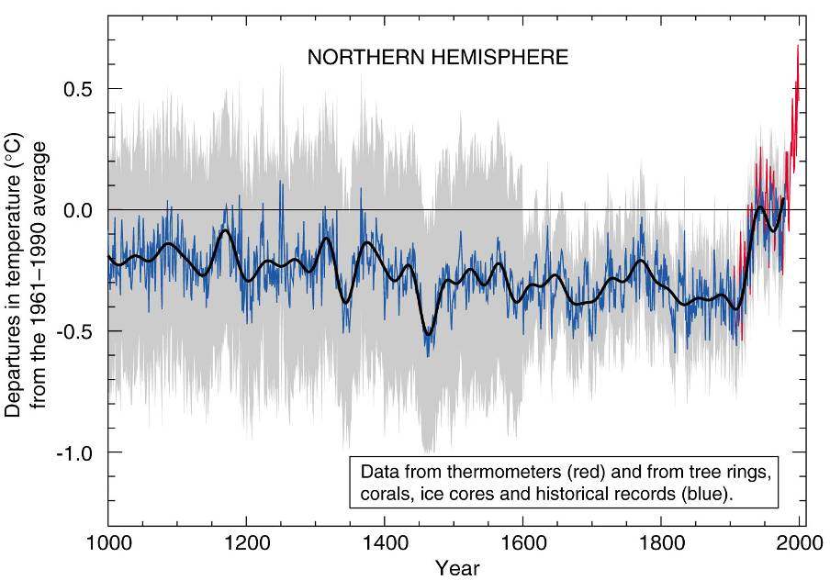
The graph shows standard deviation of the temperature from global averages.

Slide 12
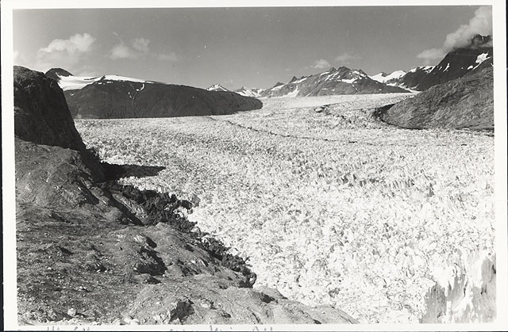
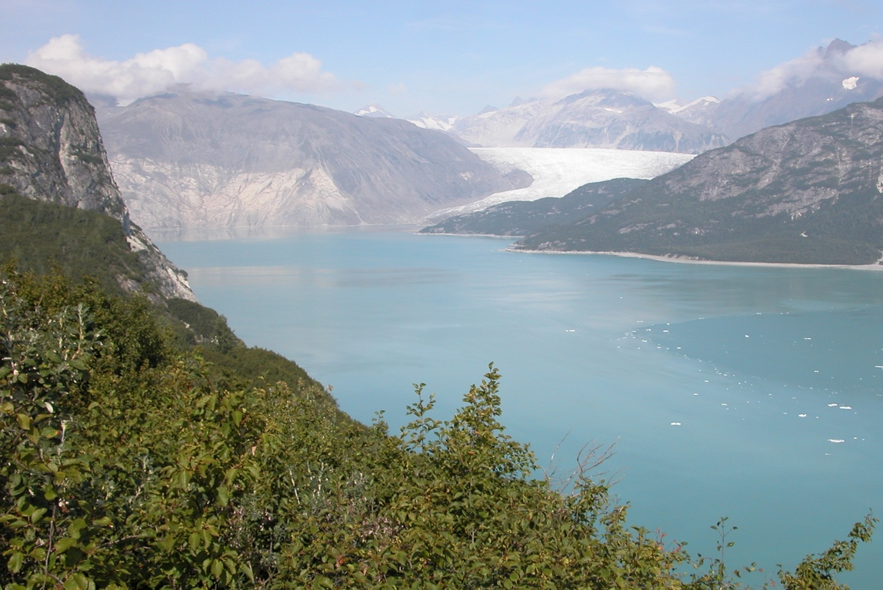
Small glaciers and ice caps are melting
2004
1941

Slide 13
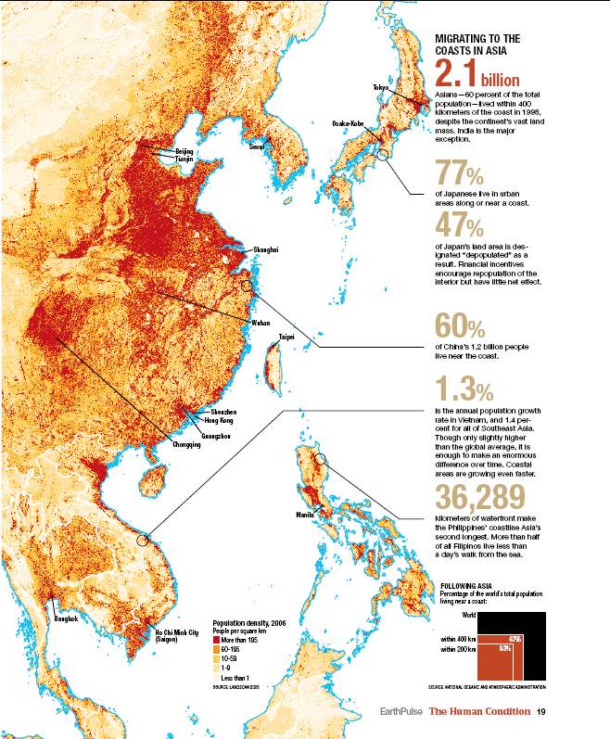

Slide 14
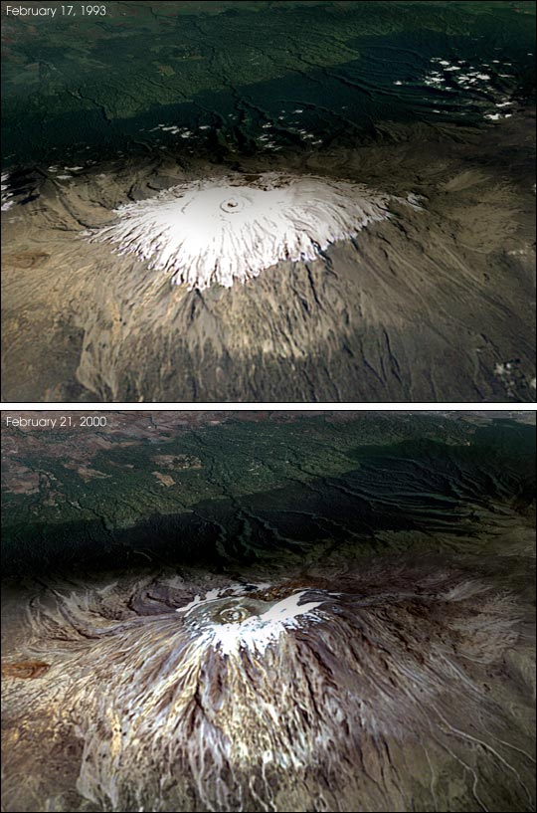
1993
The images show the effect of global warming on a ice covered mountain
2000

Slide 15
Projected risks due to climate change

Slide 16
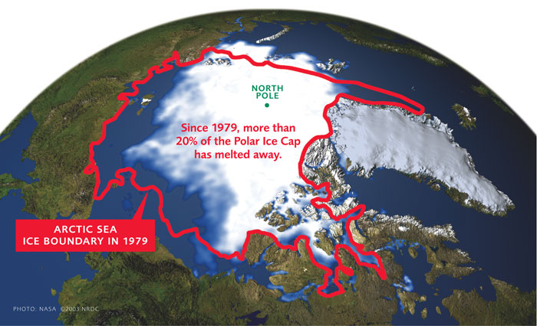
Major Effects Of Global Warming
Melting Of Polar Ice Caps
  Rise in Sea Levels
  Throw global ecosystems out of balance
  Will endanger several species of animals

Slide 17
Other fallouts include
  Spread of disease
  Warmer waters and more hurricanes
  Increased probability and intensity of droughts and heat waves
  Economic consequences
  Loss of Biodiversity
  Destruction of Ecosystems

Slide 18
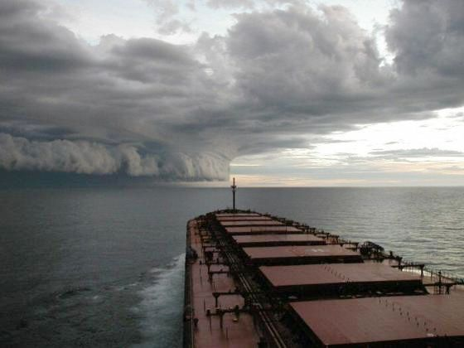
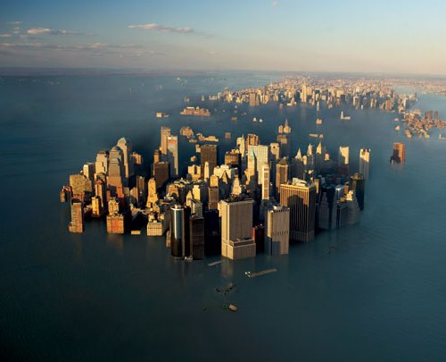
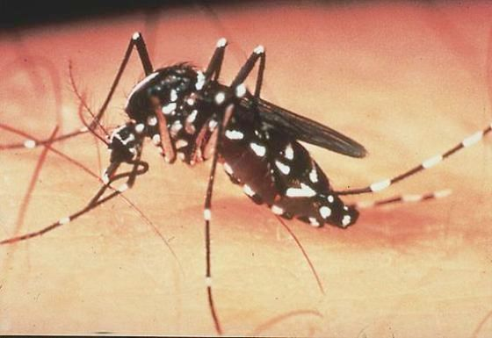
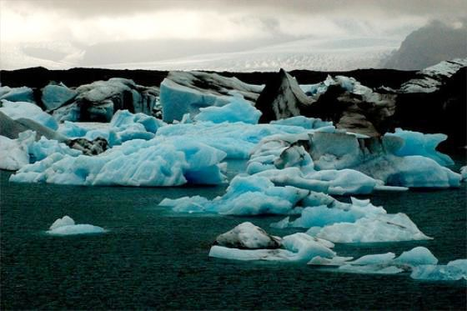
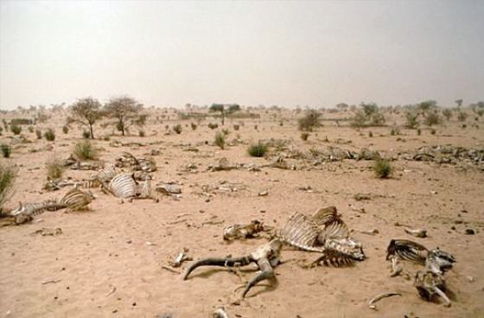
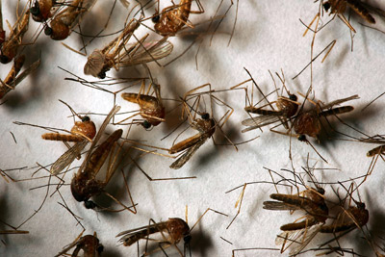

Slide 19
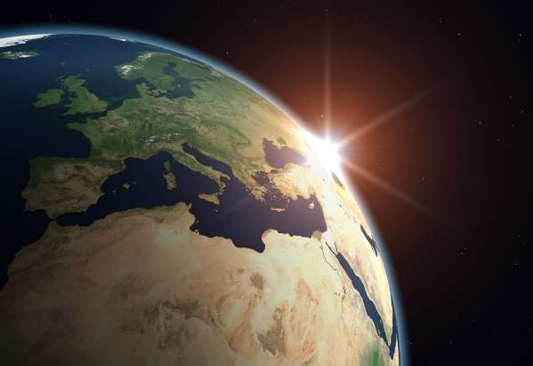
Mitigation Of Global Warming
Mitigation of global warming involves taking actions to reduce greenhouse gas emissions and to enhance sinks aimed at reducing the extent of global warming. This is in distinction to adaptation to global warming which involves taking action to minimize the effects of global warming.

Slide 20
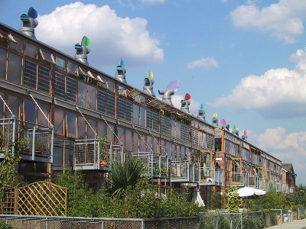
Energy efficiency and conservation
Urban Planning
Building Design
  Use of passive solar building design, low-energy building, or zero-energy building techniques, using renewable heat sources
Transport
  plug-in hybrid electric vehicles
  A shift from air transport and truck transport to electric rail transport
  Increased use of biofuels

Slide 21
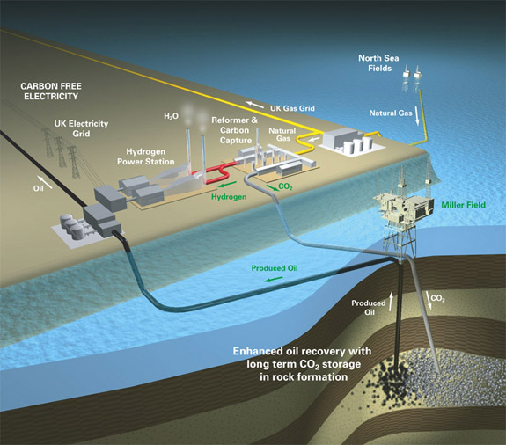
Carbon Capture And Storage
(CCS)
Carbon capture and storage (CCS) is a plan to mitigate climate change by capturing carbon dioxide (CO₂) from large point sources such as power plants and subsequently storing it away safely instead of releasing it into the atmosphere.

Slide 22
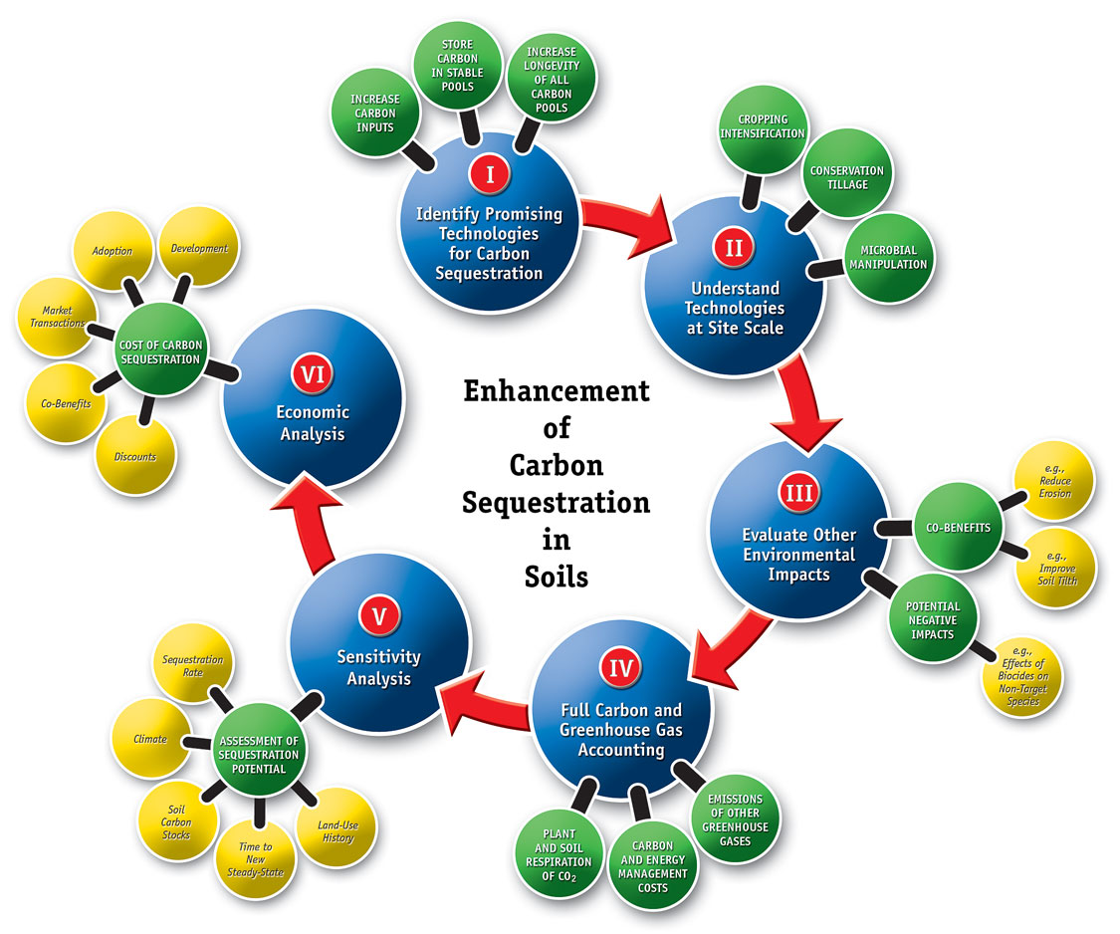
Carbon Sequestration
  Carbon sequestration is a term that describes processes that remove carbon from the atmosphere.
    Seeding oceans with iron
    Solar shades
    Geoengineering

Slide 23
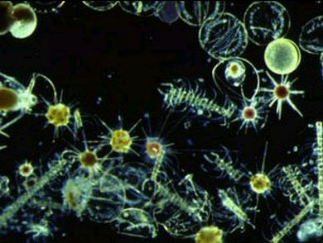
Seeding Oceans With Iron
It is motivated by evidence that seeding the oceans with iron will increase phytoplankton populations, and thereby draw more carbon dioxide from the atmosphere.

Slide 24
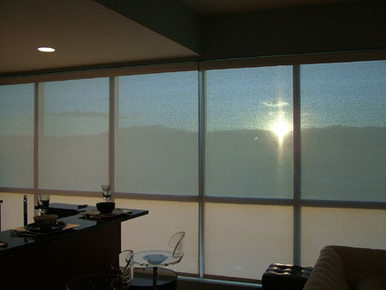
Solar Shades
Some scientists have suggested using aerosols and/or sulfate dust to alter the Earth's reflectivity by burning sulfur in the stratosphere, as an emergency measure to increase global dimming and thus stave off the effects of global warming.
It would, however, increase the environmental problem of acid rain and drought.

Slide 25
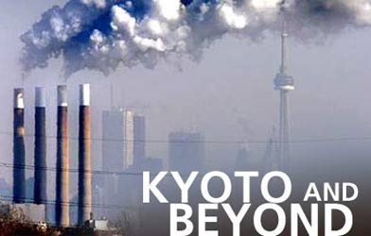
Governmental And Intergovernmental Action
Policies like:
  Kyoto Protocol
  Carbon emissions trading
  Carbon tax

Slide 26
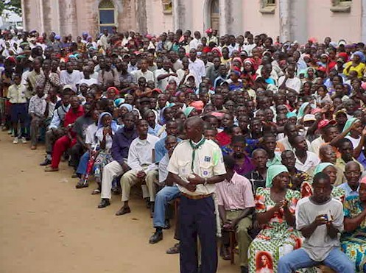
Population Control
The population explosion is a fundamental factor that has led to global warming
Because of this, various organizations promote population control as a means for mitigating global warming. Proposed measures include improving access to family planning and reproductive health care and information, public education about the consequences of continued population growth.

